Slide 1
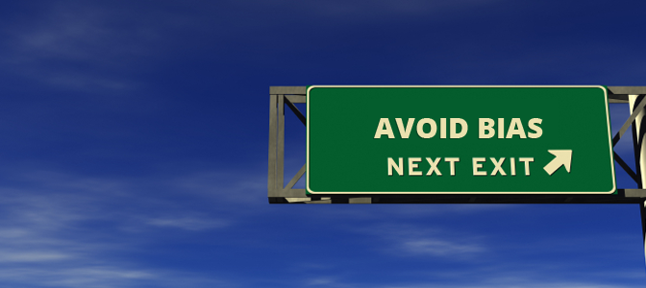
Are There Biases on Search Engines?
By:
Vandana Anand
Fareya Ikram
Daniel Mcdonough

Slide 2
Preliminary Research
Suggested that there is liberal information bias on our search engines
http://www.canirank.com/blog/analysis-of-political-bias-in-internet-search-engine-results/
https://studybreaks.com/news-politics/google/
https://productforums.google.com/forum/#!topic/news/YWd7lSno5Ww;context-place=forum/news

Slide 3

Hypothesis
We hypothesize that more than half of the first ten articles about the liberal figures will be positive articles, praising the figure and that more than half of the articles about the conservative figures will be negative, criticizing their action.
Scope: Liberal figures are those that currently belong to the democratic party and conservative figures that are currently members of the republican party.

Slide 4
Definitions and Confounding Variables
Definition: A bias search engine is a search engine that has prejudice in favor of or against one thing, person, or group. The search results of such a search engine will show this prejudice.
Possible Confounding Variables:
-Major events that take place pertaining a certain political figure may temporarily, significantly change search results
-Values of American political parties are continuously changing, and therefore the labels of conservative and liberal are not exact
-Timing (i.e. Donald just gave the state of the Union Address)

Slide 5



People:
Hillary Clinton (Democratic)
Barack Obama(Democratic)
Donald Trump (Republican)
Marco Rubio (Republican)

Slide 6
Research Methodology
Collect the first 10 articles/ search results for each political figure in three separate search engines: Google, Yahoo, DuckDuckGo
Note: for this experiment we excluded social media and Wikipedia
For each article, determine if the political figure is being presented in a positive, negative or neutral manner
Do this by scanning the websites for opinions and keywords that show the point of view of the author
i.e Author chose to use “lack of success” vs failure
Check website against bias checking tool
https://mediabiasfactcheck.com/
Compare the results within each search engine and compare the results across the search engines and determine if there is a bias

Slide 7
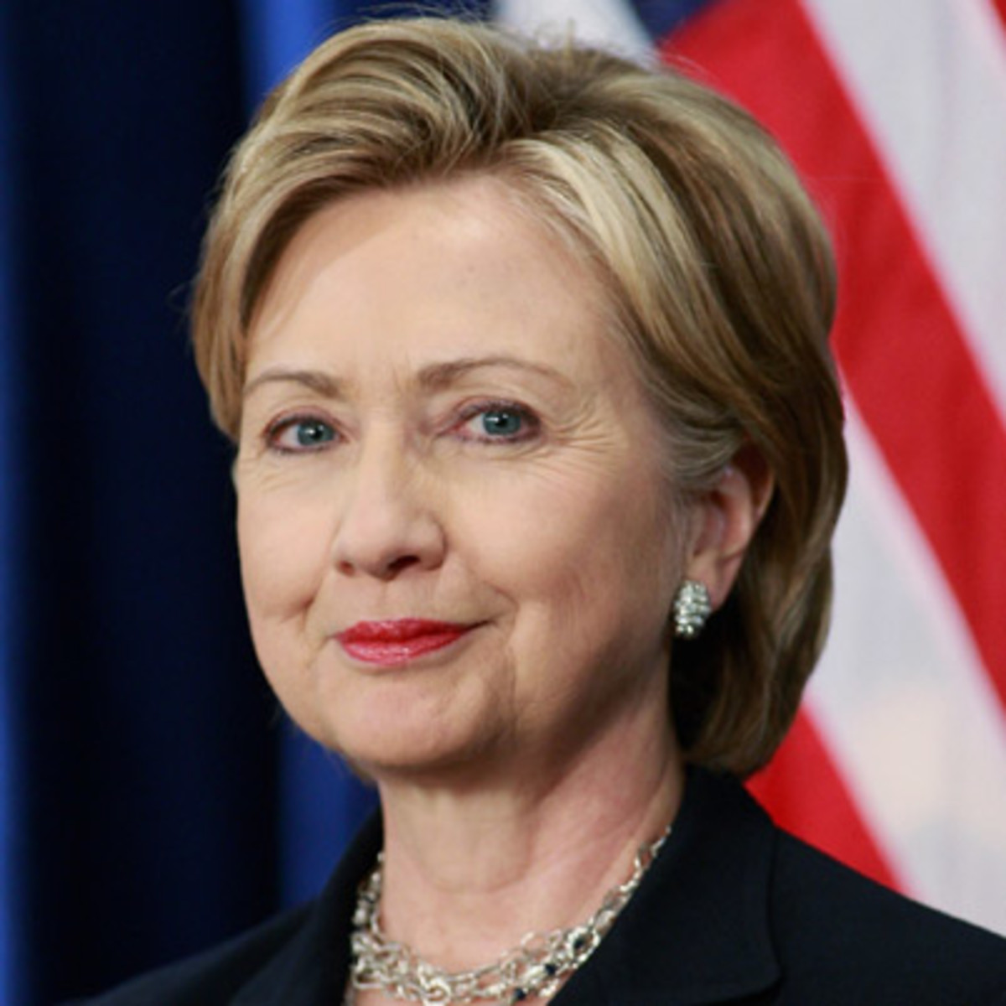
Chart/Data
 |  | Google | Yahoo | DDG
Hillary Clinton | Positive | 5 | 4 | 6
 | Negative | 2 | 0 | 0
 | Neutral | 3 | 6 | 4
 | Passed Test? | NO | NO | YES

Slide 8
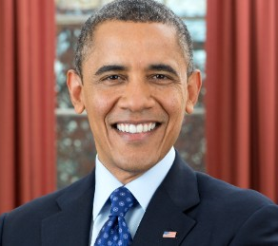
Chart/Data
 |  | Google | Yahoo | DDG
Barack Obama | Positive | 7 | 8 | 8
 | Negative | 0 | 0 | 0
 | Neutral | 3 | 2 | 2
 | Passed Test? | YES | YES | YES

Slide 9
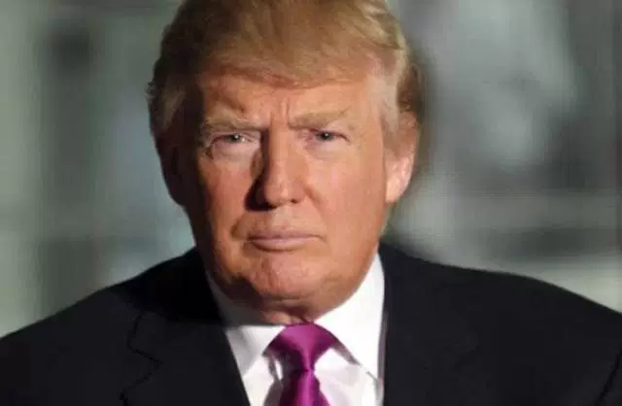
Chart/Data
 |  | Google | Yahoo | DDG
Donald Trump | Positive | 3 | 5 | 5
 | Negative | 5 | 2 | 3
 | Neutral | 2 | 3 | 1
 | Passed Test? | NO | NO | NO

Slide 10
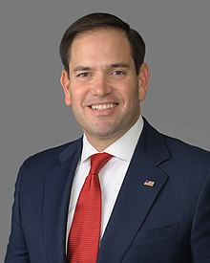
Chart/Data
 |  | Google | Yahoo | DDG
Marco Rubio | Positive | 1 | 3 | 3
 | Negative | 2 | 4 | 2
 | Neutral | 7 | 2 | 5
 | Passed Test? | NO | NO | NO

Slide 11
Results
120 Data Points
Tested Hypothesis 12 Times
Over 3 Search Engines (Google, Yahoo, DuckDuckGo)
Hypothesis Passes 4 of those 12 times
Hypothesis Failed
We hypothesized that more than half of the first ten articles about the liberal figures will be positive articles, praising the figure and that more than half of the articles about the conservative figures will be negative, criticizing their action.

Slide 12
Interesting Findings
Entering in a political figure’s name into google the second time gave us a different set of pages than the first time we entered their name
The first website that popped up for each political figure no matter the search engine is their official site. This probably indicates bias because the politicians may have paid to get their own website shown first
The experiment did show that liberal figures had more positive articles than conservative figures. (Liberal: 38 Conservative: 20)

Slide 13
Conclusion
We were able to collect data that suggests that a bias does exists
self-promoting websites as the top results
Revised Experiment: We would focus on how difficult it is to get different views on the same figures, as many of the articles show the figures in a positive light.
Search engine results differed from one another, but not significantly
They may use similar algorithms
Basis of a possible new hypothesis that states that search engines do not show different perspective on news stories and figures.

