Slide 1

Do Android Apps Request Too Many Permissions?
By: Vandana Anand
Fareya Ikram
Daniel McDonough

Slide 2
Apps Used:
Financial/Shopping
Coinbase
TD Bank
Steam
Groupon
Bank of America
Navigation/Travel
Google Maps
AirBnb
Social
Instagram
Snapchat
Messenger
Facebook
Utility
IR Remote
Vibrate by Force
Outlook
Weather
Entertainment
Youtube
Jet Set Radio Live
Reference/News
BBC News

Slide 3
 | # APPS | AVG PERMISSIONS
Financial/Shopping | 5 | 12
Utility | 4 | 9
Social | 4 | 25.75
Entertainment | 2 | 13
Navigation/Travel | 2 | 19.5
Reference/New | 1 | 6

Slide 4
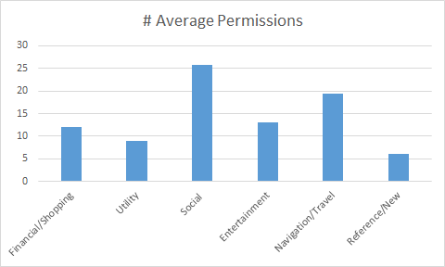

Slide 5
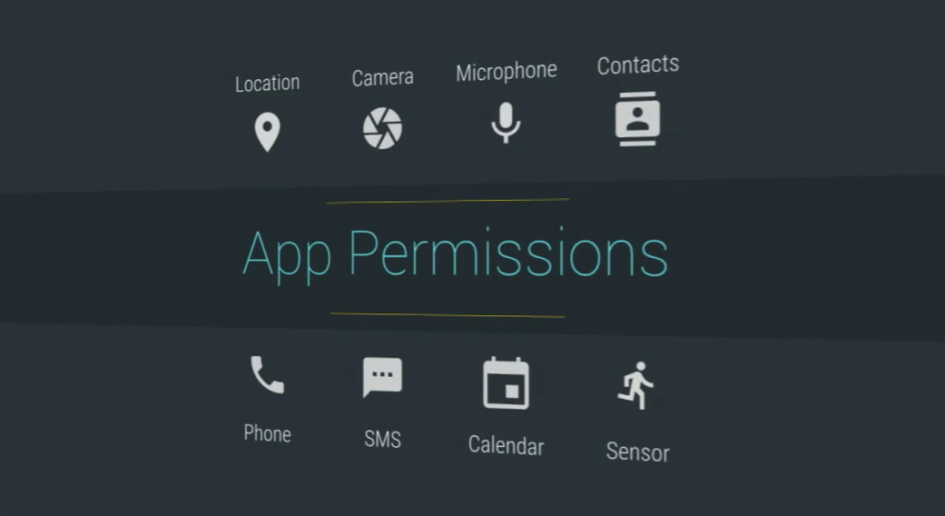
What Kind of Permissions?

Slide 6
App History: Permissions that keep track of active or previously active processes installed on the device
Identity: Permission to make/remove/track accounts with apps on the device
Contacts: Permission to track the contacts of the users device
SMS: Access to read/write/edit SMS & MMS
Location: The right to track the user’s device by GPS or approx. Network location
Phone: Permissions to call and keep records of phone calls
Media: Access to USB/SD card data

Slide 7
Camera: Access to device’s camera
Microphone: Access to device’s Microphone
Device ID: Permission to keep track to the device ID on the user’s phone
Calendar: Permission to modify/read/send emails about events
Network: Permission to transfer data from networks and track what networks and when
Bluetooth: The right to communicate with bluetooth devices
SysTool: Allowed rights to system calls on low level basis
UI: Access to cover up other apps running on the device
Battery: Permission to track battery information and control battery settings
In-App Purchases: Ability to give/store credit card information to purchase goods/services
Google Play Services: Access to set a advertising ID to the specific user’s account
Other: Permission to access wall paper sizes, flashlight, IR, audio, shortcuts
Notes:
Each of us talk about an example of an app that asked for permission that were needed/not needed -> not sure if time will permit

Slide 8
Permissions Beneficiary Classifications
USER: Any permission that serves the main functionality of the application (ex: Google Maps and using the GPS)
VENDOR: Any permission that does not serve the main functionality of the application. (ex Facebook keeping track of App History)
AMBIGUOUS: Any permission that is either optional or has the potential to be used maliciously. (ex: any access to SD cards or In app purchases)

Slide 9
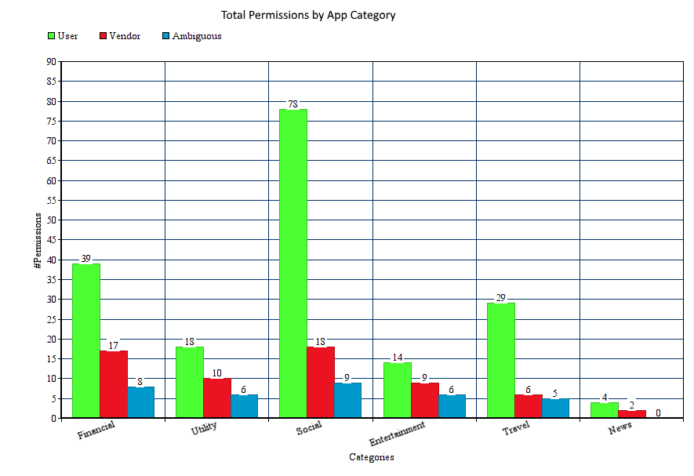

Slide 10
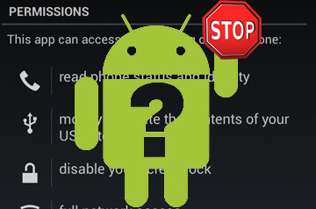
Our Conclusion:
We’ve observed that most apps ask for more permissions than necessary
The social apps ask for the most amount of permissions followed by financial apps, while utility apps ask for the least amount
Although users have the option to turn on or off most of them, there are some that are for the specific use of vendors to mainly learn more information about the users

Slide 11


Permission Sources:
PlayStore
Application Manager

