Slide 1
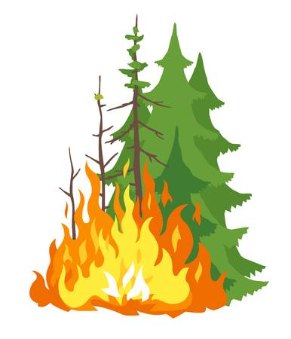
Wildfire Prediction
We Can Do Better!
Our Team:
Ziyu, Qiaochu, Anqi Mao, Weixiao, Anqi Wang, Vandana Anand, Soumya Joshi, Shweta Shinde

Slide 2
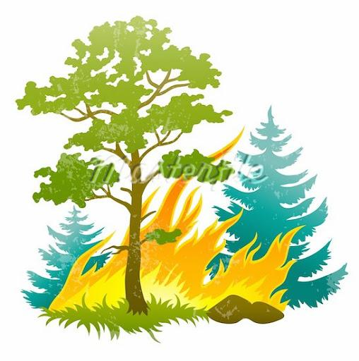
Who is affected?
People who live in smaller towns and suburbs, especially those who are not recognized in the dataset covering large areas, are most affected
After looking at and exploring the dataset, we can see that because it is shown that many wildfires happen in smaller areas than larger areas, we may not be able to identify many wildfires that happen in smaller areas with the current model
Predicting wildfires in smaller areas can alert civilians to flee to other areas that are safe

Slide 3
Data for Better Prediction
Historical Data
Remote Sensing
Large area ❌
Out-of-date ❌
With remote sensing data collected by various satellites, e.g. MODIS of Nasa Terra, we can get thermal information:
of any place;
1000 m spatial resolution;
four times daily.

Slide 4
Skills
Prediction Modeling
Evaluation
Data Visualization
The model that we are going to apply is --
KNN, decision tree, random forest methods applied
Skills Needed: Python, R
An interactive dashboard is necessary for the convenience of our customers. We can build a website for showcasing.
Skills Needed: HTML, Java, JavaScript
We need historical data and expert knowledge to evaluate the loss that can be avoided by the better prediction.
Skills Needed: expert knowledge

Slide 5
Is It Worth the Cost?
Cost of New Data Source
Cost of Data Visualization
Cost Evaluation
Many Remote sensing data are for free. Algorithms regarding wildfire prediction are also well-developed.
There’s well-developed dashboard model that can fit the project. One software engineer specialized with UI design and front-end building
It is necessary to evaluate the cost and get the whole team properly managed in the financial way.

Slide 6
SWOT ANALYSIS
Strengths
Opportunities
Weaknesses
Threats
Modelling can help to make prediction by using previous data
Recently, there is no better way than data analysis to make this prediction
Data analysis can only predict the trends, there are many issues, such as human factors, that might affect the result
Since the result might be not correct, it might be considered as a program that wasting money and time

Slide 7
Research Has Been Done (since 1970s)
Predict fire size at the time of ignition
KNN, decision tree, random forest methods applied
USDA Forest Service’s Wildland Fire Assessment System
Fire danger rating using current and historical weather (10-min average wind, 24 hr rain total, temperature, relative humidity, dew point...) and fuel data to give present condition information and predict what may happen tomorrow
Canadian Forest Fire Weather Index (FWI) system
Six codes (Fine fuel moisture code, duff moisture code, drought code, initial spread index, buildup index, fire weather index) to predict the effects of fuel moisture and wind on fire behavior
Notes:
Fine fuel moisture code, duff moisture code, drought code, initial spread index, buildup index, fire weather index
11 predictive variables were considered in this study: slope, aspect, altitude, wind effect (combination of wind speed and wind direction (Böhner and Antonić (2009)), land use, normalized difference vegetation index (NDVI), annual rainfall and temperature, and proximity to roads, rivers, and human settlements.

Slide 8
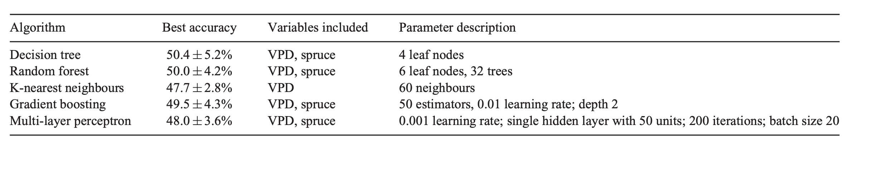
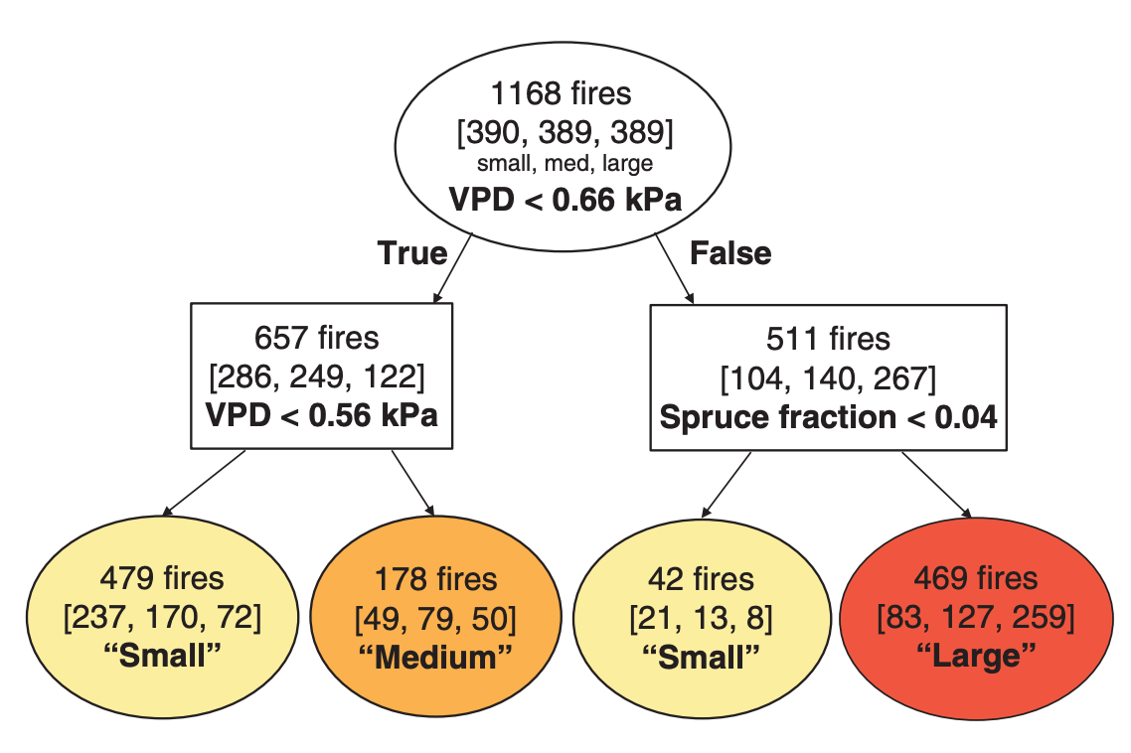
State of Art Research
Best model
Machine learning to predict final fire size at the time of ignition. International Journal of Wildland Fire 28, 861-873.

Slide 9
How can we help using data science?
At the time of ignition, give an estimation of the severity of the fire (fire size) so that
the residents in the area can prepare
law enforcement and fire departments can prepare

