Slide 1

BannerWeb
Redesign Proposal
Vandana Anand, Kaidi Ding, Liangyu Liu, Jiadong Sun, Joseph Yuen
Notes:
Hello everyone. Today, our team will be proposing a redesign for WPI’s Bannerweb.

Slide 2

Agenda
• Goal
• Background
• Analysis
• Improvement
Notes:
Before we begin, here is our agenda for the presentation. First, we will cover our goal, then some background information on BannerWeb, then we will analyze the strengths and weaknesses of the current program, and lastly cover the different improvements that we think would make BannerWeb even better.

Slide 3

Goal
Demonstrate the need for a redesign of the WPI BannerWeb User Experience
Notes:
First off, the goal of this proposal is to demonstrate that there is a need for a redesign of the WPI BannerWeb User Experience based on our analysis of the current program and share with you some ideas on how we can improve it.

Slide 4
Background
Notes:
Before we start analyzing BannerWeb in depth, we want to first establish what it is and people’s general problem with it.

Slide 5
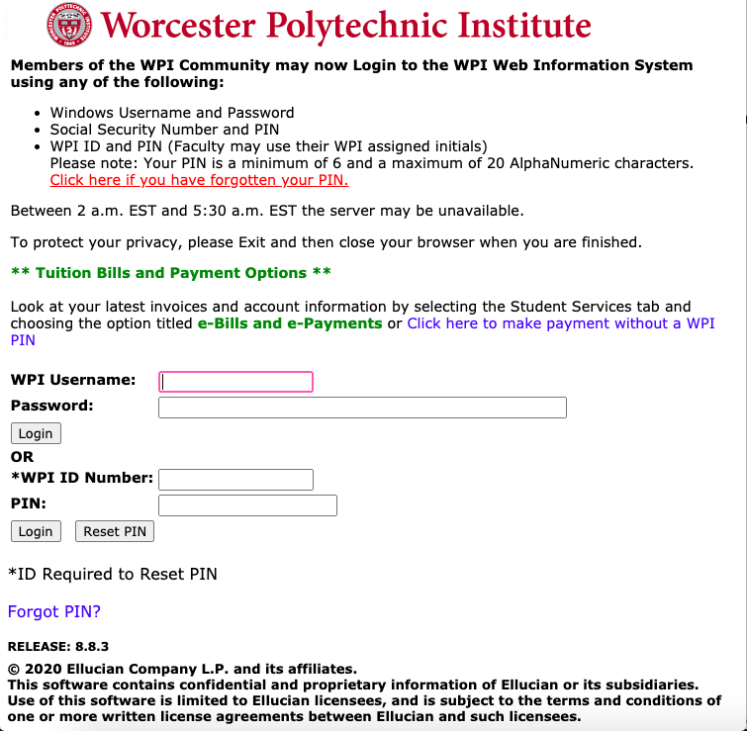
Background
BannerWeb
What is it?
WPI website that organizes and processes required logistical admin-related activities for its users
Users
Students and WPI Employees
Notes:
So what is it? BannerWeb is a website that allows WPI students and employees to handle a wide variety of important tasks. For students, these tasks include activities like paying tuition, viewing grades, updating personal information, registering for courses, and even looking up one’s mailbox combination. For employees, these tasks include setting up one’s direct deposit information or requesting a higher salary. All to say, BannerWeb handles many of the necessary logistical activities that students and employees need to complete.

Slide 6
Background
Problem
Student users complain about the BannerWeb experience because it is confusing and difficult to use
Solution
• Analyze BannerWeb’s shortcomings
• Identify points of improvement
• Implement improvements
Notes:
But we have identified a problem. And that problem, at least in our experience, is that many student users complain how BannerWeb can be confusing and difficult to use. To solve this problem, we understand we need to analyze the BannerWeb program’s strengths and weaknesses, identify points of improvement and then implement those improvements.

Slide 7
Analysis
• Strengths
• Weaknesses
Notes:
In our analysis of the program, here are BannerWeb’s specific strengths and weaknesses

Slide 8



Strength 1: Functional
Student Service
Financial Management
Information Setting
Check-In
Registration
Residential Services
Survey and Evaluation
Payment of Tuition and Fees
Financial Aid Request
Medical Insurance Management
Goatbucks Management
Account Setting
Personal Info Update
Contact Info Update
Proxy Management
Alert System Setting
Notes:
So next we will talk about the strengths of BannerWeb. First, we consider the BannerWeb functional because we think it can basically meet the needs in student services, financial management, and information setting. For example, by accessing the bannerweb, we can register courses, pay tuition, manage our GoatBucks, and also we can reset our passwords.

Slide 9




Strength 2: Informative
Academic Information
Financial Information
Personal Information
Course Schedule Review
Student Records display
Student Policy
Status of charges
Financial Statement
Personal Info Viewing
Contact Info Viewing
Notes:
Second, we think it is informative. For students, the information bannerweb provides includes all records from enrollment to graduation, including academic, financial, and personal information. For example, you can display your grades and transcripts, and also get the financial statements of payment

Slide 10



Strength 3: Flexible
Any Place
Any Time
Any Device
It can be used all over the world without any other software support.
Its features can be used at any time, and the data will be updated in real time.
The responsive design allow it to be used on a variety of devices.
Notes:
Third, we consider its flexibility a necessary advantage, because first, It can be used all over the world without any other software support, such as VPN. Secondly, we can use the functions of it at any time,twenty-four seven service. also we can use bannerweb on any device because of its responsive design. These are the strengths that we found.

Slide 11
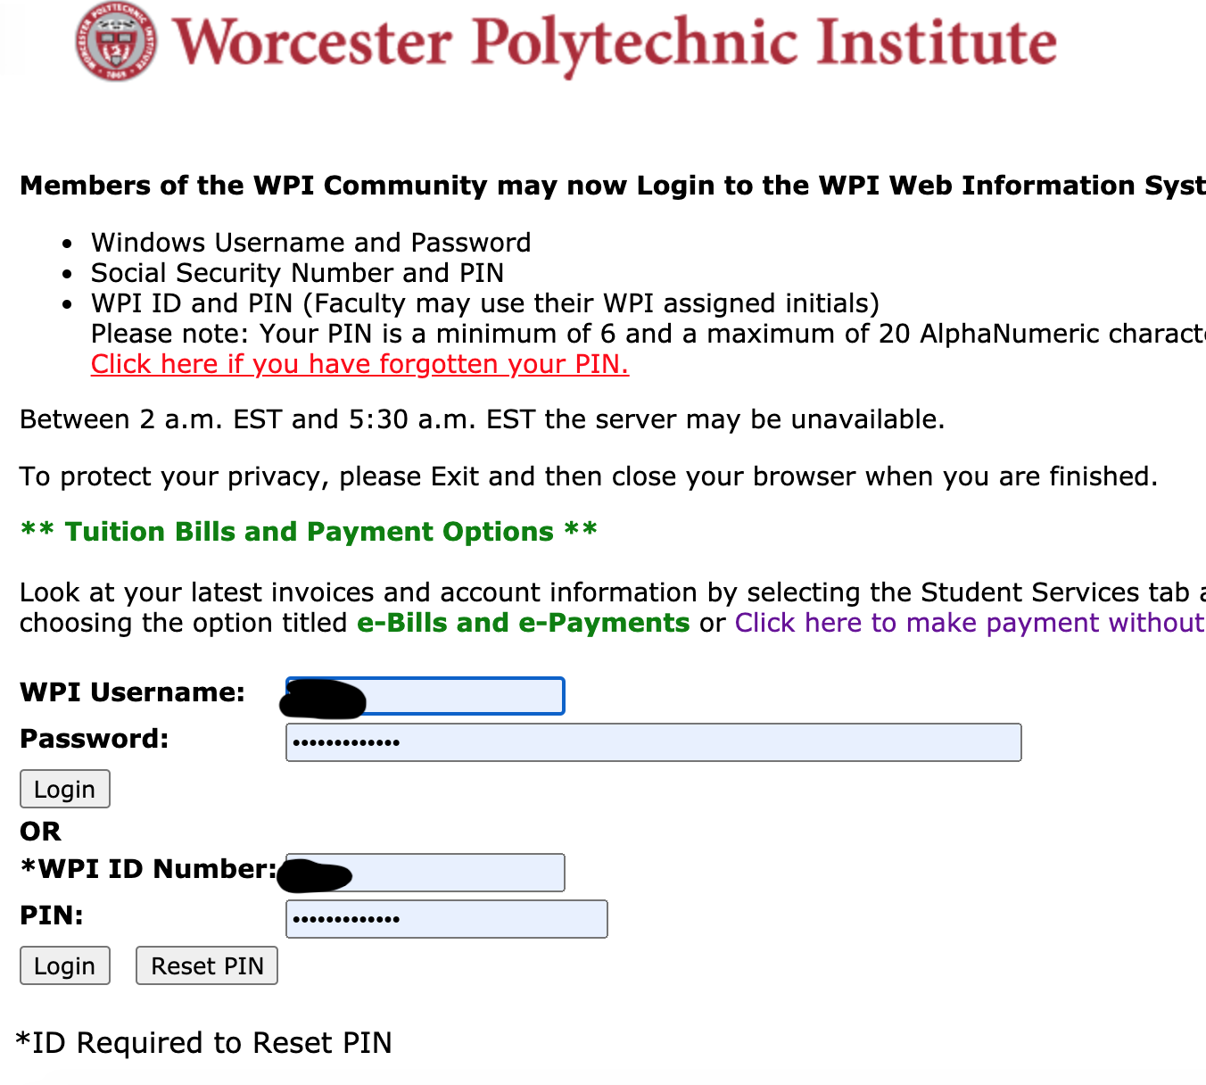

Weakness 1 Aesthetic
Notes:
For BannerWeb, a very obvious disadvantage is that it is not visually beautiful. The picture on the left shows the homepage of BannerWeb, and the picture on the right shows the homepages of University of Maryland and University of Chicago. I believe the contrast in visual effect is very obvious. The home page of official website is like the virtual gate of a school. It represents the school’s overall brand and quality. Even though the official WPI website is relatively appealing, Bannerweb is not consistent with the school’s aesthetic quality.

Slide 12
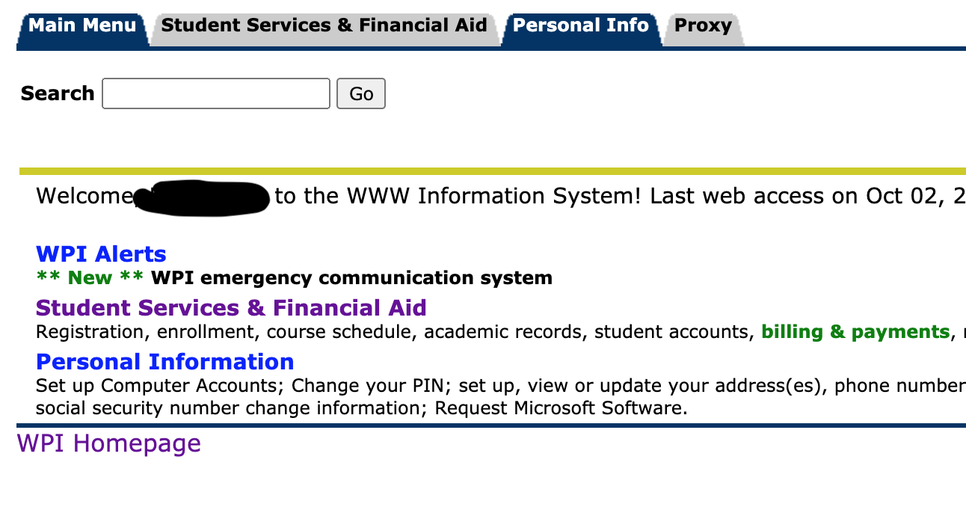
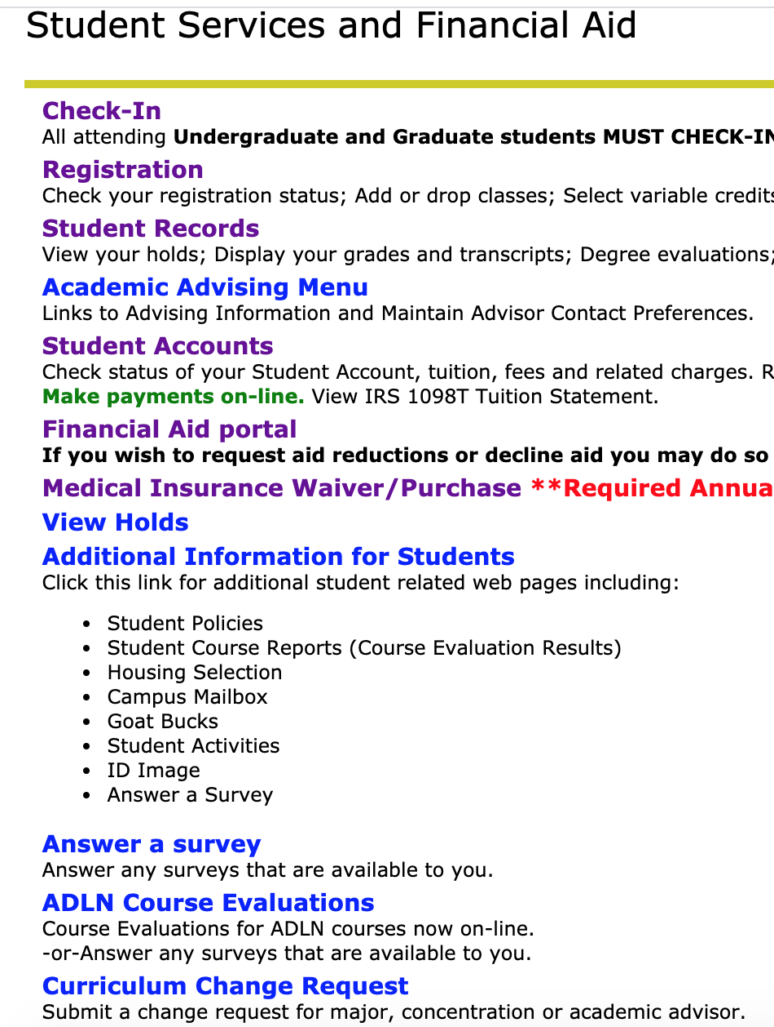
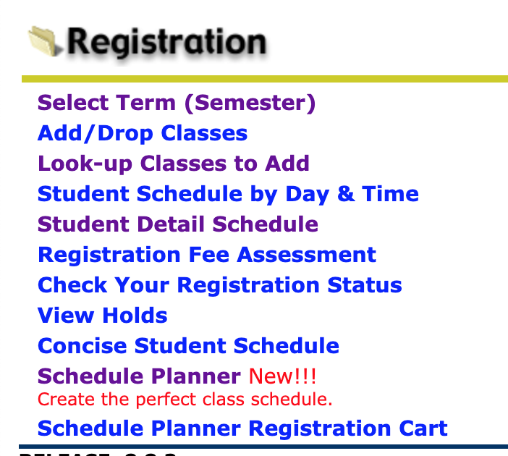
Weakness 2 Navigation
Notes:
The second problem is that the page is cluttered and not intuitive. Therefore, many students can't find the window they need quickly when they use this website for the first time. When students log in, there are three navigation keys on the homepage, but in general, students only use the second one. However, when students enter the student service page, the whole page will be occupied by different navigation keys. There are 12 different options on this page, each with a text explanation below. Once the user clicks on the registration, they are presented with 11 different options without informing the user how deep they are in the system. This can potentially overwhelm the user with too much content and confuse them.

Slide 13
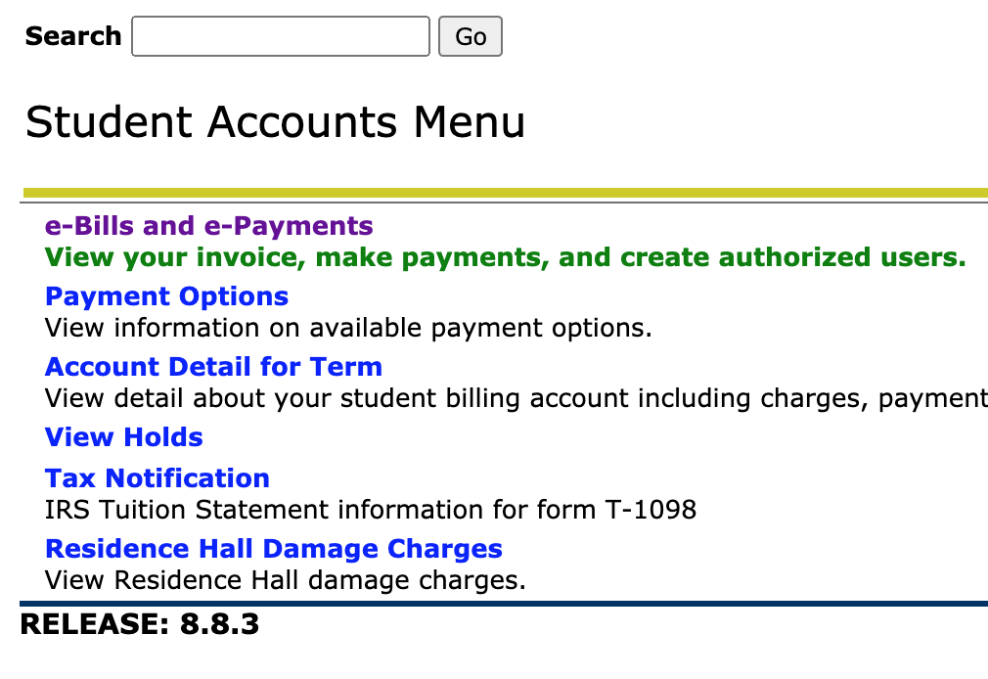
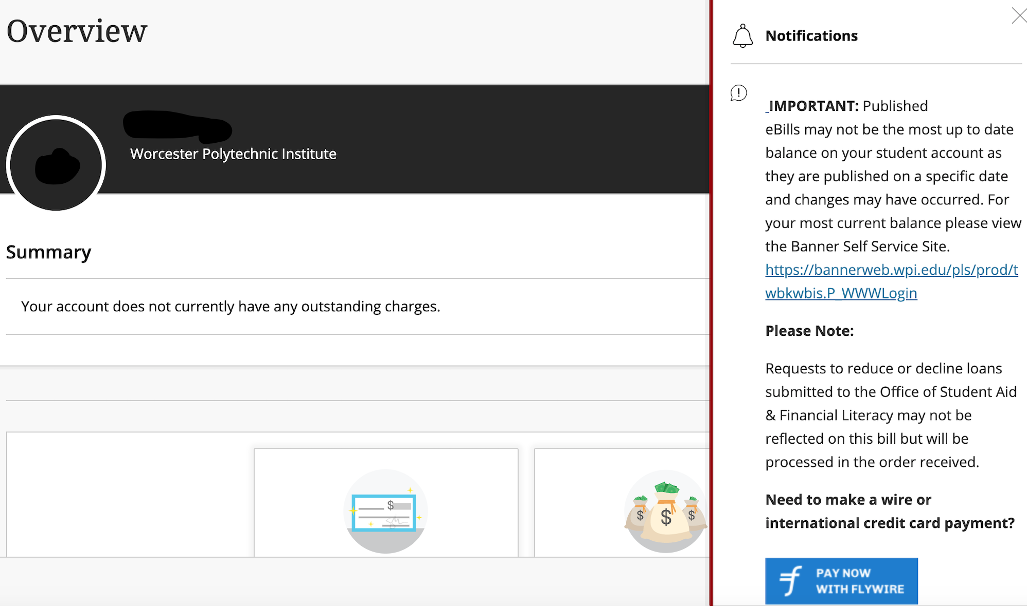
Weakness 3 External Software
BannerWeb
Flywire
Notes:
Another shortcoming is that there are some third-party software and services on the homepage which is inconsistent with the BannerWeb layout and user experience and may result in a distrust of the system. For example, when paying tuition fees, most students have to use flywire, which is unfamiliar with international students. As an international student, when I paid my tuition for the first time, I didn't trust the payment method of the platform as it was separate from BannerWeb. And flywire still needs to wait 3 to 5 days after paying tuition fees, which contributes to a negative user experience.

Slide 14
Improvements
Notes:
Now that we have gone over some of the weaknesses of bannerweb, we will now go over potential prototype design ideas to improve the site and user experience.

Slide 15
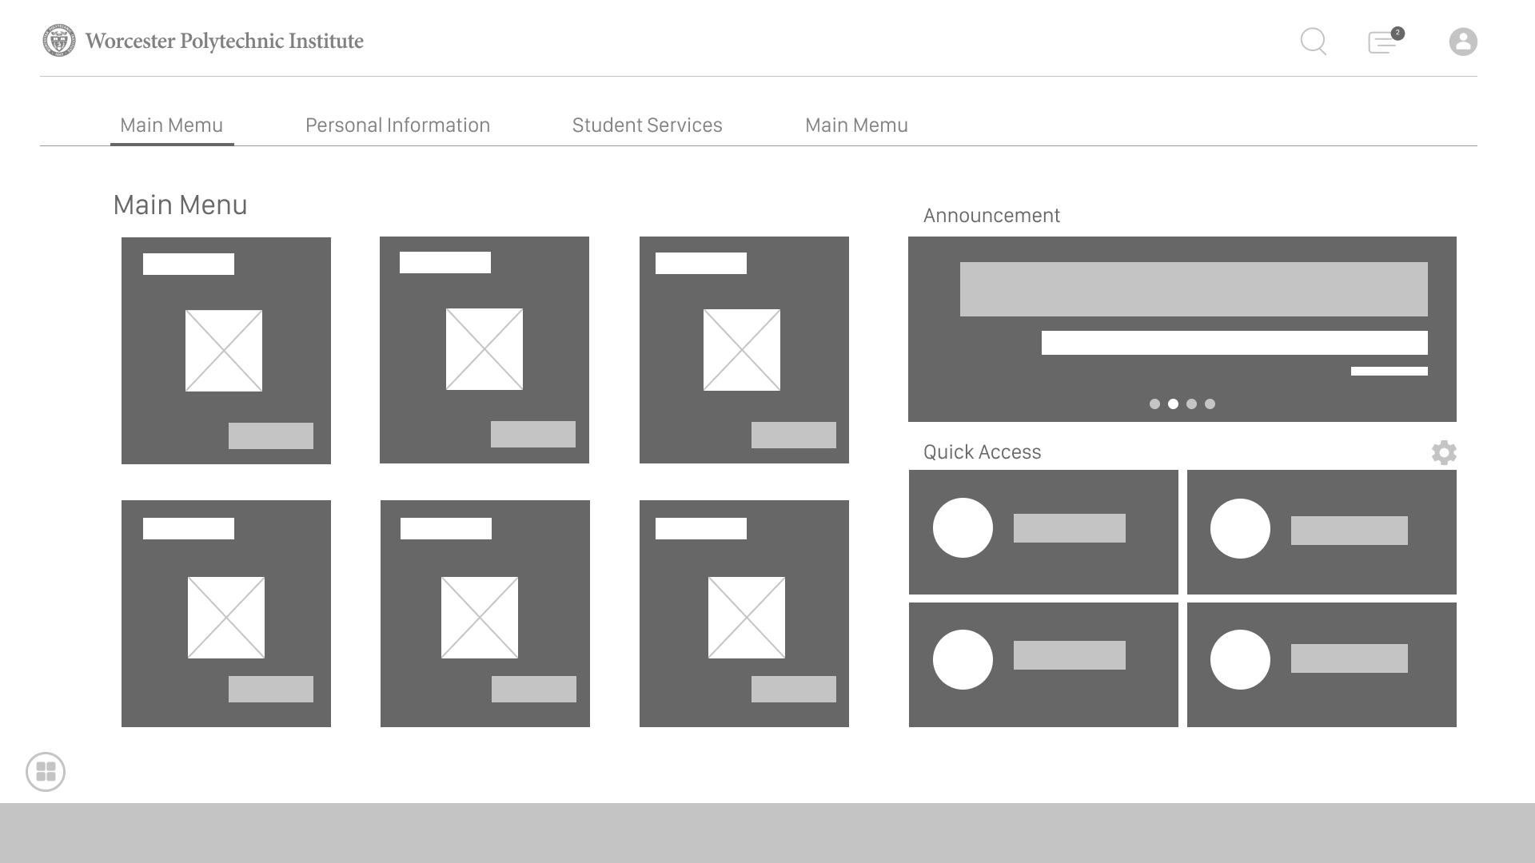
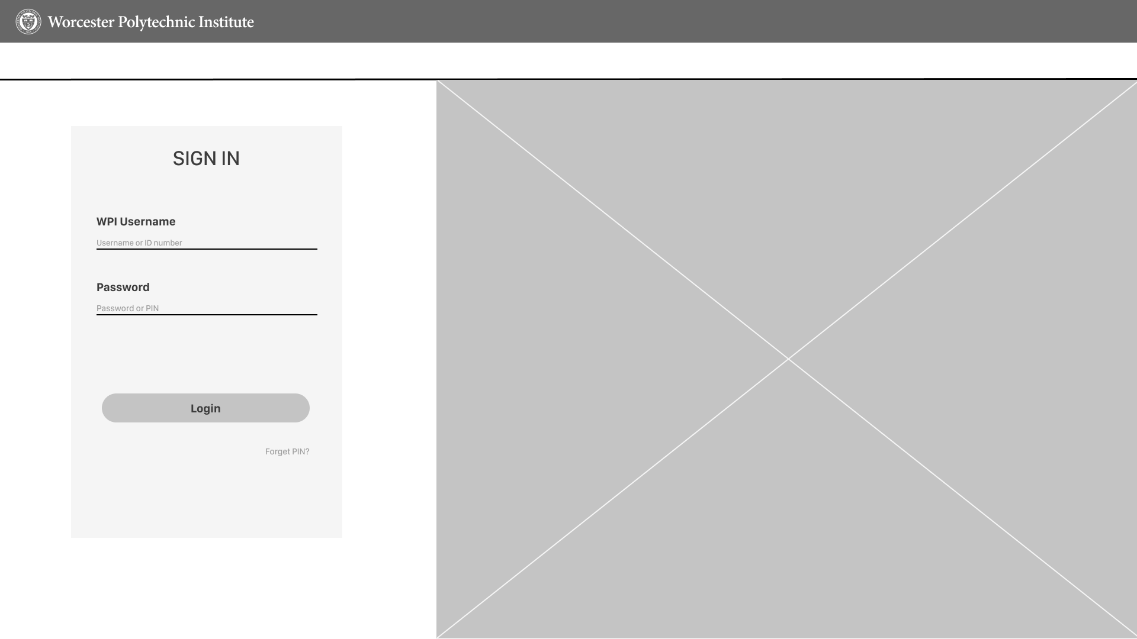
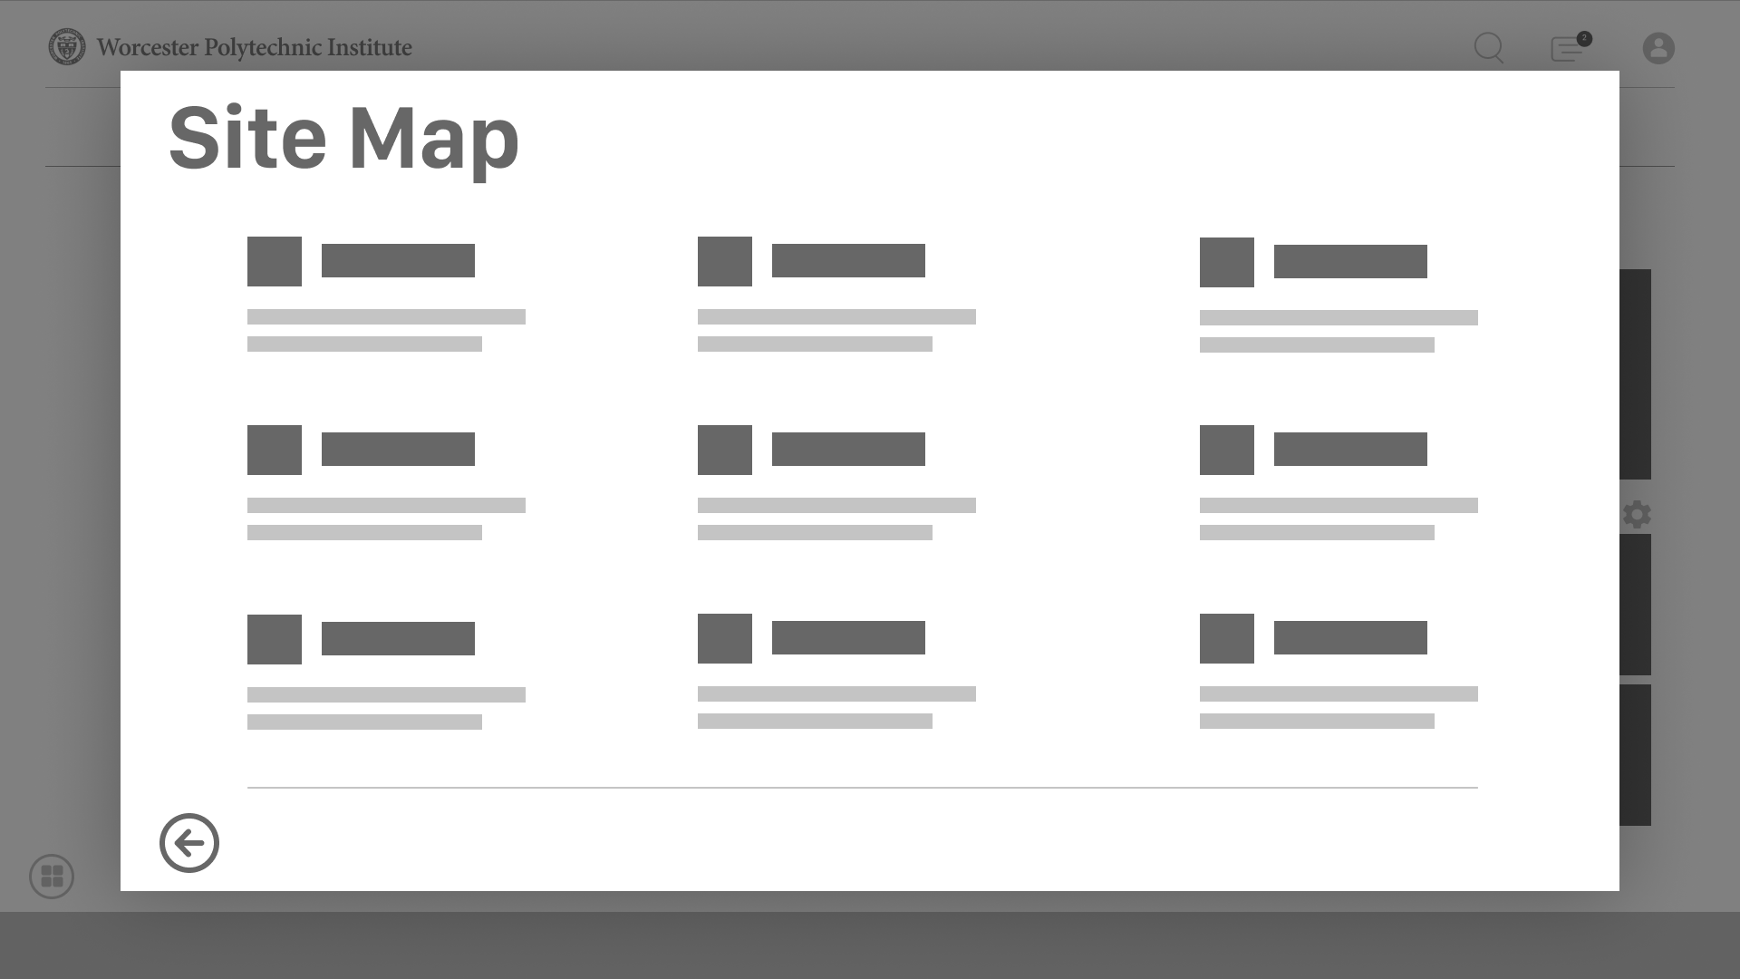
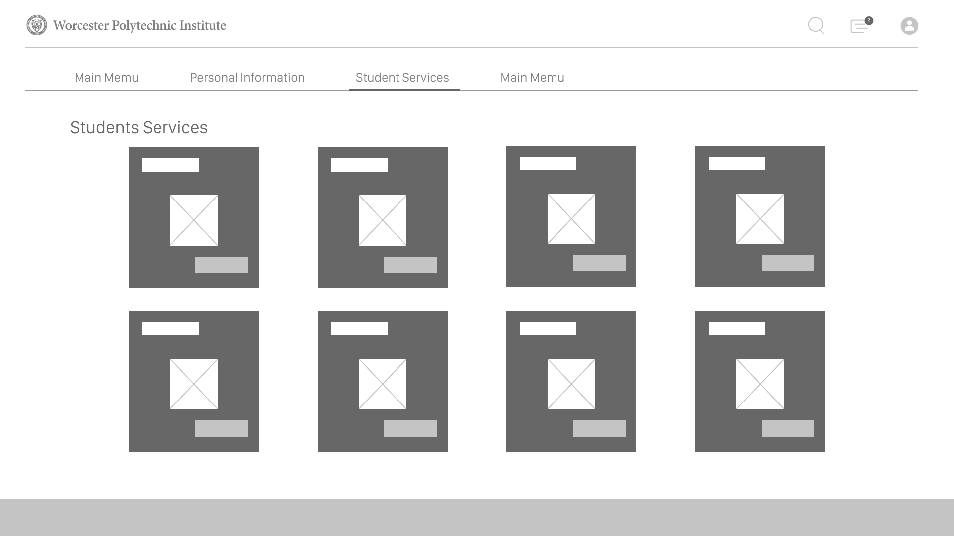
Improvement 1 Modernized UI
Notes:
The first improvement is modernizing the UI so that it is aesthetically pleasing and also easy to follow. We discussed that compared to other university sites, the WPI bannerweb site is contrasting and could be improved to really reflect the school. Some examples of improvement include revamping the sign in page to make it simpler, have one login method, and remove the extra information on the site and move it to a “more information” icon. The information on the main pages after logging in can be organized into boxes as shown in the picture to categorize or group the information uniformly across the pages. Overall, a minimalist approach to designing bannerweb would further help users with their experience of visiting the site.

Slide 16
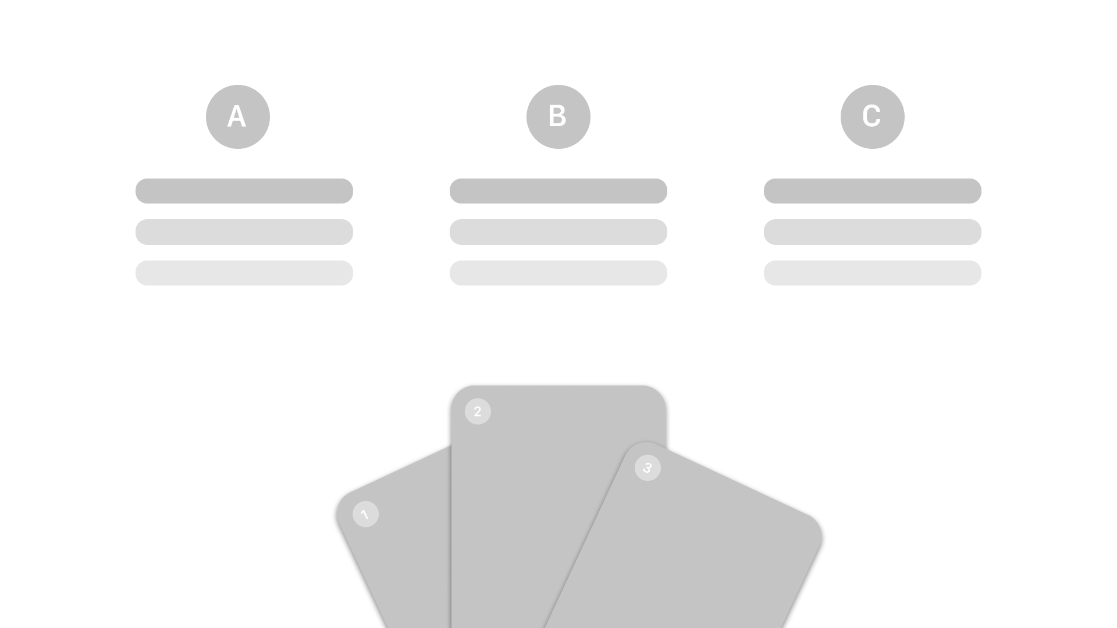
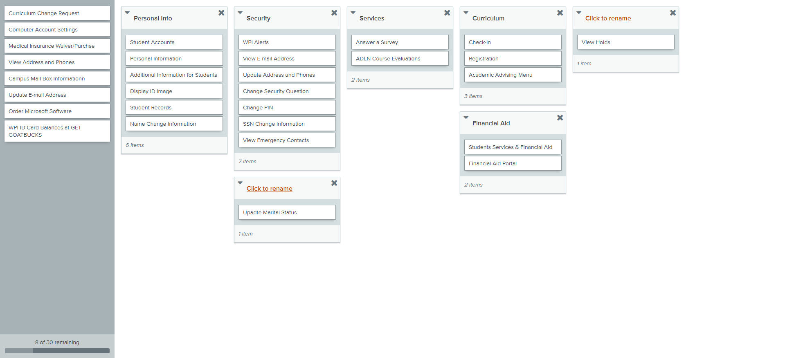
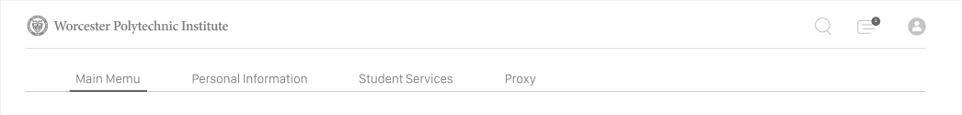
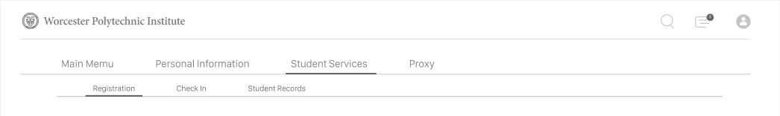
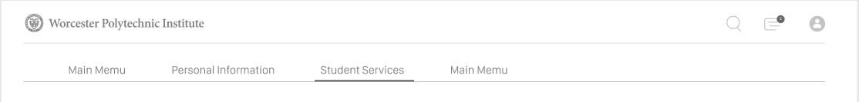
Improvements 2 Navigation Bar
Notes:
The second improvement involves a redesigned navigation bar to organize all the links that are offered to the user to manage their accounts. The picture here is about our using card sorting method to redesign the navigation bar. As we discussed, currently the links are listed one after another, making the site cluttered, confusing, and hard to find what the user is looking for. By improving this aspect, the user would find it easier to navigate the web. As you can see, our card sorting idea is still in development and will need tweaking, but we now that the current navigation bar needs to be redesigned for clearer and simpler navigation..

Slide 17
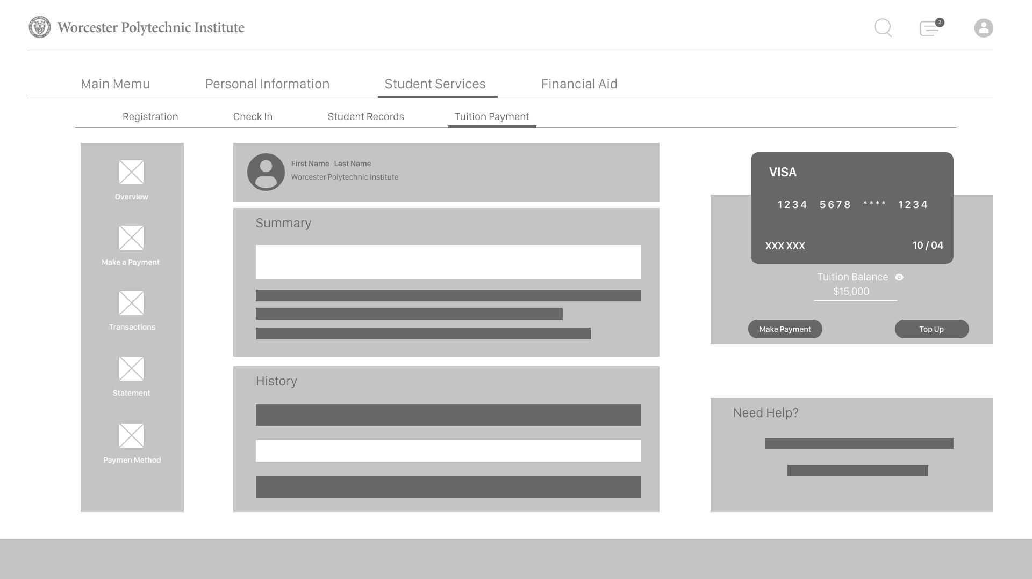
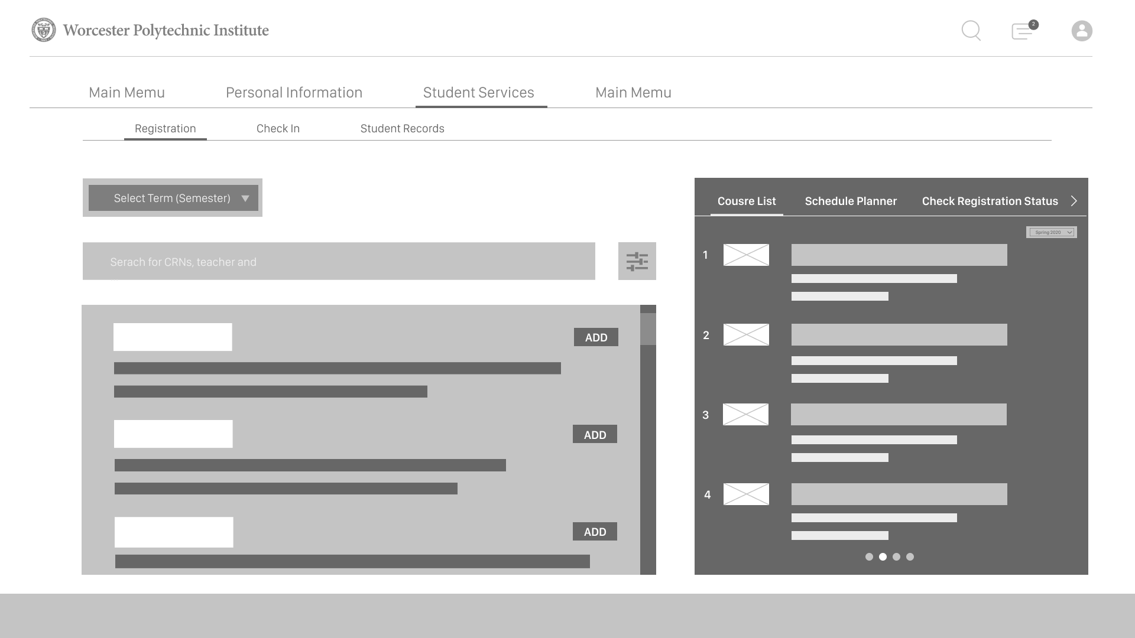
Improvements 3 In-House Features
Notes:
For in-house features, I take “Course Scheduler” and “Tuition Payment” as examples. We redesigned the interface of course scheduler, so that students can quickly find the target course and perform other operations in the same page. For “Tuition payment” , we design a internal interface which allows students to pay tuition fee in the bannerweb instead of being redirected to 3rd party website.

Slide 18
Next Step
Implement improvements
Notes:
This brings us to the conclusion of our presentation. We hope that you see the need for a redesign and approve of our proposed improvements. After approval, our next steps include designing the pages we have described throughout the presentation. Thank you for listening and let us know if you have any questions!

Slide 19
Thank You !
Notes:
This brings us to the conclusion of our presentation. We hope that you see the need for a redesign and approve of our proposed improvements. After approval, our next steps include designing the pages we have described throughout the presentation. Thank you for listening and let us know if you have any questions!

