Slide 1
CESIM Round 1
Team 1: Andrew Aberdale, Vandana Anand, Katharine Conroy, Meredith Forcier, Diego Paredes, Christopher Tillotson, and Emily Wilson
Notes:
Goal summary:
Our strategy, earn the most market share in our first round. We decided to lower our prices heavily about 35% discount on the MSRP in each market. We also forecast that we would trigger a price war for tech 1 by round 2 so get ahead on the game. We are assuming the market in Asia will increase YOY by 20% so expand our production to Asia was key. Financially we thought we would increase our market value so strategically buy back shares (sell them in the future for a higher price) and pay some dividends to shareholders(attractive stock to keep our market price).

Slide 2
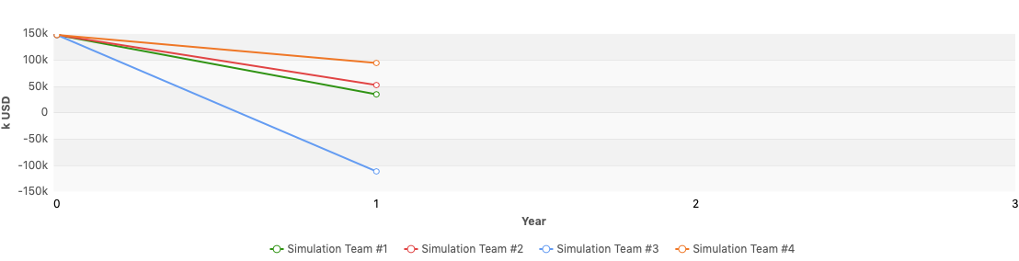
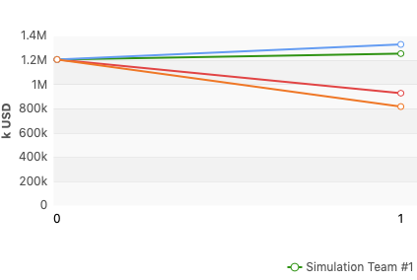
Financial Statements in k USD
Revenue | Profit | Assets | Liabilities | Equity | Cash | Investment (plants+R&D) | Financing Activities
$1,256,750 | $35, 079 | $920,204 | $558,875 | $361,329 | $156,544 | $1,647,202 | $29,207
Revenue
Profit
Notes:
You can see all of our financial statements in the appendix below
We had the second highest revenue, this came from a price cutting strategy that gave us a larger share of the market
Our profit was the second lowest because of this same price cutting strategy, the high tariffs we received with our high market share of asia, and our investment in R&D

Slide 3
Ratios
Performance:
Cumulative total shareholder return: -9.85%
Equity ratio: 39.27%
Net debt to equity: 103.31%
Stock Price:
EBITDA: 17.77%
P/E ratio: 130.97
Average Trading Price: $190.03
Notes:
Team 1 underperformed this round, however we maintained/increased our share value through buybacks and dividends. This will be useful next round when we attempt to take advantage of our new tech and market share.

Slide 4
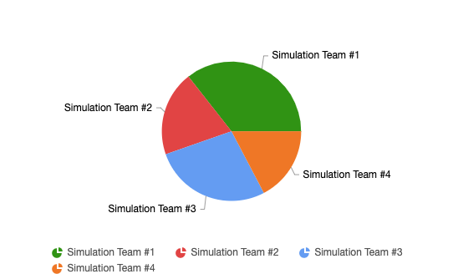
Market Share Report
Global Market Shares by Team
Region | Market Share Tech 1 | Total Market Share
USA | 41.24 | 35.71
Asia | 46.70 | 46.42
Europe | 10.65 | 10.65
Global | 36.99 | 35.61
Notes:
There is a difference in market share between the Tech 1 and total market share because Team 3 produced Tech 2, therefore slightly impacting the total market share values in the USA, Asia, and globally. In the market outlook provided at the beginning of Round 1, the market demand in Asia was projected to be the highest, followed by the USA and Europe. This projection led our team to make strides to claim the majority of the market in Asia by meeting the demand of consumers, building manufacturing plants in Asia, and increasing marketing costs using the low cost strategy as we knew a price war may be suspected in the future. We set a competitive price that could still be decreased moving forward, but was profitable to our company. We followed a similar and less aggressive strategy in the USA and did not focus as much in Europe as there are no plants to be built there and the market is not that high. Although in Europe we changed our marketing strategy to footprint as the consumers in this region care more about sustainability.

Slide 5
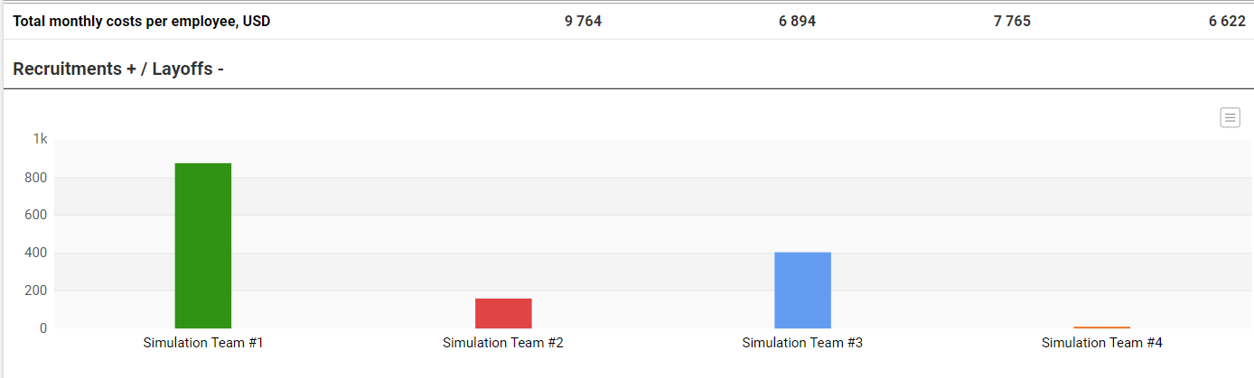
HR Report
Goal: Increase personnel to accomplish R&D goals in house (more cost effective)
300 workers last round => 1081 workers
Increased wage +$1,900/month, USD
Increased training budget +$180/month, USD
Low turnover: 0.7%
Total cost: $126,658,000 in house development V.S. $205,000,000 licensing ($78,342,000 savings)
Notes:
In order to make the best HR/R&D decisions for our company we did a cost benefit analysis between developing technology in house and licensing technology. The result was that at this stage of the simulation it is advantageous to develop in house as it is cheaper. This does come at the cost of upgrade delay by one round. Since our long term strategy is to focus of low cost high volume sales we could afford to wait to develop. We calculated the minimum number of workers/wages required to develop one Tech 1 upgrade and Tech 2 for next round. Although our HR costs went up significantly we are still saving $78,342,000 minus the unmeasurable benefits of having developed tech right away.

Slide 6
Production Report
Forecast Demand Report
US Manufacturing: | 62.8 K
Asia Manufacturing: | 680
Capacity Utilization | 80%
Production Plants: | 12 Plants
Demand Estimates: | 13, 000k (Round 2)
Capacity Utilization | 80%
Production Plants: | 16 US Plants 6 Asia Plants
Produced 6,960,000 units ---> Lost Sales Due to Production Shortage 1,461,000 units
Notes:
We maxed out the amount of contract manufacturing in the USA because it would be less expensive with he tariffs imposed to USA being $12 per unit when exported to Asia. When we did the math, to contract in China would be $109 per unit and in the USA it would be $86 per unit. The tariff and the USA manufacturer to Asia would be $98 vs $109 per unit. However we did not account for the shipping ($11 per unit in logistics) so we did end up paying $3 extra a unit. We will also have to maximize production because of our low prices which caused 1461K units in lost sales.

Slide 7
Cost Reports
Average Logistics Cost per unit sold (usd)
Average Production Cost per unit: $75 (usd)
Contractor Manufacturing Cost per unit (usd)
USA | Asia | Europe
$0 | $23.10 | $12
USA | Asia
$86.2 | $109
Notes:
The reason that the logistics cost were so low in the US, is because we set up the logistics to fulfill the US orders from the US plant first, in order to avoid tariffs. Our asian cost of logistics was high, because of the high tariff but we did our best to mitigate this by fulfilling the orders from the asia plant first.

Slide 8
Conclusion and Recommendations
We found that, in comparison to other teams, we performed better than most of the competition. There is still a firm that has a better competitor edge than us, but we are not the worst performing team.
For round 2, some changes we can make in order to perform better is to continue to increase the salary for workers because each round represents one year and it makes sense to give employees an annual incentive to keep working at the firm
Moving forward we will want to increase production and keep a competitive cost in the market that allows us a reasonable profit while keeping a low cost that appeals to customers

Slide 9
Thank you for your time!

Slide 10
Appendix

Slide 11
