Slide 1
CESIM Round 2
Team 1: Andrew Aberdale, Vandana Anand, Katharine Conroy, Meredith Forcier, Diego Paredes, Christopher Tillotson, and Emily Wilson
Notes:
Goal summary:
Our strategy for this round was to build more factories in each in the US and Asia. Assuming these two areas are the strongest in potential revenue, the intention of building more factories is to avoid tariffs to increase our profit. We then decided to profit on tech 2 and start developing tech 3.

Slide 2
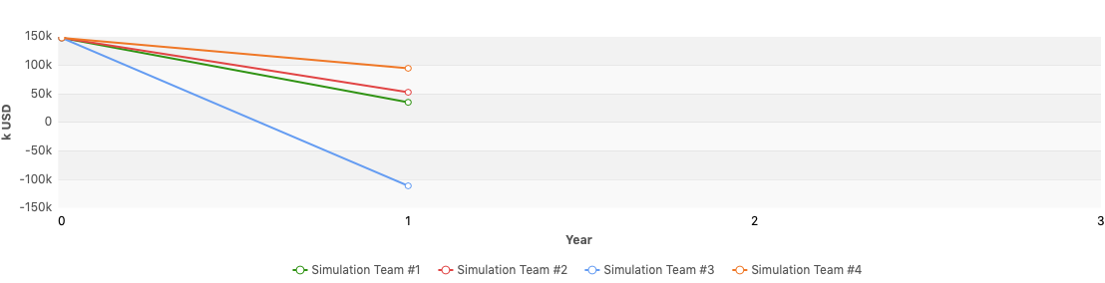
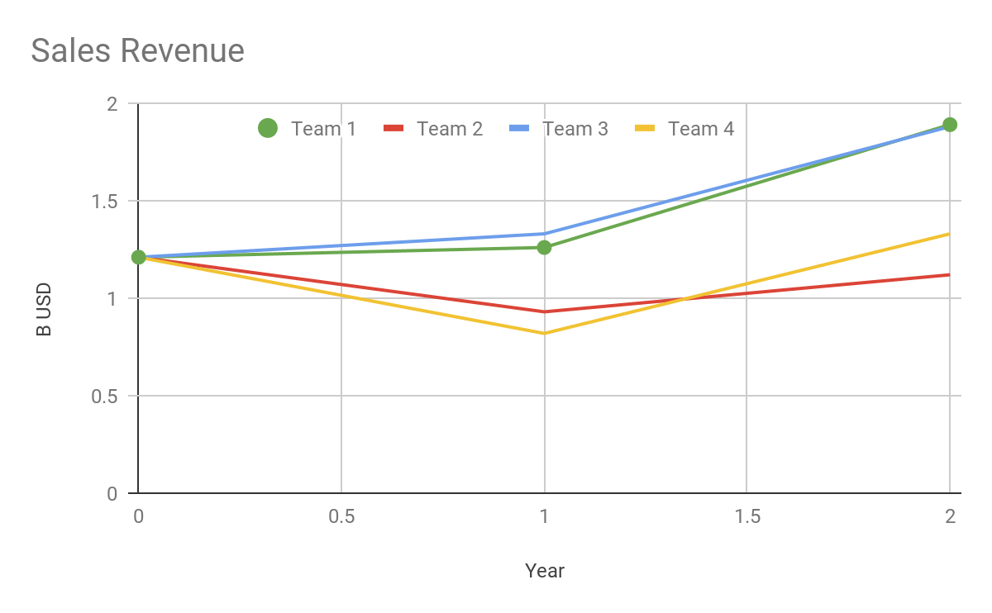
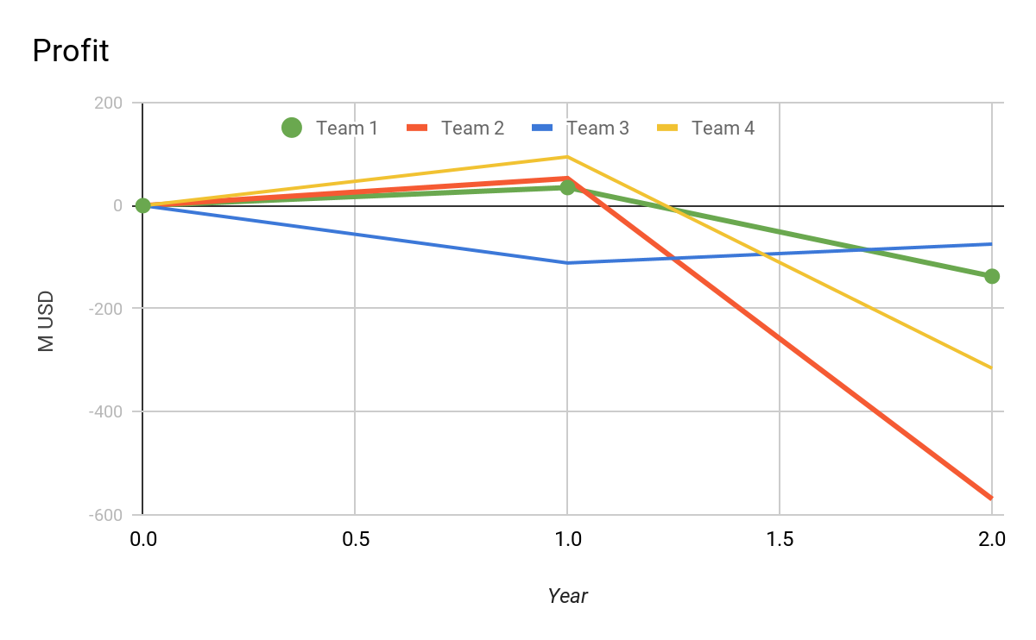
Financial Statements in k USD
Round | Revenue | Profit | Assets | Liabilities | Equity | Cash | Investment (plants+R&D) | Financing Activities
1 | $1,256,750 | $35, 079 | $920,204 | $558,875 | $361,329 | $156,544 | $126,658 | $29,207
2 | $1,894,787 | $(137,108) | $2, 049, 765 | $1,825,544 | $224,221 | $76,832 | $1,698,421 | $40,180
% Change | 50% | -490% | 102% | 226% | -37% | -50% | 1240% | 37%
Notes:
You can see all of our financial statements in the appendix below
We had the highest revenue, this was an improvement from last round. We continued to lower our prices for tech one while pricing competitively for tech 2 and we were able to maintain our market share
Our profit was the second highest because of this same price cutting strategy, last round we had high tariff fees that we were able to drastically improve

Slide 3
Ratios
Performance:
Cumulative total shareholder return: -38.1%
Equity ratio: 10.94%
Net debt to equity: 761.98%
Stock Price:
EBITDA: 22.4%
Average Trading Price: $161.47
Notes:
These ratios indicated that we have underperformed in returns and took under more debt. This can be seen as and is reflecting our actions of investing in more capital and technology.
Stock price decreased, however this can be expected as it has yet to be seen if this investment will pay off.

Slide 4
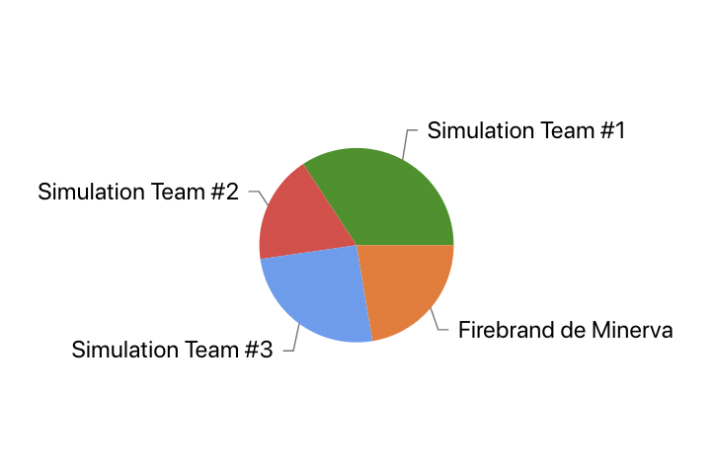
Market Share Report
Global Market Shares by Team
Region | Market Share Tech 1 | Market Share Tech 2 | Total Market Share
USA | 41.69 | 19.92 | 37.48
Asia | 40.52 | 20.34 | 38.00
Europe | 30.06 | 18.44 | 24.80
Global | 38.75 | 19.23 | 34.24
Notes:
We saw a change in market share across the board, most notably in Europe where we were able to secure a portion of the market after deciding to increase production and send more goods for selling, going from a total market share of 10.65 in round 1 to 24.80 in round 2, increasing our overall market share by almost 150%. In this round, we also introduced tech 2 and through marketing strategies and low pricing, we were able to claim a portion of the market in tech 2, most notably in Asia, but the other countries and global market do not fall far behind. Our total market share was consistent within 2%, however there was about an 8% decrease in our total market share in Asia and about a 2% increase in the USA. Our decrease in Asia could be due in part to competition increasing in the market, especially with the high demand of tech 2.

Slide 5
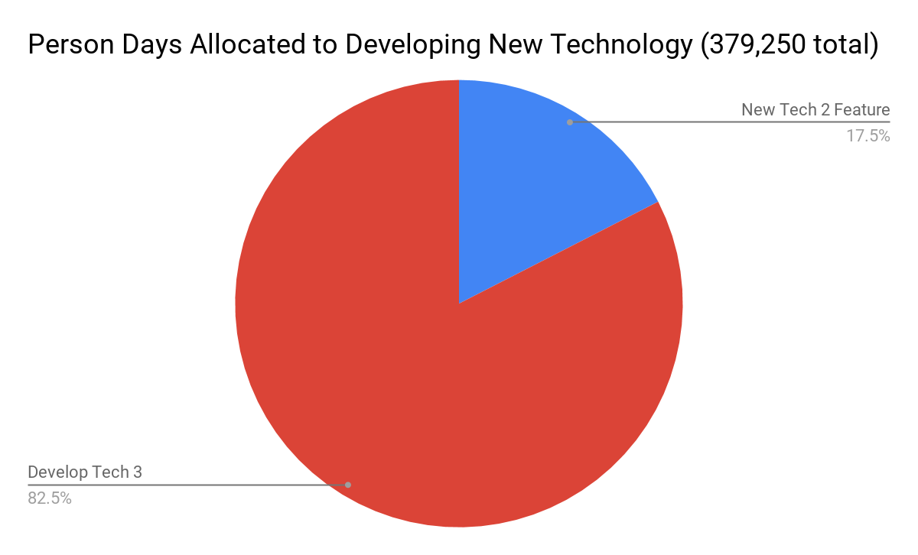
HR Report
Goal: Increase personnel to accomplish R&D goals in house (more cost effective)
1081 workers last round => 1517 workers
Increased wage
Increased training budget
Low turnover: 0.8%
Development of 1 Tech 2 feature and Tech 3:
Licensing Cost: $535,000
Total in house HR costs: $178,696
Savings: $356,304‬
Notes:
Round 2: Our strategy for R&D has not changed from the last round as it still supports our company’s overarching strategy. Producing technology in house is financially advantageous to a high degree. We chose to develop 1 new feature for tech 2 and develop tech 3 to meet our business needs for next round. It would have been significantly more expensive to purchase licensing (savings of $356,304).

Slide 6
Production Report
Forecast Demand Report
 | Round 1 | Round 2 | % Change
US Manufacturing: | 6.28 K | 6.75K | 7.48%
Asia Manufacturing: | 680 | 3.55 K | 522%
Capacity Utilization: | 80%USA 0% ASIA | 64%USA 74%ASIA | -20%US 740%ASIA
Production Plants: | 12 USA | 16 USA 6 ASIA | 33.3%USA 600%ASIA
Demand Estimates: | 13, 500k (Round 3)
Capacity Utilization | 81.8%
Production Plants: | 16 US Plants 6 Asia Plants
Produced 10.3 K units ---> Lost Revenue due to Production Surplus 1.013 K units
Notes:
ROUND2: This round we increased the manufacturing in the United States and China because we were unsure how the tariffs would change over time. Therefore, we wanted to get the highest amount of capacity in both the US and China to avoid the tariff war that was about to ensue. The extra units we could not produce we contract manufactured in the US because it would cost a lot less than if we produced it in China. It was over 200% to product tech 2 in China, so we rather pay the tariff.
ROUND 1: We maxed out the amount of contract manufacturing in the USA because it would be less expensive with he tariffs imposed to USA being $12 per unit when exported to Asia. When we did the math, to contract in China would be $109 per unit and in the USA it would be $86 per unit. The tariff and the USA manufacturer to Asia would be $98 vs $109 per unit. However we did not account for the shipping ($11 per unit in logistics) so we did end up paying $3 extra a unit. We will also have to maximize production because of our low prices which caused 1461K units in lost sales.

Slide 7
Cost Reports
Average Logistics Cost per unit sold (usd)
Production Cost per unit (usd):
Contractor Manufacturing Cost Tech 2 per unit (usd)
USA | Asia | Europe
$0 | $12.10 | $10.10
USA | Asia
$70.10 | $61.30
USA | Asia
$99.60 | $139.70
Notes:
R2: Production scrap 1.5% Tech 1 USA, Asia 2.5% Tech 1. We changed our logistics strategy this term. We made it our goal to avoid US sending products to asia and vice versa to avoid tariffs. This time we set the priority for US manufactured goods to send to 1) US 2) Europe 3) Asia. And for our goods manufactured in Asia we did the reverse 1) Asia 2) Europe 3) US.

Slide 8
Conclusion and Recommendations
Team Dynamics
We are going to keep expanding in the US and Asia mainly because some of our competitors are not in Asia so we will have a better hold in this region. We also have the highest percentage of the market in both of these areas so it would make sense to keep expanding here.
We also have the highest revenue out of all of our competitors so we will continue to keep the decision we made to keep this up when making decisions in future rounds.
We know that expanding HR will give us the capability to produce more so we will be making sure to expand on this sector in the future and increasing our employee’s wages as an incentive.
Our strategy is to first have each member take ownership of a department and look at the numbers. Then we sit down together as a team and discuss what each individual’s thought process was for their decisions. We then make the necessary changes based on general consensus and then move on to the next department.
This strategy works well for our team because not only do we get to deeply understand one department, but we also get to learn about other’s decisions and departments. We also get to discuss together and deeply analyze what is going on in each sector of the firm.
The challenge is that the team has less common times to meet so it is difficult to coordinate a meeting per week.

Slide 9
Thank you for your time!

Slide 10
Appendix

Slide 11
