Slide 1
CESIM Round 3
Team 1: Andrew Aberdale, Vandana Anand, Katharine Conroy, Meredith Forcier, Diego Paredes, Christopher Tillotson, and Emily Wilson
Notes:
Goal summary:
Our strategy for this round was to build more factories in each in the US and Asia. Assuming these two areas are the strongest in potential revenue, the intention of building more factories is to avoid tariffs to increase our profit. We then decided to profit on tech 2 and start developing tech 3.

Slide 2
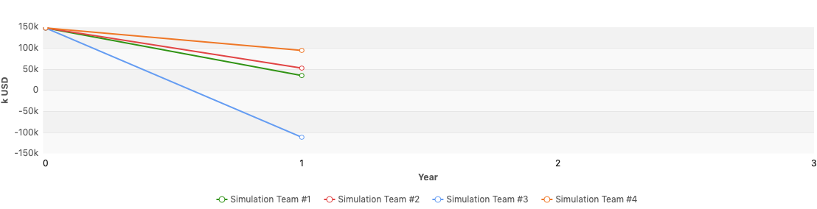
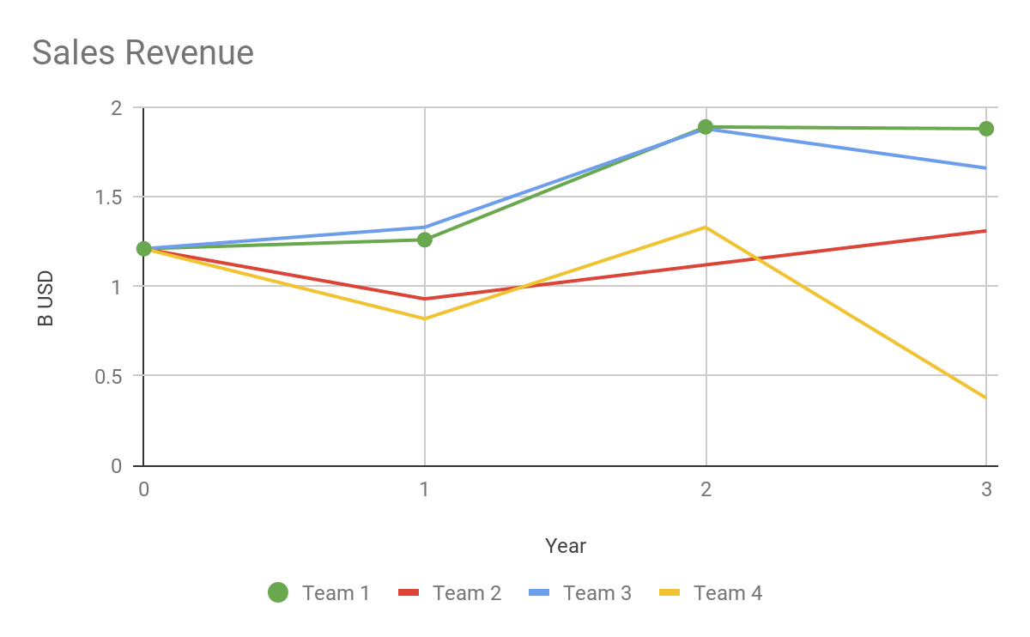
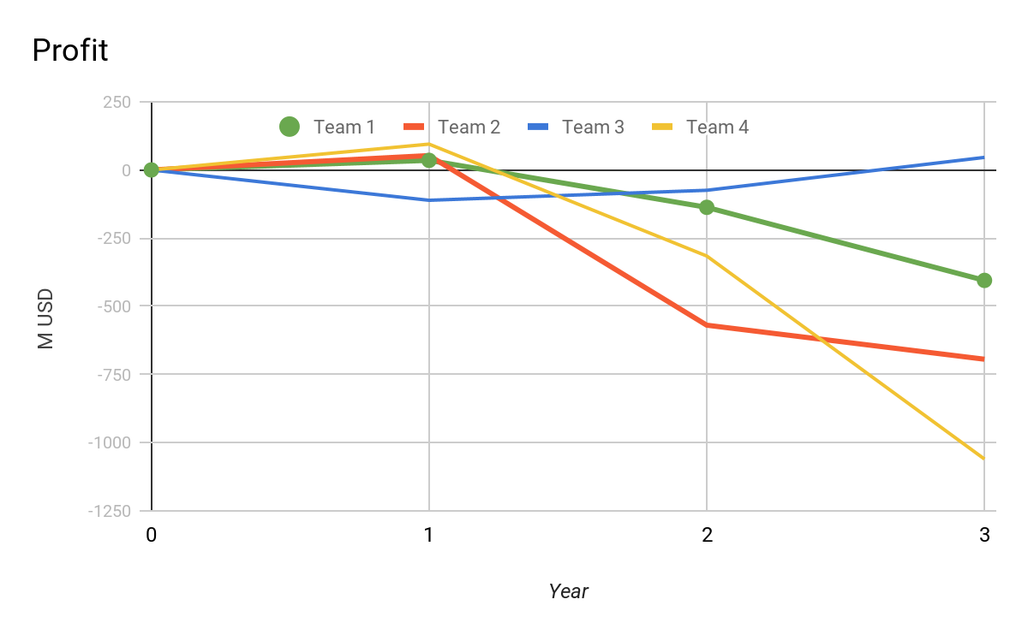
Financial Statements in k USD
Round | Revenue | Profit | Assets | Liabilities | Equity | Cash | Investment (plants+R&D) | Financing Activities
2 | $1,894,787 | $(137,108) | $2,049,765 | $1,825,544 | $224,221 | $76,832 | $1,698,421 | $40,180
3 | $1,875,047 | $(367,626) | $2,750,198 | $2,747,164 | $3,034 | $9,022 | $178,421 | $36,291
% Change | -1% | -168% | 34% | 50% | -99% | -50% | -90% | -9%
Notes:
You can see all of our financial statements in the appendix below
We had the highest revenue, this was an improvement from last round. We continued to lower our prices for tech one while pricing competitively for tech 2 and we were able to maintain our market share
Our profit was the second highest because of this same price cutting strategy, last round we had high tariff fees that we were able to drastically improve

Slide 3
Ratios
 | Last Round | Current
Cumulative Total Shareholder Return | -38.1% | -31.82%
Equity Ratio | 10.94% | 0.11%
Net Debt to Equity | 761.98% | 89054.7%
EBITDA | 22.4% | 24.08%
Average Trading Price | $161.47 | $61.48
Notes:
Based on the shareholder returns, we are lowering the costs to shareholders which shows improvement. Looking at EBITDA, it’s clear the company is starting to improve. While we have increased our debt, we should be seeing significant improvement over the next few rounds provided no external factors seriously impede progress.

Slide 4
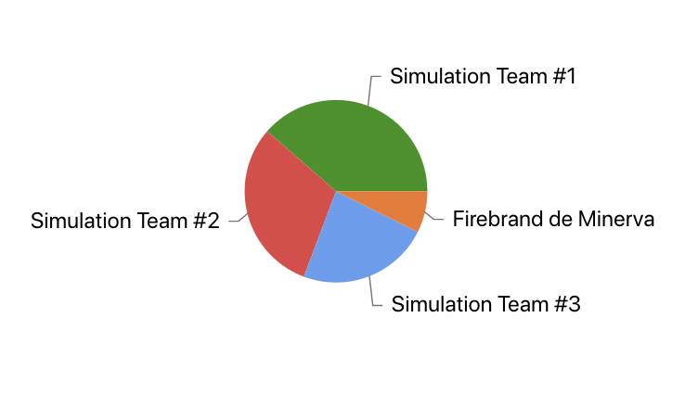
Market Share Report
Global Market Shares by Team
Region | Market Share Tech 1 | Market Share Tech 2 | Total Market Share
USA | 40.57 | 14.81 | 29.15
Asia | 54.62 | 28.65 | 49.25
Europe | 45.68 | 16.35 | 26.82
Global | 50.11 | 19.25 | 38.58
Notes:
We saw a change in market share across the board with some increases and decreases in market share in different regions. There was a significant decrease in market share in the USA between rounds, overall with an 8% decrease. As a team, in this round, we decided that it made more financial sense if we only produced products solds in the USA, in USA manufacturing plants and sent extra products made in Asia to Europe. This reasoning was because of the high tariff prices between the USA and Asia. Market share went up in Asia (~11%) for this reason because we produced a high volume in Asia and directed all products to Asia before sending them to Europe for selling. We saw a slight decrease in total market share in Europe but a significant increase in market share of Tech 1 because of increased production/marketing/sales. Globally, we saw a significant increase in market share of Tech 1 and kept a consistent market share for Tech 2, resulting in the slight increase in total market share. This is likely due to the significant increase in market share of Tech 1 in Asia and Europe, while keeping other market and technologies consistent.

Slide 5
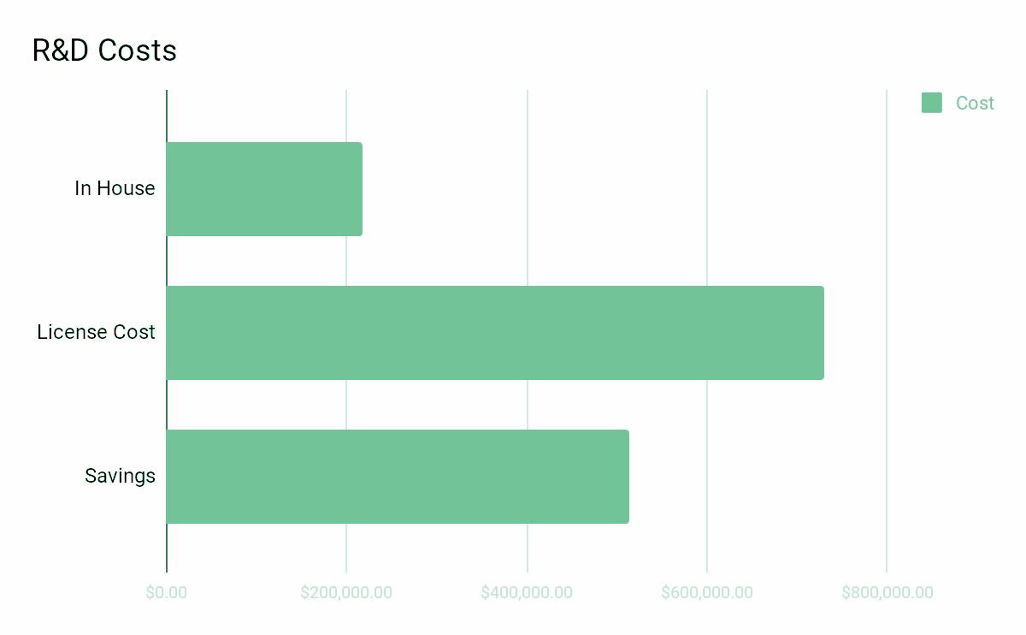
HR Report
Goal: Increase personnel to accomplish R&D goals in house (more cost effective)
1517 workers last round => 1846 workers
Same Wage
Same Training Cost
Low turnover: 0.8%
Development of 1 Tech 3 feature and Tech 4:
Tech 3 license feature upgrade $70,000 Technology 4 License Cost $660,000
Tech 3 Person days needed 72,930 = 461,207
-> 1,846 personel @ 6,000 wage & 500 Training
=Total Cost: $217,111 = $512,889 Savings
Notes:
Round 2: Our strategy for R&D has not changed from the last round as it still supports our company’s overarching strategy. Producing technology in house is financially advantageous to a high degree. We chose to develop 1 new feature for tech 3 and develop tech 4 to meet our business needs for next round. It would have been significantly more expensive to purchase licensing (savings of $512,899).

Slide 6
Production Report
Forecast Demand Report
 | Round 2 | Round 3 | % Change
US Manufacturing: | 6.75K | 4.27K | -37%
Asia Manufacturing: | 3.55 K | 5.86K | 65%
Capacity Utilization: | 64%USA 74%ASIA | 30% USA 70% ASIA | -53%US -5.4%ASIA
Production Plants: | 16 USA 6 ASIA | 18 USA 12 ASIA | 12.5%USA 100%ASIA
Demand Estimates: | 10, 500k (Round 4)
Capacity Utilization | 30% USA 70% Asia
Production Plants: | 16 US Plants 6 Asia Plants
Produced 10.3 K units ---> Lost Revenue due to Production Surplus 1.013 K units
Notes:
ROUND 3: This round we decreased the manufacturing in the United States and increased in China because the tariffs and shipping was less in China then the US. Therefore, we wanted to get the highest amount of capacity in China to not have a lot of tariffs from the US.Production scraps, 1.4% and 2.1% for US and Asia respectively shows we are selecting the right plant production for our demand.

Slide 7
Cost Reports
Average Logistics Cost per unit sold (usd)
Production Cost per unit (usd):
Contractor Manufacturing Cost Tech 2 per unit (usd)
USA | Asia | Europe
$0 | $2.9 | $11.7
USA | Asia
$70.10 | $52.5
USA | Asia
$99.00 | $145.8
Notes:
R3: Production scrap 1.4% Tech 1 USA, Asia 2.1% Tech 1. We stuck with our logistics strategy from the last round as it was working. Because of our production plan we were able to reduce logistics cost for USA and Asia, and Europe only went up slightly. Europe is the highest because we are not producing there. Our production cost per unit went down in both USA and Asia. Our contract manufacturing cost went down in the US, and in Asia it went up slightly.

Slide 8
Conclusion and Recommendations
Team Dynamics
We currently have a high % market share in Asia. Next, we will focus on lowering cost and implementing new features to maintain demand.
We also have the highest revenue out of all of our competitors so we will continue to keep the decision we made to keep this up when making decisions in future rounds.
Finally, our biggest challenge right now is production cost. As sales cost is intentionally low to drive demand, we need to find alternative ways to reduce spending. Re-evaluating our suppliers and factories will be two options to explore.
We have decided to continue with our strategy of each team member owning a decision. Team members are starting to develop expertise in the area, allowing us to further refine our decision making strategy.
While each member owns a decision, we still go through each decision as a team. This has allowed us to think outside the box and provide input where the owner might have not thought of something.
Everyone is now dispersed so we are meeting virtually instead of in person. While this is new to us, it has been going well so far and we have been able to continue with our normal meetings.

Slide 9
Thank you for your time!

Slide 10
Appendix

Slide 11
