Slide 1
CESIM Round 4
Team 1: Andrew Aberdale, Vandana Anand, Katharine Conroy, Meredith Forcier, Diego Paredes, Christopher Tillotson, and Emily Wilson
Notes:
Goal summary:
Our strategy for this round was to build more factories in each in the US and Asia. Assuming these two areas are the strongest in potential revenue, the intention of building more factories is to avoid tariffs to increase our profit. We then decided to profit on tech 2 and start developing tech 3.

Slide 2
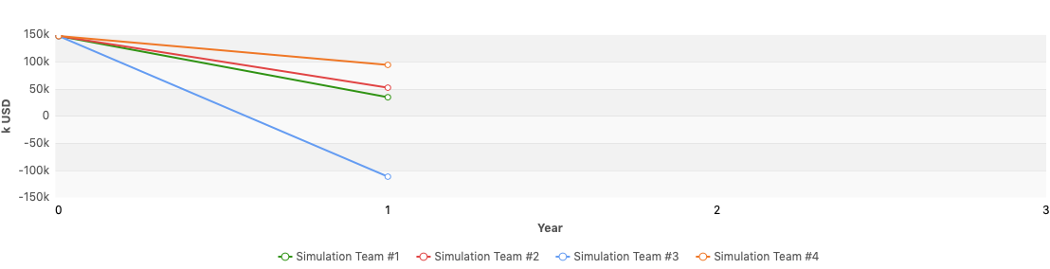
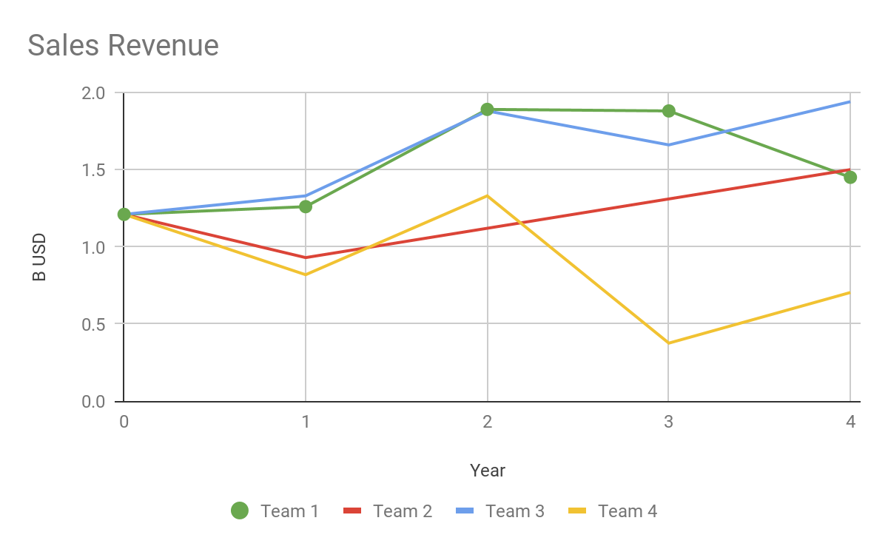
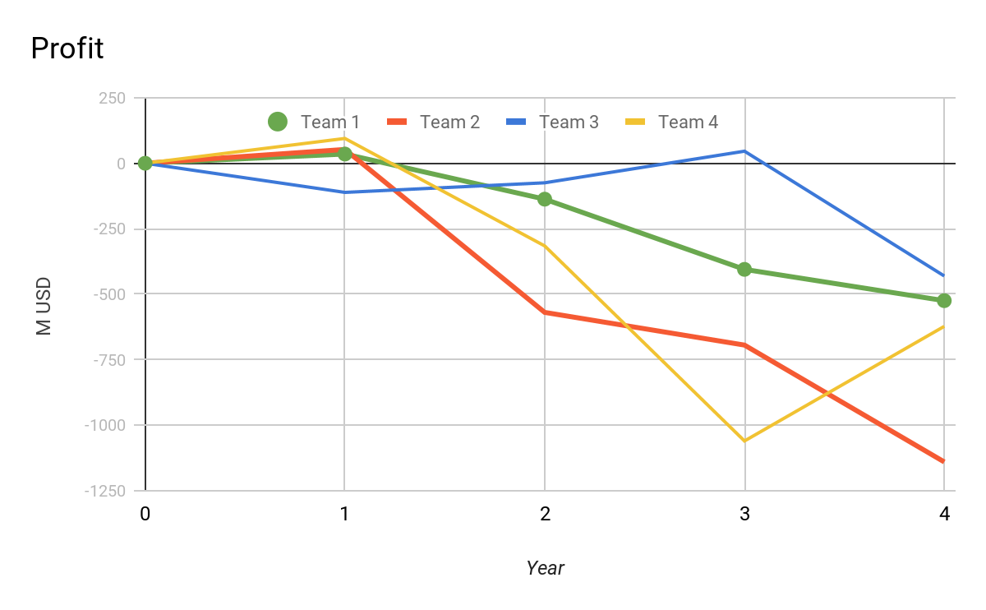
Financial Statements in k USD
Round | Revenue | Profit | Assets | Liabilities | Equity | Cash | Investment (plants+R&D) | Financing Activities
3 | $1,875,047 | -$367,626 | $2,750,198 | $2,747,164 | $3,034 | $9,022 | $178,421 | $36,291
4 | $1,446,935 | -$524,462 | $2,330,345 | $2,411,915 | -$81,570 | $6,000 | $159,555 | $348,058
% Change | -23% | 43% | -15% | -12% | -2789% | -33% | -11% | 859%
Notes:
You can see all of our financial statements in the appendix below
We had the third to highest revenue, we lost revenue from last round, we knew this was going to happen mainly because we cut production of Tech 2. Hence, we lost revenue in Asia and market share. We continued to lower our prices for tech 1 while pricing competitively. We introduced tech 4 to the market, thinking other teams were going to the same, so we tried to price it reasonable. Our profit was the second highest because of a new price cutting strategy, laying off people and selling plants.

Slide 3
Ratios
 | Last Round | Current
Cumulative Total Shareholder Return | -31.82% | -18.83$
Equity Ratio | 0.11% | N/A
Net Debt to Equity | 89054.7% | N/A
EBITDA | 24.08% | 24.26$
Average Trading Price | $61.48 | $41.96
Notes:
Based on the shareholder returns, we are lowering the costs to shareholders which shows improvement. Looking at EBITDA, it’s clear the company is starting to improve. We just cut factories this past round. We should expect significant improvement in all ratios starting next round. Our strategy has been growth over the long term investments. With the current trend, we begin to see that strategy work, but have yet to see the preformance stage of the company development.

Slide 4
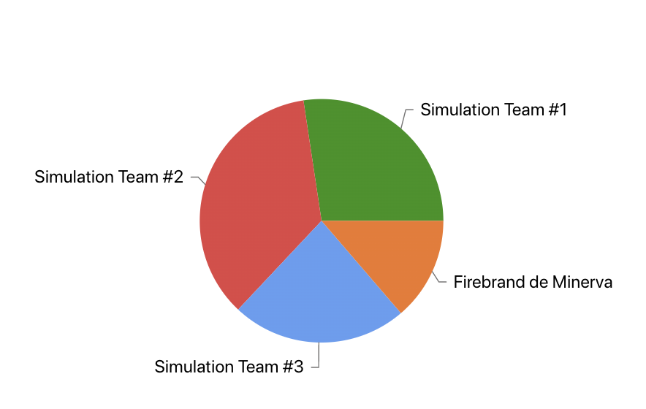
Market Share Report
Global Market Shares by Team
Region | Market Share Tech 1 | Market Share Tech 4 | Total Market Share
USA | 38.07 | 64.49 | 24.14
Asia | 38.45 | 0 | 30.45
Europe | 49.35 | 61.47 | 24.28
Global | 39.41 | 62.59 | 27.37
Introduced Tech 4 and continued to produce Tech 1
Notes:
We saw a pretty drastic change in market share percentages in this round as they shifted between different techs. We made different marketing and strategic decisions this round with the introduction of Tech 4 and continuation of Tech 1. We had a slight decrease in market share of Tech 1 across the board, but claimed the market with Tech 4 in the USA and Europe. We do not have market share for Tech 4 in Asia because it was not produced and sold there. Our total global market share decreased by a about 10% this round, probably due to having a general shift in strategy, especially with the introduction of Tech 4 in only the US and Europe. We changed some marketing strategies for Tech 1 to brand because we felt that we could rely on our brand image as well-established and trustworthy this late into the simulation and focused on balanced marketing for Tech 4, with a lot of funds resourced to getting it marketed in the US and Asia, which seemed to work out as we have the majority of the market share for this tech. Overall, in the market with other teams we are holding our own and keeping an established customer base with our products.

Slide 5
HR Report
Goal: Decrease personnel to accomplish R&D goals in house (more cost effective). Position to eliminate workforce.
1517 workers last round => 1408 workers
Same Wage
No training cost
Low turnover: 0.8% last round to 1.1% this round
Development of 1 Tech 1 feature and 2 features for Tech 4:
Still cheaper to produce in house! These were the last features that we intend to develop for the rest of the simulation.
Year in Advance Lay Off Warning: We believe that our employees matter and we wish to tell them that we will be doing layoffs next year. This will give our employees ample time to search for a job and put them in the best position possible for them and their families. Therefore in an act of good faith and transparency we have informed our workers that we will be laying off all R&D workers. Thanks for the memories...
Notes:
Round 4: Our time to pivot in R&D and HR. As we planned we no longer have need for further development of technology. Therefore we started laying off workers in this round and will be doing a total layoff in the next round. Hopefully this will help us execute our strategy in the closing rounds by eliminating overhead and capturing more profit.

Slide 6
Production Report
Forecast Demand Report
 | Round 3 | Round 4 | % Change
US Manufacturing: | 4.27K | 2.57k | -40%
Asia Manufacturing: | 5.86K | 4.49K | -23%
Capacity Utilization: | 30% USA 70% ASIA | 18% USA 56% ASIA | -40%US -20%ASIA
Production Plants: | 18 USA 12 ASIA | 18 USA 12 ASIA | 0%USA 0%ASIA
Demand Estimates: | 10, 000k (Round 5)
Capacity Utilization | 30% USA 70% Asia
Production Plants: | 16 US Plants 12 Asia Plants
Notes:
ROUND 4: In this round, we wanted to reduce both US and Asian manufacturing quite a bit because it was a lot less expensive to manufacture it from an outside source. Therefore, this decreased out capacity utilization on production. We also shut down 2 plants in the US in the next round to improve utilization and save money.

Slide 7
Cost Reports
Average Logistics Cost per unit sold (usd)
Production Cost per unit (usd):
Contractor Manufacturing Cost Tech 4 per unit (usd)
USA | Asia | Europe
$0 | $1.7 | $10.4
USA | Asia
$66.00 | $49.06
USA | Asia
$141.09 | $147.02
Notes:
RR: Production scrap 1.3% Tech 1 USA, Asia 2 % Tech. We stuck with our logistics strategy from the last round as it was working. Because of our production plan we were able to reduce logistics cost for USA and Asia and Europe only.. Europe is the highest because we are not producing there. Our production cost per unit went down in both USA and Asia. Our contract manufacturing cost went down in the US, and in Asia it went up slightly.

Slide 8
Conclusion and Recommendations
Team Dynamics
Team Ownership
Demand
Andrew
Production
Diego
HR/R&D
Chris
Marketing
Meredith
Logistics
Emily
Finance
Katharine
Review overall decisions
Vandana
While these are our leaders for each time, we all go through every section to make sure we are all on the same page, especially since the decisions made before you affect your decision.
Overall we have established a strong customer base and have been able to retain a strong standing in the market. While this round we did see a decrease in revenue, we secured a majority of the market share for Tech 4. Our goal was to break into that market early in order to be well positioned for the end of the rounds. We also were able to lower our overall liabilities, and bring up our credit ratings. In the last round we were able to produce enough features to get us through the rest of the game, so now we will be able to start reducing our costs. We believe that we have positioned ourselves well for the final stages of the simulation.

Slide 9
Thank you for your time!

Slide 10
Appendix

Slide 11
