Slide 1
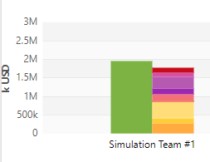
CESIM Round 5
Team 1: Andrew Aberdale, Vandana Anand, Katharine Conroy, Meredith Forcier, Diego Paredes, Christopher Tillotson, and Emily Wilson
Notes:
Goal summary:
Our strategy for this round was keep reducing costs to become a profitable company. Try to increase demand for Tech 4 and prepare company for final round.

Slide 2
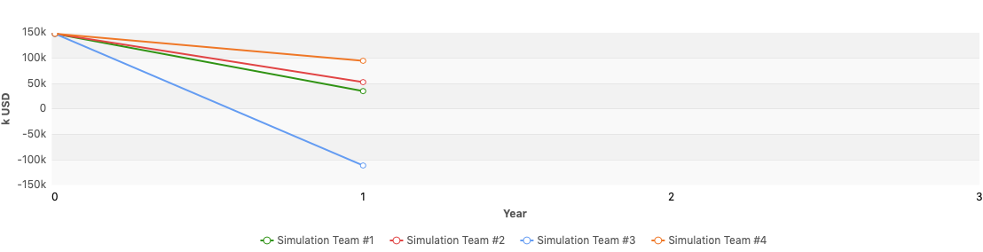
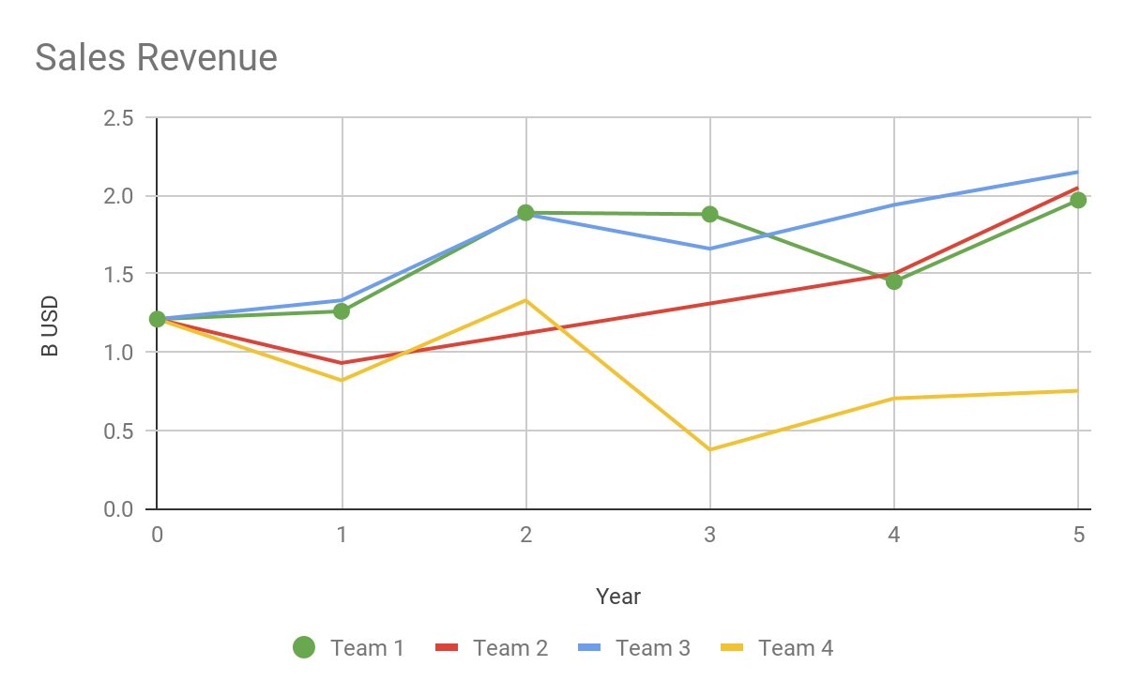
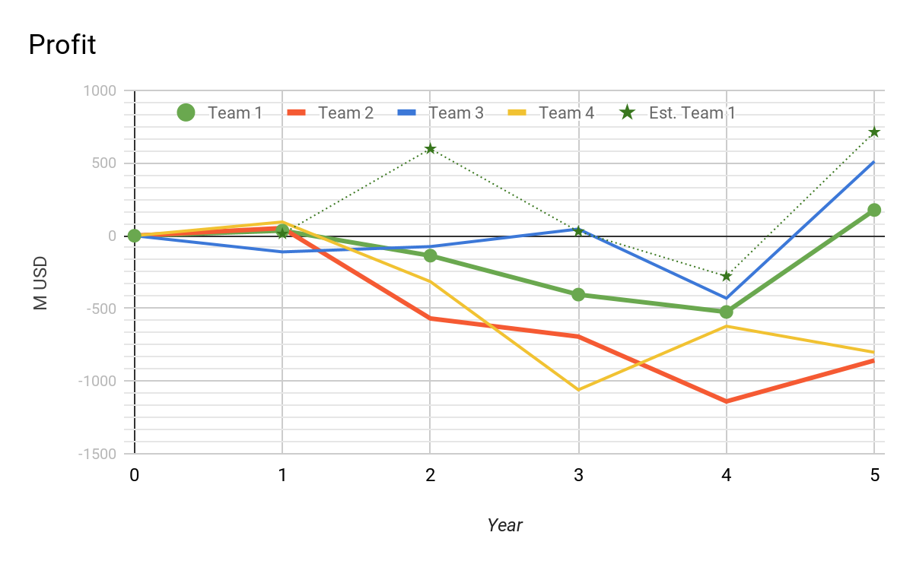
Financial Statements in k USD
Round | Revenue | Profit | Assets | Liabilities | Equity | Cash | Investment (plants+R&D) | Financing Activities
4 | $1,446,935 | -$524,462 | $2,330,345 | $2,411,915 | -$81,570 | $6,000 | $159,555 | $385,106
5 | $1,966,381 | $177,083 | $1,819,648 | $1,102,968 | $716,680 | $6,000 | -$197,280 | $114,361
% Change | 36% | -134% | -22% | -54% | -979% | 0% | -224% | -70%
Notes:
You can see all of our financial statements in the appendix below.
We manage to increase our sales revenue by only producing Tech 1 and 4. Team 3 (PineApple) has the highest revenue but is producing 3 products at the time. We expect to surpass Team 2 and hopefully Team 1 in the last round, to claim highest sales revenue title.
Our cost-cutting strategy can be appreciated across all numbers in the table above. Assets, Liabilities and Equity were reduced and numbers are below our income.
Profit in the other hand had a very positive outcome. Team 1 havent seen green numbers since round 1. This is highly attributed to our cost-cutting strategy and improving sustainability of our business. We added our projected numbers to the graph. As you can see we were very disappointed to see the market did not react the way we thought. We estimated profits of 700k and came short to 177k. We are expecting this number to grow since Tech 4 demand is still growing worldwide.

Slide 3
Ratios
 | Last Round | Current | Leading Comp.
Cumulative Total Shareholder Return | -18.83% | -8.2% | 5.58%
Equity Ratio | N/A | 39.39% | 91.13%
Net Debt to Equity | N/A | 148.38% | -18.95%
EBITDA | 24.26% | 37.83% | 43.23%
Average Trading Price | $41.96 | $62.12 | $209.93
Notes:
Based on the shareholder returns, we are lowering the costs to shareholders which shows improvement. Looking at EBITDA, it’s clear the company is starting to improve. Our strategy has been growth over the long term investments. With the current trend, we begin to see that strategy work, but have yet to see the performance stage of the company development. Our leading competitor is ahead, but not by much considering our latest improvement. Optimistically, we may overtake them by simulation end.

Slide 4
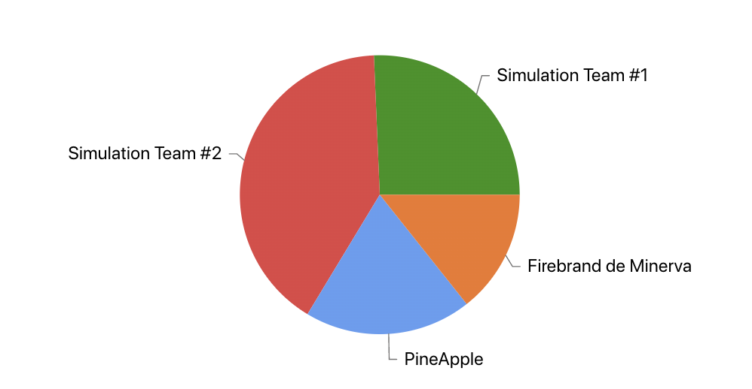
Market Share Report
Global Market Shares by Team
Region | Market Share Tech 1 | Market Share Tech 4 | Total Market Share
USA | 45.68 | 45.06 | 25.37
Asia | 33.48 | 100 | 26.44
Europe | 38.27 | 42.63 | 24.02
Global | 35.25 | 45.77 | 25.67
Introduced Tech 4 in Asia and continued to produce Tech 1
Tried to continue low price, high marketing (brand)
Notes:
We saw an overall drop in market share in this round due to increased competition of Tech 4 and decisions made by other teams in regards to pricing and marketing of their Tech 1. We continued our same pricing strategy with a low cost product and high marketing while relying on brand marketing as we feel like we have an established brand this many rounds into the simulation. However while we thought we were a low cost option, other teams dropped their prices and in some cases we were the higher cost product (see cost reports for more detailed information on cost of goods for our team). In the previous round we did not sell in Asia which we thought was a result of a lower market share in last round. In this round we were the only team in this market so were able to claim 100% of the market for Tech 4 in Asia. We can use this to our advantage in the next round yet also be mindful of other competition who may try to come in and take some of the market in Asia.
Our biggest competitor for Tech 1 is currently team 2 which decreased their prices overall and we ended up being the higher cost good. We were able to maintain market share due to our continuous marketing strategy throughout the simulation. Team 3 is our biggest competitor for Tech 4 (except in Asia), and they have a similar strategy in terms of what Team 2 did and we become the higher cost good in this round.

Slide 5
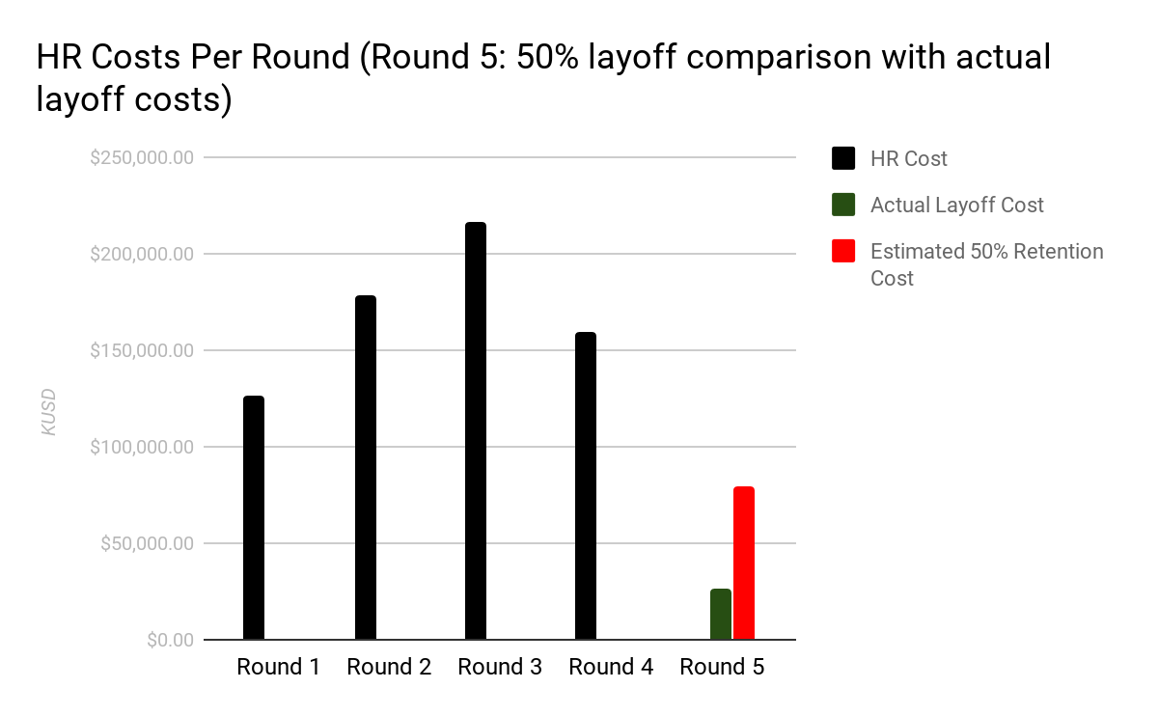
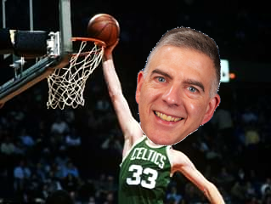
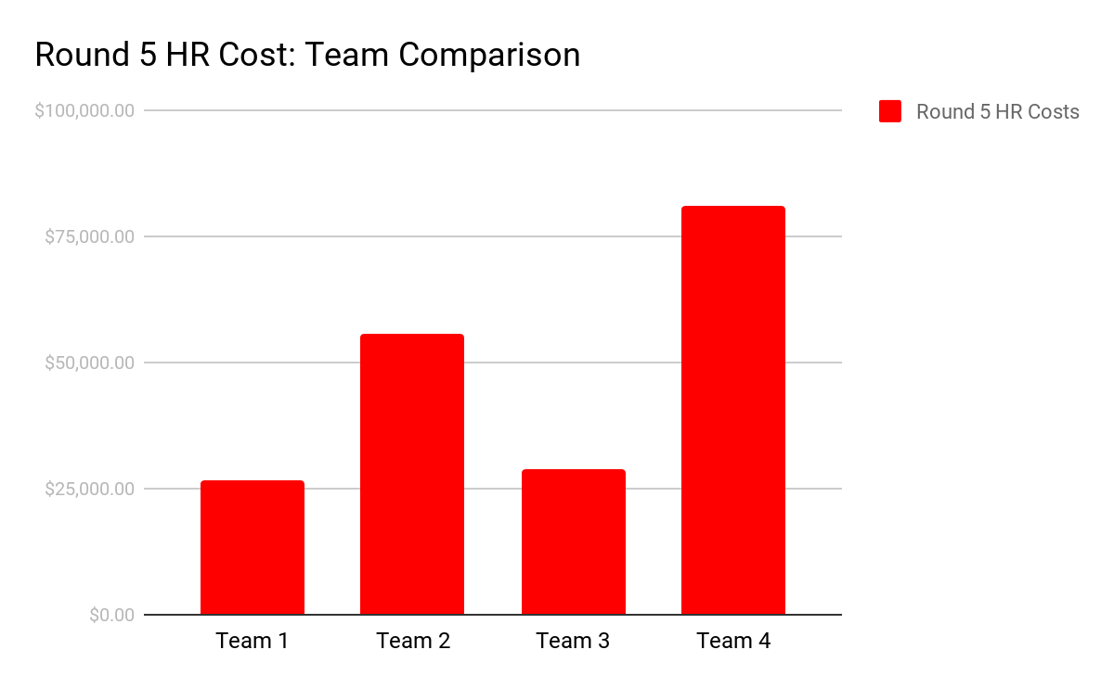
HR Report:
Goal: Eliminate HR & R&D Costs to Support Overarching Strategy of Optimizing Profit
There is no longer a substantial benefit to retaining R&D workers. Our team compared our level of feature development with other teams and we feel comfortable that we can end the simulation with the amount of features that we have.
In round 5 we saved $132,835,000 and we will save $159,555,000 every following year by laying off all R&D workers. Our Board concluded that the savings outweighed possible gains made by developing additional features.
These graphs show HR costs per round. Note that the costs of drawn out layoffs are greater than layoff costs.
Notes:
Round 5: Laying off all our workers was a slam dunk move to cut costs. There is no evidence that our layoffs will cause ill will that could impact market share. Freeing up this cash will allow us to pay off all debt, share dividends, free up cash for reinvestment, and reassess social responsibility. We anticipate this will improve our credit rating, allow us to gain market share, increase EPS, and increase overall profit.

Slide 6
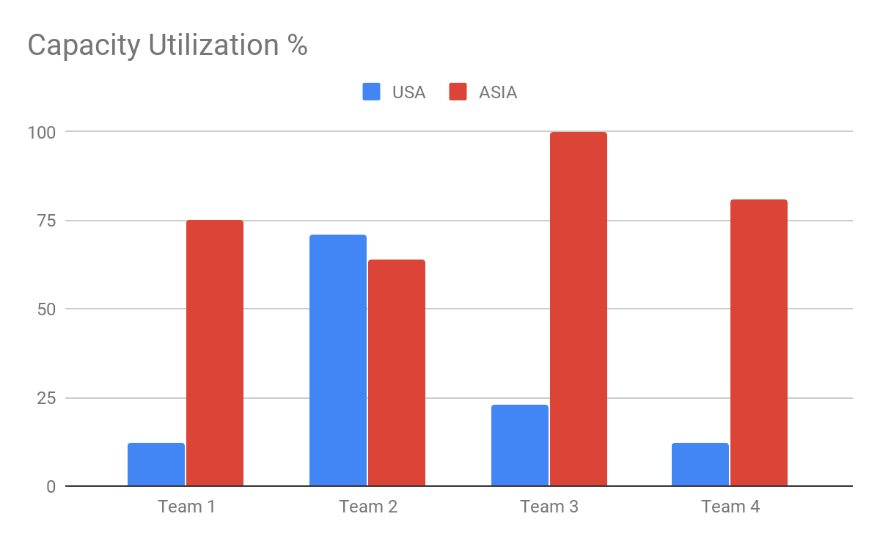
Forecast Demand Report
Production Report
 | Round 4 | Round 5 | % Change
US Manufacturing: | 2.57k | 2.53k | -2%
Asia Manufacturing: | 4.49K | 6.38k | 42%
Capacity Utilization: | 18% USA 56% ASIA | 12% USA 75% ASIA | -33%US 34%ASIA
Production Plants: | 18 USA 12 ASIA | 16 USA 12 ASIA | -11%USA 0%ASIA
Demand Estimates: | 13, 000k (Round 6)
Capacity Utilization | 100% USA 85% Asia
Production Plants: | 11 US Plants 12 Asia Plants
Notes:
ROUND 5: Last round our production strategy was to produce Tech 1 inhouse since average production cost was about $50. Tech 4 in the other hand, in-house manufacturing was very expensive over $300, whereas $152 for contract manufacturing. So our goal was to produce as little as possible while satisfying our demand. Round 5 was no different.
We decided to shut down 5 more plants in the US for next round. This would help our capacity utilization efficiency and save money in the long run. We found that the company might be placed in the tough spot for subsequent rounds, but our simulation wouldn't run that far. We noticed our competitors were also having the same issue with US plants expect for team 2.

Slide 7
Cost Reports
Average Logistics Cost per unit sold (usd)
Production Cost per unit (usd):
Contractor Manufacturing Cost Tech 4 per unit (usd)
USA | Asia | Europe
$0 | $0 | $8.9
USA | Asia
$57.40 | $42.60
USA | Asia
$149.4 | $155.90
Notes:
RR: We were able to eliminate logistics costs completely in both the US and Europe where we are producing tech 1

Slide 8
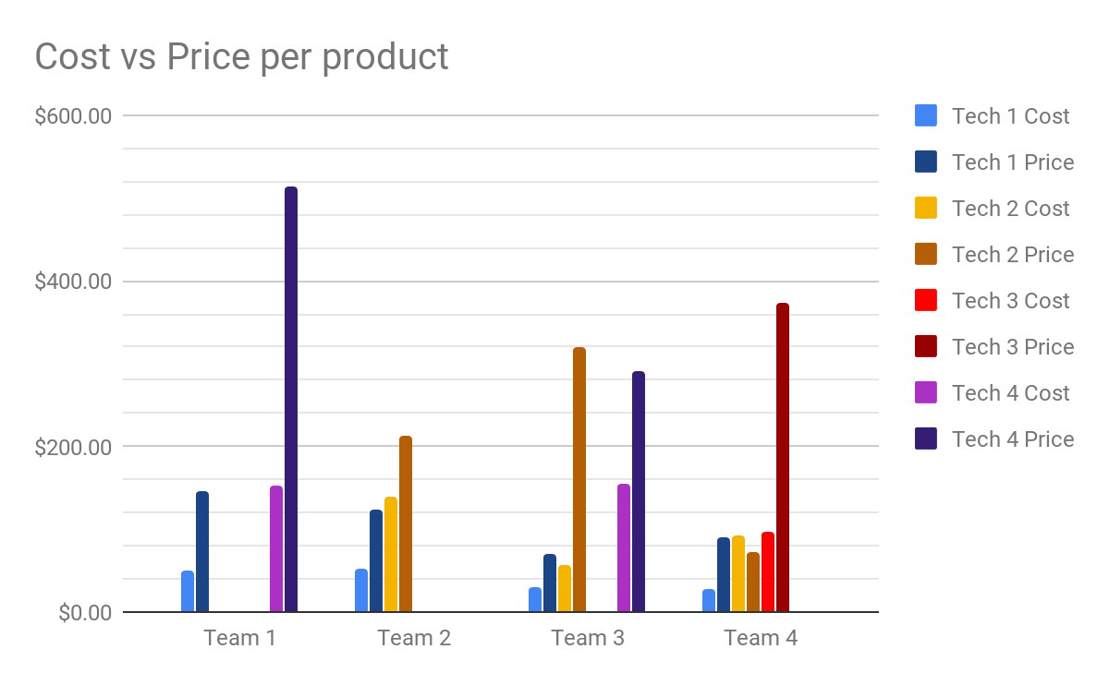
Cost Reports
 | Team 1 | Team 2 | Team 3 | Team 4
Tech 1 | 192% | 134% | 125% | 216%
Tech 2 | N/A | 53% | 467% | -22%
Tech 3 | N/A | N/A | N/A | 388%
Tech 4 | 237% | N/A | 88% | N/A
Notes:
In this past round we had the second highest mark-up for tech 1. We chose our price based on the features we had available and our price we had sold tech 1 for in the past. One reason why our markup was so high was because we have been able to cut costs related to that product. While we have the highest markup for Tech 4, this price was also based off a competitors price in the previous round which had been much higher than ours. This round they decided to cut the price to gain market share which led us to be the highest price.

Slide 9
Conclusion and Recommendations
Team Dynamics
While doing our analysis about our performance last round, we found that we lost market share. We also found that our stocks in Asia are not doing so well compared to last time. The good news is we are doing well financially.
In terms of other teams, we determined that Team 3 is our biggest competitor. We seem to be doing better than Team 4, but Team 2 is currently doing better than us which we will be keeping an eye on.
We also noticed that one of the teams had drastically decreased their selling price of their product when it was $300 higher than our price in previous rounds.
For next time, we aim to lower our prices to be able to compete better. Also, we were able to get rid of all our debt! Now we can think about investing in other tech for ex.
We are all meeting virtually and have gotten comfortable with it at this point. We do a screen share session on zoom where one person shares and puts in the decisions that the team discusses.
We are continuing to follow the same strategy as in previous rounds to make our final decisions. We first discuss our overall progress in the round. Then, we compare our progress with other teams to see what their strategies might be. We take this into account when we start looking into the different areas that each person in the team has expertise on. They give the team their opinion about what to do and the rest of the team discusses it.
This has been effective in our decisions as we make sure each team member is on board with the decision.

Slide 10
Thank you for your time!

Slide 11
Appendix

Slide 12
