Slide 1

CESIM Round 6
Team 1: Andrew Aberdale, Vandana Anand, Katharine Conroy, Meredith Forcier, Diego Paredes, Christopher Tillotson, and Emily Wilson
Notes:
Goal summary:
As our last round, we wanted to leave the competition with the highest credit rating as possible, making sure the value of our stock increased since the round 0. Tried to be the most profitable and have highest sales revenue. To do this we tried to reduce costs and increase our Tech 4 sales.

Slide 2
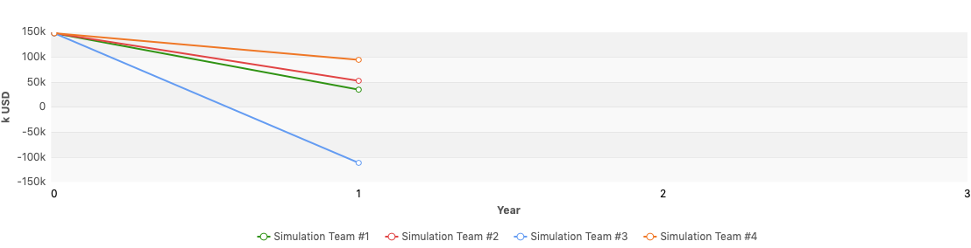
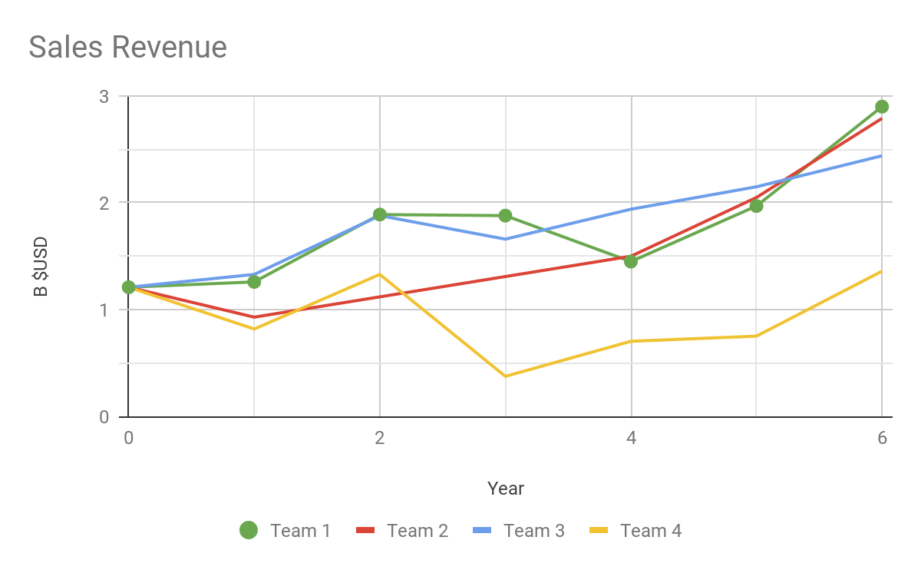
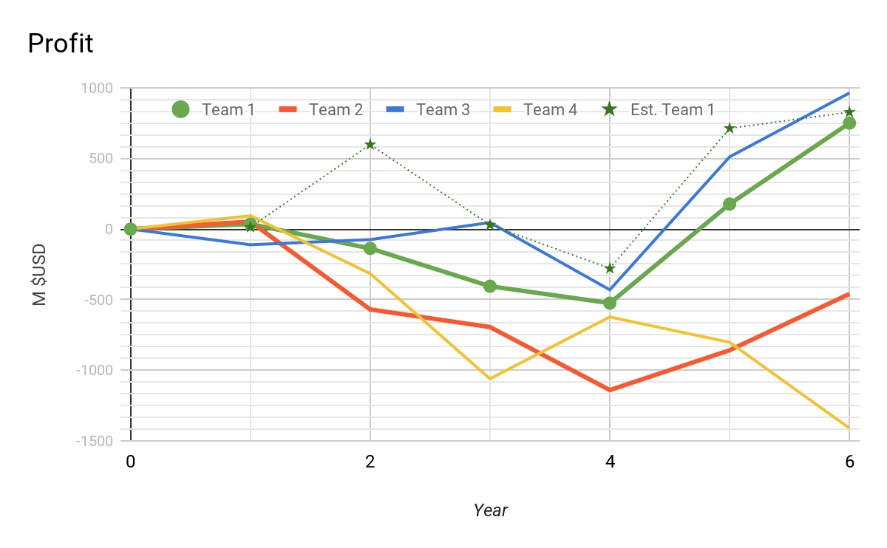
Financial Statements in k USD
Round | Revenue | Profit | Assets | Liabilities | Equity | Cash | Investment (plants+R&D) | Financing Activities
5 | $1,966,381 | $177,083 | $1,819,648 | $1,102,968 | $716,680 | $6,000 | -$197,280 | $114,361
6 | $2,898,100 | $750,325 | $1,353,619 | $1,295,418 | $1,353,619 | $314,959 | -$647,257 | $24,393
% Change | 47% | 324% | -26% | 17% | 89% | 5149% | 228% | -79%
Notes:
You can see all of our financial statements in the appendix below.
Last round we focused to increase our sales revenue by focusing only in Tech 1 and 4. This round was no different, we thought that producing two products was most cost-efficient and nice differentiator between our tech value. Our biggest competitors Team 3 (PineApple) and Team 2 had the higher sales revenue last round, we managed to surpass them in this final round, achieving our goal of highest sales revenue title.
Given our cost-cutting strategy we can see how our Assets went down by 26% and our Investment generated 228% cash back by selling plants. This allowed us to fix our debt problems. We can appreciate this by looking an 89% increase in equity and 5149% in retained cash.
Our profits last round were disappointing as we missed our projections by almost $600M. This round we increased our profits by 324%, while we still missed our projection, we were very close. This can be attributed to correctly estimating our demand and overall good synergy of the company.

Slide 3
Ratios
 | Last Round | Current | Leading Comp.
Cumulative Total Shareholder Return | -8.2% | 3.62% | 11.93%
Equity Ratio | 39.39% | 95.7% | 98.36%
Net Debt to Equity | 148.38% | -24.31% | -87.46%
EBITDA | 37.83% | 37.68% | 50.34%
Average Trading Price | $62.12 | $119.41 | $238.02
Notes:
Across the board we can see our company has completely turned around. With the amount of growth seen, we are now a profitable company and will be for the foreseeable future. Our long term strategy was successful. However, it could have been rushed a bit more to see larger gains by the end of the simulation. At this rate, we would overtake the leading competitor’s profitability in a matter of rounds.

Slide 4
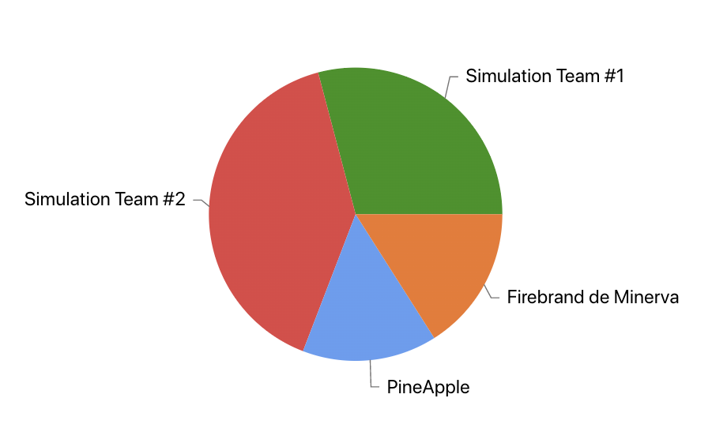
Market Share Report
Global Market Shares by Team
Region | Market Share Tech 1 | Market Share Tech 4 | Total Market Share
USA | 39.75 | 54.21 | 32.96
Asia | 33.35 | 65.40 | 29.02
Europe | 40.31 | 41.82 | 25.60
Global | 34.45 | 50.95 | 29.12
Continued with Tech 4 and Tech 1, increased marketing for Tech 4
Tried to continue low price, high marketing (brand)
Notes:
We saw an overall drop in market share however this is bound to happen as the market expands to multiple technologies and our competitors, like us, make their image known in the market. The most notable change in this round is our Tech 4 market share, which increased across the globe. In this round, we changed our price to be more competitive in the market and increased marketing, which paid off as our market share varies from about 40-65%. For Tech 1, since we have been producing this product from round 1 to the end, we knew that our brand was well known so relied on brand marketing and dropped the price of marketing, which still proved to be successful as we had a significant portion of the market share. The global market share is a bit lower because the market is more spread and diverse in products offered, but we continue to have a significant portion that allows us to operate with our overall business strategy.

Slide 5

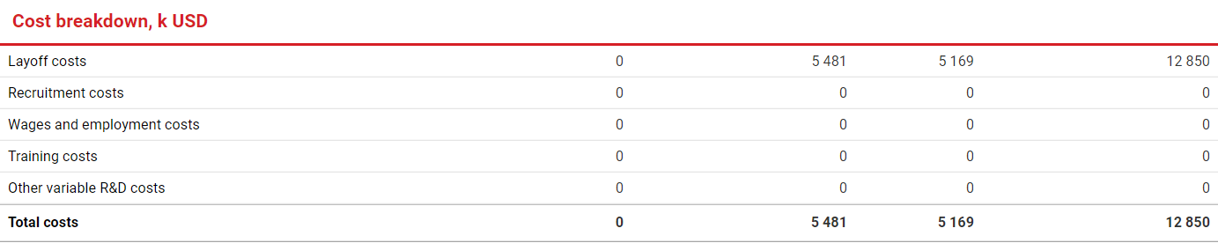
HR Report:
Goal: Minimize Costs in Order to Maximize Profits.
There is no longer a substantial benefit to retaining R&D workers. Our team compared our level of feature development with other teams and we feel comfortable that we can end the simulation with the amount of features that we have.
We saved $159,555,000 this round by laying off all workers. This put us in a very healthy financial position. It is questionable if we would have seen any improvements due to upgrades.
Team 1 (us)
Notes:
Round 6: The team is pleased how we ended this simulation. Now looking at R&D and HR in hindsight I think there was little room for improvement. We knew our strategy and executed well. Pineapple was our only close comeditor in terms of profits and they did not appear to have gained competitive advantage over upgrades. The whole simulation came down to price war.

Slide 6
Final Production Report
 | Round 5 | Round 6 | % Change
US Manufacturing: | 2.53k | 4.87k | 92.5%
Asia Manufacturing: | 6.38k | 7.42k | 16.3%
Capacity Utilization: | 12% USA 75% ASIA | 54% USA 88% ASIA | 350%US 17%ASIA
Production Plants: | 16 USA 12 ASIA | 11 USA 12 ASIA | -31%USA 0%ASIA
Overall Goals:
Increase manufacturing to keep up with demand
Keep our capacity utilization high
Make sure we are using the most cost effective strategy in terms of production plants
Notes:
As we concluded the final round, we can see how we were able to accomplish our goals by keeping our production costs low and keep close attention to demand.

Slide 7
Cost Reports
Average Logistics Cost per unit sold (usd)
Production Cost per unit (usd):
Contractor Manufacturing Cost Tech 4 per unit (usd)
USA | Asia | Europe
$0 | $1.6 | $11.6
USA | Asia
$51.30 | $325.0
USA | Asia
$152.4 | $142.6
Notes:
Overall while our costs fluctuate throughout the rounds we were able to keep them low and minimize where possible.

Slide 8
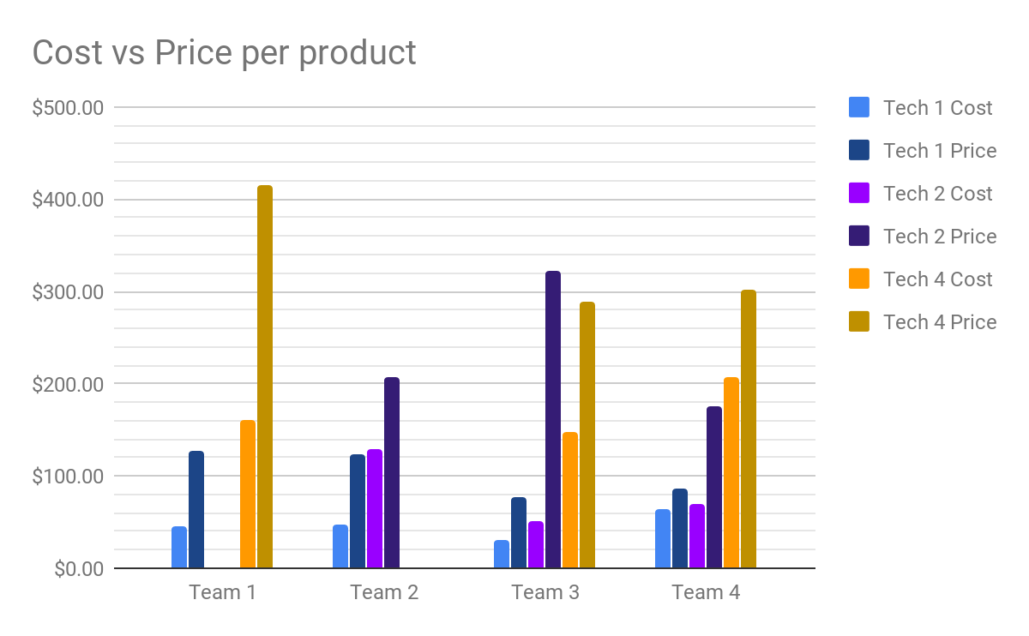
Profit Reports
 | Team 1 | Team 2 | Team 3 | Team 4
Tech 1 | 186% | 162% | 150% | 35%
Tech 2 | N/A | 61% | 526% | 149%
Tech 3 | N/A | N/A | N/A | N/A
Tech 4 | 157% | N/A | 96% | 46%
Notes:
In this round we had the highest markup for tech one, however this can be associated with the amount of features that we had for it, and the strong position in the market that we were able to hold. For tech 4 we also had the highest mark-up. Again this had to do with our strong market share, we decided to market on brand. Because we had put more money into marketing, and had decreased our product form the previous round we were able to sell at the higher markup and still hold market share.

Slide 9
Conclusion and Recommendations
Team Dynamics
While doing analysis for this round we noticed that while we did lose market share, we still performed well with the increase in competition.
Looking back at our actions throughout the simulation, not only did we perform well but we also treated our people well which we believe adds value to our firm.
Overall we had a solid long-term strategy, and while we could have tweaked it to perform slightly better, in the end we came out profitabile with the highest rate of growth.
While we were not always the top performing team, we were always able to adapt to the changes in the market and adjust to improve in future rounds
With this being our last round we reflected on our progress form the beginning. We believe that we did a good job communicating and developing a strategy for the simulation. This final round we had the highest profit, which for us was a testament to our teamwork. We had some up and downs throughout the simulation, including getting into a large amount of debt. However we were able to get out of the debt in the end and bring our credit rating up to a AAA. We did well adapting to changes in the market, which came from great communication between team members.

Slide 10
Learnings from the Simulation
Something we could have done differently is manage our debt a bit better as it was something that we consistently encountered throughout each round, although we were able to pay it all off in the end
Additionally, we also should not have researched, developed, and produced tech 2&3 because ended up not utilizing it. We lost more than $50M per plant for the products.
We thought we were going to keep our initial market share of 49% but our demand was much lower in the consequent rounds. We lost almost $56M or more per plant we were underusing.
Throughout the simulation, each team member was delegated a role and stuck to it in each round so we were able to really focus on this area of the company and provide knowledge based on learnings in this role. We were able to evolve throughout the simulation to become more familiar with our roles and more valuable to decision making as we continued learning.
Because we all took different roles, we were able to connect business decisions in different functional areas to make decisions for the overall company and its financials
As a team we now have a better understanding of how senior management works together to make decisions and problem solve. We also learned the importance of maintaining healthy financials and looking ahead when making decisions.

Slide 11
Thank you for your time!

Slide 12
Appendix

Slide 13
