Slide 1

Recession Tracker using Financial Data
By: Kratika Agrawal, Vandana Anand, Soumya Joshi, Manasi Shrotri

Slide 2

Problem
There are talks that a recession may take place in 2020 in the United States. We want to assess the efficiency of data science methods, specifically logistic regression, to predict the likeliness of a recession using historical financial data.

Slide 3
Importance and Interest
The problem is very important because a Recession can have negative impacts for citizens, nationally, and even internationally
Being able to predict a recession can help people prepare for the worst or even prevent it from happening
The team also took interest in a number of indicators that a Recession may be near and started to investigate them:

Slide 4
Solution
Analyze the data
Plot the graphs to assess whether the treasury yield curve is inverted, a high unemployment rate is present, and if there is a decline in the stock market
Use logistic regression, a machine learning model, to assess the correlation between these three graphs and predict the probabilities of a recession.
Train the model using data before the recession in 2007.
Test the model to predict the recession currently using data after 2007.

Slide 5
3 Key Indicators
An Inverted yield curve
Unemployment rate
Decline in stock market

Slide 6
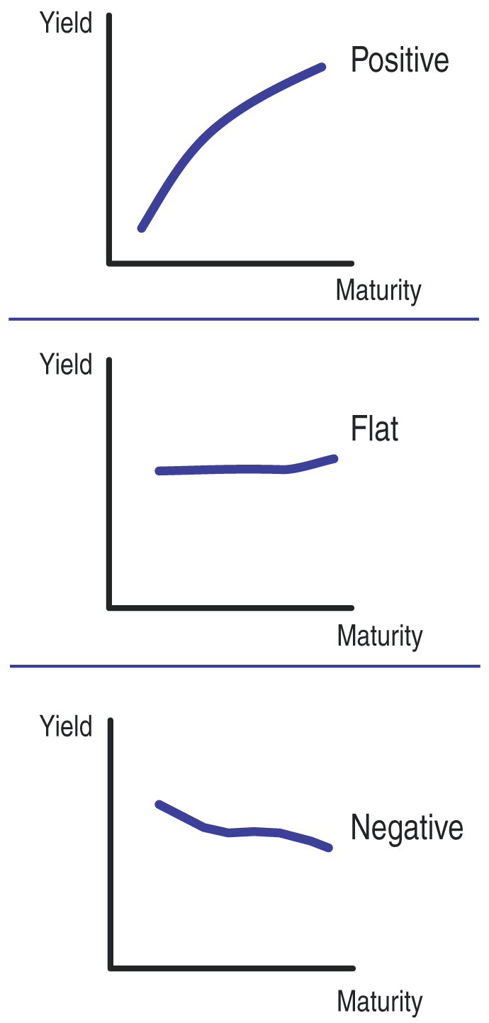
Yield Rate Curve
Yield curves plot interest rates of bonds of equal credit and different maturities.
http://traders.com/Documentation/FEEDbk_docs/2013/11/Siligardos.html
https://www.investopedia.com/terms/y/yieldcurve.asp
Notes:
●Yield rate: rate of interest of bond or stock
●Different rates for short term period and long term period
●The three key types of yield curves includes normal, inverted and flat. Upward sloping (also known as normal yield curves) is where longer-term bonds have higher yields than short-term ones.
●While normal curves point to economic expansion, downward sloping (inverted) curves point to economic recession.

Slide 7
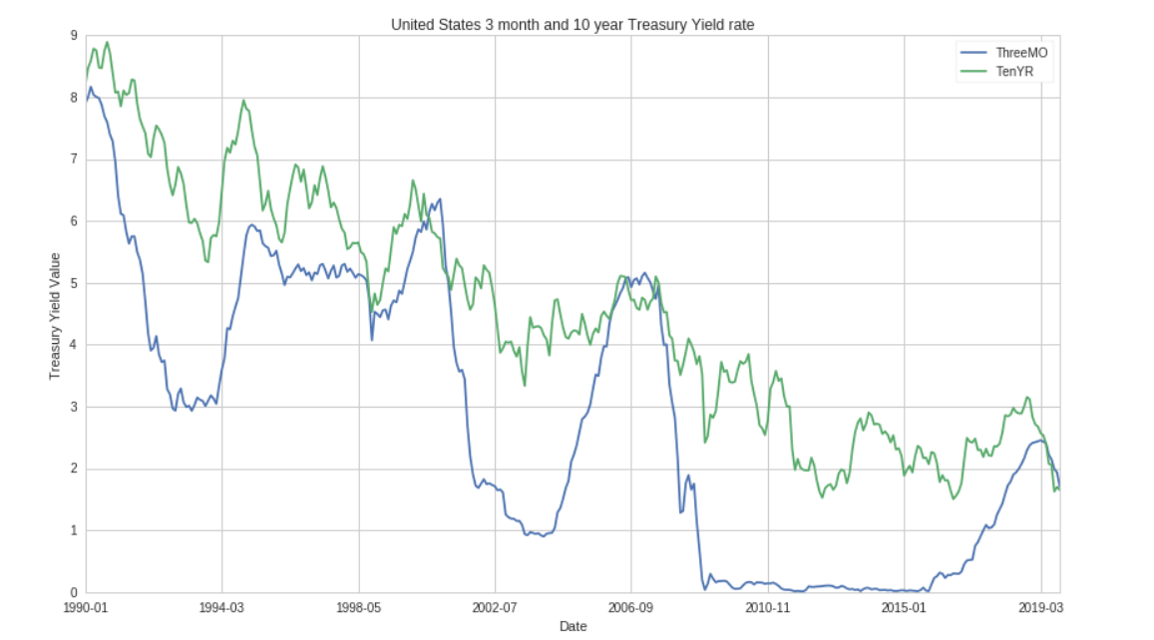
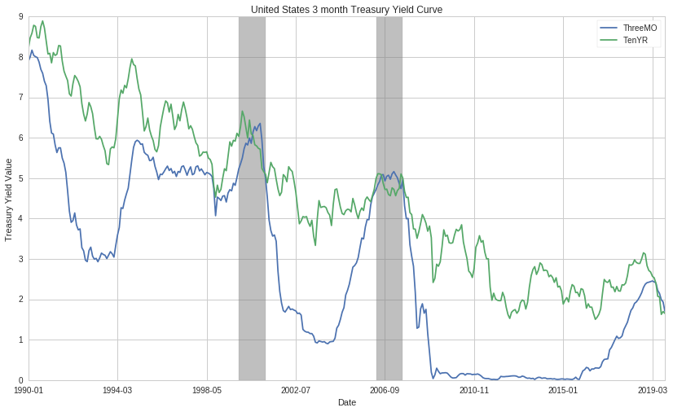
Yield Curve
Notes:
Quandle

Slide 8
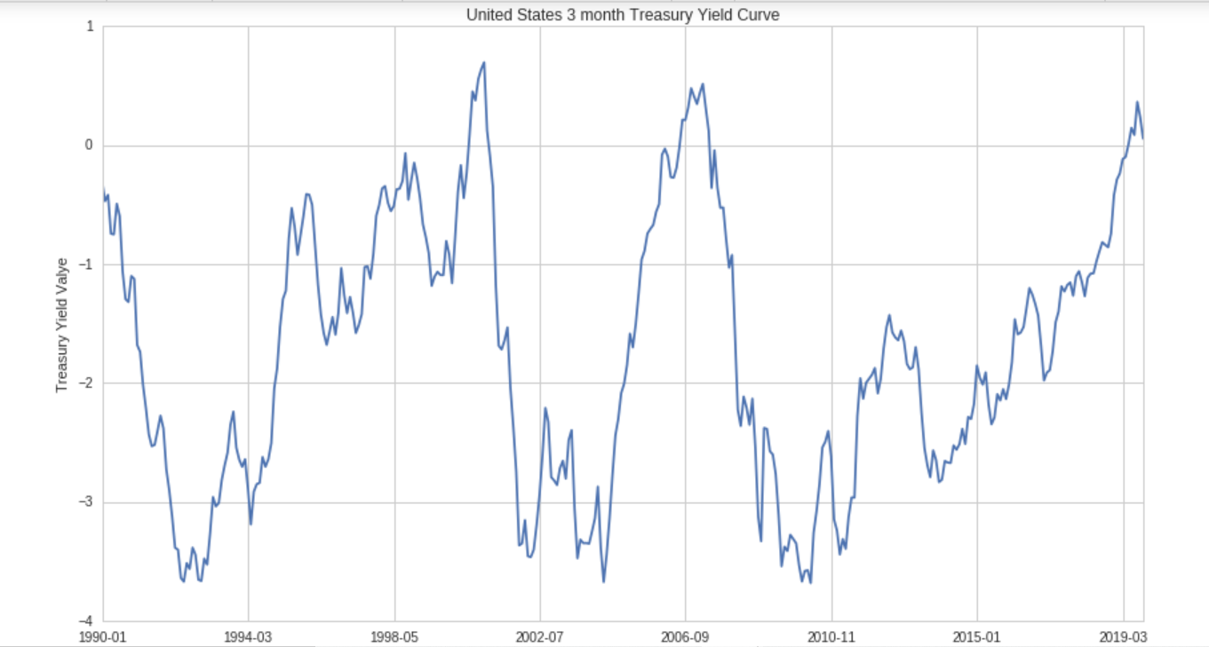
Three Month to Ten Year yield curve

Slide 9
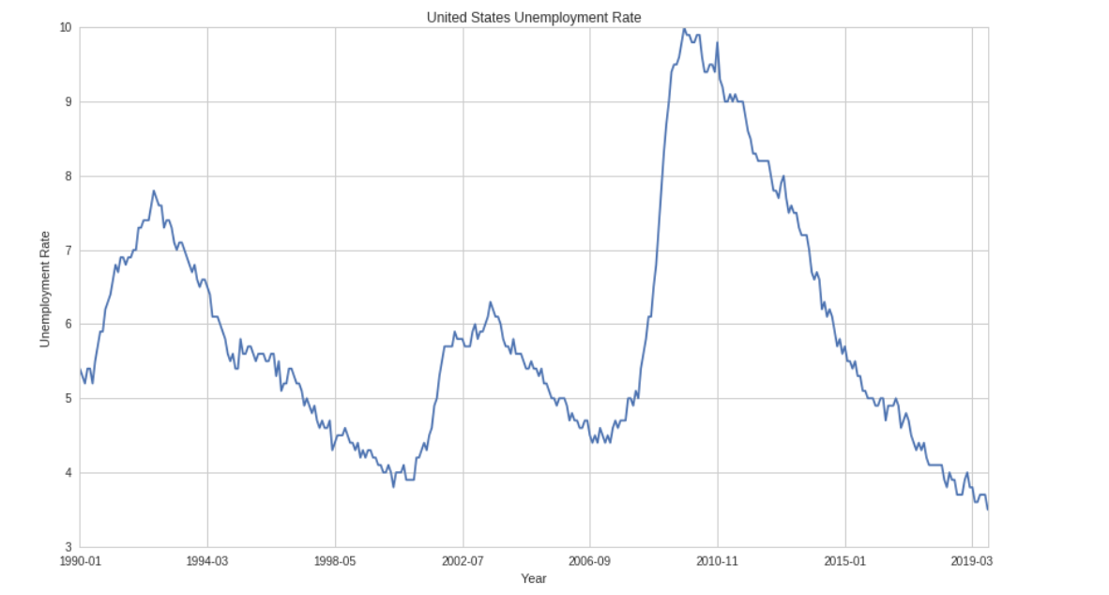
Unemployment Rate

Slide 10
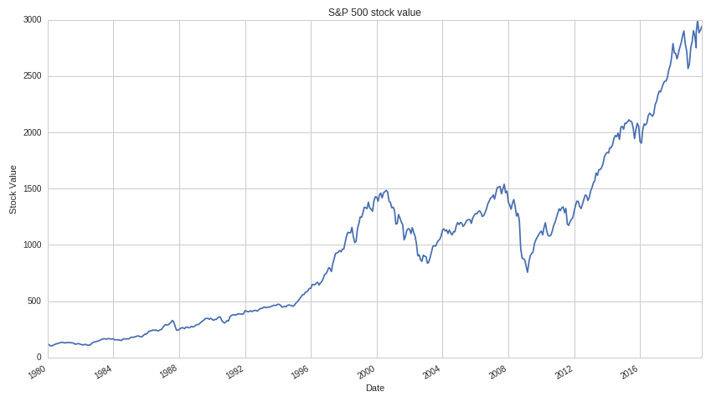
Stock Market Trends
Notes:
The S&P 500, or just the S&P, is a stock market index
It measures the stock performance of 500 large companies listed on stock exchanges in the United States
most commonly for the equity indices S&P 500 is followed

Slide 11
Solution Approach
Tried various models to analyze the Recession graph
Used Logistic Regression approach for Recession Tracking
Logistic Regression from Scikit-Learn Library
Input Features include:
Treasury Yield Rate difference of 3 Months to 10 Years Rate
Stock Rate Value
Unemployment rate

Slide 12
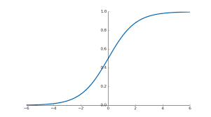
Logistic Regression
Classification Technique
Sigmoid Function
Evaluated probability of an event to belong to each class labels.
Predicts belongingness to a class if Probability for that event >= 0.5

Slide 13
Training and testing the model
The model is trained on month wise data available from January 1990 until January 2006 and the testing data is from January 2006 onwards.
The class labels are divided into 2 categories depending upon the Recession probability
0: Recession probability less than 50%
1: Recession probability greater than or equal to 50%

Slide 14
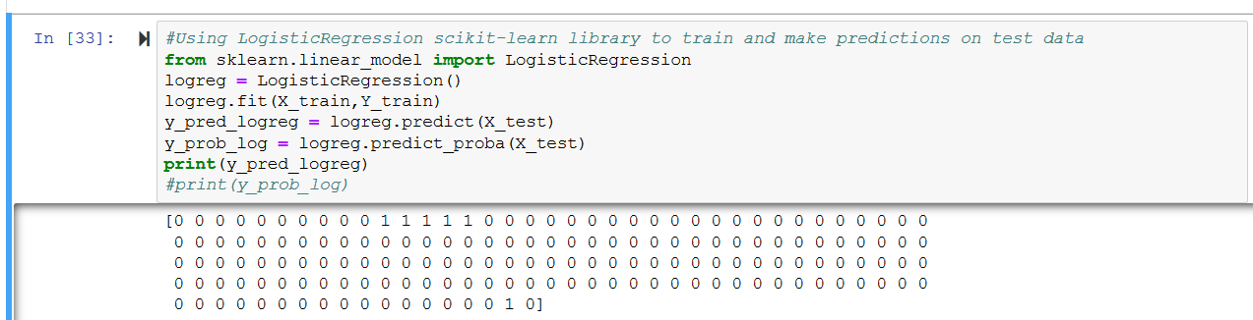
Final output of Logistic Regression

Slide 15
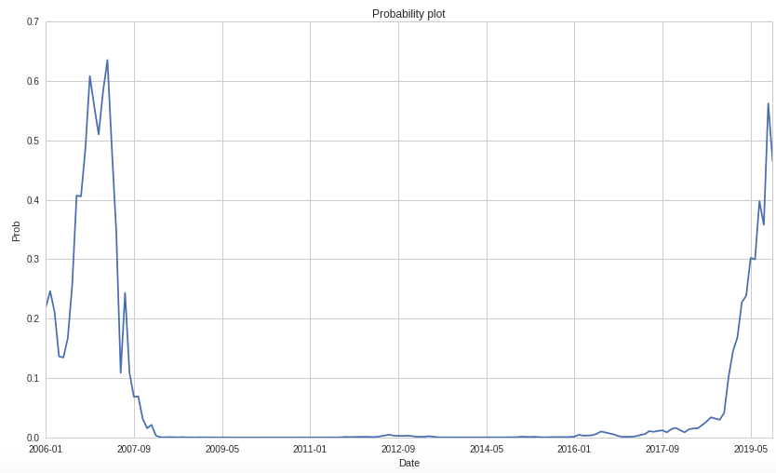
Final Result: Logistic Analysis

Slide 16
Conclusion/Interesting Findings and Analysis
According to our Logistic Regression model, there is a slight probability of a recession currently in 2019, but if the market stabilizes in the next few months then the probability of recession in 2020 may decrease.

