Slide 1
Case Study 4
Group 9
Vandana Anand
Prakhar Srivastava

Slide 2
Problem
The movie entertainment business is a booming industry with many interested customers viewing their content. We want to help upcoming movie businesses create a better business model, be able to satisfy their customers, and get better reviews on their content based on how much the customer likes the movie.

Slide 3
Importance and Interest
This problem is important because customers can lose interest if they cannot find a movie that may be of interest to them. They may not want to get into a movie and end up disliking it.
This would be an interesting problem for movie service providers that centers its business around providing recommendations to customers
In particular, we wanted to see how intriguing an age group would find each genre such as comedy, drama, action, etc.
We also wanted to know which genre of movie is most suitable to be recommended to a specific age group in order to generate positive reviews from customers across all ages.

Slide 4

Solution
We used the MovieLens data to predict the best genre to recommend to a specific age group
We broke up the age groups into intervals:
Ages 0-9 (youngsters), 10 -19 (teenagers), 20-29 (young adults)
30-39 (young/middle-aged), 40-49 (middle-aged), 50+ (seniors)
We looked into these parameters:
Mean Rating of each genre in each age group
Average Genre Rating among all age groups
Max Genre Rating for a Movie
We then used those ratings and used a prediction algorithm to apply the ratings to the equation below in order to find the percentage a genre may be of interest to a specific group
Recommendation % = Mean Rating * (Genre Rating / Max Genre Rating)

Slide 5
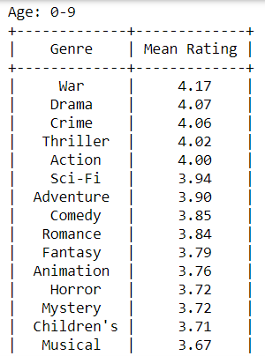
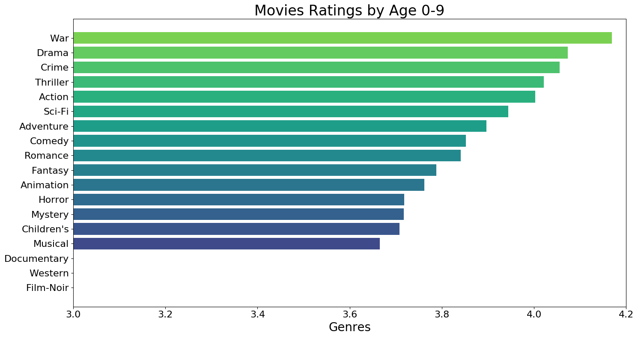
For e.g., corresponding to a table for age group 0-9, we get the following plot

Slide 6
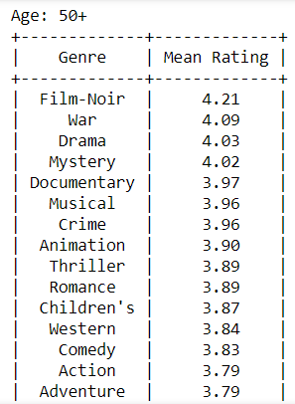
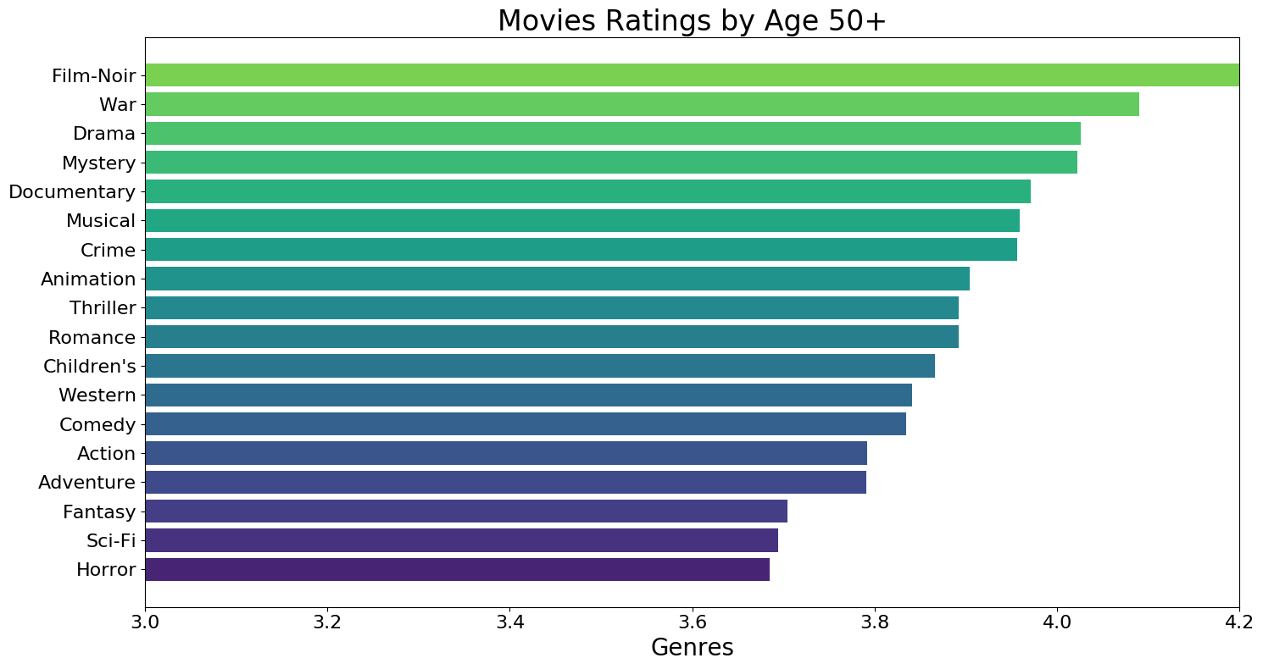
Similarly, for age group 50 and older, we get
and older

Slide 7
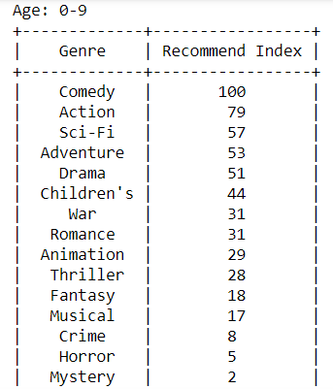
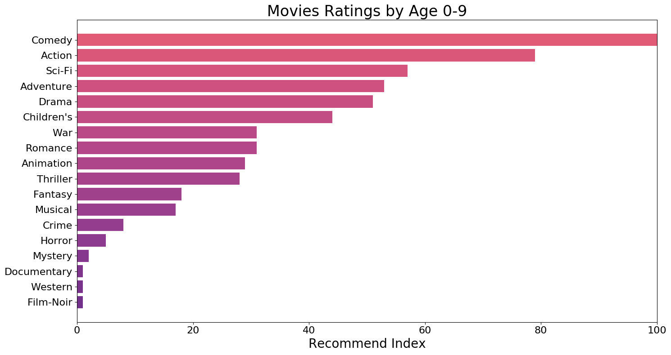
Results/Visualizations
%
Notes:
We want to recommend another genre the the customer would potentially be interested in other than what they have been watching

Slide 8
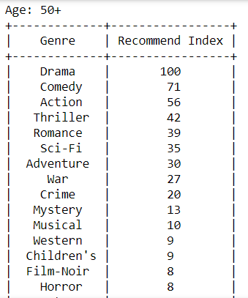
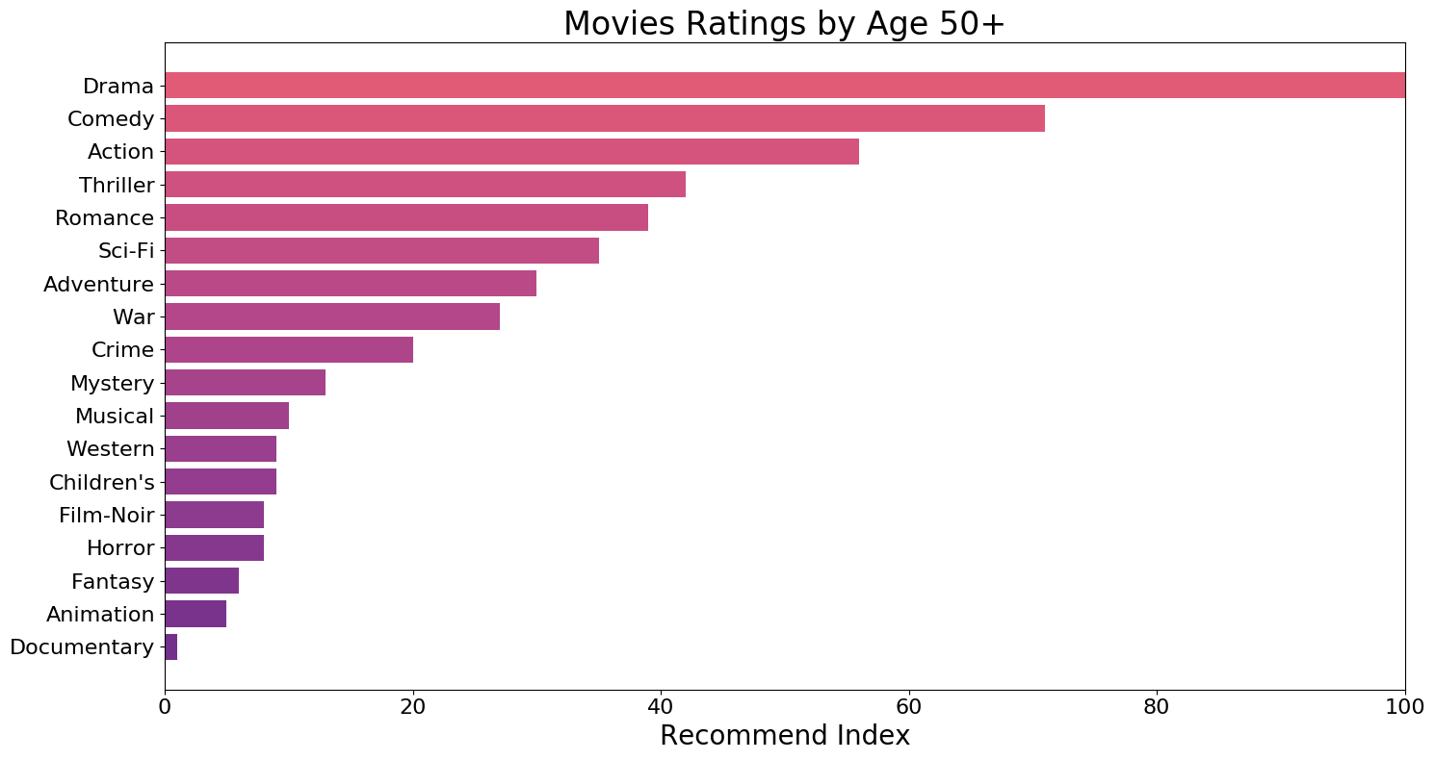
and older

Slide 9
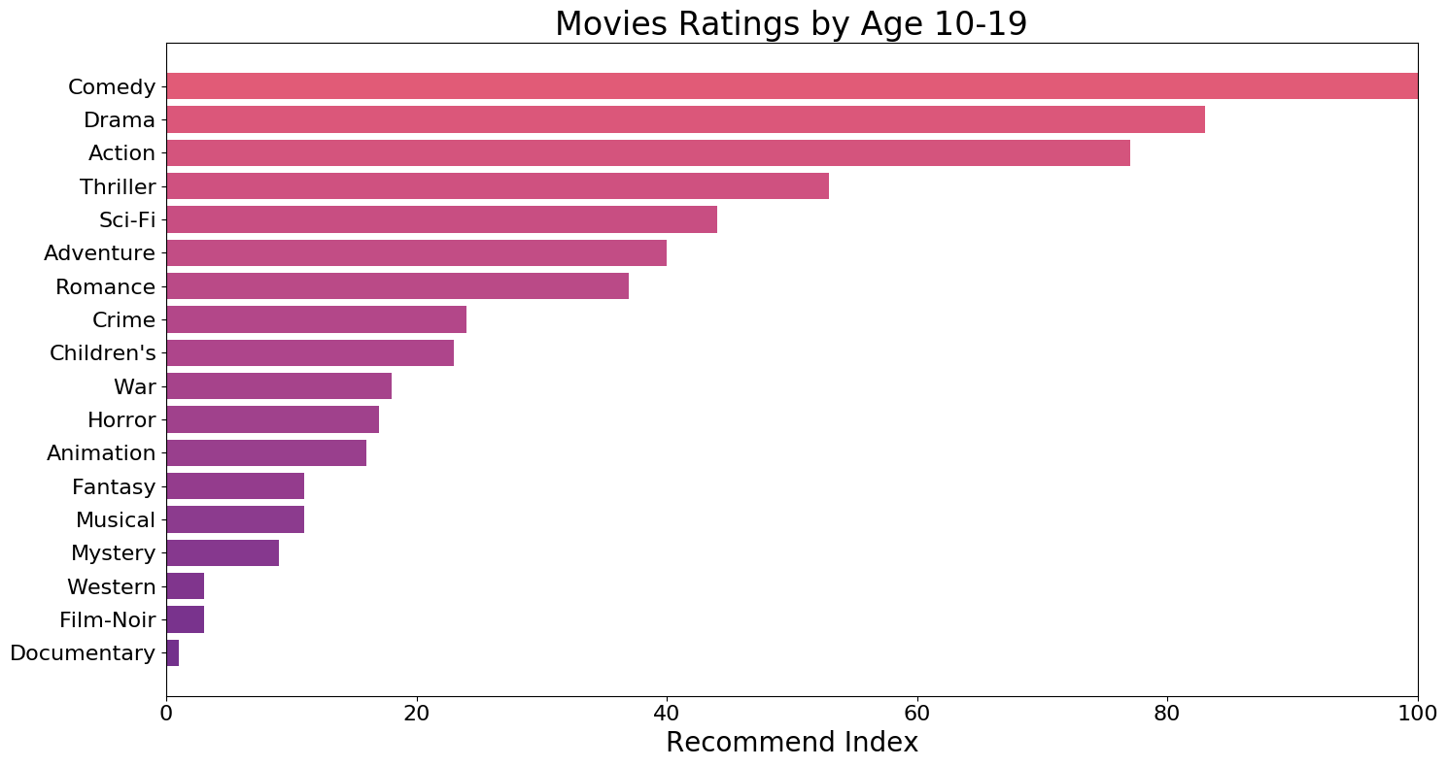
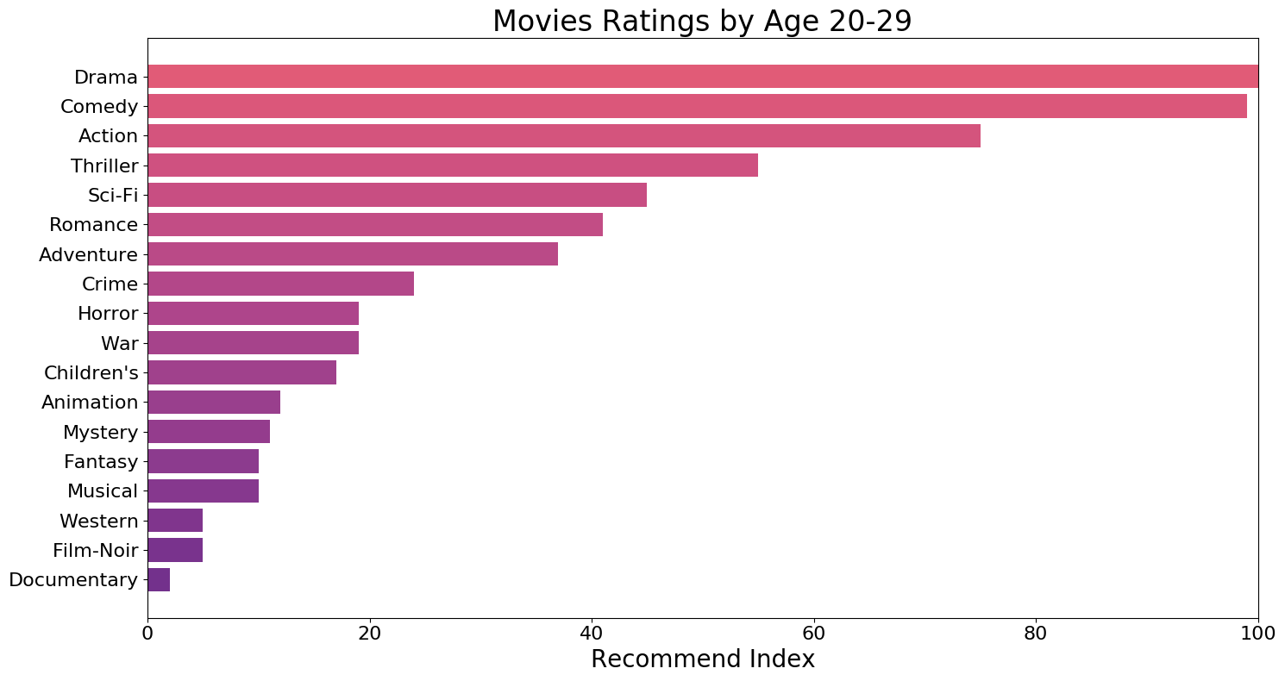

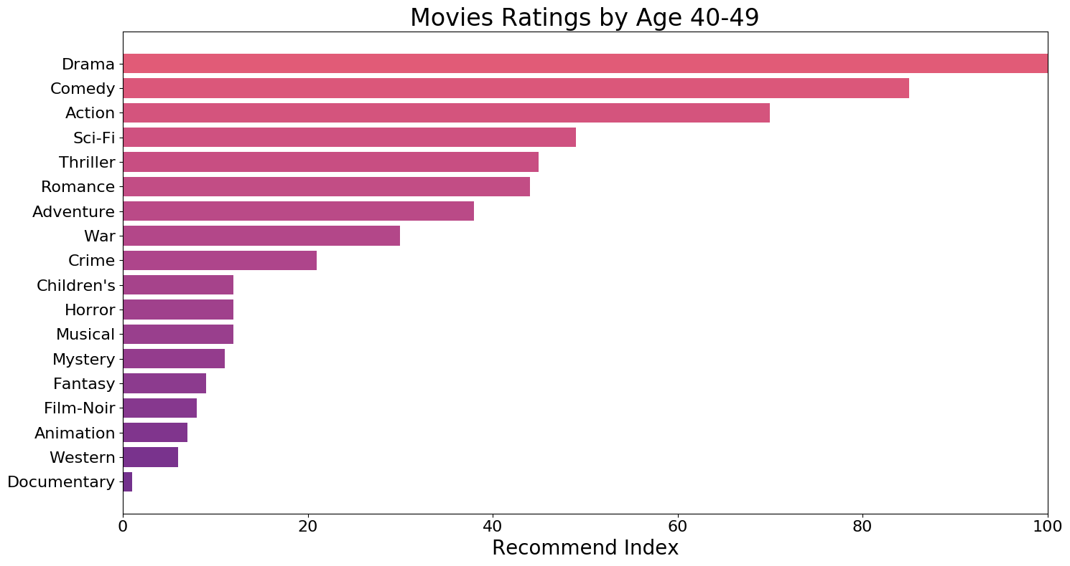

Slide 10

Results
Comedy would be recommended to age groups 0-9 as well as 10-19
Drama would be recommended to age groups 20-29, 30-39, 40-49, and people 50 and older

Slide 11
Conclusion and Interesting Findings
Drama seems to be the most recommended genre for ages 20 and above, whereas for ages below 19, comedy is the most recommended.
For the age group from 0-9, the children’s genre is rated lower than expected.
This model has the potential to be effective in recommending different genres that customers would potentially be interested in watching

Slide 12
Thank you!

