Slide 1

LEHMAN BROTHERS: CRISIS IN CORPORATE GOVERNANCE
BY: Andrew Aberdale, Vandana Anand, Katharine Conroy, and Diego Paredes

Slide 2
EFFECTIVE OVERSIGHT?
No! During the case, you can see how the effective oversight was not present with the board which caused the company to fail. Throughout the company breakdown, the board searched for any solution that would keep their business afloat with any costs. They were not looking for permanent and long term solution. Additionally they did not look to see how one decision might affect future outcomes. Lehman’s board was looking for someone to bail them out so they did not have to take responsibilities for their bad decisions and company culture they created. Once one domino fell, it was only a matter of time until the whole set fell.
Notes:
The whole company played hard and rolled fast, which was a culture created by the board because company culture is top down. That mentality led them to higher risks and more miscalculations on all levels leaving them with lots of debt and low payback.

Slide 3
PRECURSORS TO CRISIS
The governance principles that guided the board during the crisis were transparency and rule of law. There was transparency because the media and public were informed and involved in the crisis. They had debates over how involved the government should be in helping Lehman because they already faced backlash for using taxpayer dollars to help save another banking company. Since the government were strict on what they could do, rules of law were followed and the company strived to find other legal ways to deal with the issue that unfortunately didn’t work out. Overall, these principles helped the company members eliminate options and ultimately arrive at the best decision, which was to close down the company.

Slide 4
WHO DID LEHMAN BROTHERS SAVE?
The board and the senior management acted more on the behalf of the corporation and their own interests than the shareholders during the financial crisis in 2008. It was apparent that they really wanted to do whatever it would take to save the company. All the signs pointed to the eventual downfall of the company since they were not making any profits and had bad markets in the industry. However, board members wanted to still save the company who knew that what they would be doing would not help shareholders.

Slide 5
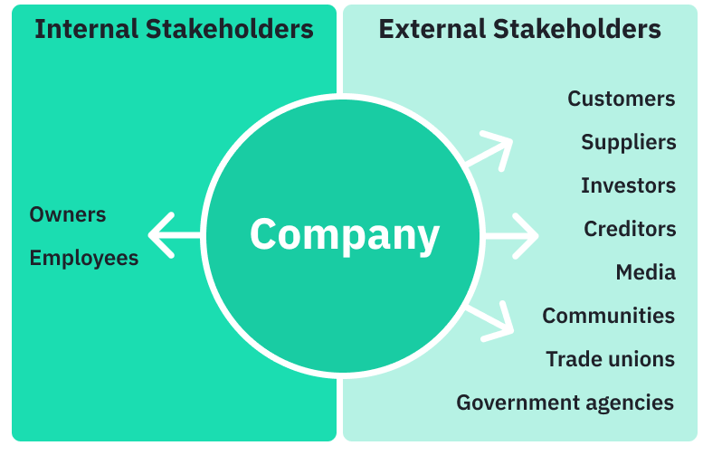
STAKEHOLDERS
Primary Stakeholders:
Lehman Brothers and their employees
primary decision makers that were misleading investors
Lehman Brothers’ debt and equity holders
All holders that are directly financially tied to Lehman Brothers financial performance
Secondary stakeholders:
Lehman Brothers’ employees’ families
affected if they lost their jobs and social perception for being tied to a corrupt corporation
US and UK stock market
Repercussions of one US main banks failing could have domino effect in the market
UK was involved as bank owned many bonds from their housing market
World Economy
If US economy went down, triggering global financial instability
Notes:
While we can see the internal stakeholders were a small group of people, such a large corporation has a huge impact. Whether people liked it or not, everyone was tied to lehman’s decisions.

Slide 6
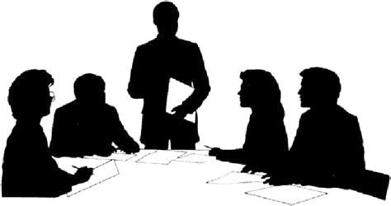
SEPT 14TH BOARD DECISION
The board should have delayed
Bankruptcy would have global scale impact
Staying open would just cause further damage
Notes:
Delaying was the best option. Staying open would have just “dug the hole deeper” and caused more damage. Bankruptcy was in no one’s best interest. Delay would allow for more opportunities to sell and work out the liquidity problem.

Slide 7
ADVANTAGES AND DISADVANTAGES OF RICHARD FULD’S POSITIONS
Advantages
Disadvantages
Fuld has a vested interest in the survival of the company.
As Chairman and CEO he has better relationships with board members, promoting cooperation.
Fuld has developed an extensive and advanced skill set.
Personal bias towards Fuld impacts his relationships.
Lack of new perspective in management.
Traditional methods of management and execution.
Inclined to not sell the company.
Notes:
Overall, having Fuld as both Chairman and CEO was beneficial, but it did come with some disadvantages which impede progress or sway company direction.

Slide 8
CONCLUSIONS AND TAKEAWAYS
Bad behaviour is mostly influenced by upper management asking for higher returns
Risky bonds were an easy way out
Management decided to double their bond stakes putting the company in a higher risk
Government tried to save Lehman Brothers after their last bullet fell out, they gave up on them
They were more interested in saving the US economy than Lehman Brothers
Bankruptcy was the next best scenario
Overall we think that Lehman Brothers were at fault, bankruptcy triggered a domino effect on the failure of global economy, but it was necessary to stop this bad behavior

Slide 9

GROUP CASE TAKEAWAYS
Working as a group allowed everyone to have a different perspective of the case
We all worked on different slides but came back to discuss and add additional details
Group conversation opened everyone eyes to parts that people may have missed
Allowed everyone to delve deeper into the case content

Slide 10
REFERENCES
Lehman Brothers: Crisis in Corporate Governance Article

