Slide 1

Intern Project Final Updates
FBT RISK Team
Vandana Anand (WPI) and Jeremy Wisbey (RPI)
Software Engineering Interns
August 10th, 2017

Slide 2
Agenda:
-Recap of the projects: Risk Site, WORM, Karma
-What we learned during our internship experience
-Internship feedback

Slide 3
Recap

Slide 4
2017 Summer Internship Timeline
Week 1 – Week 12
Week 3 – Week 10
Week 7 – Week 12
Risk Team Ribbit Site
WORM Project
Karma Testing for Angular JS 4.0
Notes:
We have been updating the Ribbit Site ever since we created it. We have worked on the WORM project for some time and been updating ever since. We started karma testing for angular 4.0 after we finished the majority of the WORM project and currently are trying to configure the karma settings to the MF Recon code.

Slide 5
Recap: Risk Team Ribbit Site

Slide 6
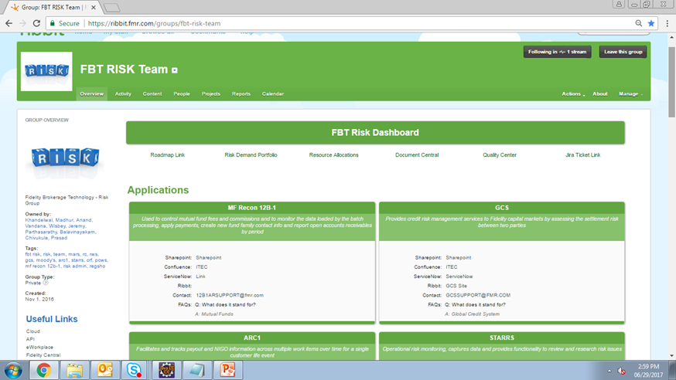
Purpose: Create a robust site on ribbit that will hold all of the team’s links and documents, acting as a Risk Team homepage
Goal: Develop a site that easily navigable and understandable for users within and outside our team, promoting efficiency
Implementation:
-HTML/CSS widgets injected into Ribbit
-Experimented with different UI
Screenshot of website
FBT Risk Team
Challenges:
-Limitations of Ribbit Framework
-Keeping links up to date manually
Takeaway: Experience with web design, UI, and getting an introduction to the various RISK applications
Notes:
Did a Ribbit Site Demo the last time. Now we will just show this picture and go over it briefly. Can also mention that Ribbit site is becoming more prominent among the team and that team members are now using that to access anything documents/links that are RISK related.

Slide 7
Recap: WORM Project

Slide 8
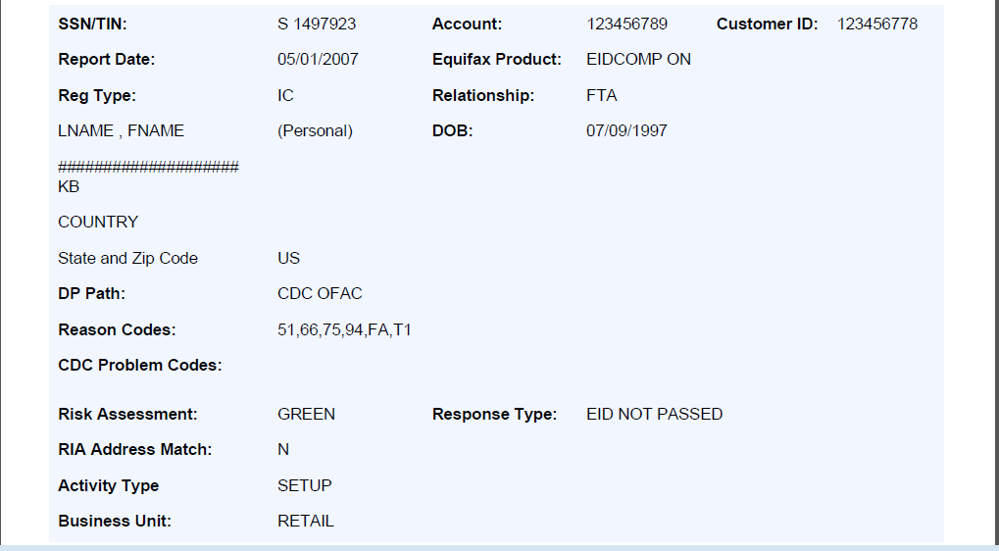
Purpose: The Write Once Read Multiple (Times) Project, otherwise known as WORM, serves to take customer data (as text) and convert it into a PDF to inject into the CMIS web service so that the data is easily accessible by authorized team members.
Implementation
-Created a java program
-Used Apache PDFBox for PDF conversion
-Used Springboot for dependency injection
-Used Maven for compilation
Challenges
-Converting old CMIS code
-Getting access to the web server
Takeaway
Learning the software development lifecycle and file structure of a commercial application
Screenshot of the PDF document that contains a sample of a customer’s data, generated by our Java program.
Notes:
Did a WORM Demo on what we had done so far at the time. We will mention that now that we have finished it, we can show you the design and structure and it is ready for production in 2018. Rob and the team have mentioned it is a really good jump start for them. Get to make one project on the roadmap blue, meaning completed. Did some basic SQL using Toad for Oracle 10.6

Slide 9
Angular 4.0 Testing with Karma and Jasmine

Slide 10



Purpose: Build a Risk application, setup Karma, and write some unit tests in typescript
Our Implementation:
Cloned the MFRecon 12b1 repository from GIT using SourceTree
Downloaded Karma and wrote a basic test
Challenges:
Issues with Karma configuration
Access limitations with setting up Angular CLI
Takeaway: Experience with not only running Karma unit tests in typescript but also Angular 4.0

Slide 11
What Have We Learned?

Slide 12
Soft Skills
-Presentation
-Communication
Goals
-Continue Learning
-Finish school and get that degree
Experiences
-New Corporate Setting
-How things work at Fidelity
What Have we Learned?
Risk Team
-Meet and work with team members
Leaps and Interns
-Meet with other interns who share same interests
-Learn a lot about Leap
Challenges
-First time in a company setting
-Understanding the various things our team does
Finance
-Brokerage Accounts
-What services we provide to our customers
Technical Skills Risk Site WORM Karma
HTML SQL Testing
CSS Java

Slide 13
Internship Feedback

Slide 14
What Worked Well:
-Awesome experience ☺
-Really liked the intern events that were held for us. We got to meet with other interns, leaps, and employees
-Got to know, interact, and work with the team
Suggestions for the Future:
-One mentor on the team who would guide us through projects/questions would be beneficial
-More opportunities to explore other roles or departments for those who are interested
Notes:
How to do internship better or what they did well AND what you thought the team did well or what they could do better

Slide 15
Thank you! Any questions?

