Slide 1
Final Intern Presentation
Thursday, August 2nd 2018
Direct Data Team
Vandana Anand and Jeff Kennan
Software Engineering Interns

Slide 2
Agenda
Introduction
Vandana’s Google Trends Project
Jeff’s Credit Card Project
Jeff and Vandana’s Verbatim Team Project
What We Learned
Thank you!
Notes:
Why we have done this, how we have done it, where it has been used, what’s next
For each one, say thank you to the people who have worked with

Slide 3


Introduction
Direct Data Team
Mike Canny, Krishna Valluru
Vandana Anand
Class of 2020 (Rising Junior)
Last summer: FBT Risk Team
Internal Ribbit Site and PDF conversion tool
Jeff Kennan
Class of 2020 (Rising Junior)
Last summer: POC document retrieval and display UI.
Now in AlphaSearch.
Notes:
Mention last year we were here and we came back!

Slide 4
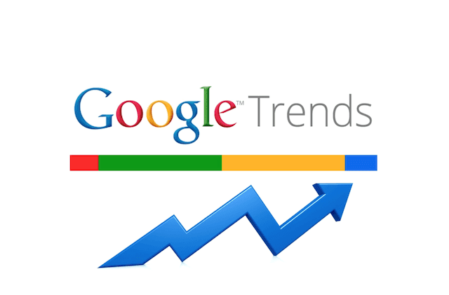
Krishna Valluru, Technical Lead
Vandana Anand, Software Developer
Roshan Taheri, Data Scientist
Kunal Chavan, Engineer
Michael Ahmadi, Engineer
Anna Bachvarova, UX Designer
Mike Fuller, Analyst
North Carolina Team, Standups
Notes:
Special shout out to the people listed as I have worked with them on this project, thank you!

Slide 5
Project Overview
Can enter up to 5 keywords to compare how popular they were overtime
Got permission to acquire this data for research purposes
Python tool to extract Google Trends data
Display this information that’s helpful for researchers/analysts to use the data

Slide 6
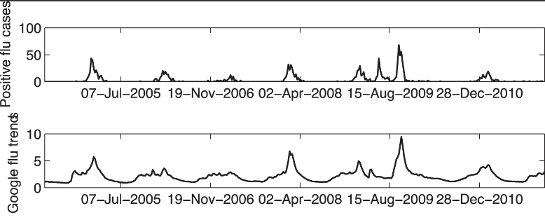
Google Trends Data
Research paper on using Google Trends data to predict the number of flu cases
Highlights:
High correlation between the two charts
Scores are normalized when comparing two or more keywords
as opposed to searching one keyword
Google data is very valuable as its historical data can be used to
predict the future
Notes:
Google Trends used to predict the flu, google data is valuable and the flu research paper showcases this as shown in the graphs. The correlation between the first two charts are high and the scores are normalized when combining and comparing all the keywords together -> http://journals.plos.org/plosone/article?id=10.1371/journal.pone.0056176
-Google data is valuable because the conclusion of this report was that individual medical centers can predict advanced warning of future influenza cases

Slide 7
The Process and Software
Data Extraction
Generating Graphs
API
Linux Server
Developed a program that can also take in a CSV file with keywords and a region to extract Google Trends Data
Software:
Used python for this whole program
Built-in package called pytrends for data extraction
Added a function in order to have a chart functionality to build a graph for the data
Software:
Package in python for generating graphs called plotly
Created an API to get input parameters from the URL based on user needs and display data in an organized table
Software:
A tool to serve an application online called flask
Installed this program on the Linux server for the team to access
Software:
The WSGI (web server gateway interface) called gunicorn to call a port for hosting a site

Slide 8
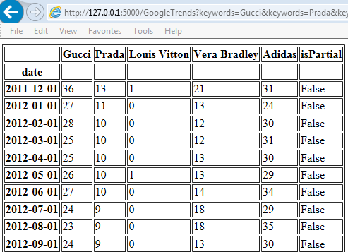
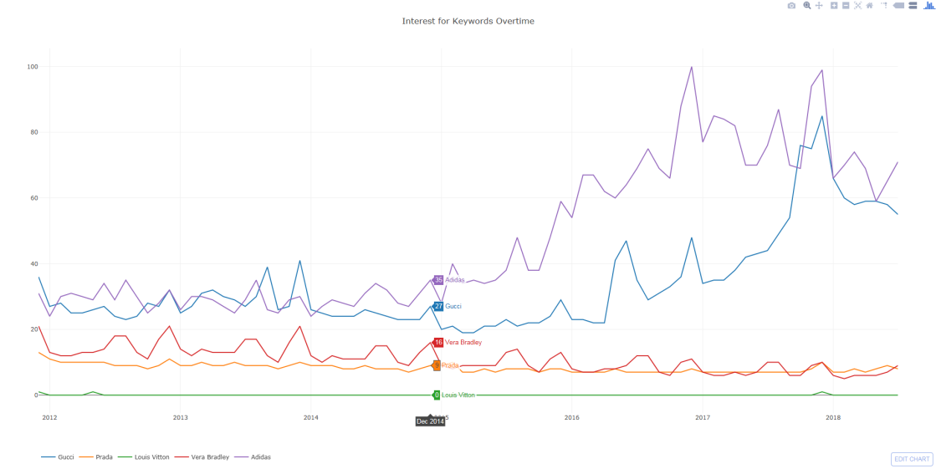
Final Product
Interest for Keywords Overtime
Snip-it of the Google Trends Data Table
Input : Output:
- Up to 5 Keywords -Data Table
- Region (ex. US, UK) -Chart with
- Start/End Date keywords
Chart generated by Plotly of the Google Trends Data Table
Notes:
Plotly is not on the flask website and it is a 3rd party website
On the chart, the y axis is the scores and the x axis is the months -> the scores are normalized since there are 5 keywords -> mention the huge spike in Adidas
How and where is it being used? -> in research reports by research analysts
Ryan Anderson’s report is based on using App Annie and Google Trends to support the buy of the weight watchers stock
Especially since 4Q17, the year over year downloads of the weight watchers app corresponds with its popularity tracked by Google Trends which means that it is predicted that subscriber growth would increase
Allison and Harsh’s report is based on vaping products that has seemed to become popular recently
Google trends data over time show the same group of keywords in different regions, so for example the search term JUUL (grayish blue) is popular in regions such as UK, Germany, France, Italy and markten which doesn’t seem to be as popular

Slide 9
What’s Next
Convert the data format (ex. JSON)
Insert Google Trends data into the database
Integrate into App Annie
Use the chart for other applications
Expand by predicting performance of companies in the stock market
Notes:
Expanding on this project in the future
JSON format, , insert in database, integrate into App Annie, other applications, stock market predictions

Slide 10
Internship Takeaways
The data generated by this python program has been included in Research Notes by:
Ryan Anderson
Allison & Harsh
Got the opportunity to learn and experience:
The software developing life cycle from gathering requirements to production
Working with experts in the field
Gained a lot of new technical knowledge such as:
Python programming skills
Data visualization/data science techniques & concepts
Web development
Notes:
Produced Research Reports:
Ryan Anderson -> paper on weight watchers stock and how app annie and google trends supported that it will rise
Allison and Harsh -> paper from data on vaping products such as JUUL as it is becoming popular nowadays and whether google data supports if it is becoming popular or not

Slide 11
Questions?

Slide 12
Credit Card Data Browser
Krishna Valluru, Technical Lead
Jeff Kennan, Tool Development
Rahul Metta, Engineer
Kunal Chavan, Engineer
Anna Bachvarova, UX Designer
Mike Fuller, Analyst
Apijay Kumar, Engineer
Kevin Wayne, Engineer

Slide 13
Motivations
Recently acquired data set
Uses purchase data to predict sales trends before reporting
Sales estimates provides alpha for securities
Create the biggest picture possible for analysts
Notes:
Consumer team

Slide 14
End Use Case
Display data set on AlphaSearch
“One-stop shop” for traditional and alternative research
Repository for data analytics projects

Slide 15
Design
Then Now
Excel Tool
Vendor Data
DB
API
UI
Named queries
Static display
Many copies of one file
Daily feed file
Processed and loaded into database automatically
Data stored in Direct Data tables
Direct database connection
Procedures in Credit Card DB package
Automatic serialization
C#, ASP.NET Web API
Integration with AlphaSearch
Rich information display
Chart exporting
Angular 4.0

Slide 16
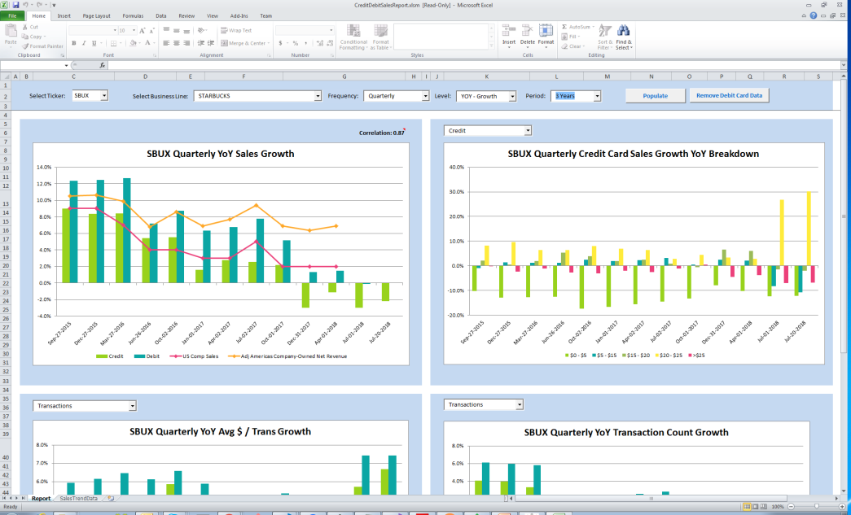
Excel Tool

Slide 17
What’s Next
Version 1 in release pipeline
Data science
Predictive model on data set for actual sales numbers
Beyond general trends
Version 2

Slide 18
Internship Takeaways
Building a software app for production release
Building corporate relationships
Code review process
Continuous iteration and improvement

Slide 19
Questions?

Slide 20
Verbatim
Krishna Valluru, Technical Lead
Jeff Kennan, Tool Development
Rahul Metta, Engineer
Kunal Chavan, Engineer
Anna Bachvarova, UX Designer
Mike Fuller, Analyst

Slide 21
Motivations
Additional recent data acquisition
Real-world SSS estimates from stores themselves
Even more accurate predictor of quarterly reports
Another source of alpha
Final Product
Display data set on AlphaSearch
“One-stop shop” for traditional and alternative research
Repository for data analytics projects
Notes:
The same end user case as Credit Card

Slide 22
Tech Stack
Database
API
AlphaSearch
Angular 4.0
ASP.NET Web API
Vendor
Feed file inserted into database
Direct database connections
Notes:
Vendor/DB getting data
What’s next -> Put into Alphasearch

Slide 23
Learning Experience
Building production-level tools for Enterprise systems
Fidelity
Internship
Got to meet and hear from the CEO Abby Johnson ☺
Team exposure, mentor/technical advice
Fast-paced, Agile teams
Learned more about the financial sector

Slide 24
Acknowledgements
Michael Canny (Manager)
VP of Quant and Business Intelligence, Asset Management
Krishna Valluru (Technical Lead)
Director of Software Engineering Development, Asset Management
The Entire Direct Data/Quant/Enterprise(NC) Team

Slide 25
Thank you!

