Slide 1

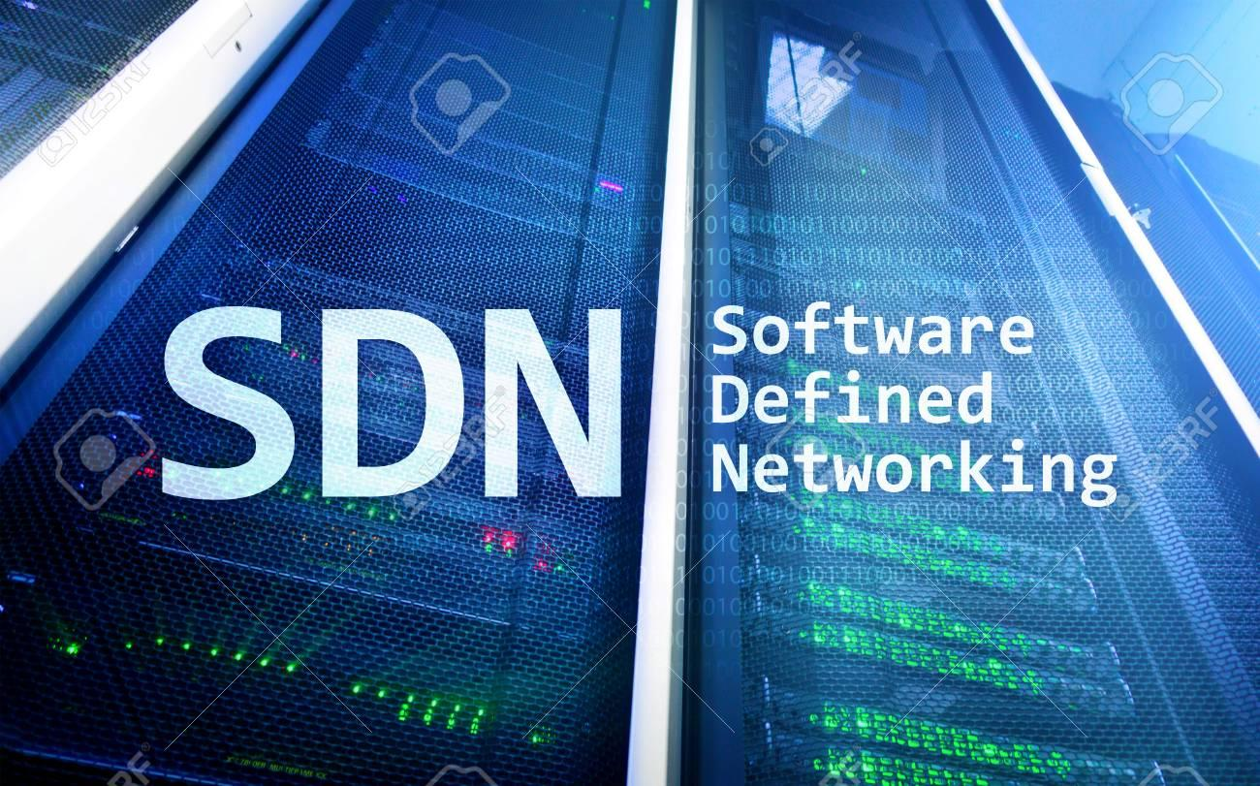
Final Internship
Presentation
Vandana Anand, SDN Planning
Data Science Analyst Intern
8/6/20

Slide 2
Agenda
Introduction
Project Overview
Contributions
Results
Q&A

Slide 3

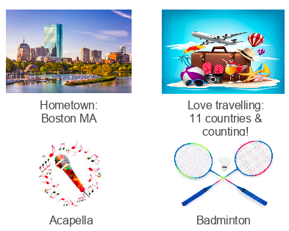
Vandana Anand
Masters
Data Science
2020

Slide 4
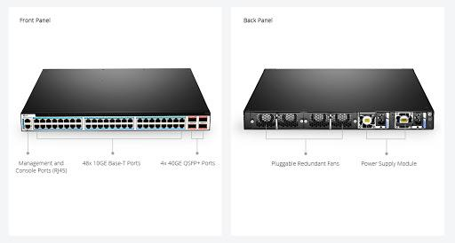
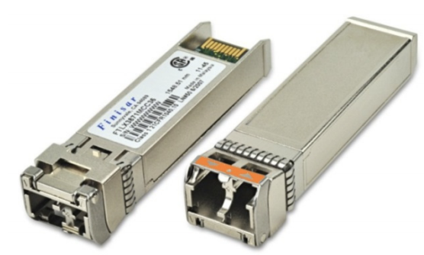
Developing Automated Test Tool for Optical Transceivers
Motivation
Save on transceiver costs
Switch (Forwarding Box)
SFP+ Ports
QSFP+
Ports
Goals
Test based on transceiver performance data (ex. temperature, power levels)
Ensure transceivers are generating valid data
Qualify transceivers for production deployment
connects
Transceiver
Vendor A
Transceiver
Vendor B
Notes:
This summer I focused on developing an automated test tool for optical transceivers. In our environment, there are many different transceivers that are manufactured by 7 different vendors for SFP+ and the price range for each vendor is different, for instance the 10G SFP+ long range price ranges from lowest price $40 to the highest price $2000. Our motivation is to see if the less expensive transceivers will perform optimally. We are adding value because we are testing transceivers based on performance such as temperature or power levels in different environments and not physical attributes which are already being looked at in other Verizon labs such as using the eye diagram to measure wavelength accuracy. The other goals are to ensure data quality and qualify transceivers for production deployment.
(ME = Maintenance Engineering)
Manufactures also have their own certification/spec testing process but we, Verizon, do our own.
So, one of our goals is to set up this automation tool so that if a third party transceiver get connected to our forwarding box, we can test it to make sure it is compatible and performs well in our environment based on its performance data such as temperature and power levels.
------------------------------------------------------------------------------------------------------------------------------------------------------------------------------------
Optical transceivers are devices that transmit and receive communications. They convert electrical packets to optical signals and vice versa. OpenEdge is our data model driven platform used to collect these data.

Slide 5
Testing Process
Define the scenarios
no traffic
low traffic
moderate traffic
high traffic
stressed traffic
Generate network traffic & collect data
Monitor, Analyze, Evaluate
Produce Reporting Dashboard
Notes:
This is the certification process that goes hand in hand with the script that I built using Python. First was to define the scenarios that we can use to apply varying amount of pressure on transceivers to see how they will behave in different network environments. These environments are from gradually increasing the traffic from no traffic all the way to high traffic or putting the maximum amount of pressure on the transceiver. Next the network traffic was generated with our traffic utility tool using the automated script and collected the data. Then the transceiver behavior was monitored, analyzed, and evaluated to see if features such as its temperature or power levels were within the thresholds determined by the Multi Source Agreement specifications document. Then a reporting dashboard was produced to showcase the results.

Slide 6

Data Science Workflow
1
2
3
4
Research & Requirements Gathering
Data Collection
Data Pre-
processing
Data Visualizations
Get familiar with network domain knowledge
Initial data analysis on Kibana
Read documents to find standard values of features
Query data from different sources (testbeds and FOA) using open source search platforms like ELK Stack
Data Validation
Transform data using Python
Combine multiple datasets to find trends
Create visualizations for combined data
Perform data anomaly checks and quality assurance
Report discrepancies to vendors
5
6
7
8
Feature Engineering
Modeling
Testing & Validation
Communicate Results
Pinpoint key features to use
Eliminate insignificant features
Determine testing process
Develop script using Python
Evaluate results
Test and validate using more data
Give a pass or fail rating for the transceiver and communicate to the team
Notes:
First office application (FOA) - first instance after deployment
Data validation, making sure that all data from each dataset match with each other (aka reported at the same time) after collection
Use Python to process and transform data into a workable form
Combine multiple datasets to find trends and correlation between features
Create visualizations to find meaningful insights from the combined data

Slide 7
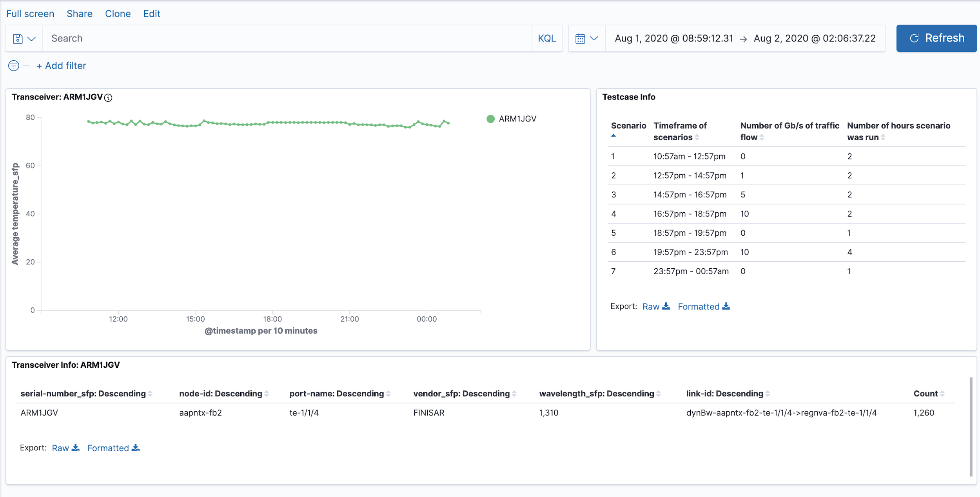
Results
Checked and monitored transceivers and its collected data for quality
Built an automation tool to qualify transceivers
Created a UI dashboard to report results
Laid a foundation for future work:
Real-time monitoring of production environment
Root cause analysis for failing transceivers
Machine learning to learn patterns of a transceiver reaching its EOL
UI Dashboard
Notes:
Found outliers and communicated to vendor who issued an update on their system. There was a bad driver on the operating system of the forwarding box so it couldn’t send meaningful data.
Executed various test cases in different environments to monitor performance
Certified and provided recommendations on best/worst performance
verify data is useful and meaningful/correct 2. Monitored transceiver performance
Created a UI dashboard pictured on the right to report the results. Due to time limits, I focused on testing one transceiver for a vendor for SFP+ 10G. This one passed and gained insight about inexpensive transceivers meeting the requirements. The same tool can be used for testing more transceivers.
Built certification tool, can be used in production to monitor the health of transceivers in live network
Collect data from transceivers to perform root cause analysis in case of failure
Identifying the end of life of transceiver based on their performance pattern to avoid service outage

Slide 8
Data Analysis Process
Learnings
Communication, presentation, teamwork skills
Gathering Requirements
Working in a new industry & gaining network knowledge
Opportunity to develop programming skills (Python)
Notes:
Applying theoretical knowledge to practical hands on project
Data preprocessing/processing is a very important part of the data science/analytics process & this is what takes a majority of the time!
Opportunity to analyze a very large dataset, make data visualizations, find trends, learn the Kibana interface/Kafka/new technologies

Slide 9
Thank you!
For the opportunity and to the SDN Planning Team
Special thanks to Hwa-Jung, Navid, Yueping, Safat, Erik, Sangwook, David, and Matt for the mentorship, advice, and help along the way!

