Slide 1
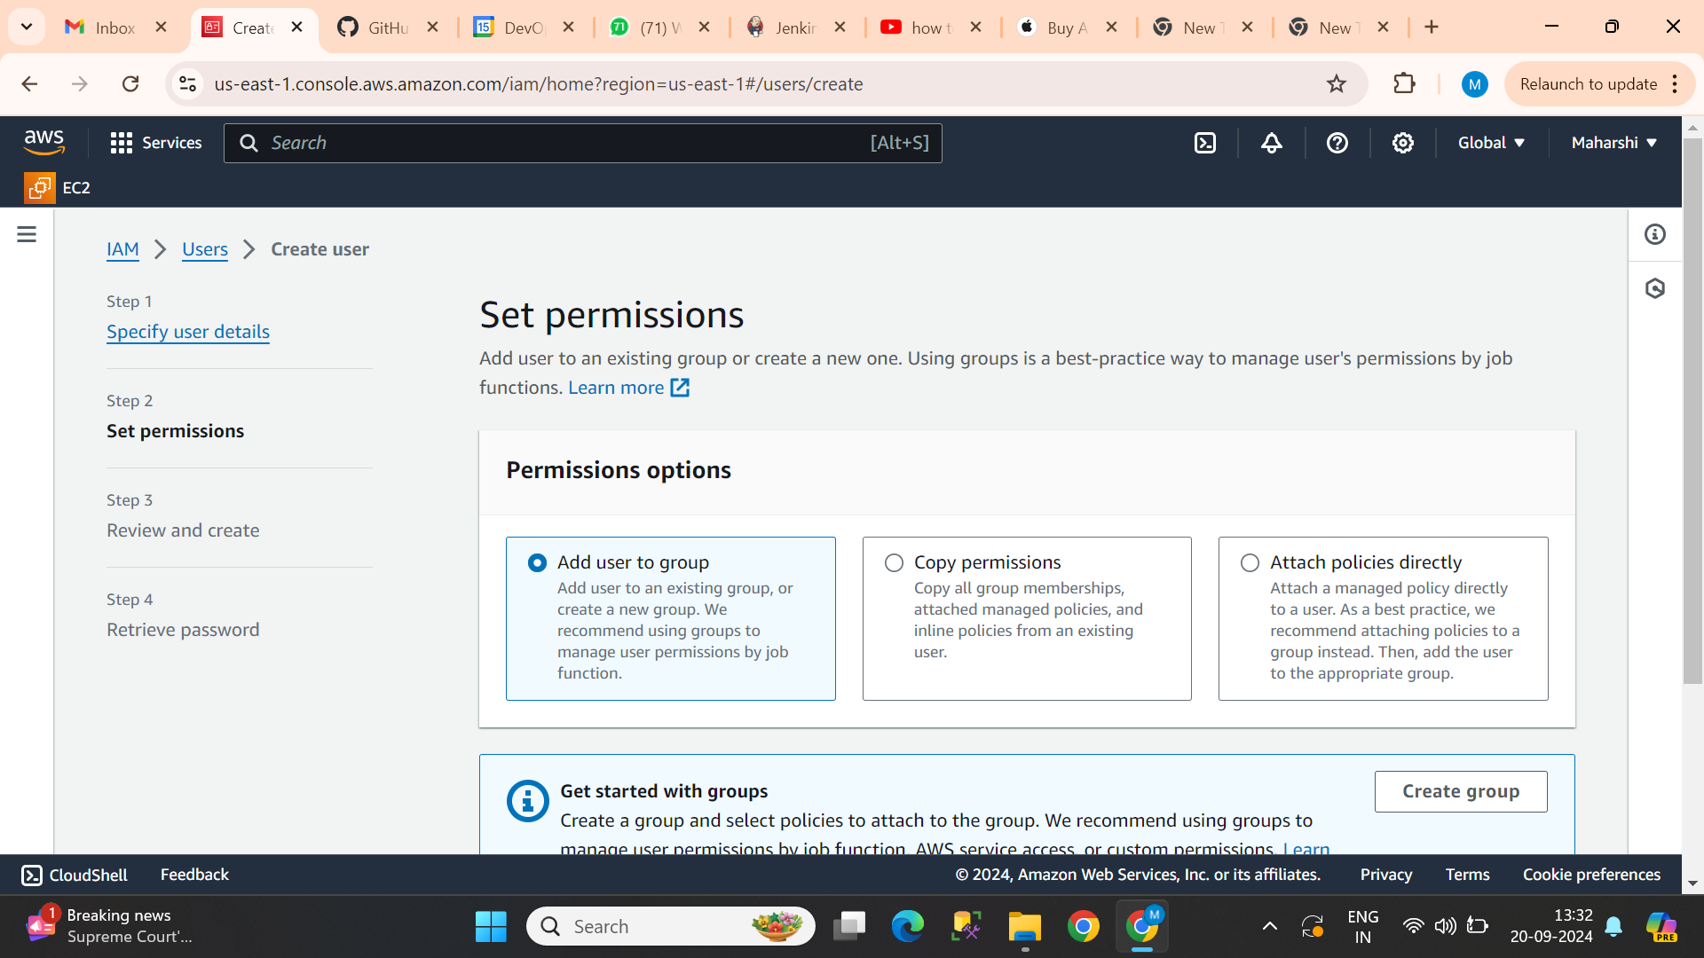
In

Slide 2
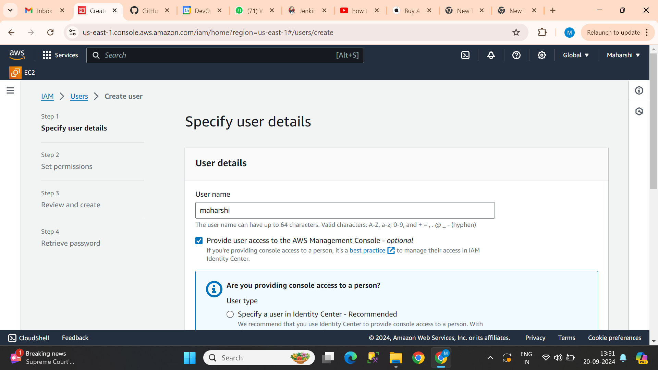
Then after u can see the above image Give user name Then select the option provide user access to the AWS management

Slide 3
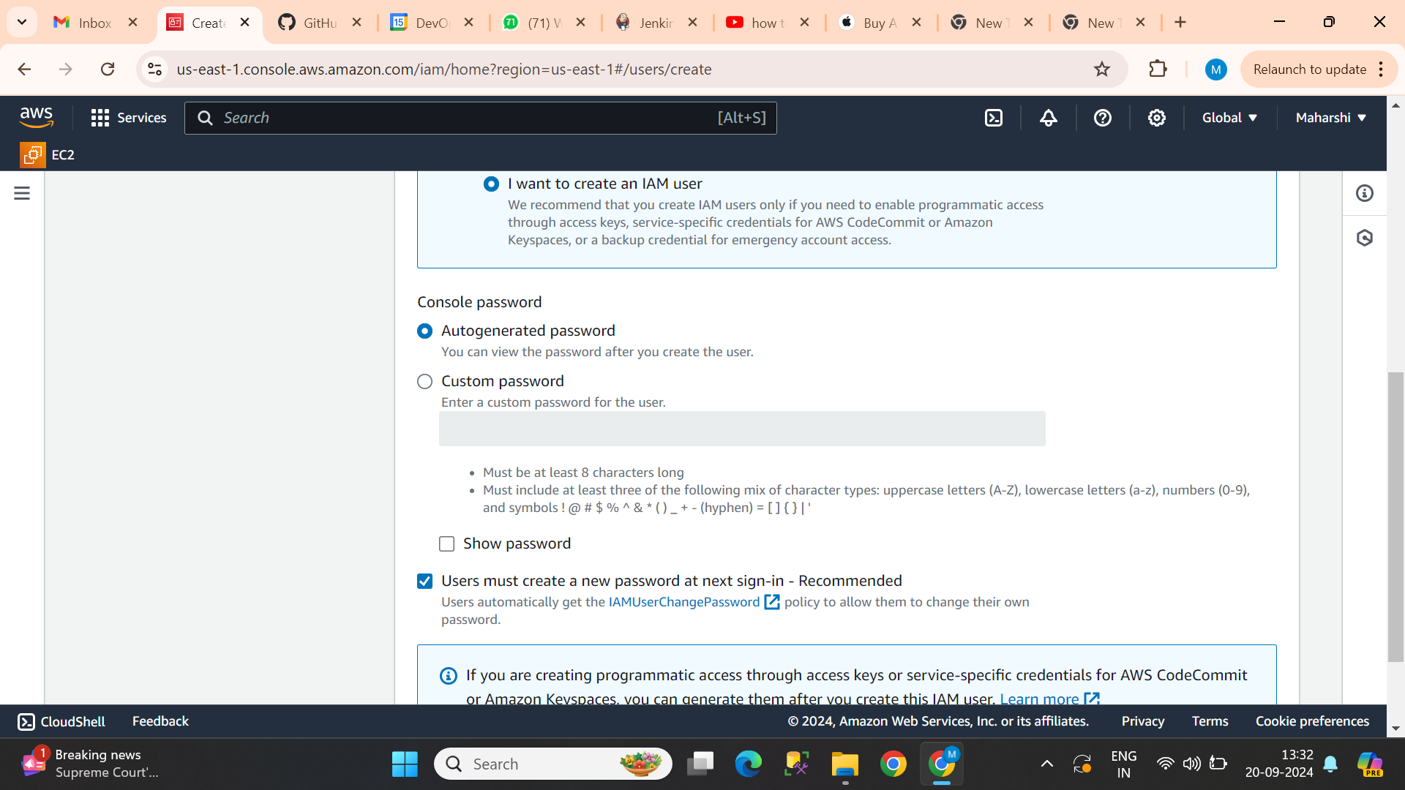
Then select the option I want to create an Iam user then select auto generated password then click on the users must be created a new password

Slide 4
Then click on the Attach Policies directly

Slide 5
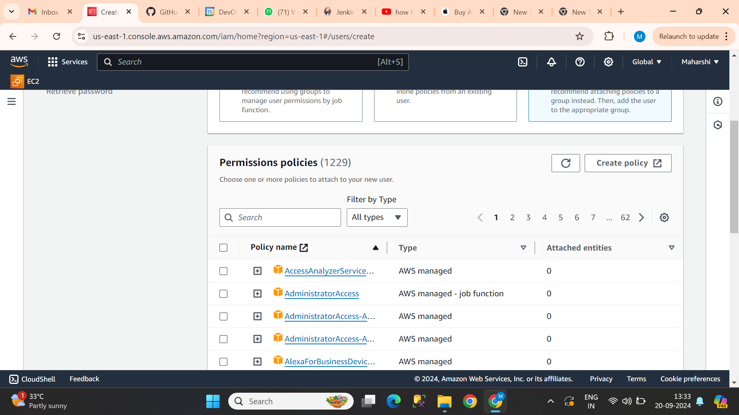
In the permission polices search bar search whatever u want give access permission like EC2,S3,code commit and more over 224 services

Slide 6
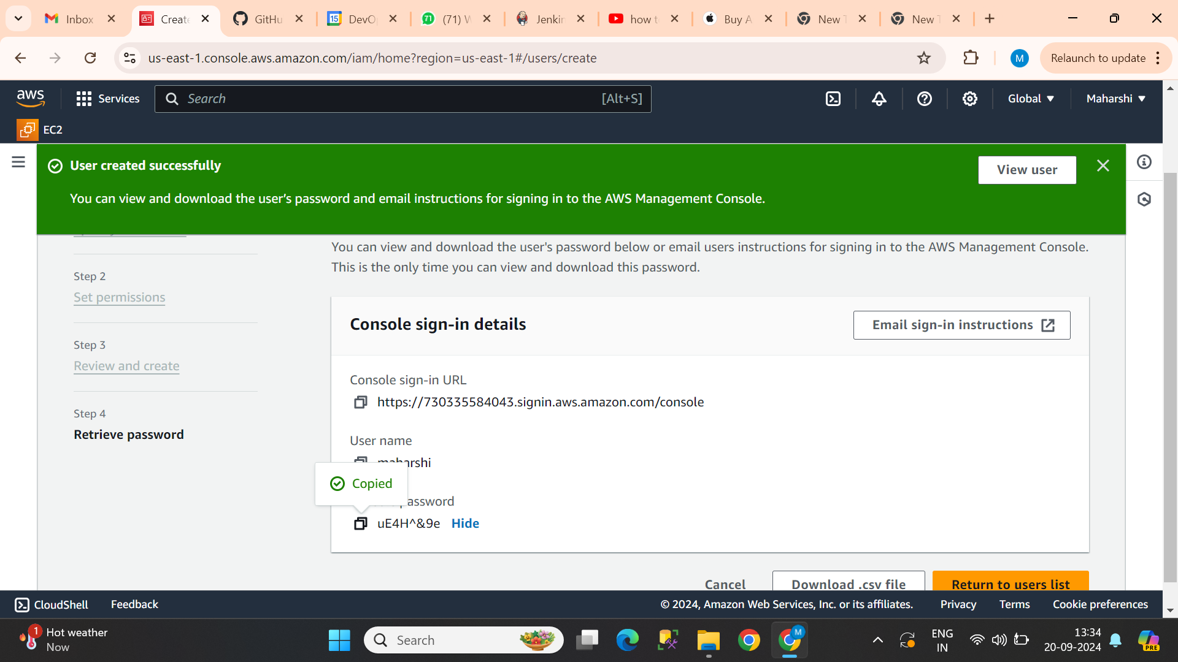
After permission policies IAM will ce created Then copy the console sign in url and password

Slide 7
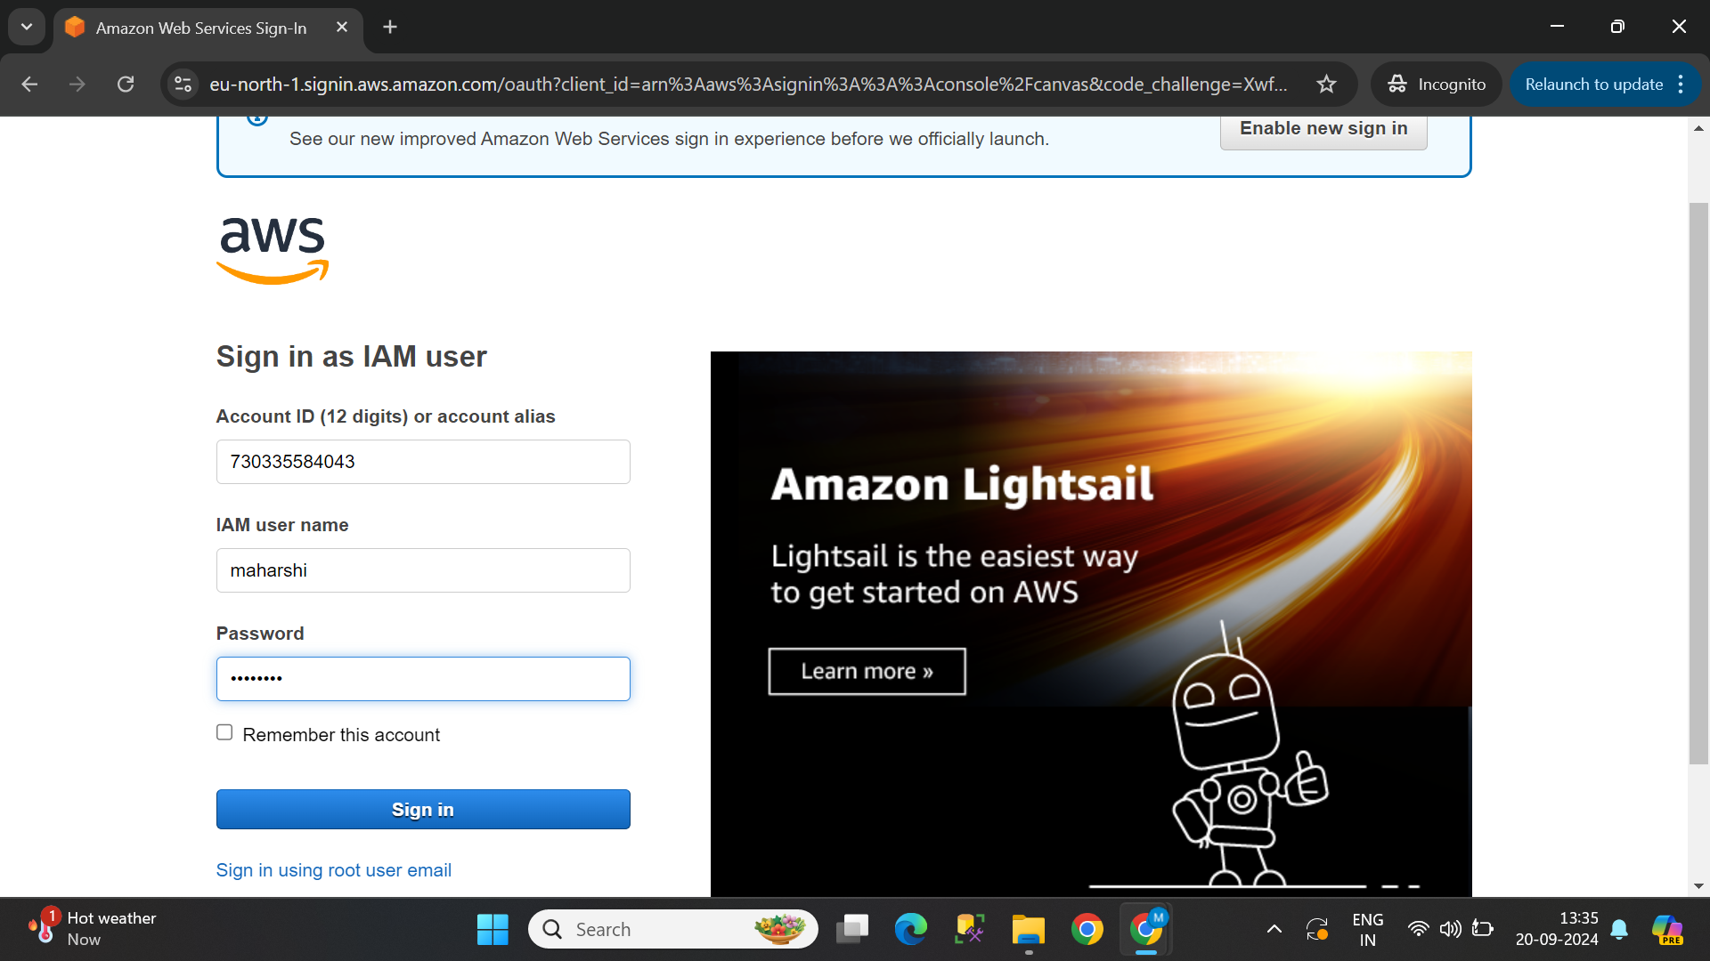
Then after open incognito tab and paste the url in search bar Then after u can see the above page Enter user name and password

Slide 8
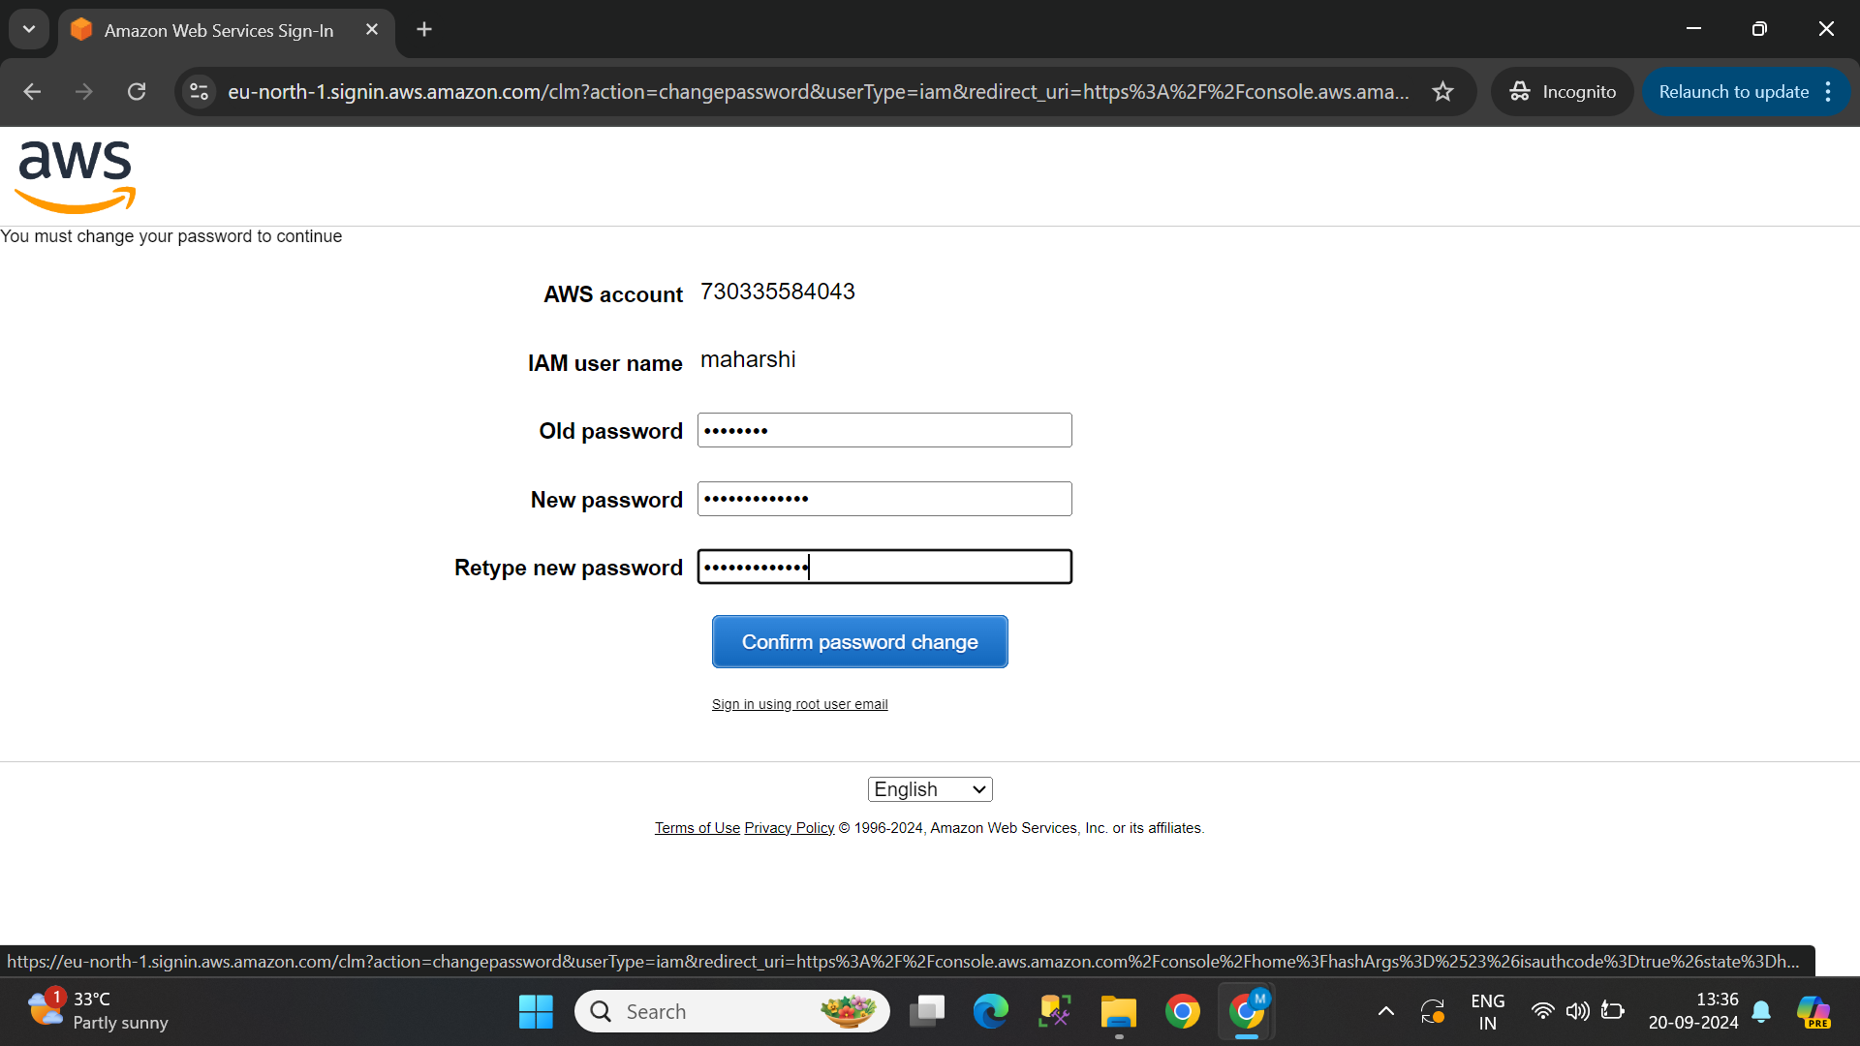
Then give the old password and enter new password and confirm change password

Slide 9
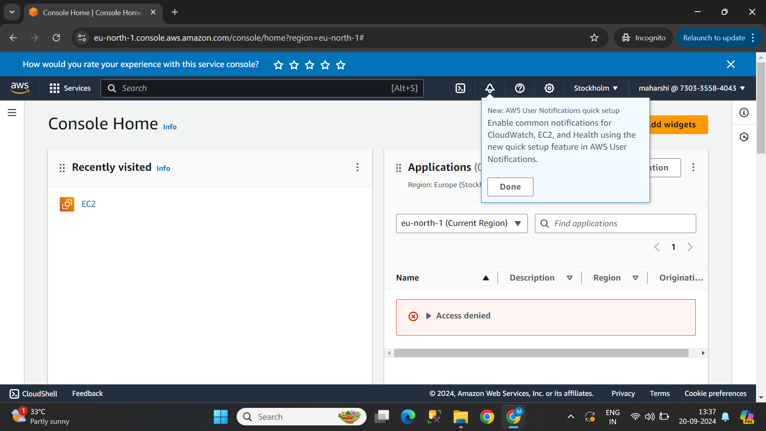
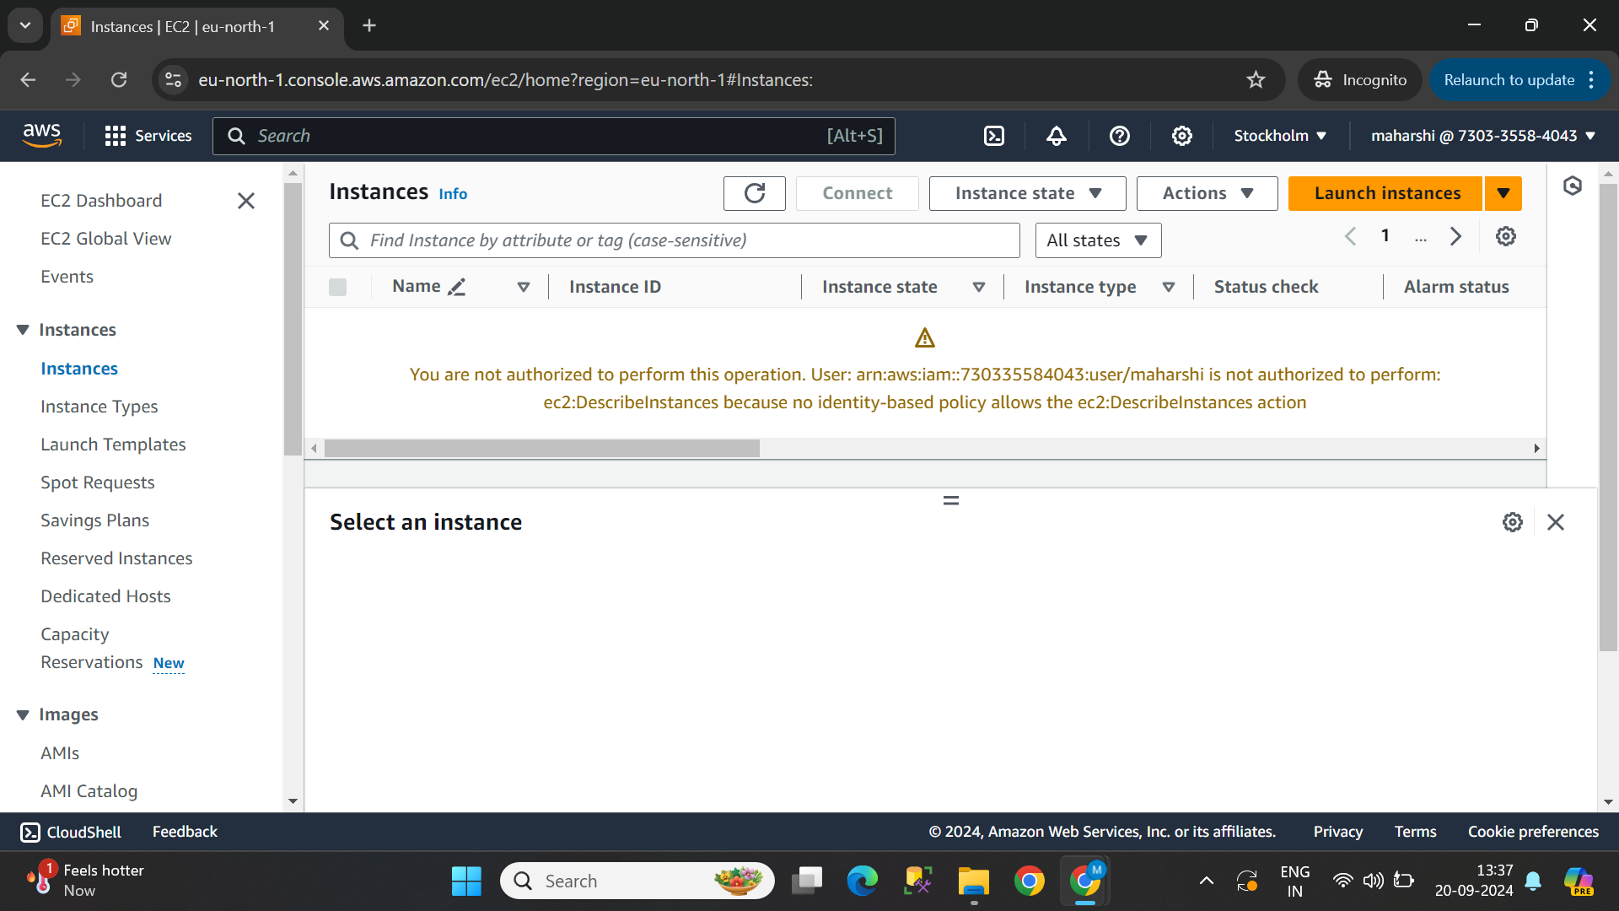
After the password change u can see the above image that your IAM has been created and the policies that u gave access will be opened.

