Slide 1
MAHATMA GANDHI INSTITUTE OF TECHNOLOGY Department of Computer Science and Engineering
Major PROJECT PRESENTATION
IMAGE PLAGIARISM DETECTION USING COMPRESSED IMAGES
Presented By:
V SANDEEP
18265A0512
Mentor:
MS M MAMATHA

Slide 2
Problem Statement
Plagiarism is the practice of copying someone else’s work or ideas, and passing them off as one’s own original work. Not only images but, architecture, flow diagram, UML diagrams, even snapshots of test results can be plagiarized. If the author has not mentioned the credit for the original author from where he/she copied the image then it is said to be plagiarized.
Previously lot of work is done to detect the plagiarism, but now in this i make an attempt to detect difference between images using image subtraction.

Slide 3
Existing Problem
Existing System:
The existing system uses Content-Based Image Retrieval (CBIR) is a kind of feature extraction method which uses may contents of an image like shape, colour, texture for representation and indexing of image.
The system has the vulnerability of re-sizing, compression and colour differentiation.
CBIR requires lot of work to detect whether the images are plagiarized or not.

Slide 4
Proposed Problem
Proposed System:
In the proposed system it uses FMM(Five modulus method) algorithm. The FMM (Five Modulus Method) algorithm converts an random image into 8*8 block matrix. I have used FMM for compression as the intended data which is required is not lost in this method
The proposed work mainly focus on finding the similarity between two images. Sample image is given as the reference and it is compared with the other image which is taken from any journal and comparison is done through histogram.
Histogram is the best way to visualize the largest intensities of an image. It is used to find the problems which originate during image acquisition such as exposure, contrast etc.

Slide 5
DESIGN METHODOLOGY
Implementation of OpenCV,Matplot and Django
Take the input from the Database.
Preprocessing of the Data i.e., Resizing, Grey scaling, Binarization.
Perform Histogram on Pre processed Images
Compare the results
Display the result whether image is Plagiarized or not.

Slide 6
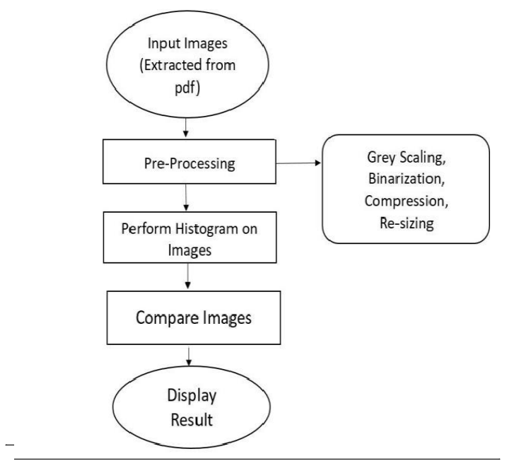
FLOW CHART

Slide 7
ALGORITHM
FMM Algorithm
The basic idea in FMM is to check the whole pixels in the 8×8 and transform each pixel into a number divisible by 5 according to the following conditions.
if A(i,j) Mod 5 = 4
A(i,j)=A(i,j)+1
Else if A(i,j) Mod 5 = 3
A(i,j)=A(i,j)+2
Else if A(i,j) Mod 5 = 2
A(i,j)=A(i,j)-2
Else if A(i,j) Mod 5 = 1
A(i,j)=A(i,j)-1
for i in range(rows):
for j in range(cols):
k = img[i,j]
k = k / 5
img[i,j] = k
temp = img.ravel()
temp = np.min(img)

Slide 8
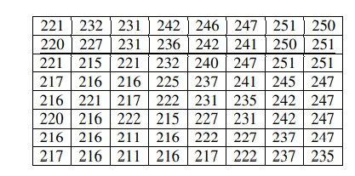
TABLE 1 sample 8 x 8 Matrix

Slide 9
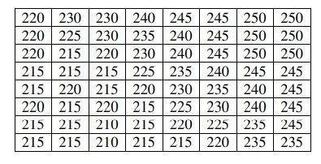
TABLE 2 Transformed block matrix using FMM

Slide 10
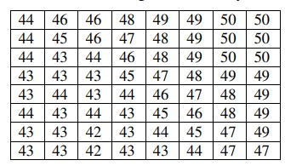
TABLE 3 Dividing FMM block by 5

Slide 11
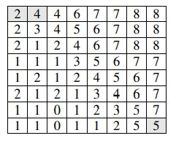
TABLE 4 AFTER SUBTRACTING MINIMUM

Slide 12
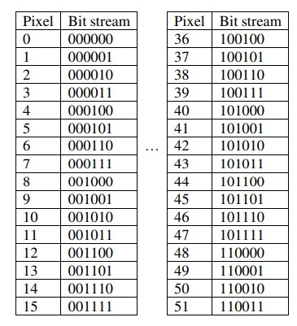
Clearly, as we know that each number 0-255 is stored at 8-bits location (1 byte). After transformation into FMM and making each number between 0-51 (255/5=51) and this can be shown in table as

Slide 13
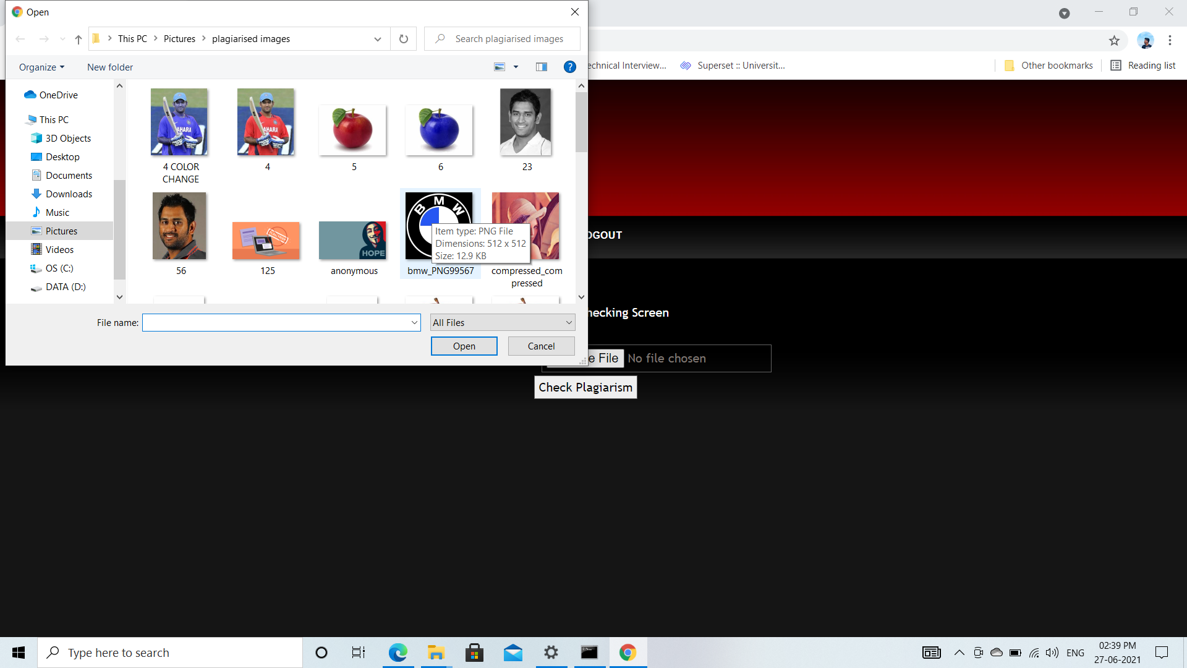
RESULTS

Slide 14
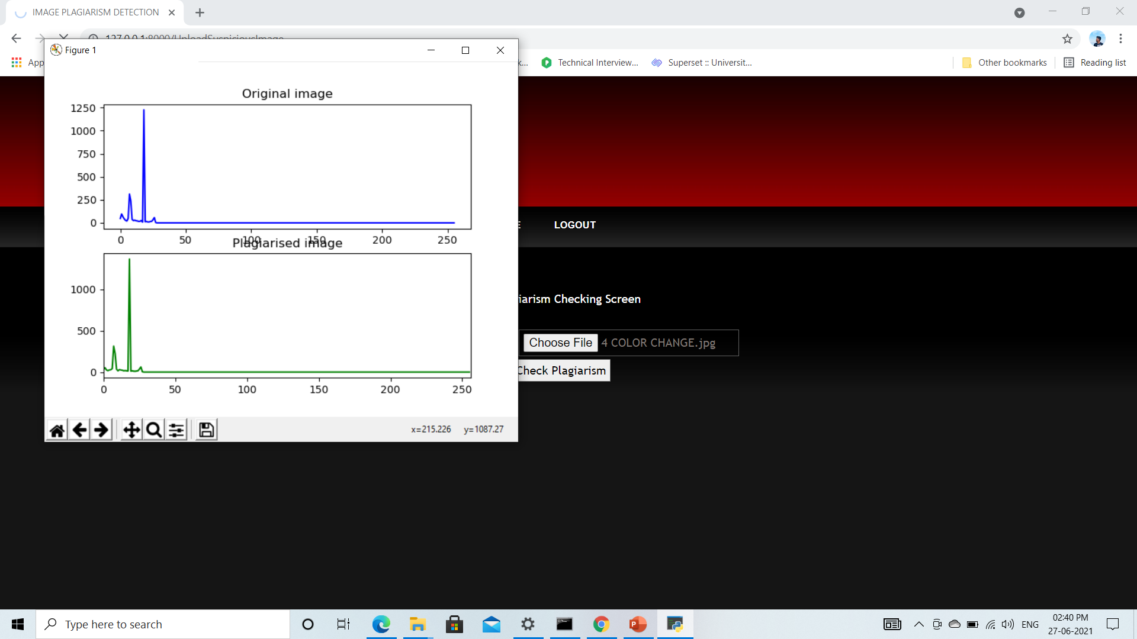

Slide 15
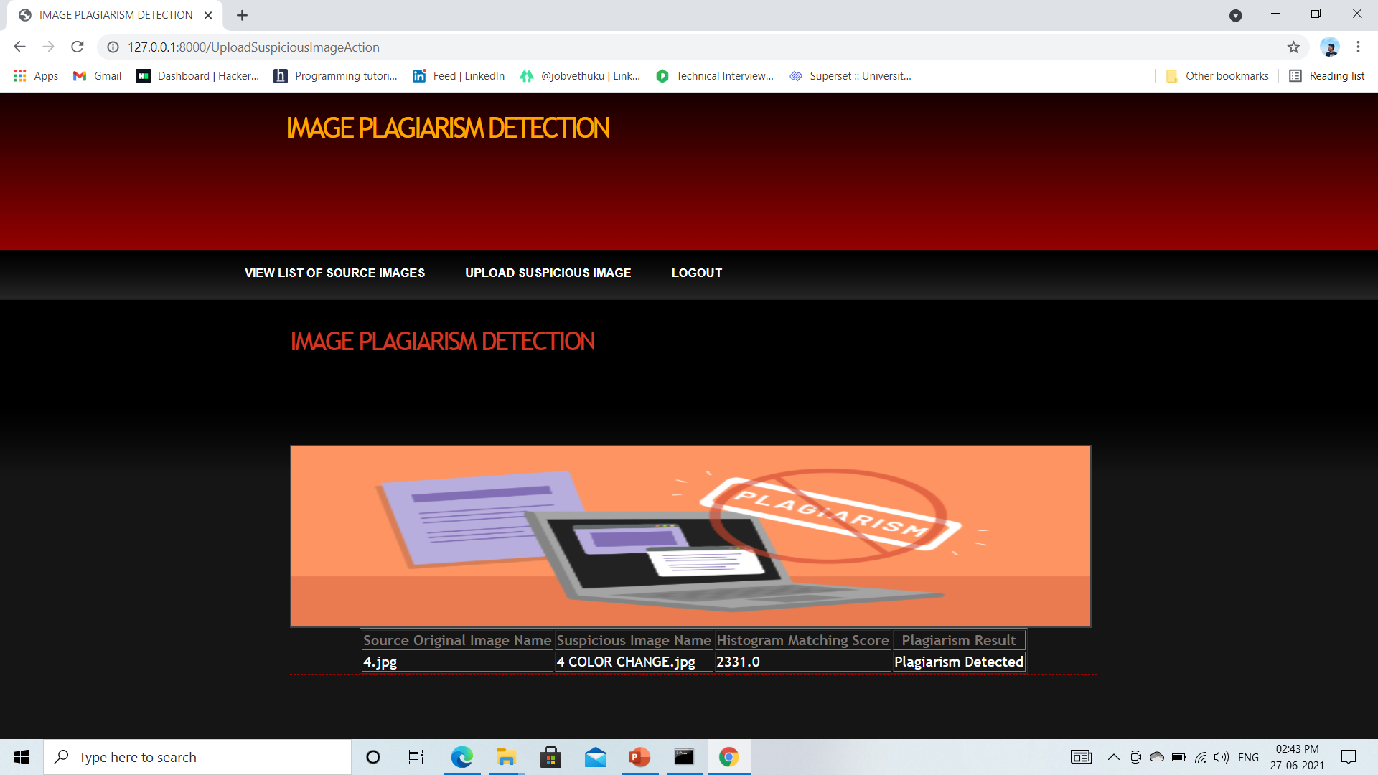

Slide 16
Conclusion
At last we conclude that we are able to detect the plagiarism in color transformed and resized images.

Slide 17
References
https://ieeexplore.ieee.org/document/9250940
https://www.researchgate.net/publication/334226542_Image_Plagiarism_Detection_using_Compressed_Images

Slide 18
THANK YOU

