Slide 1
PensiunAPP
Capstone Project

Slide 2

Loading Screen

Slide 3
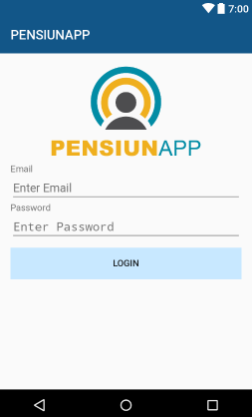
Login Screen

Slide 4
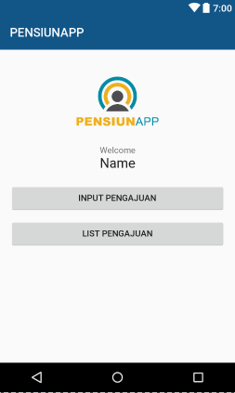
Home Manager

Slide 5
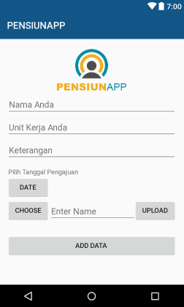
Pengajuan Manager

Slide 6
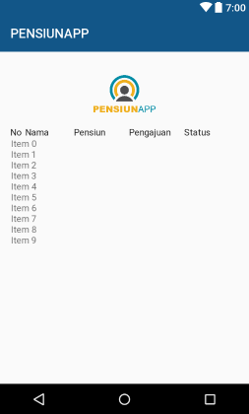
List Pengajuan Manager

Slide 7
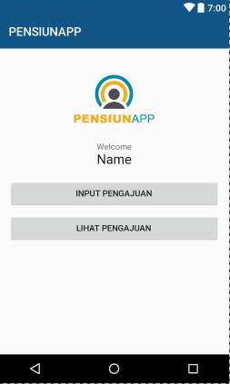
Home Karyawan

Slide 8
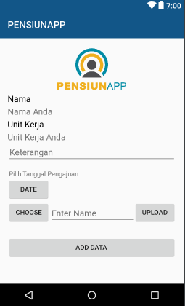
Pengajuan Karyawan

Slide 9
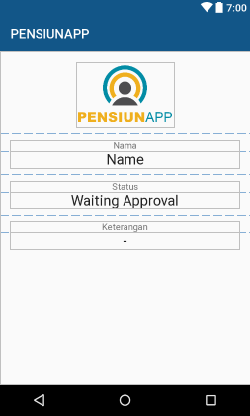
Lihat Pengajuan Karyawan

Slide 10




About
https://github.com/vanard/PensiunApp
https://vanard.github.io/
http://vianrd.student.telkomuniversity.ac.id

