Slide 1
Tunneling UDP packets through SSH to improve VoIP security
Sameer Jain
Saeesh Sinai Kakodkar
Viren Sinai Nadkarni
Pranav Prem

Slide 2
MOTIVATION AND SOFTWARE REQUIREMENT SPECIFICATION

Slide 3
Analyzed Existing VoIP solutions for Flaws
Achieving end-to-end security in a VoIP session is a challenging task
Though every popular VoIP service has their own strength, the security they offer is way below the ‘expected’ and ‘publicised’ levels
No VoIP service has capabilities to stop unprivileged participants of the network to perform traffic analysis and determine when one user calls another user.
There is scope for more improvement in VoIP network security.

Slide 4
Initial Prototype
An initial prototype capable of carrying out basic VoIP function was developed. It was capable of switching between UDP and TCP modes of transmission to analyse the performance effects of using TCP versus UDP in VoIP. The Microsoft Network Emulator for Windows toolkit was used to simulate real life network conditions.

Slide 5
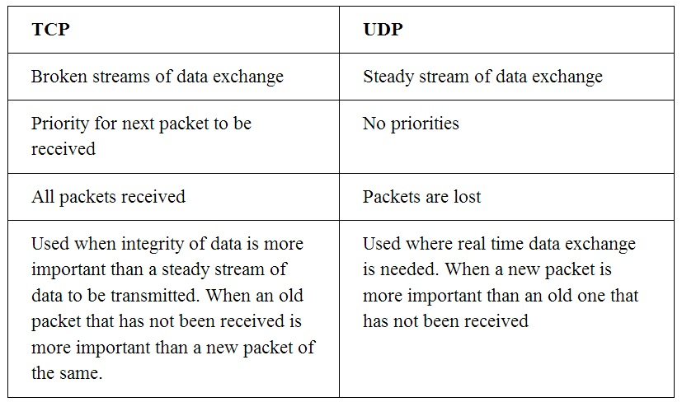

Slide 6
Software Requirement
Reliable transmission of data
Steady stream so that there is no stutter or lag
Secure data transmission
Mechanisms to improve upon the flaws in the existing VoIP solutions

Slide 7
DESIGN

Slide 8
Alternate Tunneling Practices
TOR Protocol
Complete anonymity over the world wide web
TOR circuit is established with relays between a source and destination
SOCKS5 tunnel proxy server proxies TCP connection to an arbitrary IP address and provides a means for UDP packets to be forwarded.

Slide 9
Alternate Tunneling Practices
VPN Tunneling - PPTP and L2TP
VPN tunnels use 2 major protocols: PPTP Point to Point Tunneling Protocol and L2TP Layer 2 Tunneling Protocol
PPTP uses a TCP connection to setup manage and maintain a tunnel and encapsulates packets into PPP Point to Point Packet format
L2TP establishes and maintains connections using UDP and transmits UDP packets.
Both tunnels implementation can use encryption and compression.

Slide 10
Comparison
The system implements proxy solution similar to that of SOCKS5 used by TOR by NAT address translating the destination addresses and ports of UDP packets
The system implements a TCP tunnel establishment similar to PPTP and encapsulation similar to L2TP for transmitting UDP packets with additional encryption

Slide 11
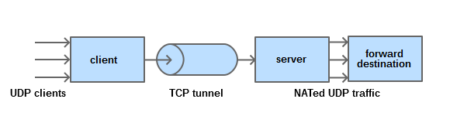
Tunnel Architecture

Slide 12
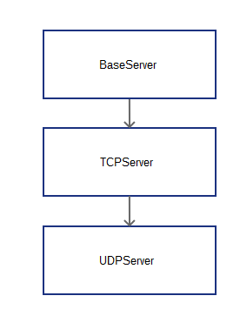
Tunnel Architecture
Socket Servers
The SocketServer module simplifies the task of writing network servers.
Provides 2 basic server classes: TCPServer and UDPServer
Classes process requests synchronously; each request must be completed before the next request can be started. This isn’t suitable if each request takes a long time to complete, because it requires a lot of computation, or because it returns a lot of data which the client is slow to process.

Slide 13
Tunnel Architecture
Encapsulation
Serialization is flattening objects
Raw packets are serialized before sending to other end of the tunnel
This is achieved by pickle, a standard Python library.

Slide 14
Tunnel Architecture
Security
Supports recommended symmetric encryption algorithms (AES, Blowfish, CAST, 3DES).
By default uses AES 256 on Cipher Block Chaining.

Slide 15
Tunnel Architecture
Threading
System is fully threaded.
Resource locks are used maintain mutual exclusion.

Slide 16
DEMO

Slide 17
Testing Phase
White Box:
Unit testing
Integration testing
Validation testing
Black Box:
Security testing
Load testing (comparison with pure UDP solution)
Endurance testing
Comparison testing (comparison with existing tunneling solution- TOR)

Slide 18
White Box Testing
Unit Testing
Individual units of source code, sets of one or more computer program modules together with associated control data, usage procedures, and operating procedures are tested.
Since the entire system was made in the form of modules, each module was tested individually post development of said module.

Slide 19
Tunnel Unit
The ports and address links for the end points of the tunnel were left open and dynamically set while the module ran along with text data that was transmitted via the tunnel to observe results.
The log messages were found to be in appropriate order and displayed at constant and desired intervals of time to show the packets of text were being transmitted appropriately over the tunnel.

Slide 20
Cryptography Unit
Packets were encrypted according to various encryption algorithms and their encryption was examined to see if it follows encryption standards
All encryption standards were met with the cryptography module and they were all tested and examined.
Random Number Generators for the cryptography algorithm requirements is generated using POSIX random number generator instead of python’s random number generator

Slide 21
Communication Unit
The communication unit has classes that deal with each independent task related to communication such as a class for sending and receiving text, a class for sending and receiving voice data a class to handle all log messages etc.
Each class is individually tested by exchanging data that the class handles to see if it works independent of all classes.
Each class is found to be syntactically correct and working independently of all other class when run in the software.

Slide 22
GUI Unit
The GUI elements such as tabs, text and checkboxes were found to be working independent of the main module and the GUI was successfully able to manipulate a configuration file.

Slide 23
Integration Testing
Communication module integrated with tunnel module and tested
Cryptography module integrated into system and tested
GUI module integrated into system and tested
The entire system is found to be working as desired by transmitting text and voice over the designed hybrid tunnel to implement security.

Slide 24
Verification and Validation control
A tunnel is being used as specified to optimally transmit UDP packets.
The tunnel is integrated with a VoIP solution as specified and found to be transmitting voice as desired.
The tunnel is integrated with a cryptography module that provides security and encryption features similar to that of SSH as specified.
As specified, all UDP packets through the tunnel are encrypted and optimized for best possible performance.

Slide 25
Black Box Testing
Security testing
Load Testing
Endurance Testing
Comparative Testing

Slide 26
Security Testing
Wireshark Test
Encrypted packets obtained
Since all packets were sent via the tunnel intercepting them once they enter the tunnel was found to be infeasible.
The only packet interception was found to lie outside the tunnel system in the application since before entering the tunnel, packets are not encrypted and thus exposed

Slide 27
Load Testing
TEST NUMBER | NO OF PACKETS SENT | NO OF PACKETS RECEIVED
1 | 10,000 | 9915
2 | 10,000 | 9913
3 | 10,000 | 9922
4 | 10,000 | 9920
5 | 10,000 | 9920

Slide 28
Endurance Testing
NETWORK LOSS % | DELAY ( in ms)
0 | 83
10 | 87
20 | 93
30 | 95
40 | 99
50 | 115
60 | 124

Slide 29
Comparative Testing
On comparing the results of the tests to that of similar tests done on the TOR network it is seen that the hybrid tunnel is faster than the TOR tunnel.
The TOR circuit takes time to setup while the system requires little setup. There is no circuit establishment needed in case of the system whereas TOR needs to establish a circuit.

Slide 30
Alpha Testing And Debugging
Alpha testing is simulated or actual operational testing by potential users/customers or an independent test team at the developers' site.
Testing, debugging and optimization revealed a bug in the system i.e., unlike TCP which can accept packet of any size with the range specified in the RFC, UDP needs a fixed packet size owing to the fact that packet size is not a parameter in a UDP header. This bug was immediately fixed by specifying a packet size within the tunnel.

Slide 31
Beta Testing and Feedback
Beta testing comes after alpha testing and can be considered a form of external user acceptance testing. Versions of the software, known as beta versions, are released to a limited audience outside of the programming team.
The system was implemented amongst a small group of students and their usage of the system was monitored by their feedback.
While most end users were oblivious to the tunnel and coding, some were interested in the ability to use the tunnel to run apps that needed real time UDP data transfer that is normally blocked by the firewall.

Slide 32
Tools Used
Python Debugger
Post mortem debugging and live debugging using Pdb module of python to debug the code
NEWT
NEWT (Network Emulator for Windows Toolkit) is a software-based emulator which can emulate the behavior of both wired and wireless networks using a reliable physical link, such as an Ethernet

Slide 33
Conclusion
Existing tunneling solutions were tested for flaws.
Initial prototype concluded that choice between TCP and UDP is specific to the application in question.
A new specification for a customised tunnel were proposed.
A VoIP system was made which utilised the said tunnel.

Slide 34
Conclusion
The system was extensively tested.
It was concluded that the proposed system performs much better with datagrams.
Industry standard encryption algorithms provide state of the art security.

Slide 35
Future Scope
The proposed system can be adapted to be used in other cases where datagram traffic is preferred over packet data in TCP format.
Establishing connections with Access Points (both wired and otherwise) involves password exchange using datagrams that are currently not secure enough
License exchange in original software purchases are done with datagrams.
All other real-time data transfer takes place on a UDP connection and the system provides a means to secure all such channels such as live multiplayer gaming and live streaming.

Slide 36
References
[1] Thomas J. Walsh, D. Richard Kuhn, Challenges in Securing Voice over IP: IEEE Security & Privacy Magazine, May/June , 2005
[2] Osamu Honda, Hiroyuki Ohsaki, Makoto Imase, Mika Ishizuka, Junichi Murayama, Understanding TCP over TCP: Effects of TCP Tunneling on End to End Throughput and Latency: Proceedings of the SPIE, Volume 6011
[3] Dingledine, Roger; Mathewson, Nick; Syverson, Paul; Tor: The Second Generation Onion Router. 13th USENIX Security Symposium. San Diego, California, 2004
[4] RFC 2341 - Cisco Layer Two Forwarding (Protocol) "L2F"(a predecessor to L2TP)
[5] RFC 2637 - Point to Point Tunneling Protocol (PPTP)
[6] RFC 768 - User Datagram Protocol
[7] RFC 793 - TCP v4[8] RFC 675 - Specification of Internet Transmission Control

Slide 37
Certifications
Paper Presented at 7th IETE Conference on RF and Wireless organized by IETE Bangalore at HKBK College of Engineering, Bangalore on “A Transmission Control Tunnel for Datagrams” which specified the details of the hybrid tunnel being used.
Certificates copies attached to Report.

Slide 38
THANK YOU

