Slide 1
Calculation and visualization of anatomical inertial parameters from raw CT scan data
Bruce Yang

Slide 2
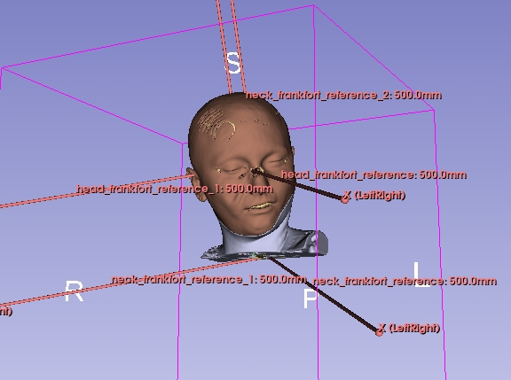
Background
1. Why do we calculate inertial parameters?
Inertial parameters (mass, volume, centre of mass, and moment of inertia) form the foundation for applications such as biomechanical simulation, human body modeling, and helmet design.
2. Why do we use DICOM(Digital Imaging and Communications in Medicine) files?
Accurately reflects anatomical structures and is suitable for high-resolution voxel-based modeling.
Mass
Volume
Density
DICOM
voxel
voxels
Mass distribution

Slide 3

Objective
The goal is to obtain a dataset of inertial parameters for children's heads.
No computational tools available
Previous calculations were based on cadavers
We don’t have access to cadavers, and even obtaining standard DICOM files is extremely difficult.
Manual segmentation of different anatomical structures is challenging

Slide 4
Methodology
Format conversion(NIFTI)
Segmentation(Skull, brain, skin)
Inertial parameters
separation(neck and head)
Segmentation(Mask)
DICOM files
Build reference(Global, Frankfort)
VTK(3D visualization)
Calculation
AutoSlicer
*NIFTI: Neuroimaging Informatics Technology Initiative

Slide 5
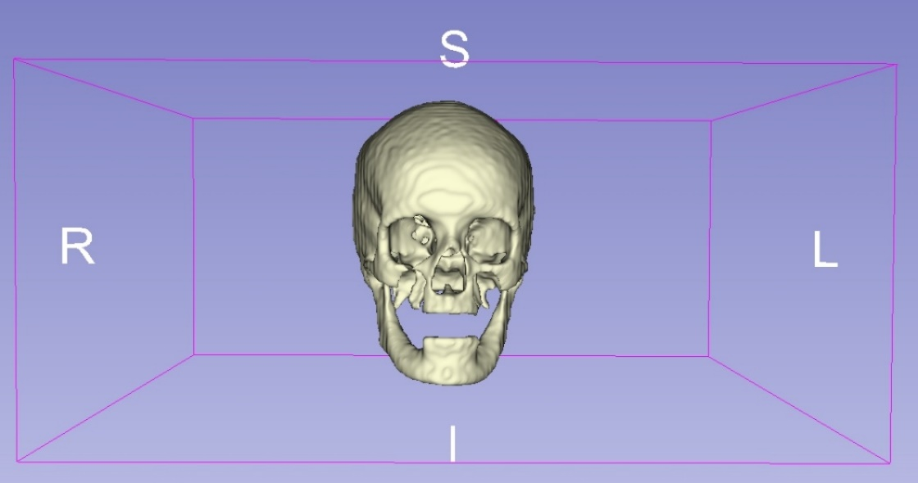
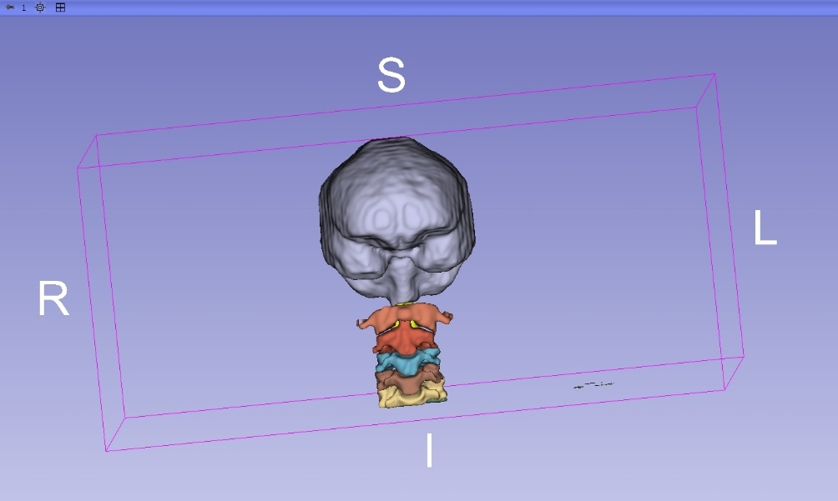
Methodology
1. What do we use to segment anatomical structures?
TotalSegmentator is a tool for anatomical structure segmentation that can identify 117 distinct structures in the human body. We use it to extract brain structures and bone components.

Slide 6
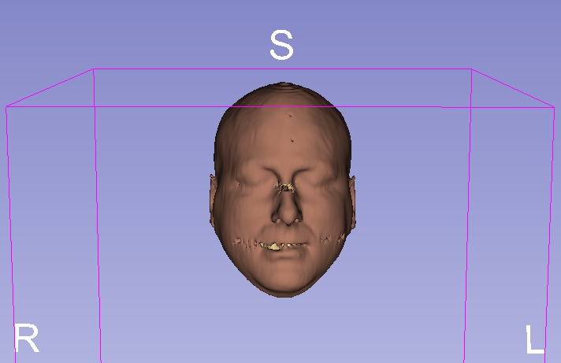
Methodology
2. How do we get the skin segmentation?
Auto Estimation of HU Range for Skin Labeling(5th and 95th)
Load CT Data:
Read the DICOM series and extract the full 3D volume of HU values.
2. Filter Soft Tissue Range:
Select HU values between -300 and +400 to exclude bone and air.
3. Trim Outliers:
Use the 5th and 95th percentiles to remove extreme values.
4. Set Thresholds:
Define the HU range for skin based on the filtered values.
5. Apply Skin Label (Label 118):
Assign this label to all unlabeled voxels within the estimated HU range.
Outliers
5%
95%
Outliers

Slide 7
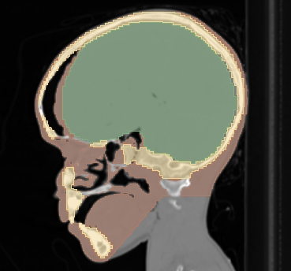
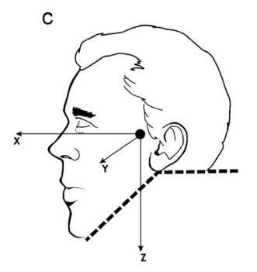
Methodology
3. How do we separate the head and neck?
Chandler’s study(cadaver research):
The first cut follows a compound trajectory through the occipital condyle and C1 to separate the head from the neck.
The second cut runs along the surface of the mandible and merges with the first transverse incision(parallel to the mandible).
We essentially follow Chandler’s method, but with computational optimizations that allow the entire cutting process to be performed automatically by the computer.
Chandler Method Paper link: https://www.sciencedirect.com/science/article/pii/S0021929009001444

Slide 8
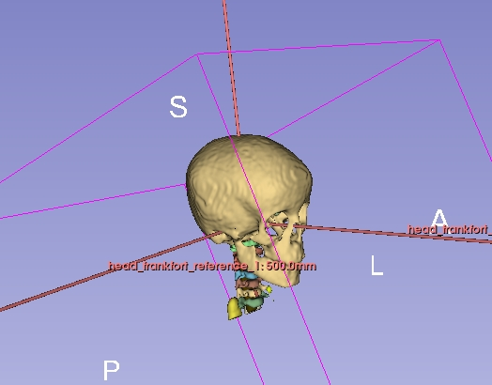
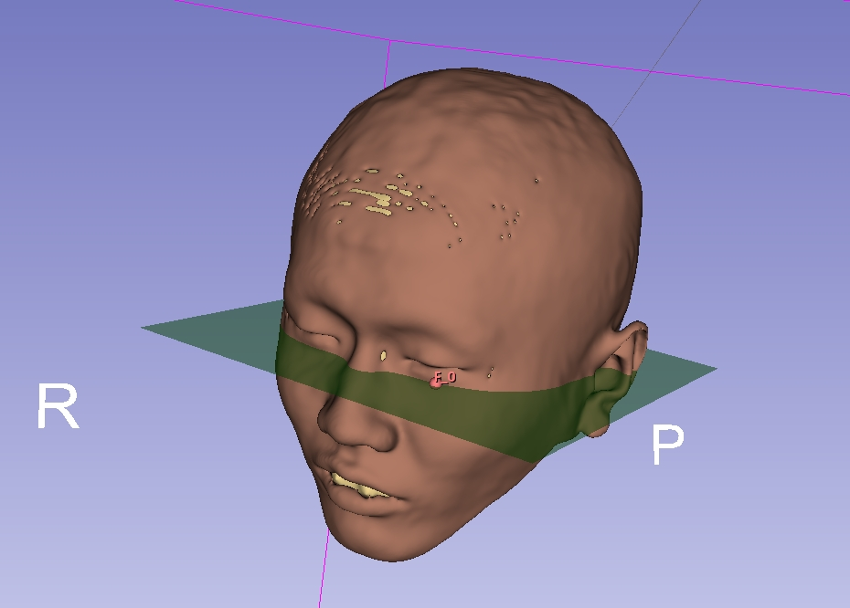
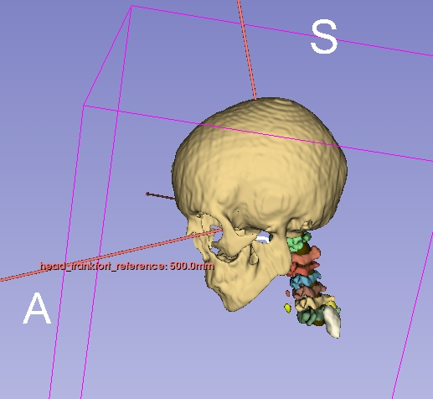
Methodology
4. How do we build the Frankfort reference?
Left ear canal top (Porion, left side)
Frankfort plane
Right ear canal top (Porion, right side)
Bottom of the eye socket (Orbitale)
The advantage of using the Frankfort plane is that it eliminates the influence of participant posture, allowing for a consistent and anatomically reliable determination of the centre of mass.

Slide 9
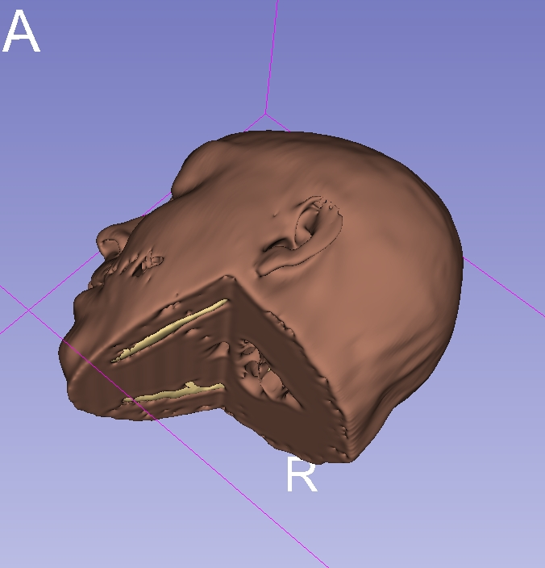
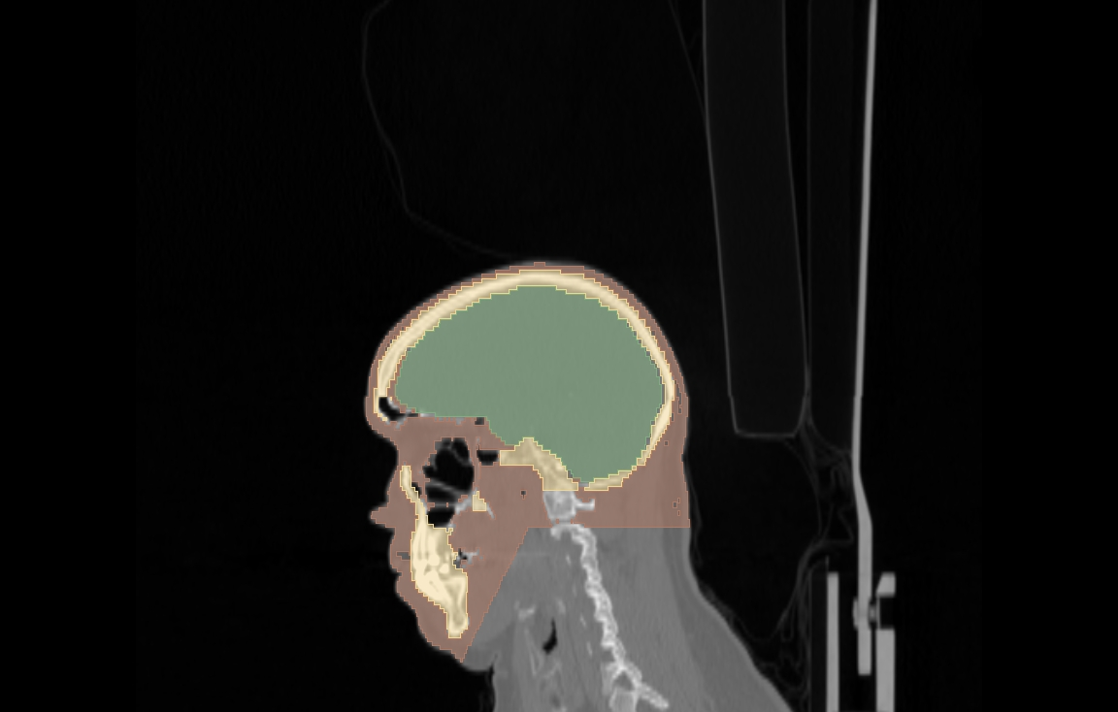
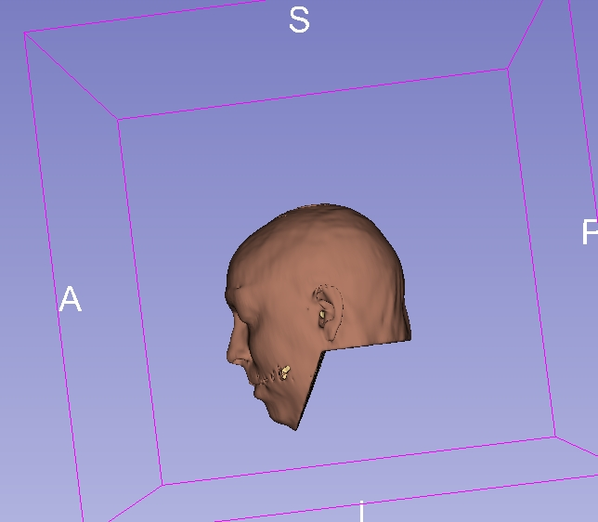
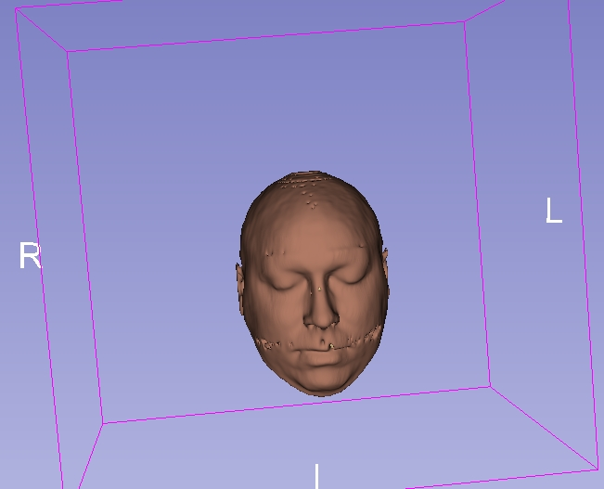
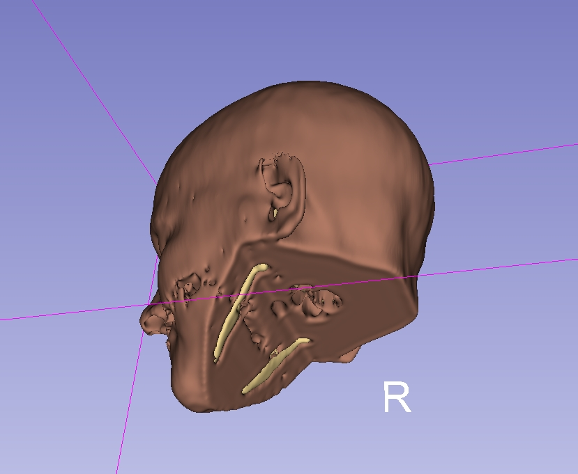
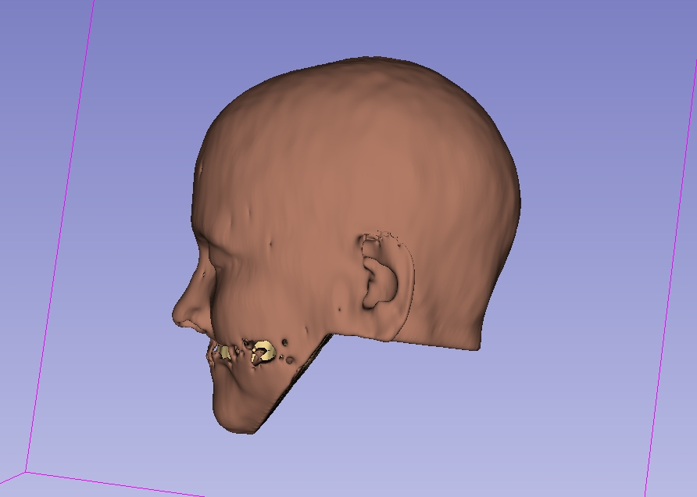
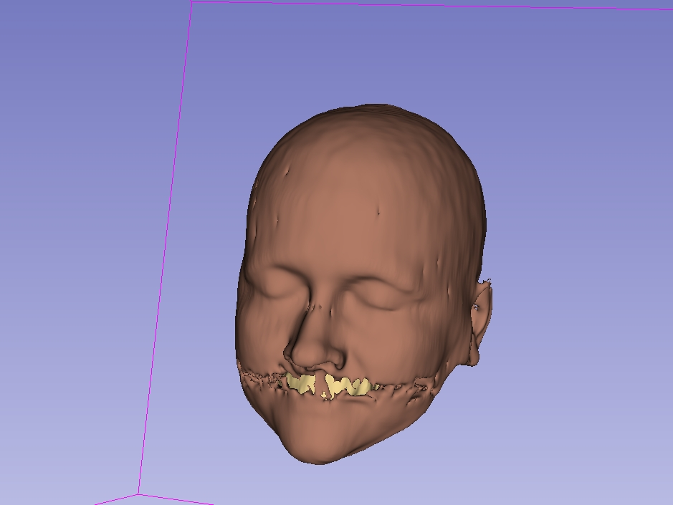
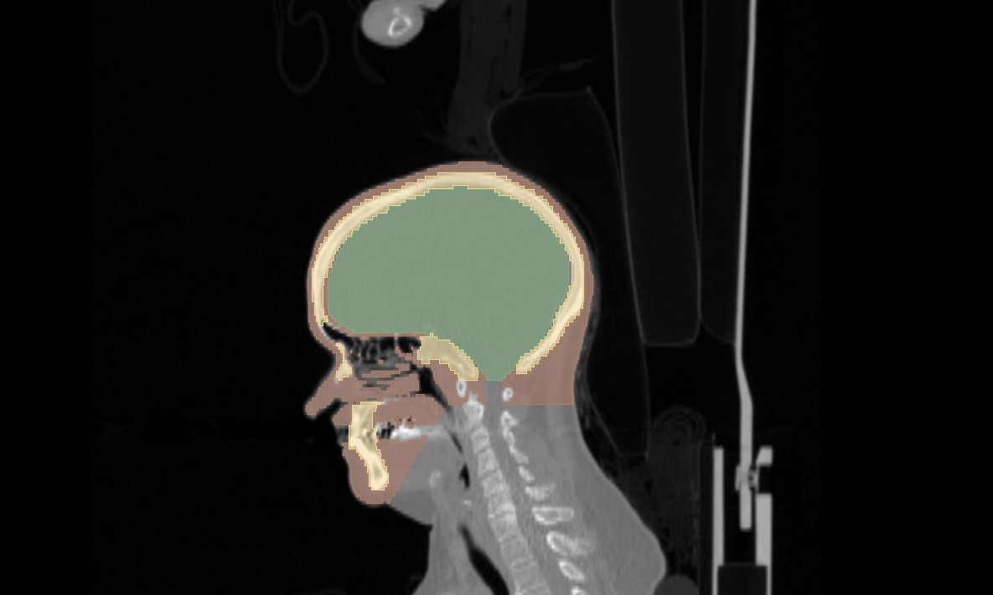
Result
1. Segmentation performance

Slide 10
Result
2. Adult dataset - Each adult has scan results from multiple time periods.
PatientGroup | PatientID | PatientSex | PatientAge | Volume_cm3 | Mass_kg | COM_x_mm | COM_y_mm | COM_z_mm | Inertia_xx_kg_cm2 | Inertia_yy_kg_cm2 | Inertia_zz_kg_cm2
001 | Healthy-Total-Body-CTs-001 | M | 078Y | 3567.099679 | 4.371417581 | 5.926277901 | -1.785917702 | 24.76638891 | 147.2422326 | 188.4507472 | 169.7303587
001 | Healthy-Total-Body-CTs-001 | M | 078Y | 3633.158364 | 4.436049514 | 5.560828443 | -0.819684065 | 22.61516611 | 150.0291862 | 192.4536443 | 173.0334657
001 | Healthy-Total-Body-CTs-001 | M | 078Y | 3544.338705 | 4.357171854 | 5.369815877 | -3.602316328 | 24.9791605 | 145.3039657 | 187.4731798 | 170.4909151
001 | Healthy-Total-Body-CTs-001 | M | 078Y | 3532.9381 | 4.34379986 | 5.553381635 | -0.900888253 | 24.40763703 | 144.6305349 | 186.1536025 | 169.6962621
001 | Healthy-Total-Body-CTs-001 | M | 078Y | 3613.057531 | 4.428866618 | 5.142159852 | -1.398742527 | 23.2943488 | 149.6455529 | 191.2448067 | 171.9197771
001 | Healthy-Total-Body-CTs-001 | M | 078Y | 3584.587314 | 4.40407542 | 6.21067735 | -1.722329685 | 23.87319748 | 149.6959862 | 190.5211689 | 170.9158561
001 | Mean |  |  | 3579.196616 | 4.390230141 | 5.627190176 | -1.70497976 | 23.98931647 | 147.7579097 | 189.3828582 | 170.9644391
001 | Std |  |  | 38.95831504 | 0.038435447 | 0.385034615 | 1.012998607 | 0.910316181 | 2.389404614 | 2.413964619 | 1.30777324
*Partial data shown - 10 samples

Slide 11
Result
3. Children dataset - The children's data is available from a single time point only.
PatientID | Sex | Age | Volume (cm³) | Mass (kg) | COM_x (mm) | COM_y (mm) | COM_z (mm) | Ixx (kg·cm²) | Iyy (kg·cm²) | Izz (kg·cm²)
15_4749 | Female | 10 | 2824.331 | 3.37 | 0.568 | 0.96 | 26.064 | 96.714 | 123.905 | 106.387
16_3745 | Male | 10 | 2826.91 | 3.352 | 1.578 | -1.357 | 30.817 | 95.089 | 115.258 | 102.785
14_0504 | Female | 11 | 2869.269 | 3.419 | 3.917 | -5.059 | 27.347 | 101.323 | 123.751 | 106.041
15_4579 | Male | 11 | 2836.286 | 3.383 | 0.695 | 0.951 | 25.783 | 97.242 | 124.52 | 106.657
19_4069 | Female | 12 | 2825.818 | 3.319 | 2.019 | -3.566 | 17.147 | 99.363 | 108.779 | 100.39
18_4807 | Male | 12 | 2765.757 | 3.358 | 8.81 | 9.66 | 32.123 | 97.73 | 116.666 | 100.402
16_0623 | Female | 13 | 2696.525 | 3.287 | 5.376 | -1.07 | 21.127 | 92.578 | 116.179 | 102.003
16_4092 | Male | 13 | 3483.739 | 4.219 | 8.203 | -2.955 | 27.616 | 143.656 | 176.769 | 146.718
17_3947 | Female | 14 | 2923.265 | 3.503 | 3.233 | -2.209 | 23.717 | 102.172 | 123.231 | 112.472
*Partial data shown - 30 samples totally (15F&15M)

Slide 12
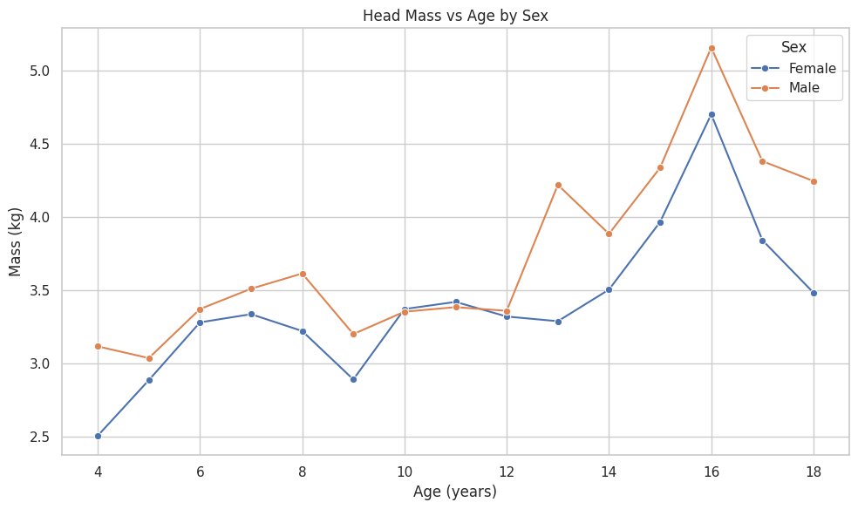
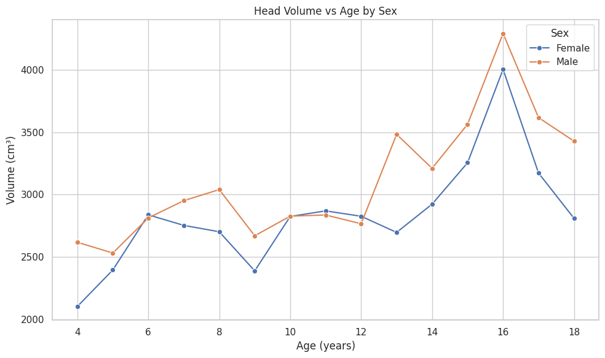
Discussion
1. Data exploration - mass and volume
Males generally show higher values than females, with an overall increasing trend. The head data for the two 16-year-old children are particularly large, primarily because of their high body weights 101kg for the girl and 123kg for the boy.

Slide 13
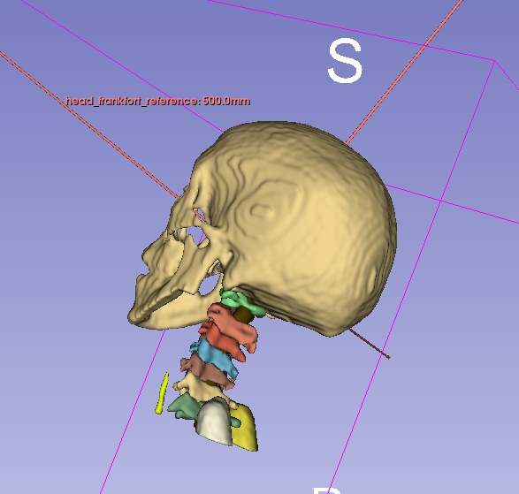
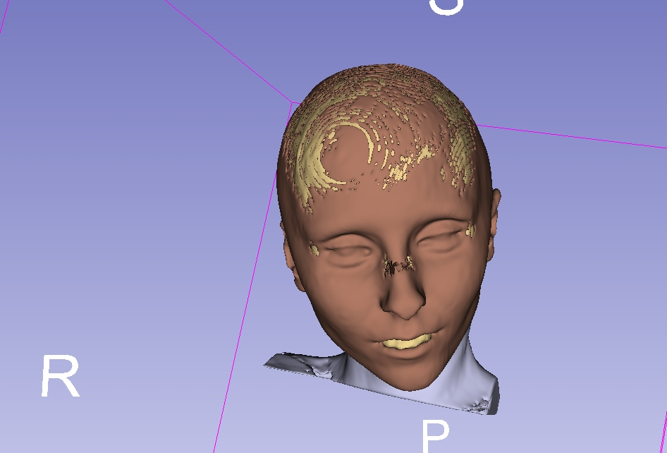
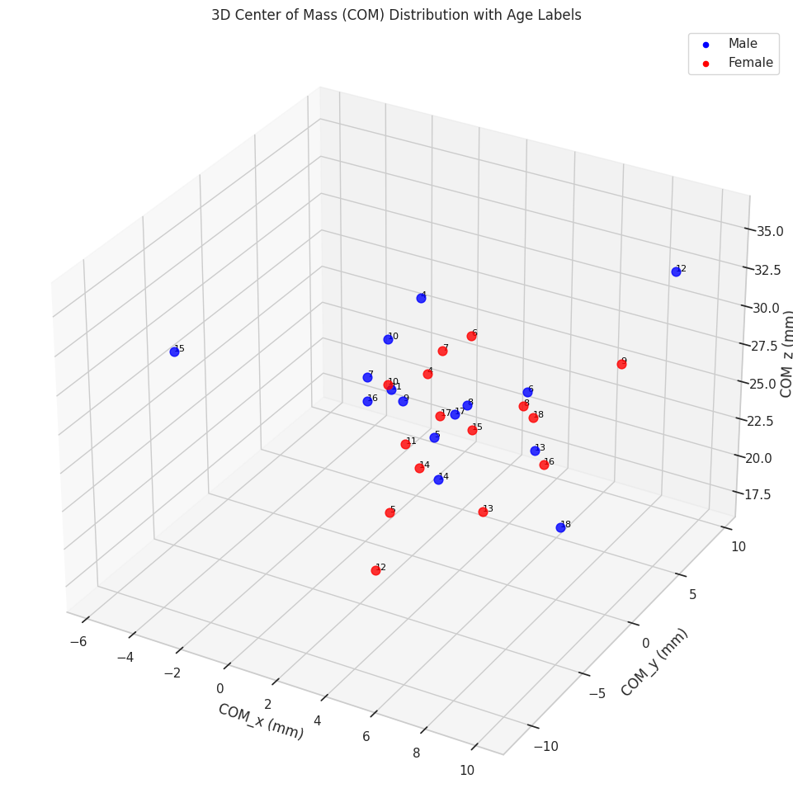
Discussion
2. Data exploration - centre of mass
The centres of mass are mostly concentrated, but there's still some variation because of different stages of development.
The skull of the 15-year-old outlier is positioned further back, potentially leading to a larger absolute x-axis coordinate.
12-year-old outlier: Possibly due to issues with the CT data itself or segmentation errors, the center of mass appears to be closer to the cranial cavity

Slide 14
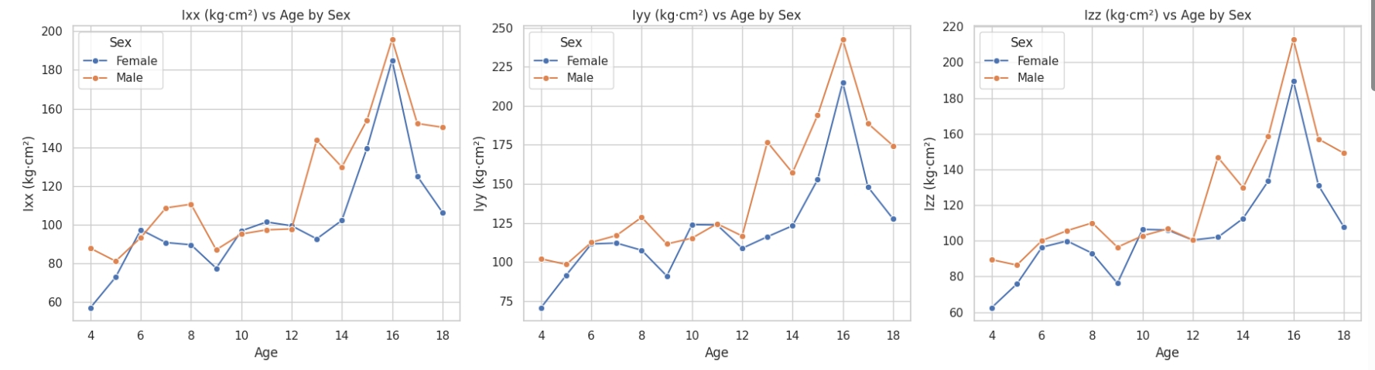
Discussion
3. Data exploration - MOI
Age Effect: Rotational inertia in all directions increases with age, showing a rapid rise after age 12. This trend aligns with expected patterns of biological growth and development.
Timing of Sex Difference: Before puberty (under 11 years old), there is no significant difference between sexes. However, during mid to late puberty (ages 12–16), sex-based divergence in inertia values becomes increasingly pronounced.

Slide 15
Conclusion
The overall data segmentation performs well, and the main inertial parameters align with expected physical patterns.
However, given the current sample size is relatively small, only 30 individuals (15 males and 15 females). Further data collection and analysis are recommended.

Slide 16
Thanks!

