Slide 1
Prompting in AI Applications

Slide 2
Catalog
Introduction to Prompting
Five-Step Prompt Design
01
02
CONTENTS
Advanced Iteration Strategies
Advanced Techniques & AI Agents
03
04
Responsible AI Practices
05

Slide 3
Introduction to Prompting
01

Slide 4


Prompt Engineering Importance
Core Competency for AI Success
Prompt engineering is the key to achieving success in AI applications, as it allows for effective communication with AI models.
Define the Goal
The first step in prompt engineering is to clearly define the goal of the task, which helps in guiding the AI model towards the desired outcome.

Slide 5

Core Competency for AI Success
Provide Maximum Scenario and Data Details
Providing maximum scenario and data details is crucial for successful AI applications, as it helps the AI model to understand the context and produce accurate outputs.
Check if the Output Meets the Goal
After receiving the output, it is important to check if it meets the defined goal. This step ensures that the AI model has understood the task and has produced the desired output.
Always Be Iterating (ABI)
Iterating continuously is a key part of prompt engineering. This means constantly refining and improving the prompts based on the outputs received, to achieve better results.

Slide 6
Five-Step Prompt Design
02

Slide 7

Define Task Goal
Task Goal Definition
Clearly outline the objective of the AI application to guide the prompting process.
Critical for saascv
The task goal is crucial for the success of AI applications in saascv.

Slide 8


Provide Context Details
Maximum Scenario and Data
Crucial for saascv
Provide comprehensive scenario and data details to ensure the AI understands the context.
Context details are essential for the effectiveness of AI applications in saascv.

Slide 9
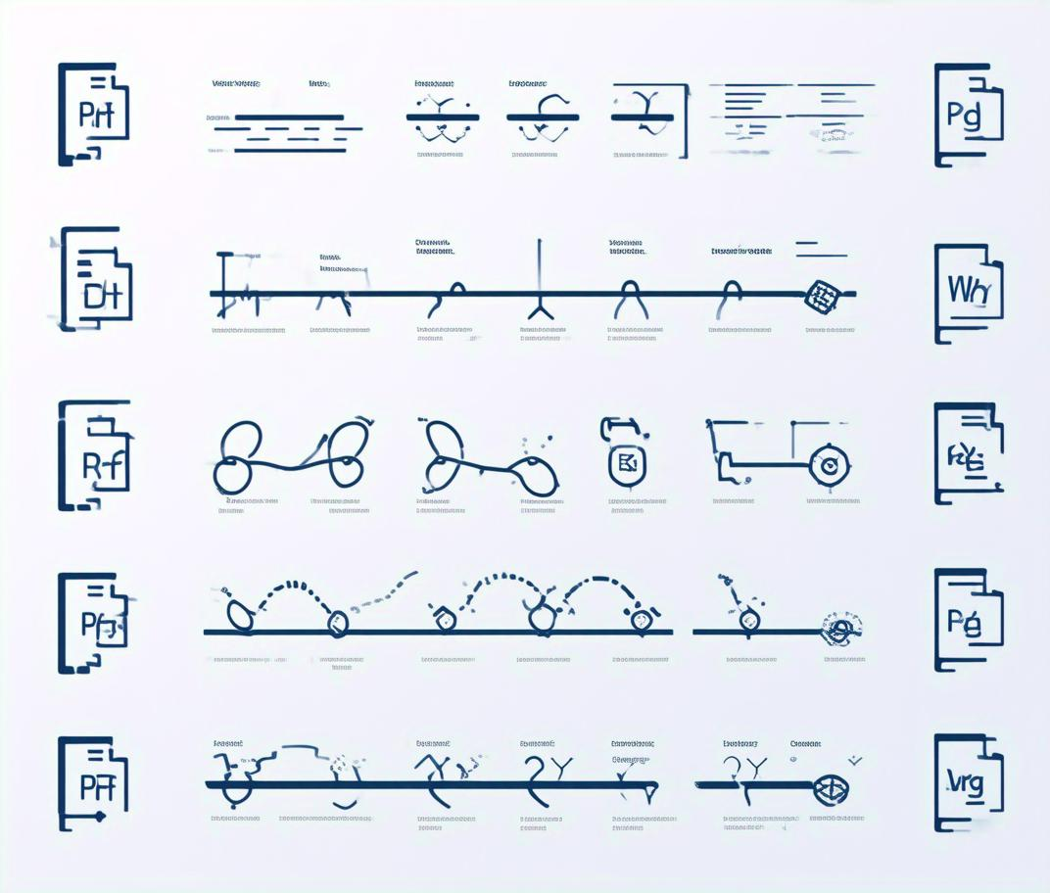

Offer References
Examples and Preferred Formats
Supply examples and specify preferred formats to guide the AI's output.
Guide AI Output
References help in directing the AI towards the desired output format and quality.

Slide 10

Evaluate Output
Check Output Alignment
Goal-Oriented Evaluation
Evaluate if the AI's output meets the predefined task goal.
Ensure the output aligns with the initial task goal for successful application.

Slide 11


Iterate Continuously
Always Be Iterating (ABI)
Continuously refine prompts and outputs through ongoing iteration.
Iterative Improvement
Iterate to enhance the quality and relevance of AI outputs over time.

Slide 12
Advanced Iteration Strategies
03

Slide 13

Revisit Framework
Check Persona and Context
Iterate for Improvement
Review the framework to ensure it aligns with the intended persona and context for optimal performance.
Continuously revisit and refine the framework to adapt to new scenarios and improve AI application success.

Slide 14

Separate Instructions
Break Down Complexity
Enhance Clarity
Divide complex tasks into smaller, manageable steps to simplify the instruction process for AI.
Clear, concise instructions help AI understand and execute tasks more effectively.

Slide 15
Analogous Tasks
Rephrase the Request
Improve Task Understanding
Change the wording of the task to a more suitable form, such as asking for a "story" instead of a "plan."
Using analogous tasks can help AI grasp the essence of the task and provide more relevant outputs.

Slide 16


Introduce Constraints
Narrow the Focus
Improve Quality of Output
Introducing constraints helps to limit the scope of the task, which can lead to higher quality outputs.
By narrowing the focus, AI can concentrate on specific aspects of the task, potentially increasing the precision and accuracy of its responses.

Slide 17
Advanced Techniques & AI Agents
04

Slide 18

Advanced Prompting Methods
Prompt Chaining
Sequential, multi-step process to guide AI through complex tasks.
Chain of Thought (CoT)
Request step-by-step reasoning to enhance understanding and output quality.
Tree of Thought (ToT)
Explore multiple solution paths for complex tasks to find the best approach.

Slide 19

Prompt Chaining
Sequential multi-step process
Enhance task completion
Guide AI through a series of steps to achieve a complex goal.
Ensure each step is completed correctly, leading to the final objective.

Slide 20
Chain of Thought
Request step-by-step reasoning
Improve understanding
AI provides reasoning behind each step, making the process transparent.
Allows for better comprehension of the AI's decision-making process.

Slide 21


Tree of Thought
Explore multiple solution paths
Consider various approaches to solve complex problems.
Find the best approach
Determine the most effective solution from multiple options.

Slide 22

Designing AI Agents
Agent Simulation
Agent X
Use simulations and role-playing to test and refine AI agent behaviors.
Incorporate expert feedback and consultation for specialized tasks.

Slide 23


Agent Simulation
Test AI agent behaviors
Refine agent capabilities
Simulations help in understanding how agents will perform in real-world scenarios.
Iterate on agent designs based on simulation outcomes.

Slide 24
Expert Feedback
Incorporate expert consultation
Experts provide valuable insights to improve AI agent performance.
Verify AI outputs
Experts ensure the quality and accuracy of AI-generated content.

Slide 25
Responsible AI Practices
05

Slide 26


Risks: Hallucinations & Biases
AI Hallucinations
AI systems can generate plausible but incorrect information, known as hallucinations.
AI Biases
Pre-existing biases in training data can lead to biased AI outputs.

Slide 27


Human in the Loop Principle
Verification of Outputs
Human Oversight
Human verification ensures the quality and accuracy of AI-generated content.
Implementing human oversight to mitigate risks associated with AI hallucinations and biases.

Slide 28
Thank You
THE END

