Slide 1
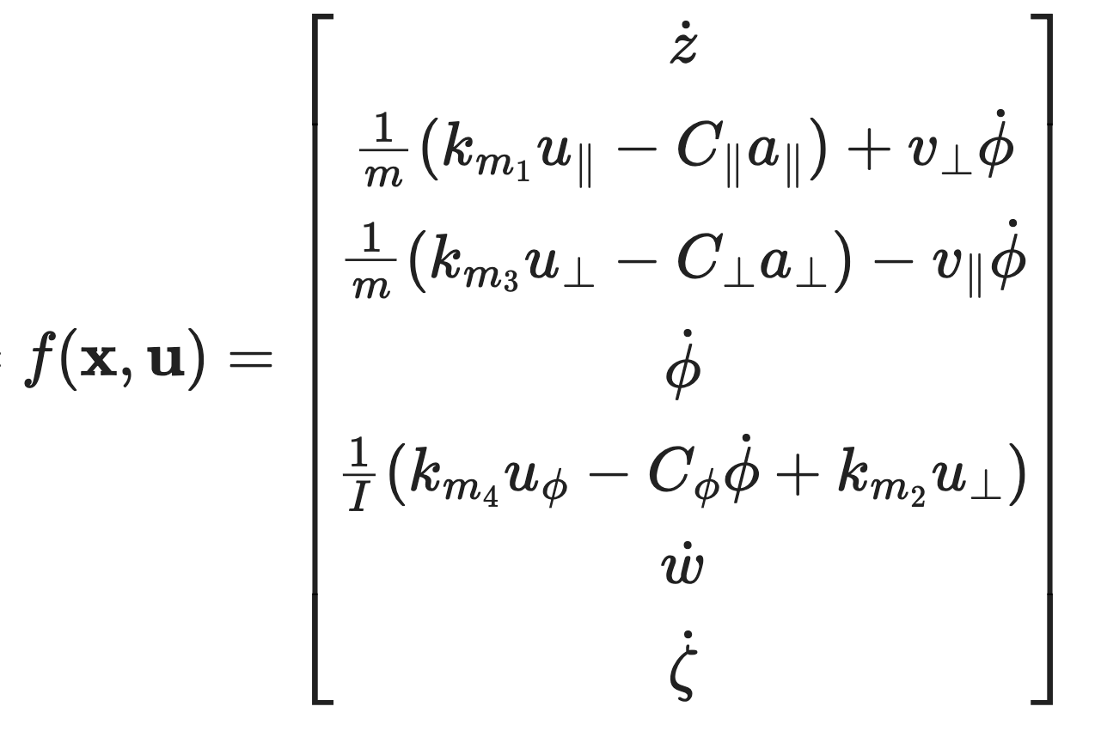
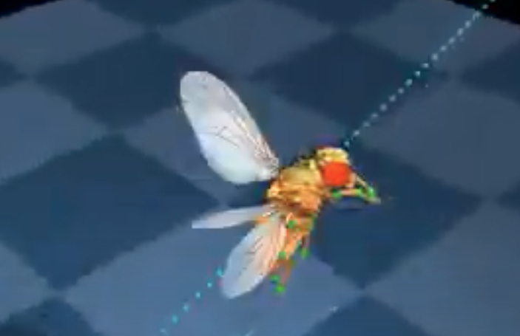
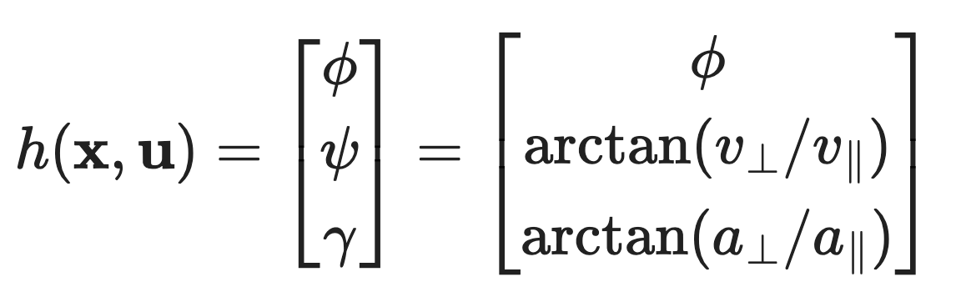
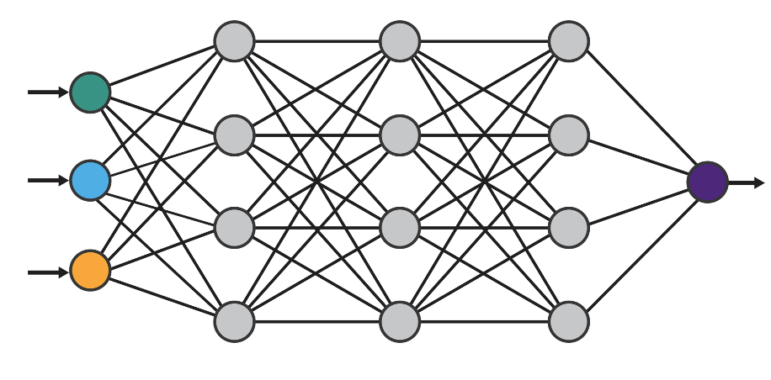
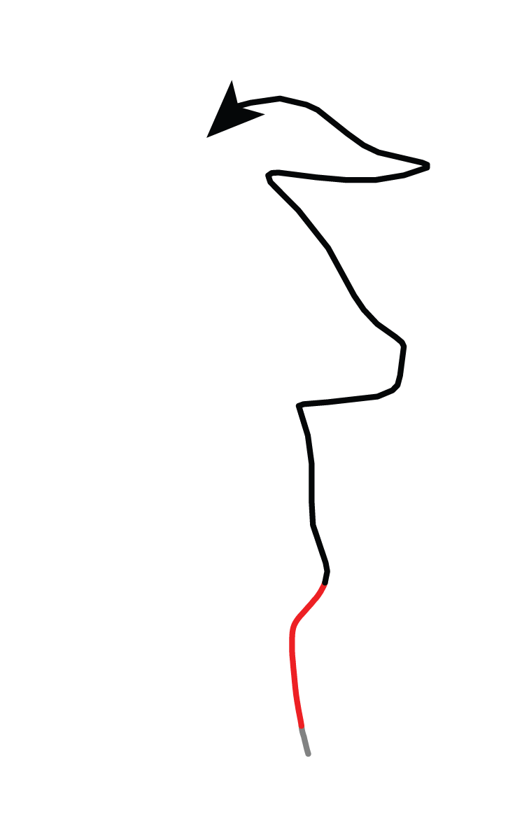
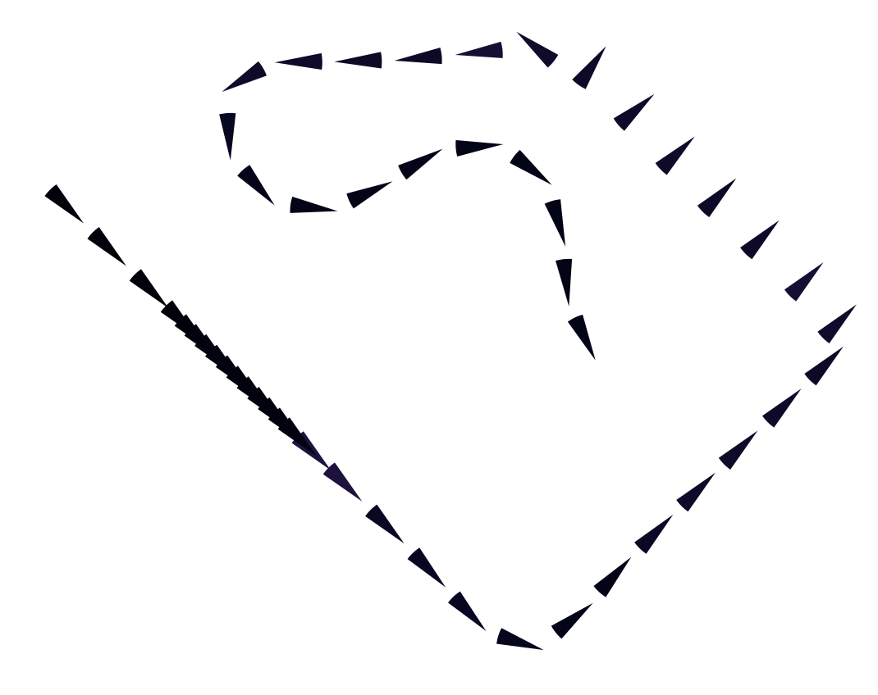
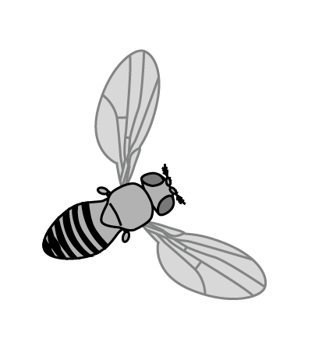
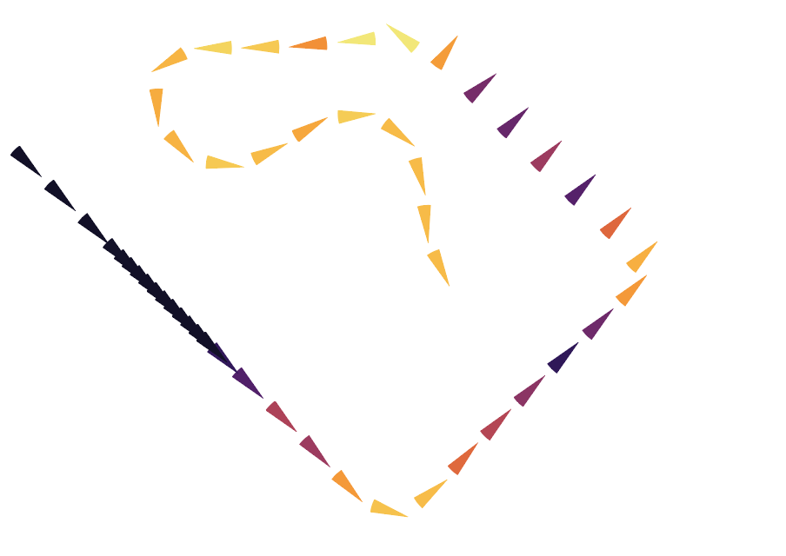

Question:
Which movement motifs allow flying agents to estimate wind direction given measurements of orientation, airflow angle, and ventral optic flow angle?
Input: user supplied knowledge
1. Dynamics model: f(x,u)
(a) analytic model
(b) empirical model
--- OR ---
e.g. physics simulator
2. Measurement model: h(x,u)
(b) analytic model
(b) empirical model
--- OR ---
e.g. neural encoding model
3. State trajectory: x over time
(a) simulated trajectory
(b) measured trajectory
--- OR ---
wind
pybounds
Model
Predictive
Control
Control inputs
Numerical
simulations
Empirical
Fisher
information
Output: individual state observability over time
turn through up/downwind
for state: wind direction
course turn
less observable
min.
error
variance
deceleration
wind
acceleration
heading turn
more observable
Answer:
Changes in the direction of movement are required for this system.

