Slide 1

WorkflowR
A strategy for organized, reproducible and sharable data analysis

Slide 2

Explore, analyse and create figures
Add notes with observations or conclusions
Share and discuss findings
Go back to code to re-explore or edit figures

Slide 3
Two key components of workflowR
An R Markdown-based website.
This consists of a configuration file (_site.yml), a collection of R Markdown files, and their corresponding HTML files.
A Git repository.
Workflowr is able to run the basic Git commands, so there is no need to install Git prior to using workflowr.

Slide 4
Detailed features
Organized
Provides a project template with organized subdirectories
Mixes code and results with R Markdown
Uses Git to version both source code and results
Reproducible
Displays the code version used to create each result
Runs each analysis in an isolated R session
Records the session information of each analysis
Sets the same seed for random number generation for each analysis
Shareable
Creates a website to present your research results
Documents how to host your website for free via GitHub Pages or GitLab Pages
Creates links to past versions of results
https://cran.r-project.org/web/packages/workflowr/vignettes/wflow-01-getting-started.html#overview

Slide 5
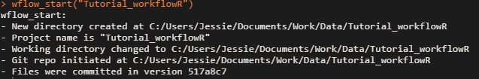
Start a project

Slide 6
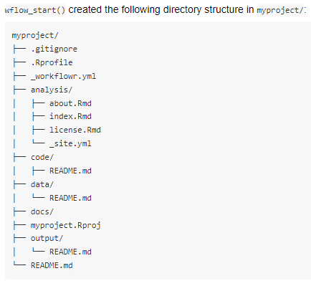
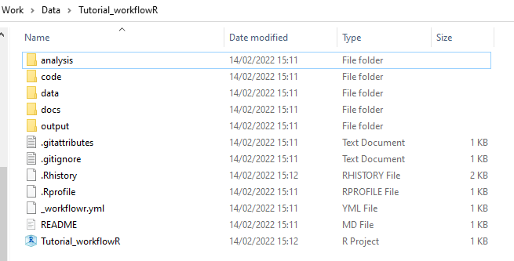
Folder structure generated
https://cran.r-project.org/web/packages/workflowr/vignettes/wflow-01-getting-started.html#overview

Slide 7
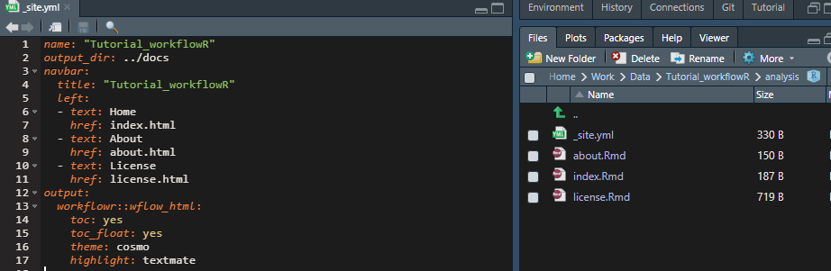
Flow of events
Open Rproject file within the created directory
Modify _site.yml content as required
Titels, output directory, links to generated html pages that will appear in navigation bar, theme & visuals.
Modified the about.Rmd with some template code

Slide 8
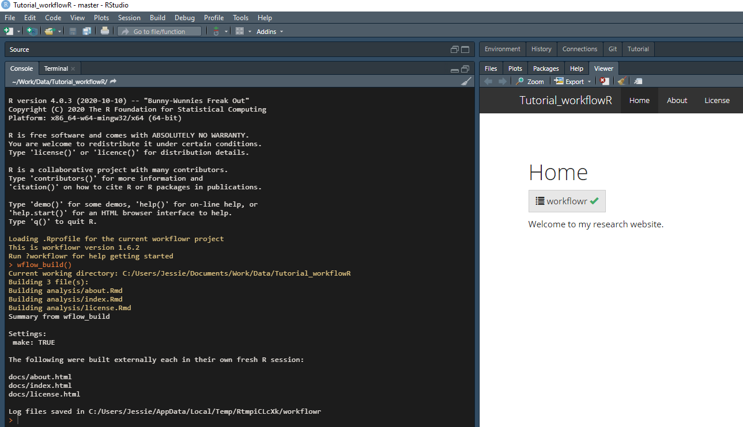
Build the website (first draft)

Slide 9
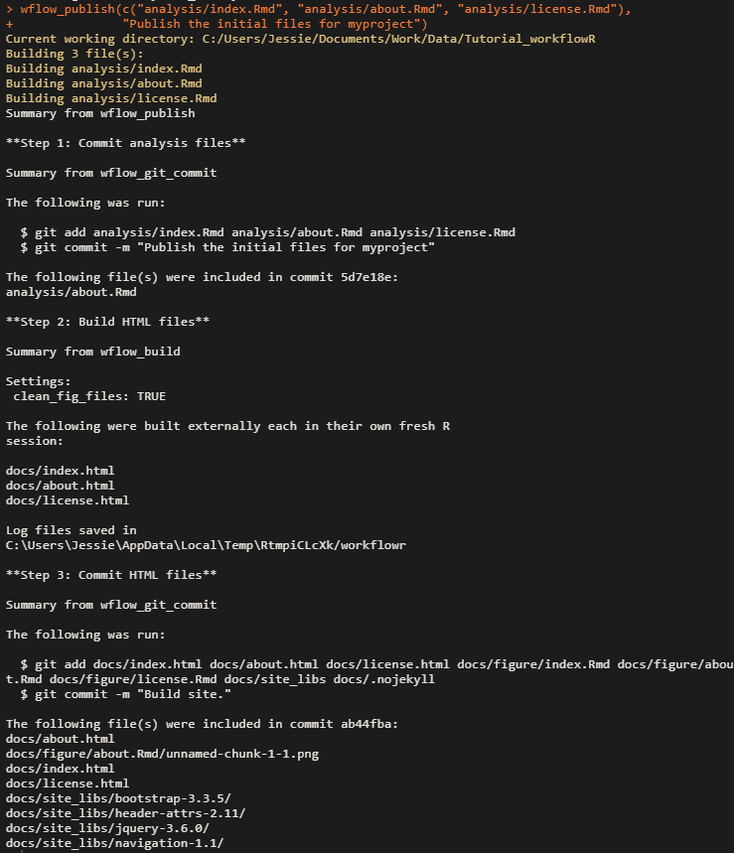
Rebuild and commit Rmd and Html files to git
wflow_publish() reports the 3 steps it took:
Step 1: Commits the 3 R Markdown files using the custom commit message
Step 2: Builds the HTML files using wflow_build()
Step 3: Commits the 3 HTML files plus the files that specify the style of the website (e.g. CSS and JavaScript files)

Slide 10
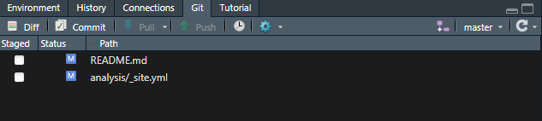
Extra notes
Not all was commited to git. For example I forgot to include “analysis/_site.yml” to list of files.
You can commit any file via wflowR function (it will skip the build):
wflow_publish(c("analysis/_site.yml"),"commit site.yml file")
wflow_publish(c("README.md"),"commit updated readme file")

Slide 11
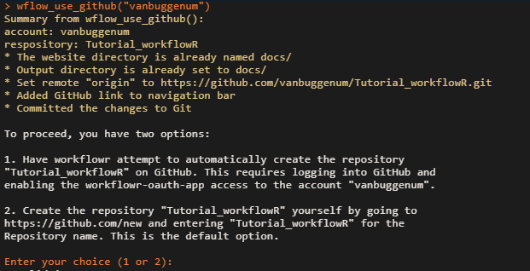
Deploy to github

Slide 12
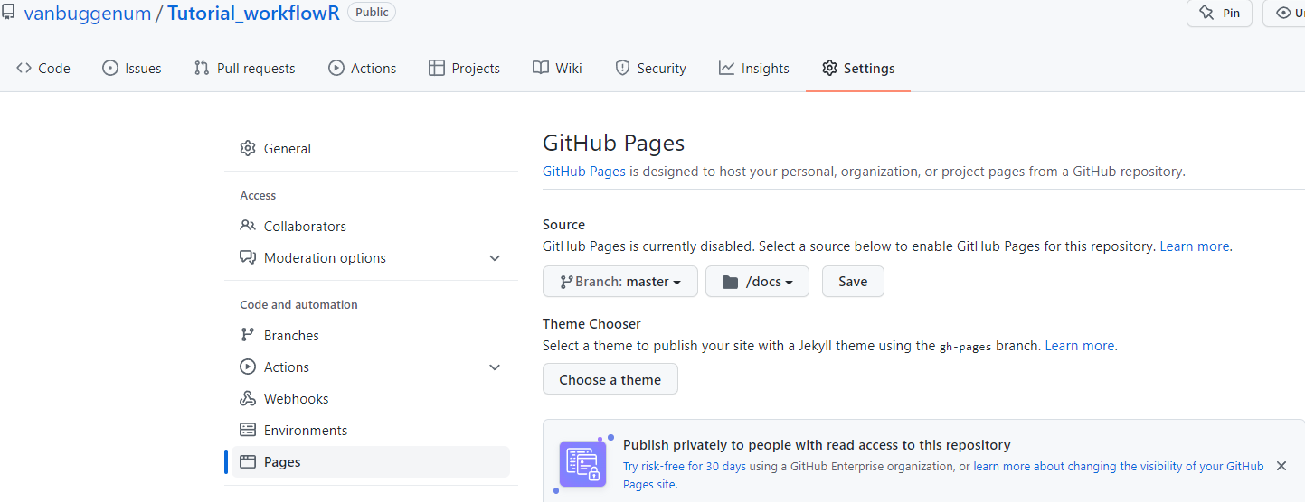

Slide 13
https://vanbuggenum.github.io/Tutorial_workflowR/index.html
More very nice tutorials
https://workflowr.github.io/workflowr/index.html

