Slide 1


Lammps Simulation of Thermal Conductivity
Yang Zhou
2015/09/12

Slide 2
Outline
Lec. 1
Molecular Dynamics & Lammps Realization
Method
Lec. 2
Thermal Conductivity Theory & Simulation
Direction
Lec. 3
Trick
Data Analysis with Python
Lec. 4
Use
Thermal Properties of Ar & GNR
Lec. 5
Doping & Rctification & Final Project
Explore
Lec. 6
Personal Presentation
Summarize

Slide 3
Lec. 2
Thermal Conductivity Theory & Simulation
Thermal Conductivity Theory
Real Space
Diffusive Equation
Green-Kubo Formula
Nanoscale Process
Fokker-Planck Equation
Ergodicity
Reciprocal Space
Boltzmann Transport Equation
Ballistic Phonon
Simulation
NEMD
Direct Method
Muller-Plathe Mehtod
Transient Method
EMD
Green-Kubo Method
BTE

Slide 4



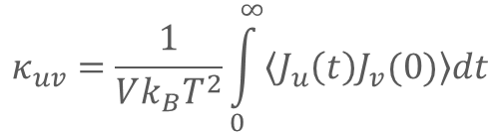
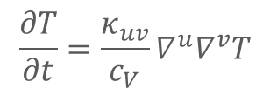

Thermal Conductivity Theory
Real Space
Diffusive Equation
$$J_{u}=−κ_{uv}∇^{v}T$$
$$\frac{∂e}{∂t}+∇^{u}∙J_{u}=0$$
$$\frac{∂T}{∂t}=\frac{κ_{uv}}{c_{V}}∇^{u}∇^{v}T$$
$$e=c_{V}T$$
$$c_{V}the specific heat$$
$$κ_{uv}=\frac{1}{Vk_{B}T^{2}}\int_{0}^{∞}{\left\langle J_{u}\left(t\right)J_{v}(0)\right\rangle dt}$$
Green-Kubo Formula
at equilibrium of T
prof.
Kaviany, Massoud, Heat Transfer Physics

Slide 5







Thermal Conductivity Theory
Real Space
Nanoscale Process
$$v_{1}(t)$$
$$v_{2}(t)$$
f3
1. heat transport is only through f3
f2
$$r_{2}(t)$$
$$r_{1}(t)$$
f1
2. f1 , f2 are the site potential
$$r_{1}\left(0\right)=r_{2}\left(0\right)=0$$
3. if N times MD simulation of
random initial velocity
(Gaussian distribution) are carried out
T1(t) and T2(t) are gotten.
4. If f3 is nonlinear with r , an equilibration will get built.
$$v_{1}\left(0\right)\sim Maxwell(T_{1}(0))$$
$$v_{2}\left(0\right)\sim Maxwell(T_{2}(0))$$
Liouville Equation
NVE or NVT
5. If T1 and T2 are controlled by heat bath, a steady state will get built.
Forker-Planck equation

Slide 6

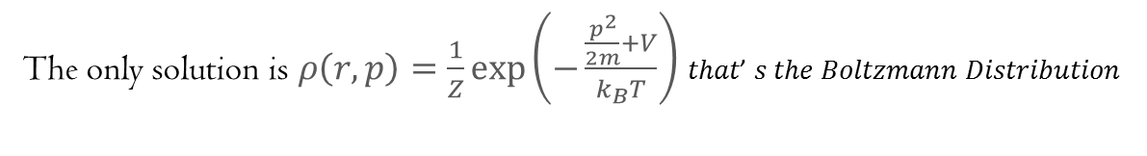

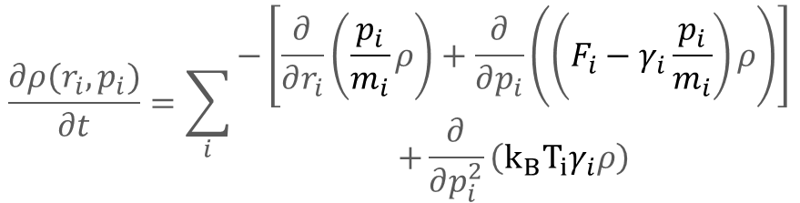

Thermal Conductivity Theory
$$\dot{r_{i}}=\frac{p_{i}}{m_{i}}$$
Real Space
Fokker-Planck Equation
$$\dot{p_{i}}=F_{i}−γ_{i}\frac{p_{i}}{m_{i}}+ξ_{i}(t)$$
$$\left\langle ξ_{i}(t_{1})∙ξ_{j}(t_{2})\right\rangle =2k_{B}T_{i}γ_{i}δ_{ij}δ(t_{1}−t_{2})$$
$$\frac{∂ρ(r_{i},p_{i})}{∂t}=\sum_{i}{\begin{aligned}−\left[\frac{∂}{∂r_{i}}\left(\frac{p_{i}}{m_{i}}ρ\right)+\frac{∂}{∂p_{i}}\left(\left(F_{i}−γ_{i}\frac{p_{i}}{m_{i}}\right)ρ\right)\right] \\ +\frac{∂}{∂p_{i}^{2}}\left(k_{B}T_{i}γ_{i}ρ\right)\end{aligned}}$$
Kramer Equation
for 1D single particle under Langevin heat bath of T, at steady state:
$$\frac{∂ρ(r,p)}{∂t}=0=−\left[\frac{∂}{∂r}\left(\frac{p}{m}ρ\right)+\frac{∂}{∂p}\left(\left(−∇V−γ\frac{p}{m}\right)ρ\right)\right]+\frac{∂}{∂p^{2}}\left(k_{B}Tγρ\right)$$
The only solution is $ρ\left(r,p\right)=\frac{1}{Z}\exp\left(−\frac{\frac{p^{2}}{2m}+V}{k_{B}T}\right)$ 𝑡ℎ𝑎𝑡’ 𝑠 𝑡ℎ𝑒 𝐵𝑜𝑙𝑡𝑧𝑚𝑎𝑛𝑛 𝐷𝑖𝑠𝑡𝑟𝑖𝑏𝑢𝑡𝑖𝑜𝑛

Slide 7
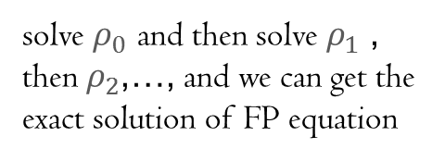
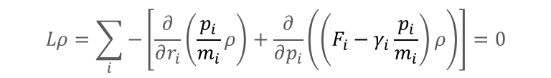
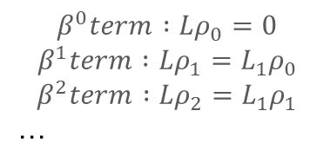

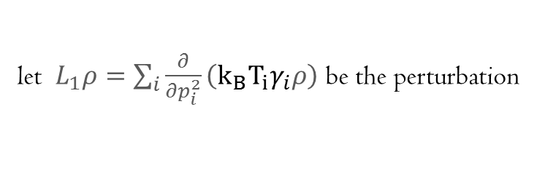
Thermal Conductivity Theory
Real Space
Fokker-Planck Equation
for 1D double particles
$$\frac{∂ρ(r_{1},p_{1},r_{2},p_{2})}{∂t}=0=\sum_{i}{−\left[\frac{∂}{∂r_{i}}\left(\frac{p_{i}}{m_{i}}ρ\right)+\frac{∂}{∂p_{i}}\left(\left(F_{i}−γ_{i}\frac{p_{i}}{m_{i}}\right)ρ\right)\right]+\frac{∂}{∂p_{i}^{2}}\left(k_{B}T_{i}γ_{i}ρ\right)}$$
there seems no way to solve this equation
perturbation theory
$$Lρ=\sum_{i}{−\left[\frac{∂}{∂r_{i}}\left(\frac{p_{i}}{m_{i}}ρ\right)+\frac{∂}{∂p_{i}}\left(\left(F_{i}−γ_{i}\frac{p_{i}}{m_{i}}\right)ρ\right)\right]}=0$$
could be solved exactly
one-order partial equation was solved exactly by Lagrange using complete integral
let $L_{1}ρ=\sum_{i}{\frac{∂}{∂p_{i}^{2}}\left(k_{B}T_{i}γ_{i}ρ\right)}$ be the perturbation
to solve $Lρ+L_{1}ρ=0$ let us solve $\left(L+βL_{1}\right)ρ=0$ first
$$ρ=ρ_{0}+βρ_{1}+β^{2}ρ_{2}+…$$
$$β^{0}term :Lρ_{0}=0$$
$$β^{1}term :Lρ_{1}=L_{1}ρ_{0}$$
$$β^{2}term :Lρ_{2}=L_{1}ρ_{1}$$
…
solve $ρ_{0}$ and then solve $ρ_{1}$ ,
then $ρ_{2}$,…, and we can get the
exact solution of FP equation

Slide 8

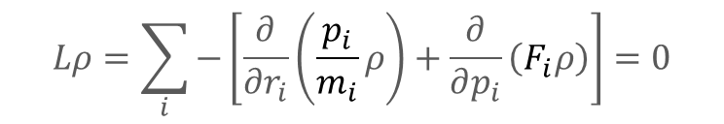

Thermal Conductivity Theory
Real Space
Ergodicity
for Liouville Equation
$$Lρ=\sum_{i}{−\left[\frac{∂}{∂r_{i}}\left(\frac{p_{i}}{m_{i}}ρ\right)+\frac{∂}{∂p_{i}}\left(F_{i}ρ\right)\right]}=0$$
$ρ=φ\left(H\right)$ with any function $φ$ is a solution
but Ergodicity tells us that its only solution would be $ρ=\frac{1}{Ω}$
the Ergodicity condition refine the solution to be not just the solution of $Lρ=0$
but also the limit solution of $\frac{∂ρ}{∂t}=Lρ$ when $t→∞$
there’s not a method to determine the Ergodicity under any condition , so FP method is
not so useful.

Slide 9
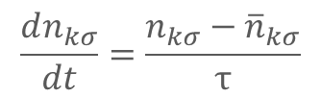


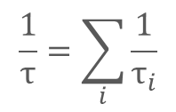
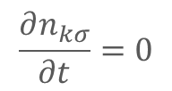

Thermal Conductivity Theory
Reciprocal Space
Boltzmann Transport Equation
$n_{kσ}$ phonon density of mode $kσ$
$$\frac{dn_{kσ}}{dt}=\frac{∂n_{kσ}}{∂t}+v_{kσ}∙ ∇n_{kσ}$$
Convection Equation
$$\frac{dn_{kσ}}{dt}=\frac{n_{kσ}−{\overline{n}}_{kσ}}{τ}$$
Single-mode relaxation approximation
$∇n_{kσ}=∇T \frac{∂n_{kσ}}{∂T}$
Temperature difference driven
$$\frac{∂n_{kσ}}{∂t}=0$$
Steady state
$$\frac{1}{τ}=\sum_{i}{\frac{1}{τ_{i}}}$$
Matthiessen’s rule

Slide 10
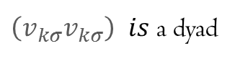
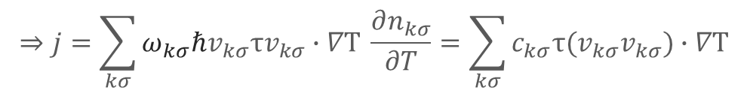
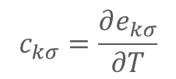
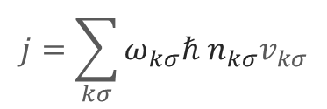

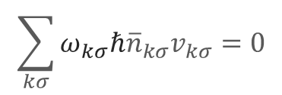

Thermal Conductivity Theory
Reciprocal Space
Boltzmann Transport Equation
$$⇒n_{kσ}−{\overline{n}}_{kσ}={τv}_{kσ}∙∇T \frac{∂n_{kσ}}{∂T}$$
$$j=\sum_{kσ}{ω_{kσ}ℏ n_{kσ}v_{kσ}}$$
Heat current
$$\sum_{kσ}{ω_{kσ}ℏ{\overline{n}}_{kσ}v_{kσ}}=0$$
Equilibrium heat current
$$e_{kσ}=n_{kσ}ω_{kσ}ℏ$$
Mode energy
$$c_{kσ}=\frac{∂e_{kσ}}{∂T}$$
specific heat capacity with V fixed
$$⇒j=\sum_{kσ}{ω_{kσ}ℏv_{kσ}{τv}_{kσ}∙∇T \frac{∂n_{kσ}}{∂T}}=\sum_{kσ}{c_{kσ}τ(v_{kσ}v_{kσ})∙∇T}$$
$\left(v_{kσ}v_{kσ}\right)$ 𝑖𝑠 a dyad

Slide 11
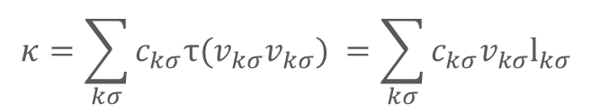
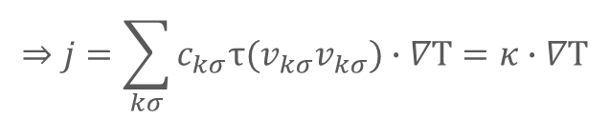



Thermal Conductivity Theory
Reciprocal Space
Boltzmann Transport Equation
$$⇒j=\sum_{kσ}{c_{kσ}τ(v_{kσ}v_{kσ})∙∇T}=κ∙∇T$$
Fourier’s law
$$κ=\sum_{kσ}{c_{kσ}τ(v_{kσ}v_{kσ}) }=\sum_{kσ}{c_{kσ}v_{kσ}l_{kσ} }$$
$$l_{kσ}=τv_{kσ}$$
Mean free Path
correlation to relaxation approximation
$$l_{kσ}=τ_{kσ}^{ }\left(v_{kσ}+∆_{kσ}\left(ω_{kσ},l_{kσ}\right)\right)$$
W Li et al. j.cpc.2014.02.015
Iterate with relaxation approx. $l_{kσ}=τ_{kσ}^{ }v_{kσ}$
$$c_{kσ} ，v_{kσ} are calculated with Phonopy$$

Slide 12




Thermal Conductivity Theory
Reciprocal Space
Ballistic Phonon
when MFP is larger than the system then the temperature profile is like this , and phonon translate without scattering like this is called ballistic phonon.
this can be understand using black body radiation and Stefan-Boltzmann law
$$T_{2}$$
$$T_{3}^{4}=T_{1}^{4}+T_{2}^{4}$$
$$T_{3}$$
MFP~L
$$T_{1}$$
Fourier zone
sufficient scattering could build local equilibrium and we get Fourier law

Slide 13




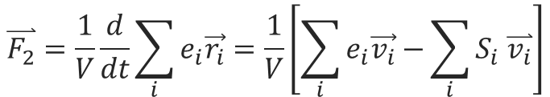
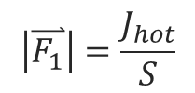


Simulation
NEMD
Direct Method
$$J_{hot}$$
$$J_{cold}≈−J_{hot}$$
heat flow $\overset{⃑}{F}$
non-periodic
two ways to calculate heat flux
fit the temperature profile to get $∇T$
from source
$$\left|\overset{⃑}{F_{1}}\right|=\frac{J_{hot}}{S}$$
so we get $κ=\frac{\left|\overset{⃑}{F_{1}}\right|}{∇T}$
$$\overset{⃑}{F_{2}}=\frac{1}{V}\frac{d}{dt}\sum_{i}{e_{i}\vec{r_{i}}}=\frac{1}{V}\left[\sum_{i}{e_{i}\vec{v_{i}}−}\sum_{i}{S_{i} \overset{⃑}{v_{i}}}\right]$$
from definition
continuation equation：
$$\left|\overset{⃑}{F_{1}}\right|=\left|\overset{⃑}{F_{2}}\right|$$
particle flow
through potential

Slide 14
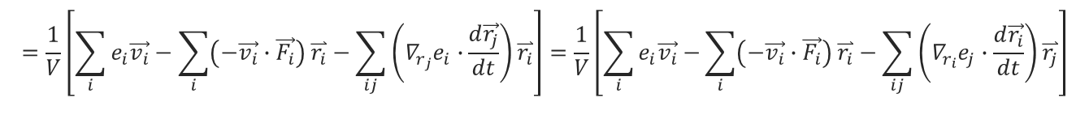

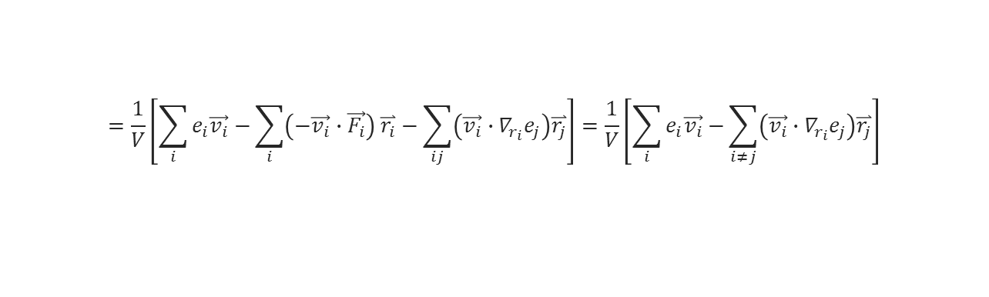

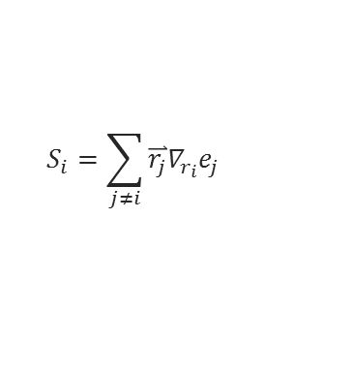
Simulation
NEMD
Direct Method
$$e_{i}(v_{i}, {\left\{r_{j}\right\}}_{ })$$
$$\overset{⃑}{F_{2}}=\frac{1}{V}\frac{d}{dt}\sum_{i}{e_{i}\vec{r_{i}}}=\frac{1}{V}\left[\sum_{i}{e_{i}\frac{d\vec{r_{i}}}{dt}−}\sum_{i}{\frac{de_{i}}{dt}\vec{r_{i}}}\right]=\frac{1}{V}\left[\sum_{i}{e_{i}\vec{v_{i}}−}\sum_{i}{\left(∇_{v_{i}}e_{i}\frac{d\vec{v_{i}}}{dt}+\sum_{j}{∇_{r_{j}}e_{i}∙\frac{d\vec{r_{j}}}{dt}}\right)\overset{⃑}{r_{i}}}\right]$$
$$=\frac{1}{V}\left[\sum_{i}{e_{i}\vec{v_{i}}}−\sum_{i}{\left(−\vec{v_{i}}∙\vec{F_{i}}\right) \overset{⃑}{r_{i}}}−\sum_{ij}{\left(∇_{r_{j}}e_{i}∙\frac{d\vec{r_{j}}}{dt}\right)\overset{⃑}{r_{i}}}\right]=\frac{1}{V}\left[\sum_{i}{e_{i}\vec{v_{i}}−}\sum_{i}{\left(−\vec{v_{i}}∙\vec{F_{i}}\right) \overset{⃑}{r_{i}}}−\sum_{ij}{\left(∇_{r_{i}}e_{j}∙\frac{d\vec{r_{i}}}{dt}\right)\overset{⃑}{r_{j}}}\right]$$
$$=\frac{1}{V}\left[\sum_{i}{e_{i}\vec{v_{i}}−}\sum_{i}{\left(−\vec{v_{i}}∙\vec{F_{i}}\right) \overset{⃑}{r_{i}}}−\sum_{ij}{\left(\vec{v_{i}}∙∇_{r_{i}}e_{j}\right)\overset{⃑}{r_{j}}}\right]=\frac{1}{V}\left[\sum_{i}{e_{i}\vec{v_{i}}−}\sum_{i≠j}{\left(\vec{v_{i}}∙∇_{r_{i}}e_{j}\right)\overset{⃑}{r_{j}}}\right]$$
$$=\frac{1}{V}\left[\sum_{i}{e_{i}\vec{v_{i}}−}\sum_{i}{S_{i}\vec{v_{i}}}\right]$$
$$S_{i}=\sum_{j≠i}{\overset{⃑}{r_{j}}∇_{r_{i}}e_{j}}$$
is called stress tensor
compute myKE all ke/atom
compute myPE all pe/atom
compute myStress all stress/atom NULL virial
compute flux all heat/flux myKE myPE myStress
variable Jx equal c_flux[1]/vol
variable Jy equal c_flux[2]/vol
variable Jz equal c_flux[3]/vol

Slide 15

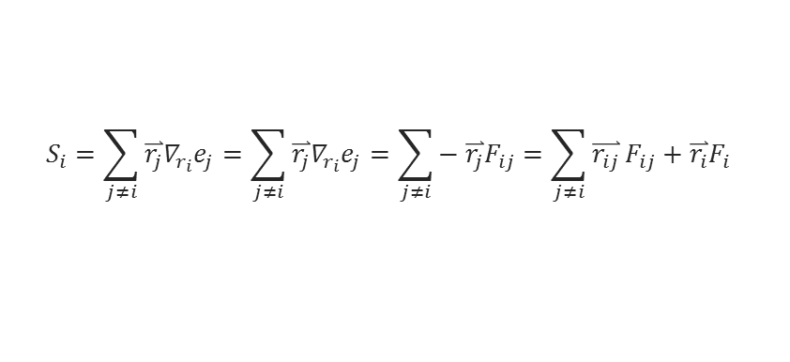
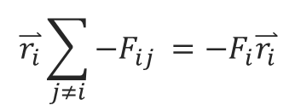

Simulation
NEMD
Direct Method
$$r_{ij}=r_{i}−r_{j}$$
$$\overset{⃑}{r_{i}}\sum_{j≠i}{−F_{ij} }=−F_{i}\overset{⃑}{r_{i}}$$
$$∇_{r_{ij}}e_{j}=−F_{ij}$$
for pair potential
$$S_{i}=\sum_{j≠i}{\overset{⃑}{r_{j}}∇_{r_{i}}e_{j}}=\sum_{j≠i}{\overset{⃑}{r_{j}}∇_{r_{i}}e_{j}}=\sum_{j≠i}{− \overset{⃑}{r_{j}}F_{ij}}=\sum_{j≠i}{\overset{⃑}{r_{ij}}}F_{ij}+\overset{⃑}{r_{i}}F_{i}$$

Slide 16
Simulation
NEMD
Direct Method
same with ave/time
fix 2 all ave/spatial 10 100 1000 z lower 0.05 v_temp file profile.langevin units box
real length unit
0.05
0.05
0.05
box low
box high
z
lower

Slide 17


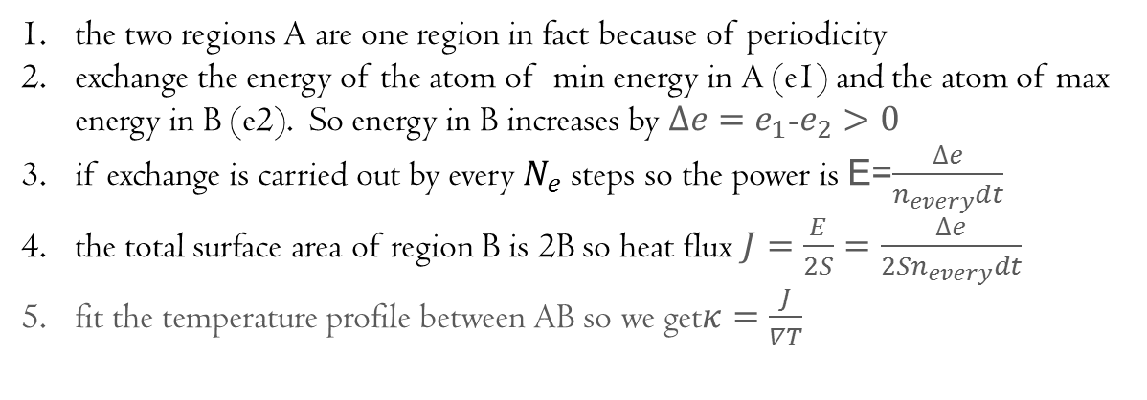

Simulation
NEMD
Muller-Plathe Mehtod
Florian Muller-Plathe. J. Chem. Phys. 1997, 106(14)
$$J_{hot}$$
$$J_{cold}≈−J_{hot}$$
heat flow $\overset{⃑}{F}$
A
S
B
S
A
periodic
the two regions A are one region in fact because of periodicity
exchange the energy of the atom of min energy in A (e1) and the atom of max energy in B (e2). So energy in B increases by $∆e=e_{1}$-$e_{2}>0$
if exchange is carried out by every $N_{e}$ steps so the power is E=$\frac{∆e}{n_{every}dt}$
the total surface area of region B is 2B so heat flux $J=\frac{E}{2S}=\frac{∆e}{{2Sn}_{every}dt}$
fit the temperature profile between AB so we get$κ=\frac{J}{∇T}$

Slide 18
Simulation
NEMD
Muller-Plathe Mehtod
fix heat_swap all thermal/conductivity $n_{every}$ z $N$
direction
1
9
（even）
N=16
A
B
A

Slide 19
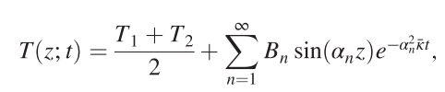
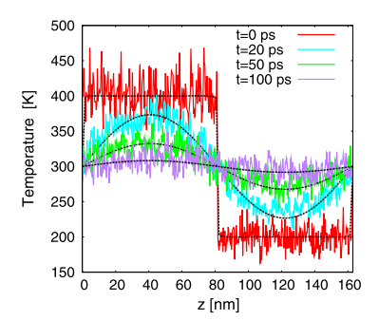
Simulation
Claudio Melis. et at. PhysRevLett.112.065901
NEMD
Transient Method
T
initial temperature distribution
z

Slide 20
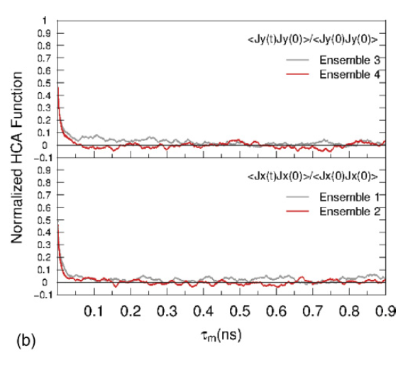
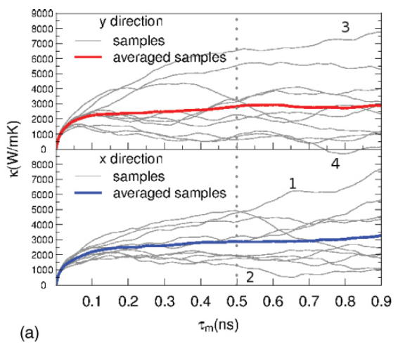
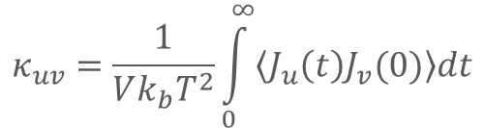

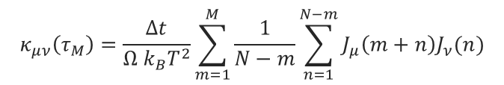
Simulation
EMD
Green-Kubo Method
$$κ_{uv}=\frac{1}{Vk_{b}T^{2}}\int_{0}^{∞}{\left\langle J_{u}\left(t\right)J_{v}(0)\right\rangle dt}$$
$$\overset{⃑}{J}=\frac{1}{V}\frac{d}{dt}\sum_{i}{e_{i}\vec{r_{i}}}=\frac{1}{V}\left[\sum_{i}{e_{i}\vec{v_{i}}−}\sum_{i}{S_{i} \overset{⃑}{v_{i}}}\right]$$
$$κ_{μν}\left(τ_{M}\right)=\frac{Δt}{Ω k_{B}T^{2}}\sum_{m=1}^{M}{\frac{1}{N−m}\sum_{n=1}^{N−m}{J_{μ}\left(m+n\right)J_{ν}(n)}}$$

Slide 21
Summery
Thermal Conductivity Theory & Simulation
Real space and Reciprocal space theory of thermal transport
NEMD simulation(direct ,MP) of TC
EMD simulation(BTE,GK) of TC
Homework
calculate TC vs. length , TC vs. T using direct method
calculate TC vs. length , TC vs. T using MP method
calculate TC vs. length , TC vs. T using GK method
compare them
hand in a report before Friday

