Slide 1


Lammps Simulation of Thermal Conductivity
Yang Zhou
2015/09/12

Slide 2
Outline
Lec. 1
Molecular Dynamics & Lammps Realization
Method
Lec. 2
Thermal Conductivity Theory & Simulation
Direction
Lec. 3
Trick
Data Analysis with Python
Lec. 4
Use
Thermal Properties of Ar & GNR
Lec. 5
Doping & Rctification & Final Project
Explore
Lec. 6
Personal Presentation
Summarize

Slide 3
Lec. 3
Data Analysis with Python
Python Introduction
Basic
Workflow
Variables & Function
List &For
Dict &Options
Class
Import
Print &File
Numpy
Array
map operations
reduce operations
TC data Analysis with Python
ASE
Create or Read in files
Atom operations
ACES
Runners
Materials
Options

Slide 4
Python Introduction
Workflow
Basic
installation
Anaconda
excution
ssh b516 ;
python a.py
py file
Indent

Slide 5
Python Introduction
Variables & Function
Basic
Create
Convert
Operations
int : a=5
float : b=5.0
str : c=‘5’
a=int(b)
b+a=a+b=10.0 (float)
b=float(a)
a+c error
b=float(c)
c+c+c=‘555’
bool : d=True=1
c=str(a)
c*a=‘55555’
str(b)=‘5.0’
c*b error
b*a=a*b=25.0 (float)
b**2=5.0*5.0=25.0
b/a=a/b=1.0 (float)
3/a=0 (int)
Functions
def f(x,z=0):
y=x+z
return y
f=lambda x:x
f(5)
f(5,z=1)

Slide 6
Python Introduction
List & For
Basic
Create
Operations
a= [0,1,2,3,4]
a= [0,1,2,3,4]
a=[1,2]
a=range(5)=[0,1,2,3,4]
a=range(2,6,2)=[2,4]
a[2]= 7
print a[2:4]
=> a=[0,1,7,3,4]
=> [2,3]
a[-2]= 7
print a[2:]
Get
=> a=[0,1,2,7,4]
=> [2,3,4]
x,y=[1,2]
=>x=1,y=2
[0,1]+[1,2]=[0,1,1,2]
x,y=（1,2）
=>x=1,y=2
tuple
[0,1]*2=[0,1,0,1]
Conbine
a= [0,1,2,3,4]
a=zip([1,2],[3,4])
=>a=[(1,3),(2,4)]
a.append(5)
=>a=[0,1,2,3,4,5]
del a[5]
=>a=[0,1,2,3,4]
Index
a= enumerate( [3,4])
=>a=[(0,3),(1,4)]

Slide 7
Python Introduction
List & For
Basic
map
reduce
a=[1,2]
b=map(float,a)
=>b=[1.0,2.0]
a=[1,2,3]
b=map(lambda x,y:x+y , a)
=>b=1+2+3=6
a=[1,2]
b=map(lambda x:str(x),a)
=>b=[‘1’, ‘2’]
a=[1,2]
b=[str(x) for x in a]
=>b=[‘1’, ‘2’]
For
for x in [0,1,2,3,4]:
if x==2:
print x
else:continue
for x,y in [(1,3),(2,4)]:
print x,y

Slide 8
Python Introduction
Basic
Dict & Options
a={‘x’:5,’y’,7}
a=dict(x=5,y=7)
print a[‘x’]
Conbine
Options
b= dict(x=3,z=6)
c=dict(a,**b)
=>c=dict(x=3,y=7,z=6)

Slide 9
Python Introduction
Basic
Class
inherit
class A:
def __init__(self,x):
self.x=x
def f(self):
print self.x
class B(A):
def g(self):
print self.x+2
B().f()
B().g()
A().f()
options
class A:
def __init__(self,opt):
self.__dict__=dict(self.__dict__,**opt)
def f(self):
print self.x
opt=dict(x=5)
A(opt).f()

Slide 10
Python Introduction
Basic
Import
new package
import numpy
a=numpy.ones([3,3])
mkdir zy
cat ‘’>zy.__init__.py
ln –s zy /home/users/tutorial/physics /tootls/python2.7.8/lib/python2.7/site-packages/zy
import numpy as np
a=np.ones([3,3])
from numpy import ones as o
cd zy
mkdir first
cd first
cat ‘’>__init__.py
cat ‘a=5’ >b.py
python –c ‘import zy.b as b; print b.a’
a=o([3,3])

Slide 11
Python Introduction
Basic
Print &File
print ‘%d %s’%(5,’monkeys’)
f=open(‘file’,’w’)
print >>f ‘%d %s’%(5,’monkeys’)
f=open(‘file’)
line=f.next()
line=‘5 monkeys’
n=int(line.split()[0])
f=open(‘file’)
all=f.readlines()
print all[1]
f=open(‘file’)
for line in f:
print line

Slide 12
Python Introduction
Numpy
Array
map operations
import numpy as np
a=np.array([1,2])
b=np.array([3,4])
a+b=np.array([4,6])
a=np.zeros([1,2])
a=np.array([[0,0,0],[0,0,0],[0,0,0])
a[2:,2:]=[[1,2],[3,4]]
=>a=np.array([[0,0,0],[0,1,2],[0,3,4]])
a*b=np.array([3,8])
a*2=np.array([2,4])
np.sin(a)=np.array([sin(2),sin(4)])
b=a.reshape([9,1])
=np.array([[0,0,0,0,1,2,0,3,4]])
reduce operations
a=np.array([1,2,3])
a.max()=3
a.cumsum()=np.array([1,3,6])
a=np.array([1,2])
b=np.array([3,4])
a.dot(b)=1*3+2*4=11

Slide 13
TC data Analysis with Python
ASE
Create or Read in files
Atomic Simulation Environment
from ase.io import read
a=read(‘POSCAR’)
from ase.io.vasp import write_vasp
write_vasp("POSCAR",atoms ,sort=True,direct=True,vasp5=True)
from ase import Atoms
a=Atoms('CN',[[0,0,0],[0,0,1]])
p=a.positions
print p
p[1,2]=1.5
a.set_cell([1,1,2])
print a.positions
from zy.lammpsdata import lammpsdata
a=lammpsdata(atoms , elements)
a.writedata("structure")
in lammps : read_data structure
mass 1 12.011000
mass 2 14.006700
pair_style tersoff
pair_coeff * * BNC.tersoff C N

Slide 14
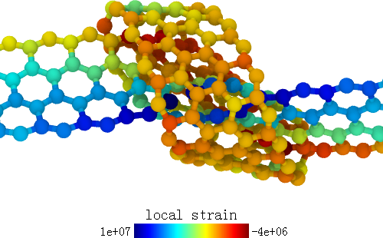
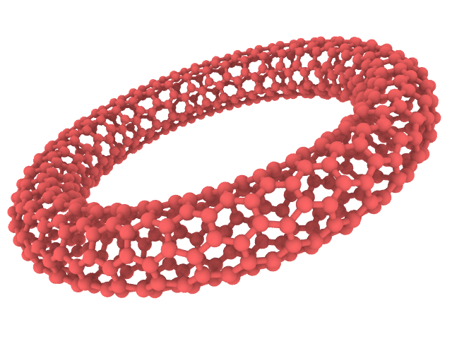
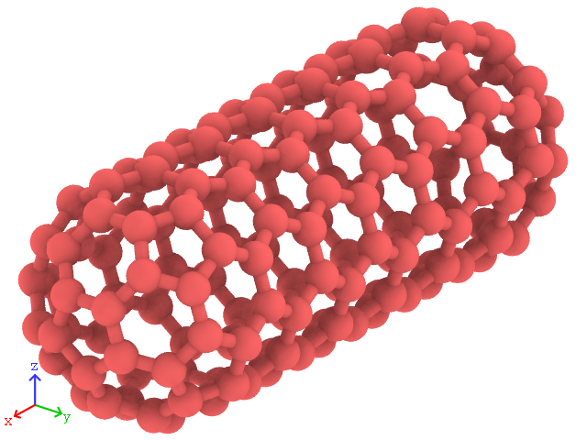
TC data Analysis with Python
ASE
Atom operations
a=Atoms('CN',[[0,0,0],[0,0,1]])
b=a.copy()
b.translate([1,0,0])
b.rotate(‘z’,pi/3.0,rotate_cell=True)
b.set_cell(a.cell*2.0)
a.extend(b)
a.center()
scale

Slide 15
TC data Analysis with Python
ACES
Automatically Computational Experimental System
Runners
class MPRunner(Runner):
def preprocess(self,m):
m=self.opt
f=open(‘in.lmp’,’w’)
print >>f, “units %s”%m.units
…
if m.useRot:
print >>f,”velocity all create %T 123 rot yes”%m.T
else:
print >>f,”velocity all create %T 123”%m.T
f.close()
def run(self):
m=self.opt
self.preprocess(m)
shell_exec(“lmp.mkl<in.lmp>log.out”)
self.postprocess(m)
class Runner:
def __init__(self,opt):
self.opt=opt
def run(self):
pass
def postprocess(self,m):
pass
def preprocess(self,m):
pass

Slide 16
TC data Analysis with Python
ACES
Materials
class Material:
def __init__(self,opt):
self.elements=[“C”,”N”,”B”]
self.__dict__=dict(self.__dict__,**opt)
masses=self.getMassFromLabel(self.elements)
self.masses=‘\n’.join(["mass %d %f"%(i+1,mass) for i,mass in enumerate(masses)])
def getMassFromLabel(self,labels):
from ase.data import atomic_masses,atomic_numbers
nums=[atomic_numbers[label] for label in labels]
masses=[atomic_masses[num] for num in nums]
return masses
def build_structure(self):
atoms = Atoms ( ‘CN’, [ [0, 0, 0], [0,0,1]])
return atoms
def write_atoms(self):
from zy.lammpsdata import lammpsdata
a=lammpsdata(atoms , elements)
a.writedata("structure")

Slide 18
Summery
Thermal Conductivity Theory & Simulation
Python Introduction
Numpy
Atomic Simulation Environment
Automatically Computational Experimental System
Homework
use ASE to build a graphene nanotube
use python to improve homework of lec2
hand in a report before Oct. 10 Saturday

