Slide 1


Lammps Simulation of Thermal Conductivity
Yang Zhou
2015/09/12

Slide 2
Outline
Lec. 1
Molecular Dynamics & Lammps Realization
Method
Lec. 2
Thermal Conductivity Theory & Simulation
Direction
Lec. 3
Trick
Data Analysis with Python
Lec. 4
Use
Thermal Properties of Ar & GNR
Lec. 5
Doping & Rctification & Final Project
Explore
Lec. 6
Personal Presentation
Summarize

Slide 3
Lec. 4
Thermal Properties of Ar & GNR
Some tricks
Direct Method
Heat Flux Distribution
GK
Compute_tc
Analyze tc
phonon dos
scatter rate
participation ratio
group velocity
GNR

Slide 4
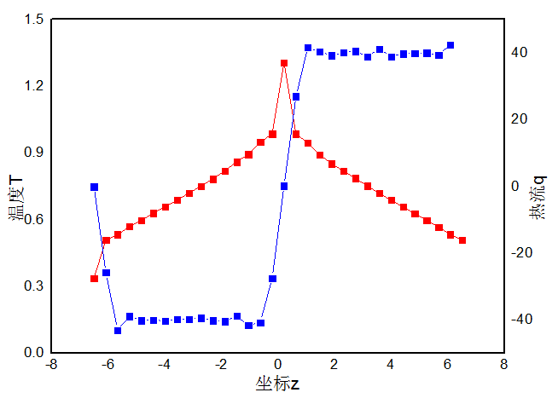
Direct Method
Heat Flux Distribution
variable jx atom (c_ke+c_pe)*vx-(c_stress[1]*vx+c_stress[4]*vy+c_stress[5]*vz)/a
variable jy atom (c_ke+c_pe)*vy-(c_stress[4]*vx+c_stress[2]*vy+c_stress[6]*vz)/a
variable jz atom (c_ke+c_pe)*vz-(c_stress[5]*vx+c_stress[6]*vy+c_stress[3]*vz)/a
for lj a=1. for metal a=1602176.500000
fix 2 all ave/spatial 1 1 1000 z lower 0.025 v_temp v_jx v_jz &
file profile.langevin units reduced

Slide 5
GK
Compute_tc
Fix ave/correlate
fix ss all ave/correlate 2 50000 100000 c_jflux[1] c_jflux[2] c_jflux[3] type auto ave running
run 500000
如果md运行500000步，则该命令把它们截取为5段，每段100000步
<j(0)j(6)>=[j(0)j(6)+j(2)j(8)+j(4)j(10)+…+j(99993)j(99999)]*2/99994
2表示取样率
极端一点的情况就是
<j(0)j(99999)>=[j(0)j(99999)]/1
ave running 表示最终的<j(0)j(99999)>是5段分别算出这个值并平均，相当于是5个数的平均
因此例子中的green-kubo方法需要重复执行20次模拟并平均。
Compute_tc 解决了上述问题
<j(0)j(99999)>=[j(0)j(99999)+j(1)j(100000)+j(2)j(100001)+…+j(400000)j(499999)]/400001

Slide 6
GK
Compute_tc
compute tc command
Syntax: compute ID group-ID tc c_temp-ID c_flux-ID v_factor_ac v_factor_tc direction portion M tc_ntimestep_start tc_ntimestep_freq ID, group-ID are documented in compute command
tc = style name of this compute command
temp-ID = ID of a compute that calculates temperature
flux-ID = ID of a compute that calculates heat flux vector
factor_ac = ID of a variable (Now it makes no sense, because I've modified the codes to obtain the normalized HCACF, so you can just keep it as 1.0)
factor_tc = ID of a variable whose value is used to transform the thermal conductivity unit defined in "units command" to the units desired
direction = x or y or z or iso, direction for thermal conductivity computation
portion = first(total heat flux: jc + jv) or second(just conductive portion: jc only) for heat flux contribution
M = M value in discrete Green Kubo thermal conductivity expression
tc_ntimestep_start = starting timestep for "ac.dat" and "tc.dat" output(timestep units, not time units)
tc_ntimestep_freq = output frequency for "ac.dat" and "tc.dat" (timestep units, not time units)
The command can output two files "ac.dat"(Normalized HCACF) and "tc.dat"(thermal conductivity), every "tc_ntimestep_freq" timesteps, and start at "tc_ntimestep" timestep. And the value returned from this command is thermal conductivity value at each timestep, so you can obtain a file like "tc_time.dat" using fix ave/time command, then you can get a curve, whose vertical value is thermal conductivity, and horizontal value is timestep. "v_factor_ac" can be used to transform dimensionless units defined by "units command" in lammps to SI units or other units you desire. Usage: compute myKE all ke/atom compute myPE all pe/atom compute myStress all stress/atom virial variable factor_ac equal 1.0 variable factor_tc equal 1.3806504e-23*sqrt(1.67e-21/6.633e-26)/3.405e-10^2 compute jflux all heat/flux myKE myPE myStress compute tc all tc c_thermo_temp c_jflux v_factor_ac v_factor_tc iso first 10000 900000 100000 fix tc_out all ave/time 1 1 1 c_tc file tc_time.dat

Slide 7
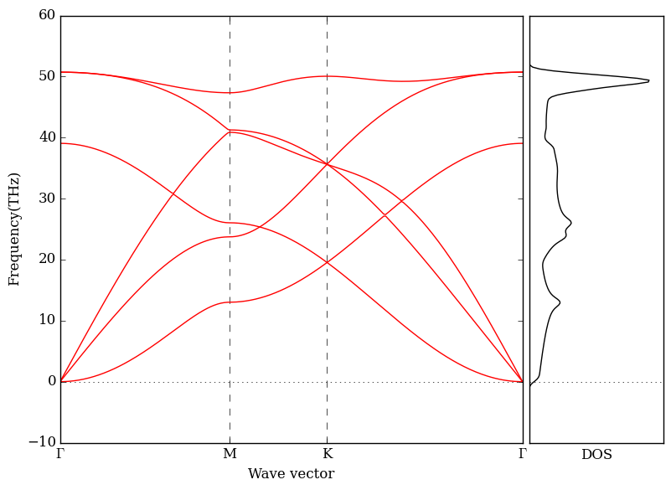
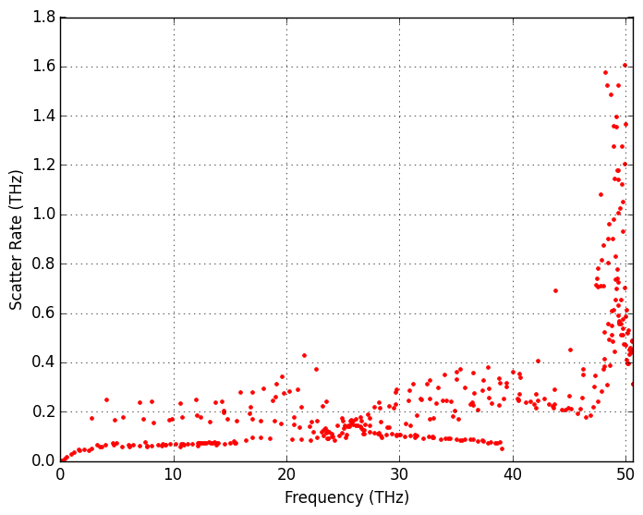
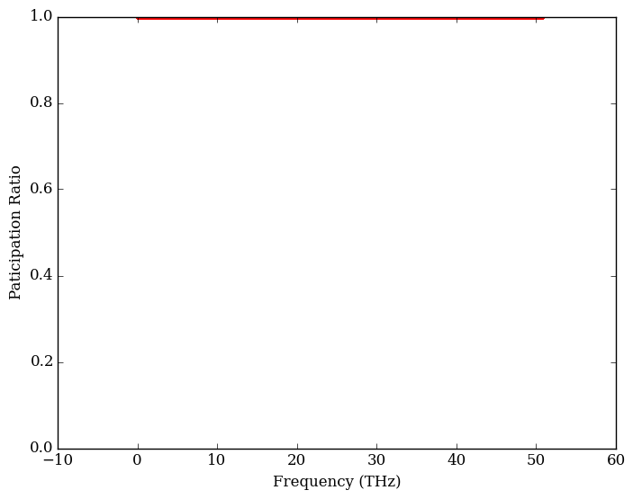
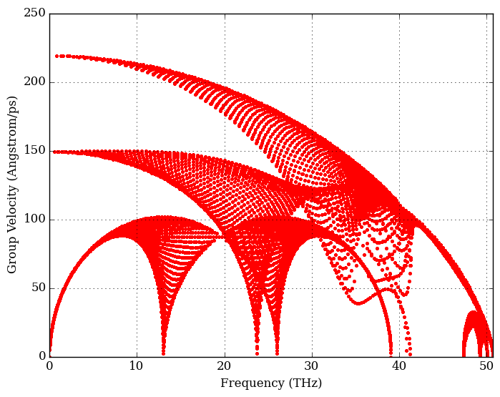
Analyze tc
phonon dos
scatter rate
group velocity
participation ratio

Slide 8
GNR
another ppt

Slide 9
Summery
Thermal Properties of Ar & GNR
Some tricks
GNR
Homework
prepare the final report

