Slide 1
MD Simulation for Calculating Thermal Conductivity of Argon
王嘉卿 11307110156

Slide 2
Content
EMD – Green-Kubo Method
Formulation
Error Analyze
NEMD – Muller-Plathe Method & Direct Thermostat
Formulation
Finite Size Effect

Slide 3
Green-Kubo Method
NVT + Small Fluctuation + Linear Response Theorem

Slide 4
MD Implementation
Interpretation:

Slide 5
MD Implementation
10*10*10 FCC Lattice, 4000 Argon Atoms
NVT Ensemble
Relax in NVE
Taking data,
Result: T=70K
kappa=0.4596 ±0.0028W/(m*K)

Slide 6
Error Analyze
Taking data before reaching steady state
Truncating correlation time
Variance in each correlation function

Slide 7
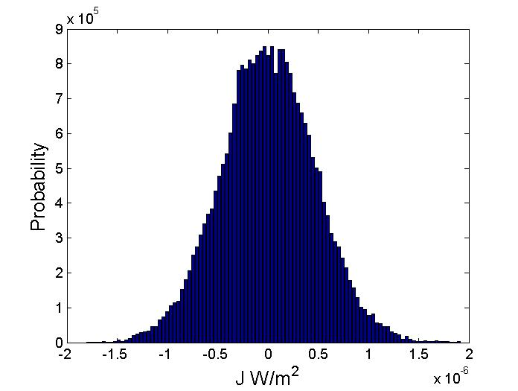
Error Analyze
Hellinger Metric
Reese E. Jones and Kranthi K. Mandadapu. The Journal of Chemical Physics 136, 154102 (2012)

Slide 8
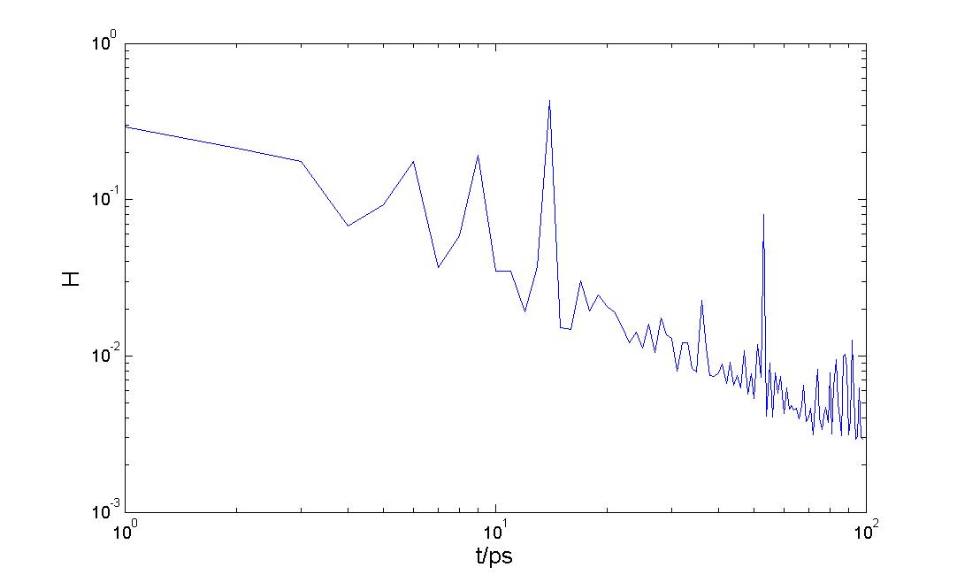
Error Analyze

Slide 9
Error Analyze
Taking data before reaching steady state
Truncating correlation time
Variance in each correlation function

Slide 10
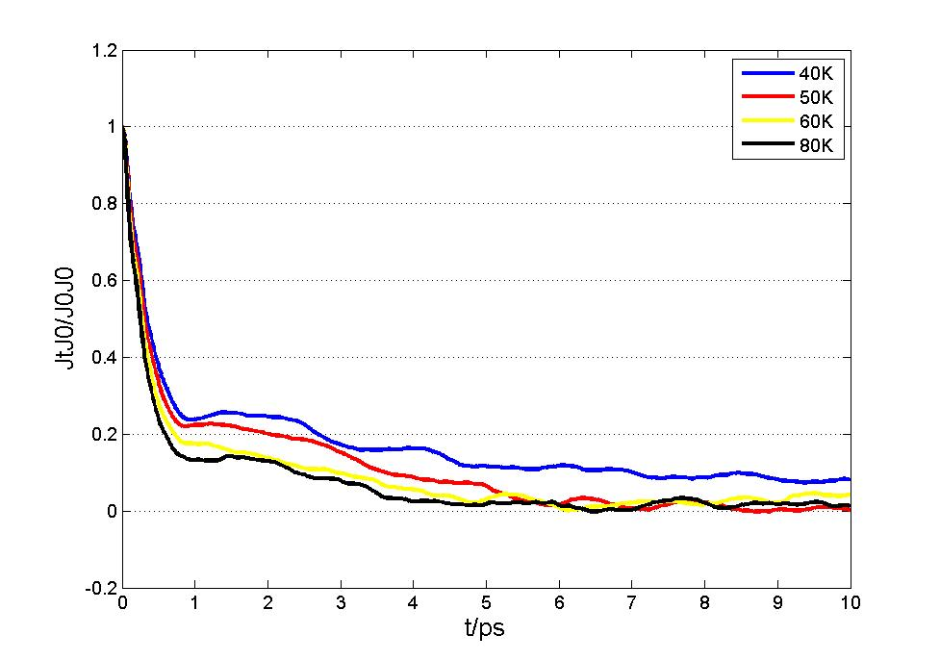
Error Analyze

Slide 11
Error Analyze
Taking data before reaching steady state
Truncating correlation time
Variance in each correlation function

Slide 12
Error Analyze

Slide 13
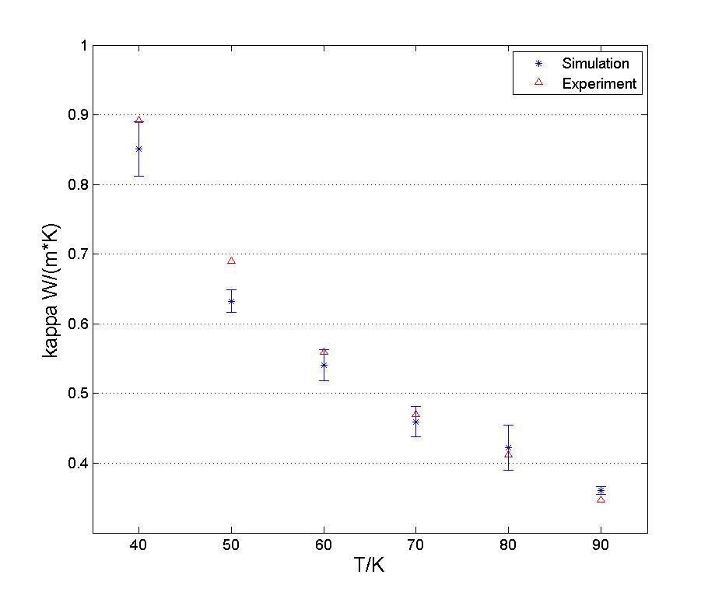
Final Result
Experimental Data: F. Clayton and D. N. Batchelder. J. Phys. C: Solid State Phys., Vol. 6, 1973

Slide 14
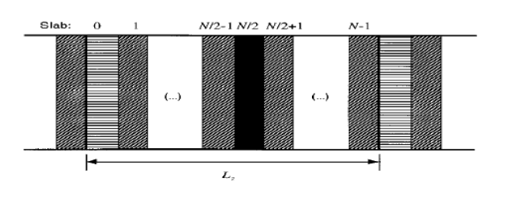
Muller-Plathe & Direct Thermostat Method

Slide 15
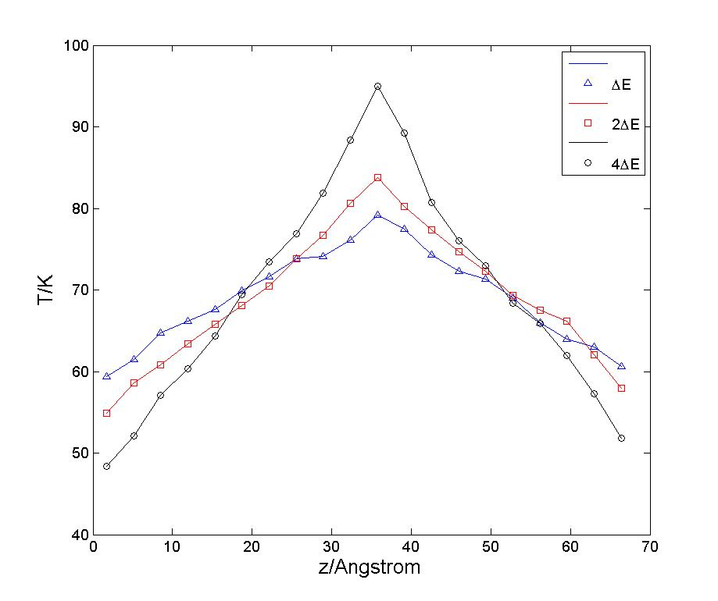
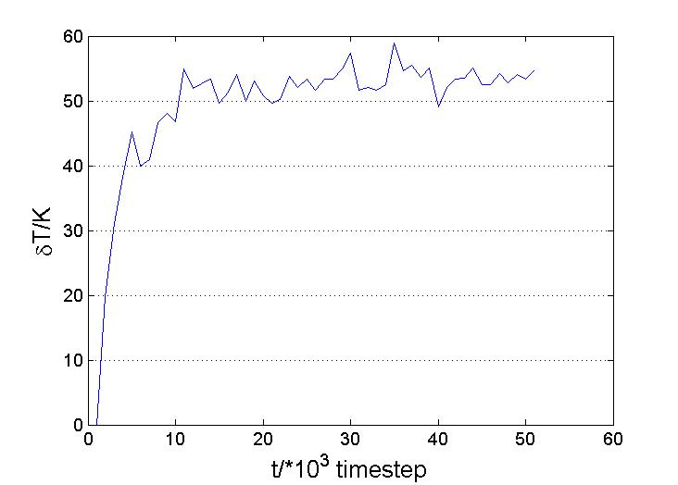

Slide 16
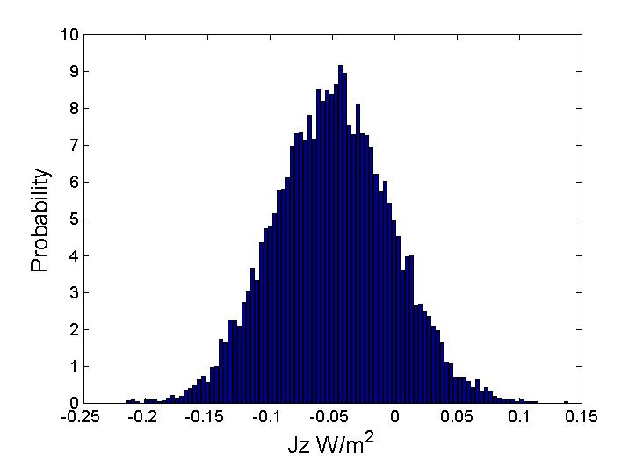
Result & Error Analyze
For a T=70K, 10*10*20 FCC system, kappa=0.345±0.052 W/(m*K)

Slide 17
Finite Size Effect
For a T=70K, 10*10*20 FCC system, kappa=0.3448±0.0518 W/(m*K)
Patrick K. Schelling, Simon R. Phillpot and Pawel Keblinski. PHYSICAL REVIEW B, VOLUME 65, 144306

Slide 18
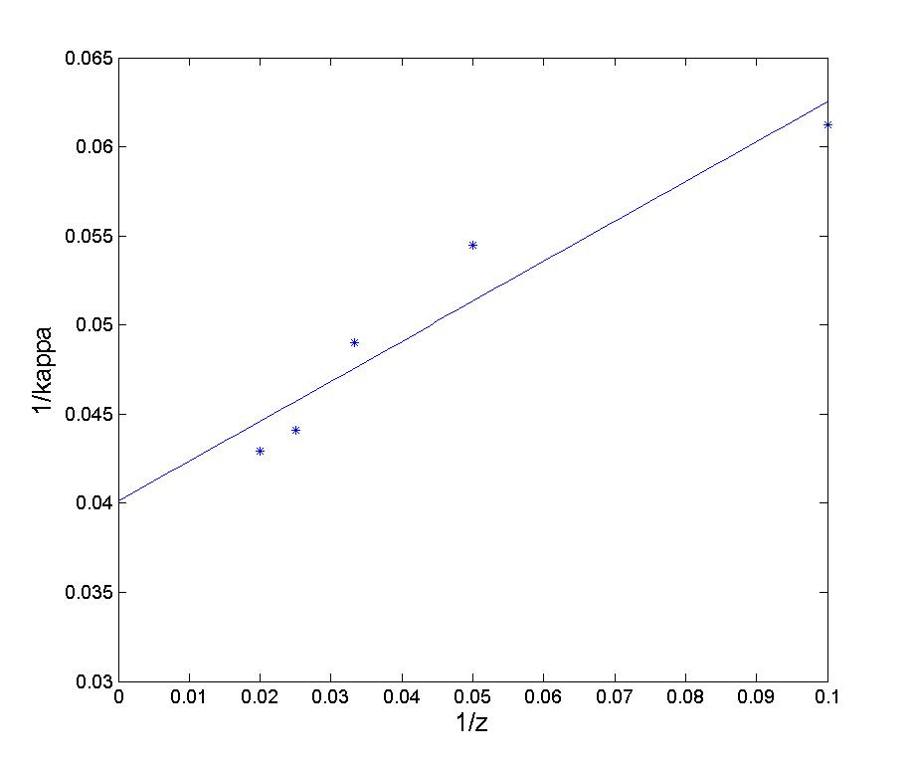
Finite Size Effect

