Slide 1


Thermal Conductivity Calculation of Argon
by Molecular Dynamics
Yang Zhou
@ Fudan University

Slide 2
Lecture 3 Calculate Thermal conductivity with LAMMPS

Slide 3
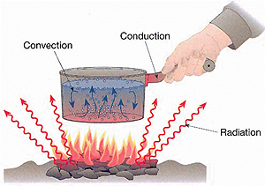
Heat Transfer
Heat transfer ：The phenomenon that heat energy transfer spontaneously from high temperature region to low temperature region when $∆T$ is presented.
Heat conduction：physical contact
Heat transfer
Convection：fluid motion
Radiation：electromagnetic wave.
Notes:
note2015.11.23
1） 把第一和第二页的title Basic Physics…改成短语
2 ) 减少字
3） 修改introduction，向电子器件的散热问题靠拢。

Slide 4
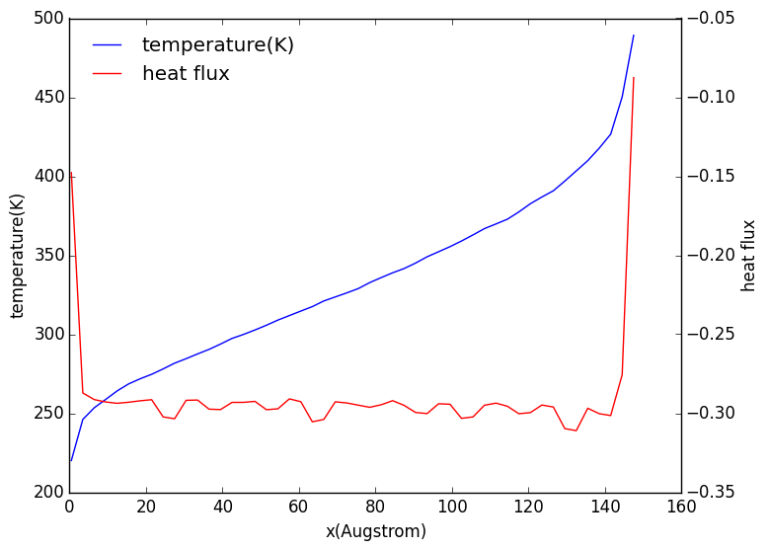
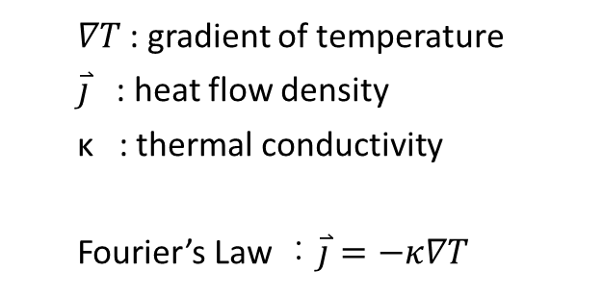
Fourier’s Law
Thermal conductivity : capability of heat conduction
$∇T$: gradient of temperature
$\overset{⃑}{j}$ : heat flow density
κ : thermal conductivity
Fourier’s Law ：$\overset{⃑}{j}=−κ∇T$
T : linear
heat flux : constant

Slide 5



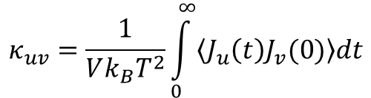
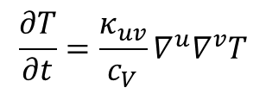

Diffusion Equation
$$J_{u}=−κ_{uv}∇^{v}T$$
$$\frac{∂e}{∂t}+∇^{u}∙J_{u}=0$$
$$\frac{∂T}{∂t}=\frac{κ_{uv}}{c_{V}}∇^{u}∇^{v}T$$
$$e=c_{V}T$$
$$c_{V}the specific heat$$
$$κ_{uv}=\frac{1}{Vk_{B}T^{2}}\int_{0}^{∞}{\left\langle J_{u}\left(t\right)J_{v}(0)\right\rangle dt}$$
Green-Kubo Formula
at equilibrium of T
prof.
Kaviany, Massoud, Heat Transfer Physics

Slide 6




Temperature Profile
Ballistic Phonon
when MFP is larger than the system then the temperature profile is like this , and phonon translate without scattering like this is called ballistic phonon.
this can be understand using black body radiation and Stefan-Boltzmann law
$$T_{2}$$
$$T_{3}^{4}=T_{1}^{4}+T_{2}^{4}$$
$$T_{3}$$
MFP~L
$$T_{1}$$
Fourier zone
sufficient scattering could build local equilibrium and we get Fourier law

Slide 7
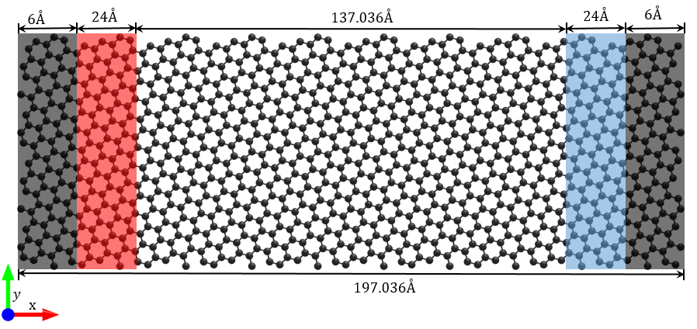
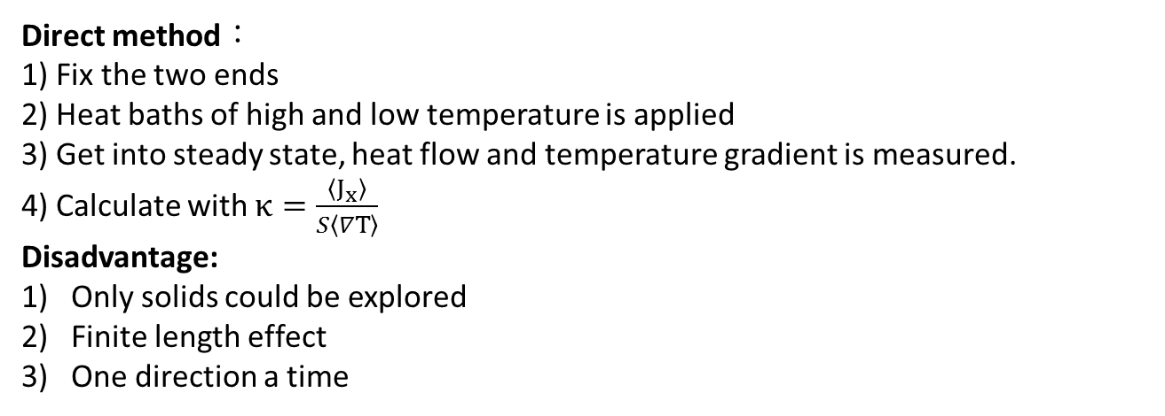
Direct method
Direct method：
1) Fix the two ends
2) Heat baths of high and low temperature is applied
3) Get into steady state, heat flow and temperature gradient is measured.
4) Calculate with $κ=\frac{〈J_{x}〉}{S〈∇T〉}$
Disadvantage:
Only solids could be explored
Finite length effect
One direction a time

Slide 8




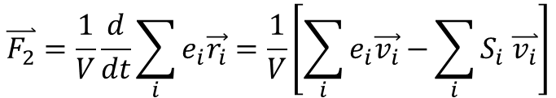
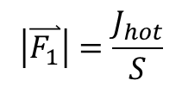


NEMD
$$J_{hot}$$
$$J_{cold}≈−J_{hot}$$
heat flow $\overset{⃑}{F}$
non-periodic
two ways to calculate heat flux
fit the temperature profile to get $∇T$
from source
$$\left|\overset{⃑}{F_{1}}\right|=\frac{J_{hot}}{S}$$
so we get $κ=\frac{\left|\overset{⃑}{F_{1}}\right|}{∇T}$
$$\overset{⃑}{F_{2}}=\frac{1}{V}\frac{d}{dt}\sum_{i}{e_{i}\vec{r_{i}}}=\frac{1}{V}\left[\sum_{i}{e_{i}\vec{v_{i}}−}\sum_{i}{S_{i} \overset{⃑}{v_{i}}}\right]$$
from definition
continuation equation：
$$\left|\overset{⃑}{F_{1}}\right|=\left|\overset{⃑}{F_{2}}\right|$$
particle flow
through potential

Slide 9
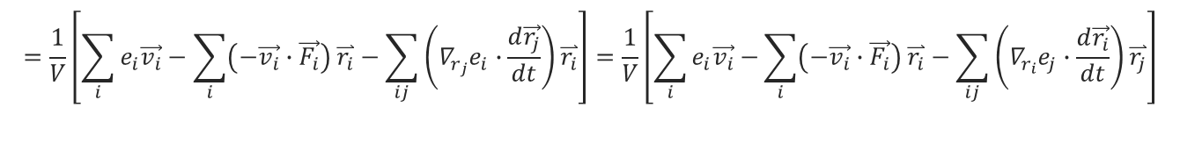

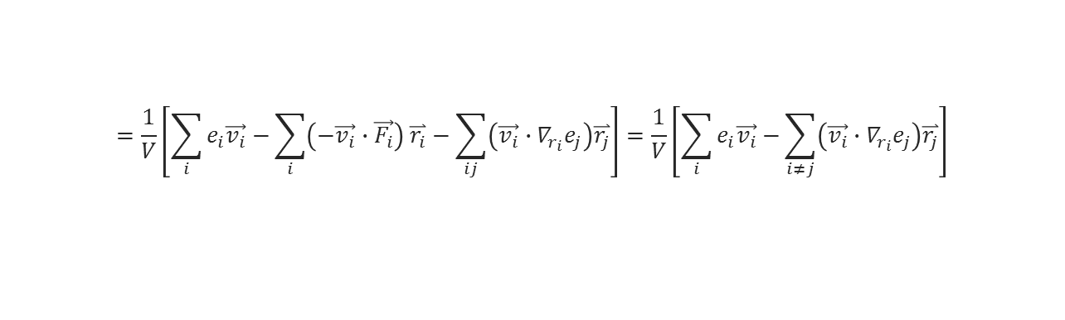

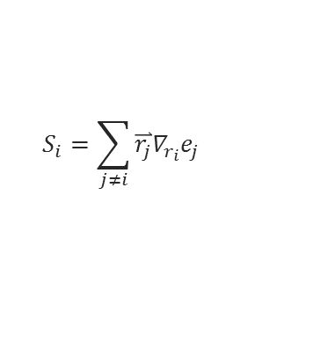
NEMD
$$e_{i}(v_{i}, {\left\{r_{j}\right\}}_{ })$$
$$\overset{⃑}{F_{2}}=\frac{1}{V}\frac{d}{dt}\sum_{i}{e_{i}\vec{r_{i}}}=\frac{1}{V}\left[\sum_{i}{e_{i}\frac{d\vec{r_{i}}}{dt}−}\sum_{i}{\frac{de_{i}}{dt}\vec{r_{i}}}\right]=\frac{1}{V}\left[\sum_{i}{e_{i}\vec{v_{i}}−}\sum_{i}{\left(∇_{v_{i}}e_{i}\frac{d\vec{v_{i}}}{dt}+\sum_{j}{∇_{r_{j}}e_{i}∙\frac{d\vec{r_{j}}}{dt}}\right)\overset{⃑}{r_{i}}}\right]$$
$$=\frac{1}{V}\left[\sum_{i}{e_{i}\vec{v_{i}}}−\sum_{i}{\left(−\vec{v_{i}}∙\vec{F_{i}}\right) \overset{⃑}{r_{i}}}−\sum_{ij}{\left(∇_{r_{j}}e_{i}∙\frac{d\vec{r_{j}}}{dt}\right)\overset{⃑}{r_{i}}}\right]=\frac{1}{V}\left[\sum_{i}{e_{i}\vec{v_{i}}−}\sum_{i}{\left(−\vec{v_{i}}∙\vec{F_{i}}\right) \overset{⃑}{r_{i}}}−\sum_{ij}{\left(∇_{r_{i}}e_{j}∙\frac{d\vec{r_{i}}}{dt}\right)\overset{⃑}{r_{j}}}\right]$$
$$=\frac{1}{V}\left[\sum_{i}{e_{i}\vec{v_{i}}−}\sum_{i}{\left(−\vec{v_{i}}∙\vec{F_{i}}\right) \overset{⃑}{r_{i}}}−\sum_{ij}{\left(\vec{v_{i}}∙∇_{r_{i}}e_{j}\right)\overset{⃑}{r_{j}}}\right]=\frac{1}{V}\left[\sum_{i}{e_{i}\vec{v_{i}}−}\sum_{i≠j}{\left(\vec{v_{i}}∙∇_{r_{i}}e_{j}\right)\overset{⃑}{r_{j}}}\right]$$
$$=\frac{1}{V}\left[\sum_{i}{e_{i}\vec{v_{i}}−}\sum_{i}{S_{i}\vec{v_{i}}}\right]$$
$$S_{i}=\sum_{j≠i}{\overset{⃑}{r_{j}}∇_{r_{i}}e_{j}}$$
is called stress tensor
compute myKE all ke/atom
compute myPE all pe/atom
compute myStress all stress/atom NULL virial
compute flux all heat/flux myKE myPE myStress
variable Jx equal c_flux[1]/vol
variable Jy equal c_flux[2]/vol
variable Jz equal c_flux[3]/vol

Slide 10
NEMD
same with ave/time
fix 2 all ave/spatial 10 100 1000 z lower 0.05 v_temp file profile.langevin units box
real length unit
0.05
0.05
0.05
box low
box high
z
lower

Slide 11
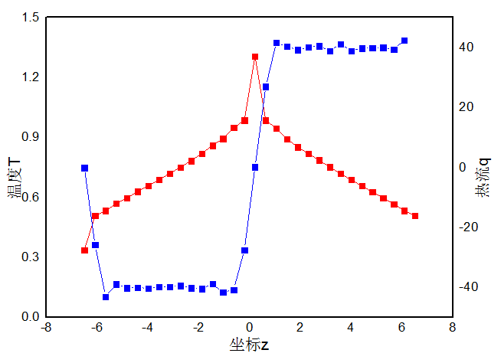
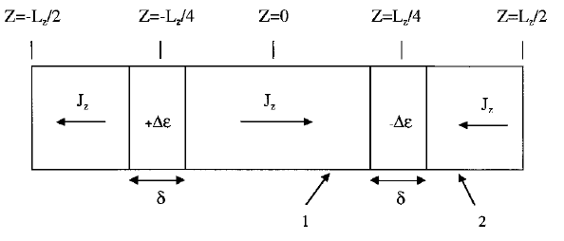
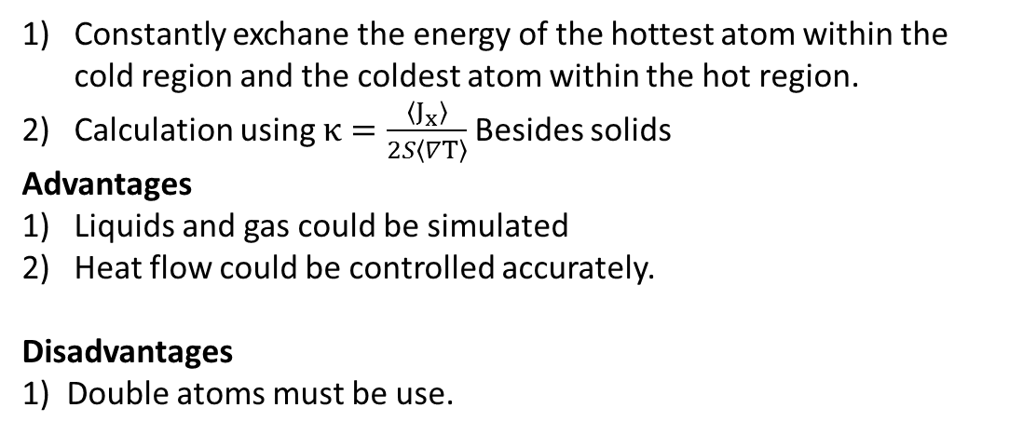
Muller-Plathe Method
Constantly exchane the energy of the hottest atom within the cold region and the coldest atom within the hot region.
Calculation using $κ=\frac{〈J_{x}〉}{2S〈∇T〉}$Besides solids
Advantages
Liquids and gas could be simulated
Heat flow could be controlled accurately.
Disadvantages
1) Double atoms must be use.

Slide 12


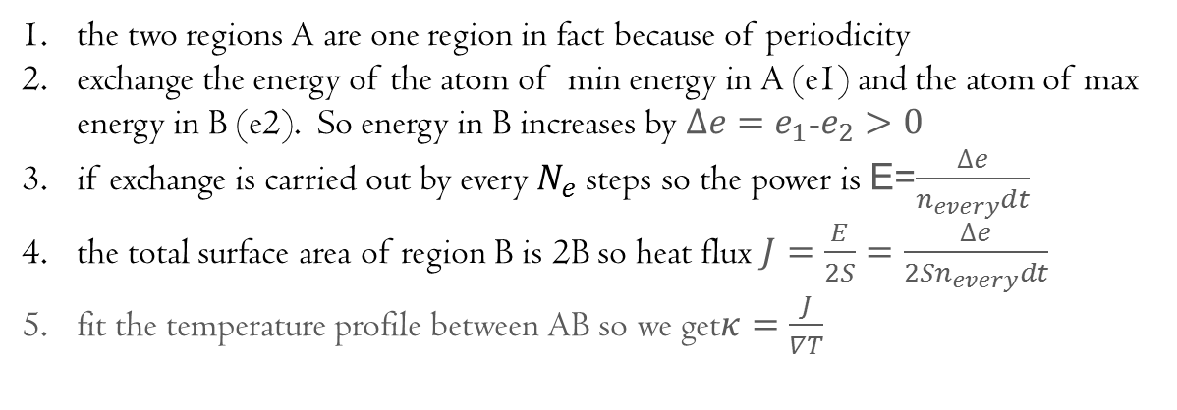

Muller-Plathe Method
Florian Muller-Plathe. J. Chem. Phys. 1997, 106(14)
$$J_{hot}$$
$$J_{cold}≈−J_{hot}$$
heat flow $\overset{⃑}{F}$
A
S
B
S
A
periodic
the two regions A are one region in fact because of periodicity
exchange the energy of the atom of min energy in A (e1) and the atom of max energy in B (e2). So energy in B increases by $∆e=e_{1}$-$e_{2}>0$
if exchange is carried out by every $N_{e}$ steps so the power is E=$\frac{∆e}{n_{every}dt}$
the total surface area of region B is 2B so heat flux $J=\frac{E}{2S}=\frac{∆e}{{2Sn}_{every}dt}$
fit the temperature profile between AB so we get$κ=\frac{J}{∇T}$

Slide 13
Muller-Plathe Method
direction
fix heat_swap all thermal/conductivity $n_{every}$ z $N$
1
9
（even）
N=16
A
B
A

Slide 14
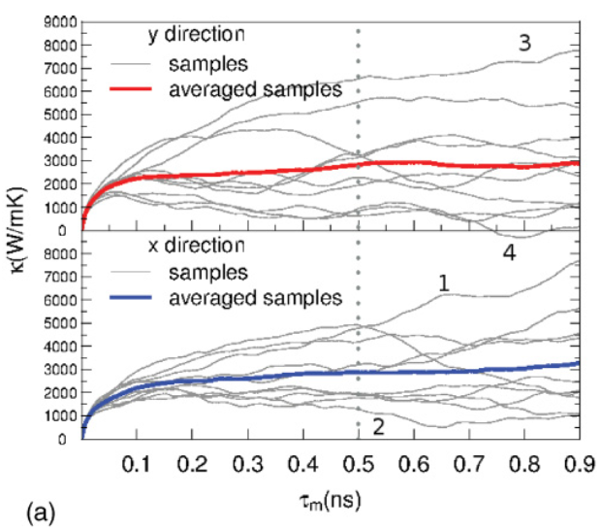

Green-Kubo Method
Calculated by integrate the heat flux autocorrelation function , which is based on a formula from Fluctuation dissipation theorem.
Advantages:
1) The size of the system is not needed to be too large
2) The whole thermal conductivity tensor could be obtained within one simulation
3) The temperature is uniform under equilibrium.
Disadvantages:
The average heat flux autocorrelation function converges really slow =>much computational affordance.
Zhang, H. et.al. Phys. Rev. B 2011, 84 (11), 115460.

Slide 15
Compare
At $T=0.71 ,ρ=0.844$, thermal conductivity of Argon calculated with three methods:
 | direct | Muller-Plathe | Green-Kubo
Condition | 20x10x10 | 20x10x10 | 10x10x10 , 12 seeds
Tc (W/mK) | 0.126 | 0.127 | 0.124

Slide 16
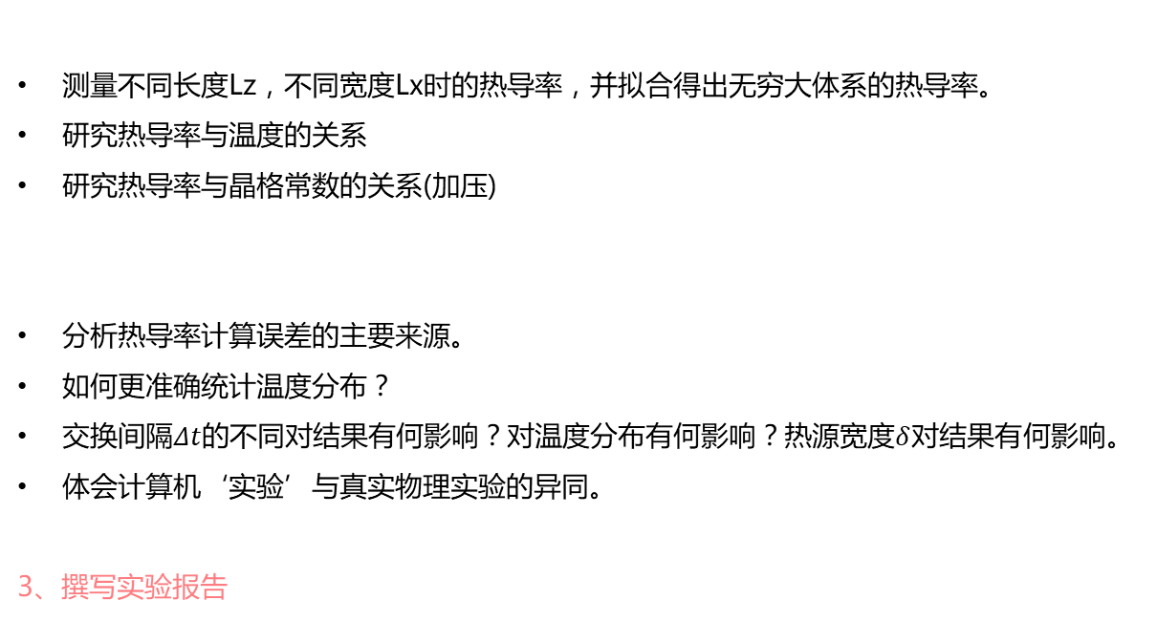
Project
1、影响热导率的因素：
测量不同长度Lz，不同宽度Lx时的热导率，并拟合得出无穷大体系的热导率。
研究热导率与温度的关系
研究热导率与晶格常数的关系(加压)
分析热导率计算误差的主要来源。
如何更准确统计温度分布？
交换间隔$Δt$的不同对结果有何影响？对温度分布有何影响？热源宽度$δ$对结果有何影响。
体会计算机‘实验’与真实物理实验的异同。
3、撰写实验报告
2、分析讨论:

Slide 17
Homework
仔细阅读本节课涉及的lammps命令，弄清热导率计算的详细过程。
开始课程大作业

Slide 18
THANK FOR YOUR ATTENTION!
Yang Zhou
@ Fudan University

