Slide 1


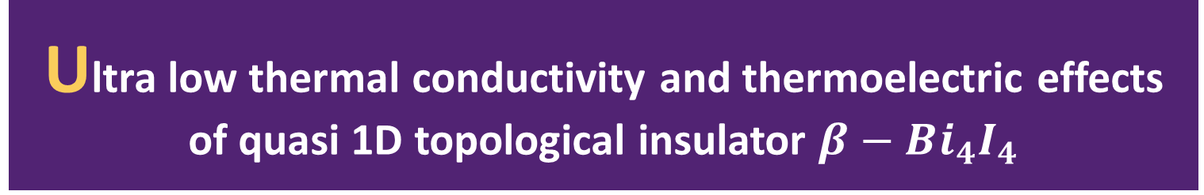
Ultra low thermal conductivity and thermoelectric effects of quasi 1D topological insulator $β−Bi_{4}I_{4}$
Yang Zhou
@ Fudan University

Slide 2
INTRODUCTION
1. Thermoelectricity
2. The potential of topological insulator and nanowire in the field of thermoelectricity
3. A recently synthetized quasi 1D topological insulator $β−Bi_{4}I_{4}$
4. From first principle we systematically investigate the phonon anharmonic thermal conductivity , Seebeck coefficient and electric conductivity with phonon-electron coupling considered

Slide 3



INTRODUCTION
1. Thermoelectricity
What is thermoelectricity
High T
Low T

Slide 4
INTRODUCTION
1. Thermoelectricity
Thermoelectricity
Peltier effect
Seebeck Effect
Thomson

Slide 5
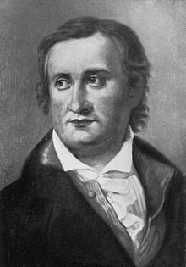



INTRODUCTION
Seebeck Effect
e
Dipole E
e
e
Space charge
e
e
Thomas Johann Seebeck
T1
(1770 -1831)
T2
V
$$V\sim \left(T_{1} −T_{2}\right)⇒seebeck coeffecient S=\frac{dV}{dT}$$
Spin Seebeck Effect:
e
$$|↑>$$
e
$$|↓>$$

Slide 6
INTRODUCTION
Seebeck Effect
T1
Conductor A
Thomas Johann Seebeck
Conductor B
(1770 -1831)
T2
V
$$relative seebeck coeffecient S_{AB}=S_{A}−S_{B}$$
V1
V2
e
e
e
e
e
e
T2
T2
e
e
e
e
T1

Slide 7
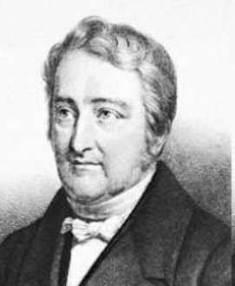
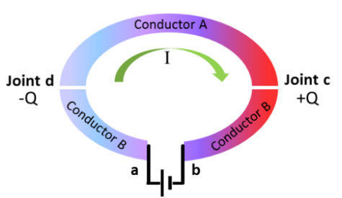
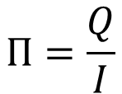
INTRODUCTION
Peltier Effect
Peltier
（1785-1845）
Peltier Coefficient
$$Π=\frac{Q}{I}$$

Slide 8
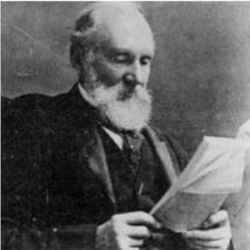
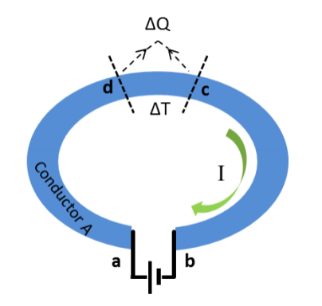

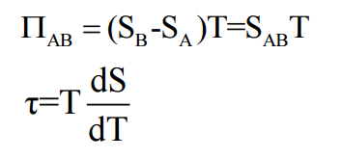
INTRODUCTION
Thomson Effect
Thomson Coefficient
William Thomson (Lord Kelvin)
（1824-1907）
Contributions :
Temperature Unit Kelvin
Kelvin Relations
Joule -Thomson Effect

Slide 9
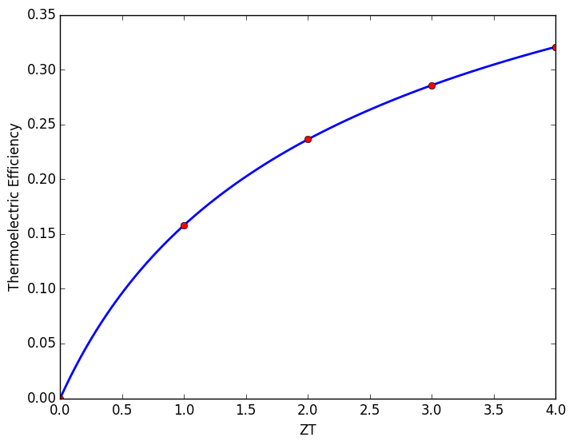

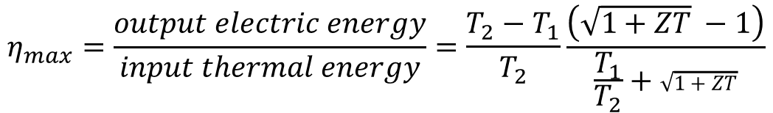
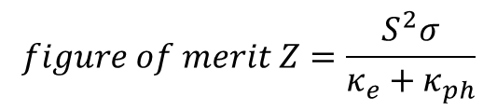
INTRODUCTION
Thermoelectric Efficiency
$$η_{max}=\frac{output electric energy}{input thermal energy}=\frac{T_{2}−T_{1}}{T_{2}}\frac{\left(\sqrt{1+ZT} −1\right)}{\frac{T_{1}}{T_{2}}+\sqrt{1+ZT}}$$
$$T=\frac{T_{1}+T_{2}}{2}$$
$$figure of merit Z=\frac{S^{2}σ}{κ_{e}+κ_{ph}}$$
When T2=900K ,T1=300K

Slide 10
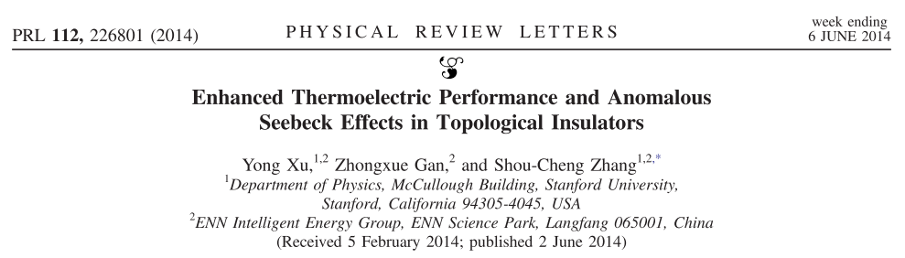
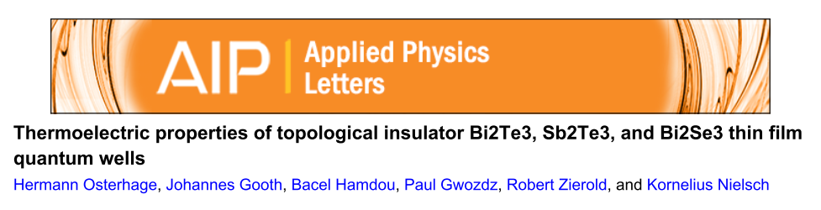
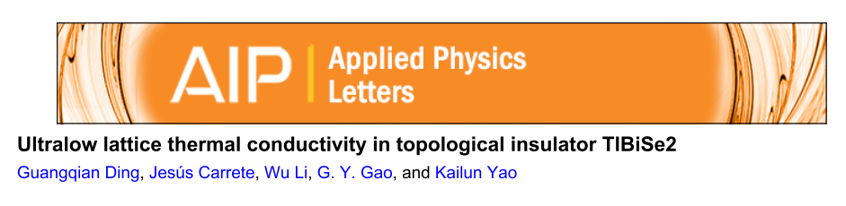
INTRODUCTION
2. The potential of topological insulator and nanowire in the field of thermoelectricity
Topological Insulator
narrow band gaps ->large Power Factor
heavy elements -> low TC
Y. Xu, Z. Gan and S. C. Zhang, Phys. Rev. Lett., 2014, 112, 1–5.
H. Osterhage, J. Gooth, B. Hamdou, P. Gwozdz, R. Zierold and K. Nielsch, Appl. Phys. Lett., 2014, 105, 2012–2017.
G. Ding, J. Carrete, W. Li, G. Y. Gao and K. Yao, Appl. Phys. Lett., 2016, 108, 233902.

Slide 11
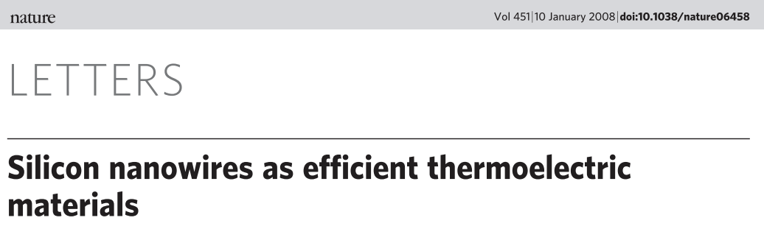
INTRODUCTION
2. The potential of topological insulator and nanowire in the field of thermoelectricity
A. I. Boukai, Y. Bunimovich, J. Tahir-Kheli, J.-K. Yu, W. A. Goddard and J. R. Heath, Nature, 2008, 451, 168–71.
Large reduction in TC while keep the value of power factor

Slide 12
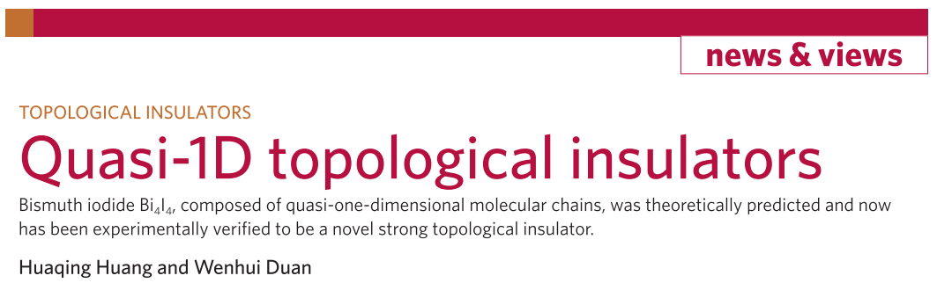
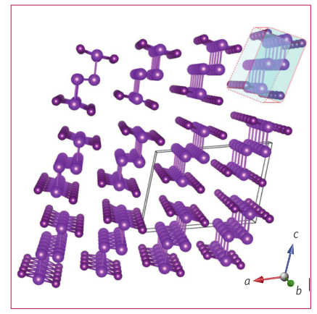
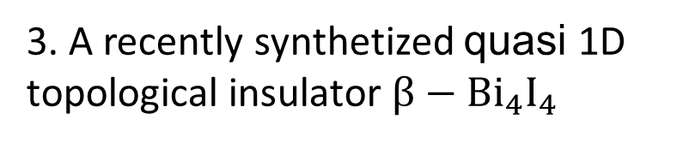
INTRODUCTION
3. A recently synthetized quasi 1D topological insulator $β−Bi_{4}I_{4}$
H. Huang and W. Duan, Nat. Mater., 2016, 15, 129–130.

Slide 13
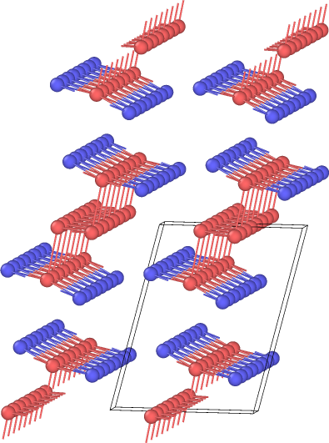
COMPUTATIONAL DETAILS
1. Phonon dos : Phonopy +VASP 3x3x3 supercell 2x2x2 kpoints
2. TC: ShengBTE + VASP 4x4x4 supercell 2x2x2 kpoints
3. Electronic band & dos: VASP 10x10x10 kpoints
4. e-p coupling : EPW+ QE 4x4x4 qpoints 6x6x6 kpoints

Slide 14
RESULTS & ANALYSIS
1. Band , dos and topological properties
2. Phonon dispersion & dos
3. Phonon Related Properties
4. Thermal Conductivity
5. Seebeck Coefficient and power factor and ZT
6. e-p coupling and it’s effects on electric conductivity and TC

Slide 15
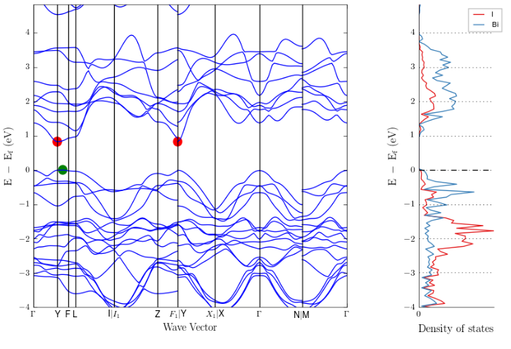
RESULTS & ANALYSIS
Band , dos and topological properties

Slide 16
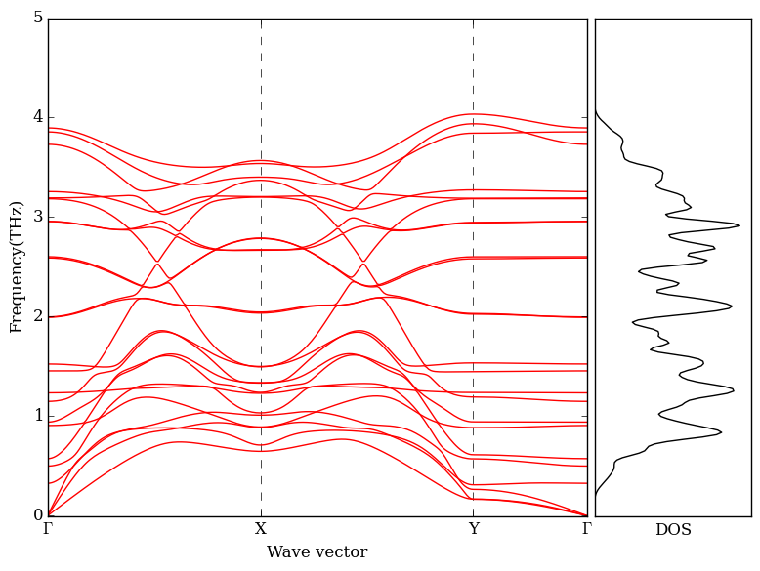
RESULTS & ANALYSIS
Phonon dispersion & dos

Slide 17
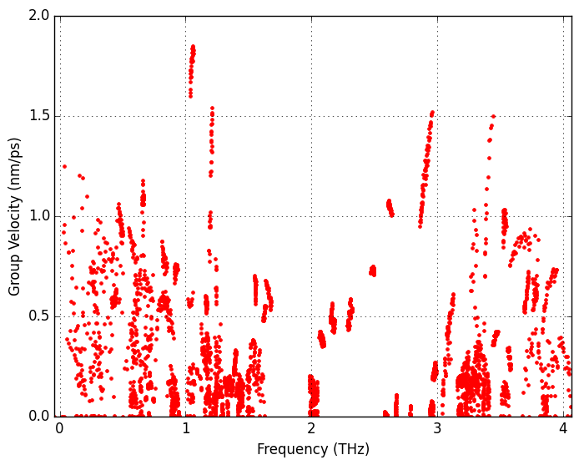
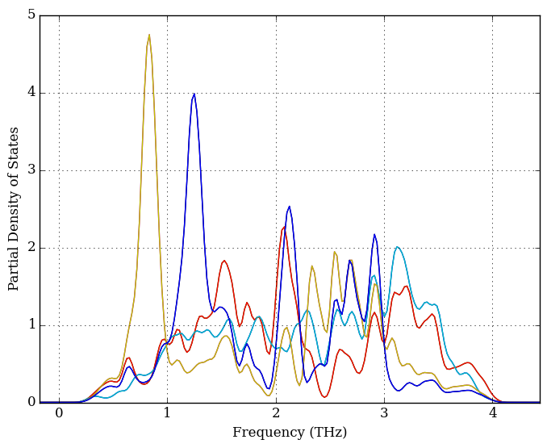
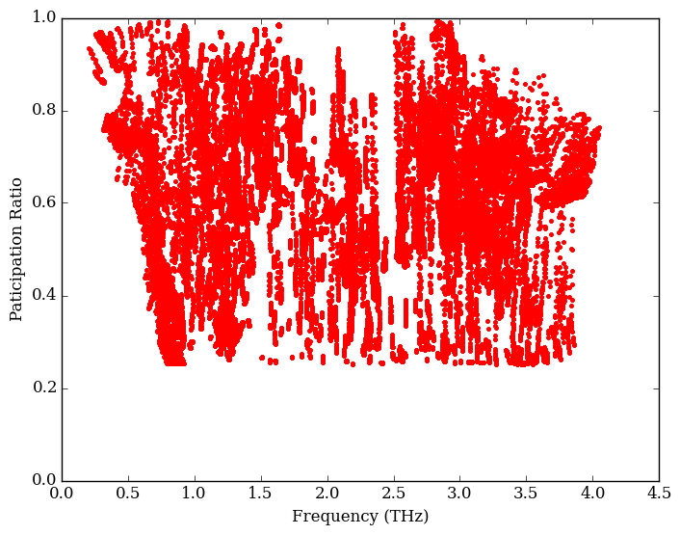
RESULTS & ANALYSIS
Phonon Related Properties

Slide 18
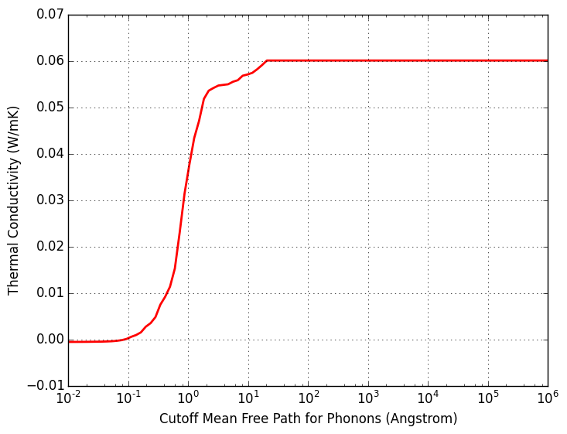
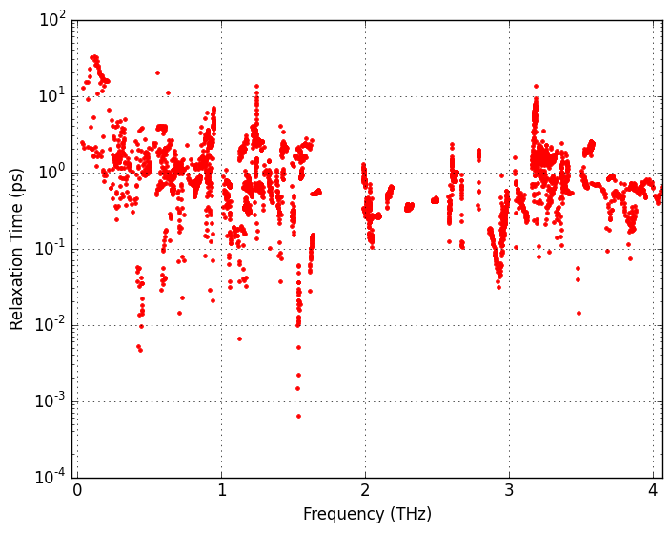
RESULTS & ANALYSIS
Thermal Conductivity

Slide 19
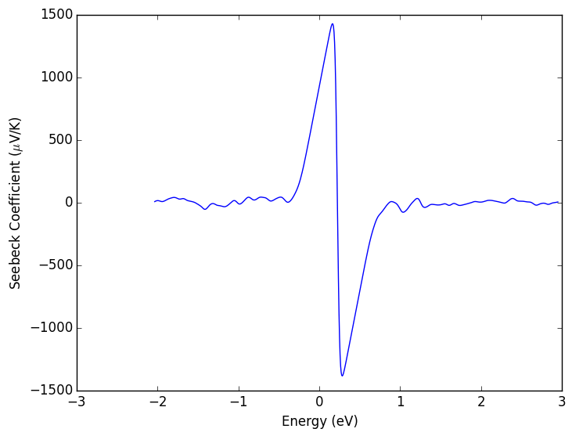
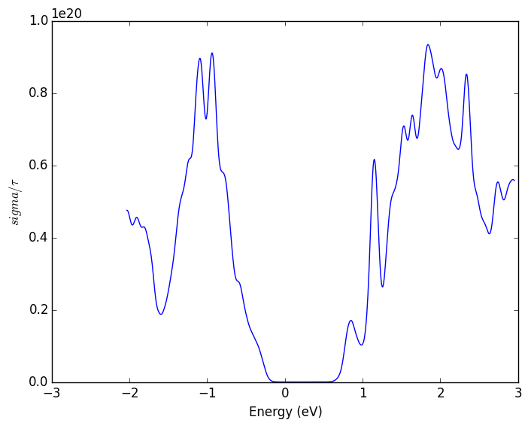
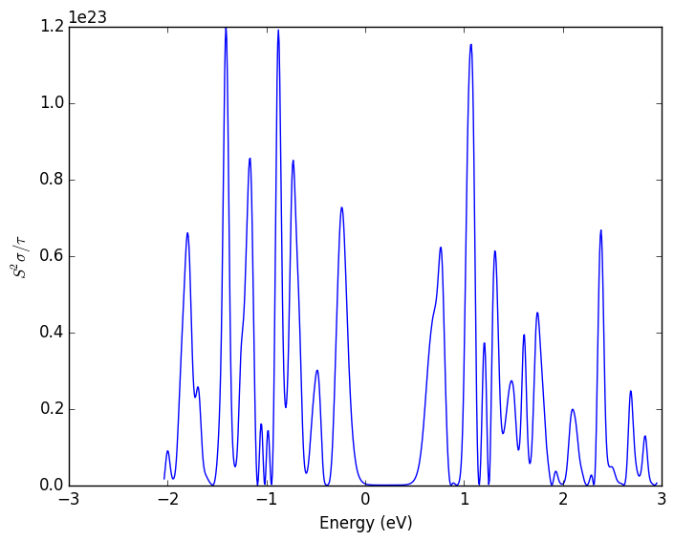
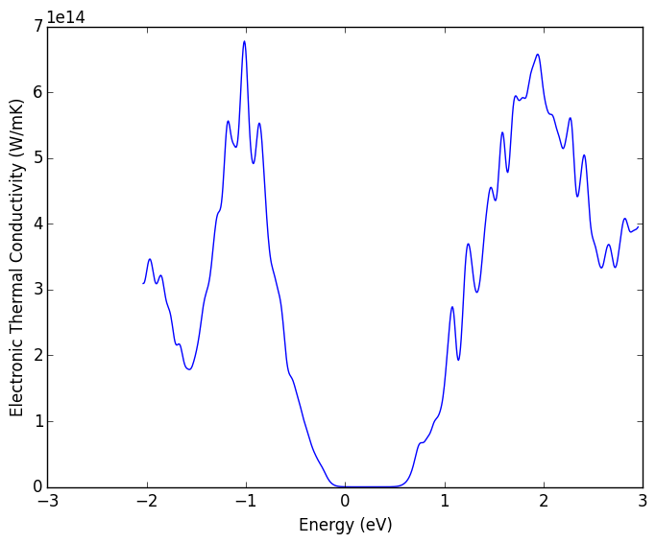
RESULTS & ANALYSIS
Seebeck Coefficient , power factor and ZT

Slide 20
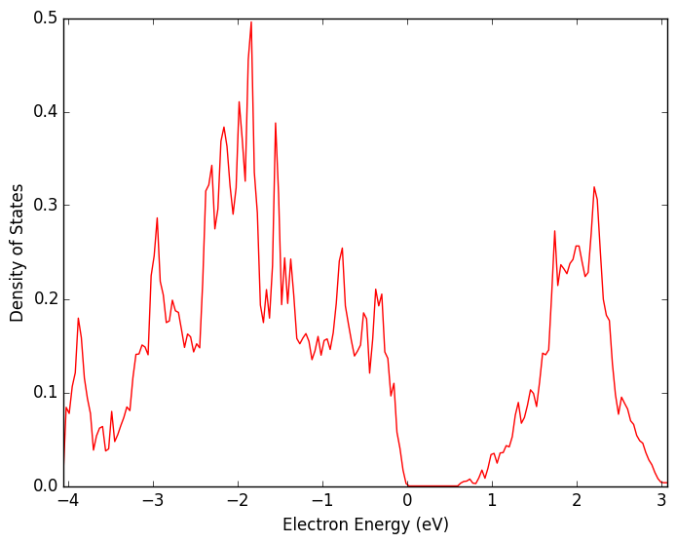
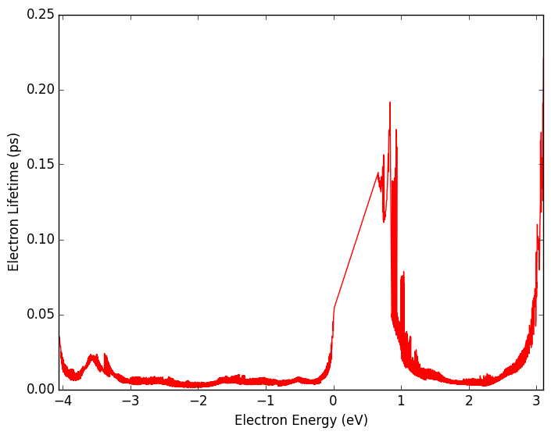
RESULTS & ANALYSIS
e-p coupling and it’s effects on electric conductivity and TC

Slide 21
CONCLUSION
1. From first principle we systematically investigate the phonon anharmonic thermal conductivity , Seebeck coefficient and electric conductivity with phonon-electron coupling considered
2. We found the low thermal conductivity is caused by the strong anharmonic scattering.

Slide 22
THANK FOR YOUR ATTENTION!
Yang Zhou
@ Fudan University

