Slide 1


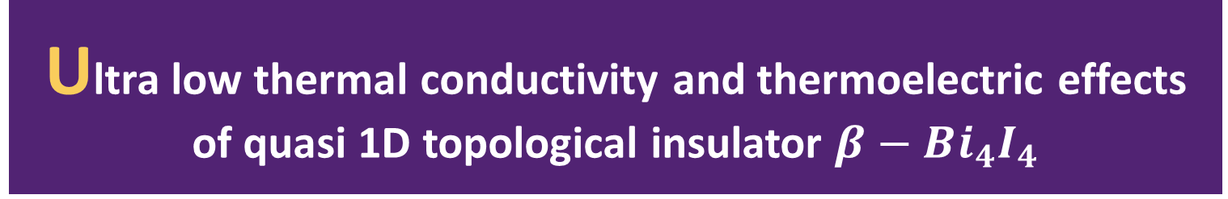
Ultra low thermal conductivity and thermoelectric effects of quasi 1D topological insulator $β−Bi_{4}I_{4}$
Yang Zhou
@ Fudan University

Slide 2
INTRODUCTION
1. Thermoelectricity
2. The potential of topological insulator and nanowire in the field of thermoelectricity
3. A recently synthetized quasi 1D topological insulator $β−Bi_{4}I_{4}$
4. From first principle we systematically investigate the phonon anharmonic thermal conductivity , Seebeck coefficient , electric conductivity and ZT

Slide 3
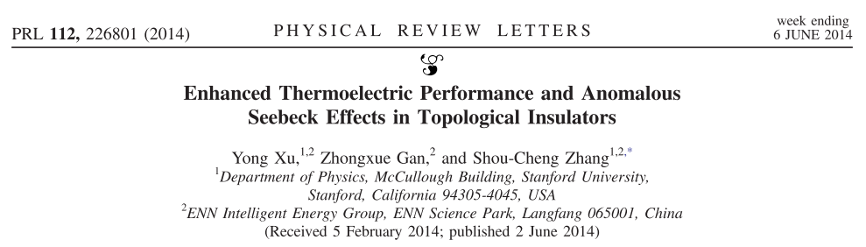
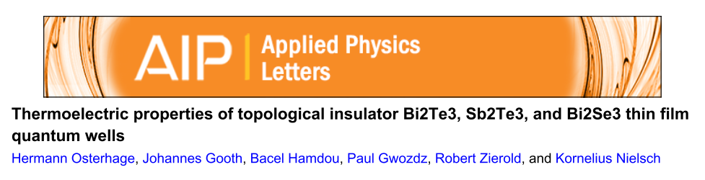
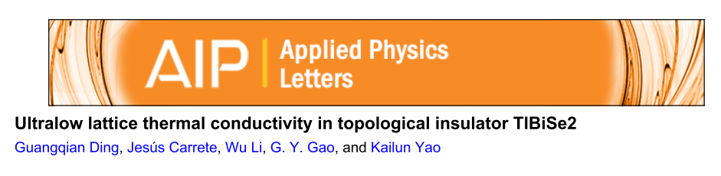
INTRODUCTION
2. The potential of topological insulator and nanowire in the field of thermoelectricity
Topological Insulator
narrow band gaps ->large Power Factor
heavy elements -> low TC
Y. Xu, Z. Gan and S. C. Zhang, Phys. Rev. Lett., 2014, 112, 1–5.
H. Osterhage, J. Gooth, B. Hamdou, P. Gwozdz, R. Zierold and K. Nielsch, Appl. Phys. Lett., 2014, 105, 2012–2017.
G. Ding, J. Carrete, W. Li, G. Y. Gao and K. Yao, Appl. Phys. Lett., 2016, 108, 233902.

Slide 4
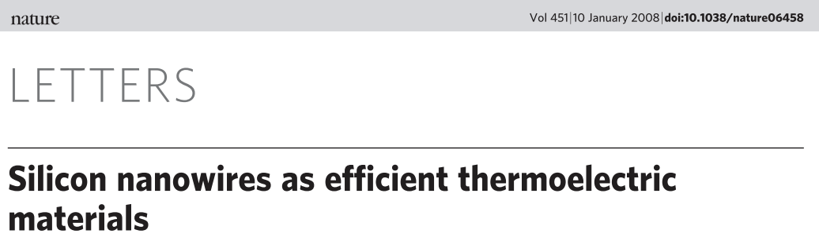
INTRODUCTION
2. The potential of topological insulator and nanowire in the field of thermoelectricity
A. I. Boukai, Y. Bunimovich, J. Tahir-Kheli, J.-K. Yu, W. A. Goddard and J. R. Heath, Nature, 2008, 451, 168–71.
Large reduction in TC while keep the value of power factor

Slide 5
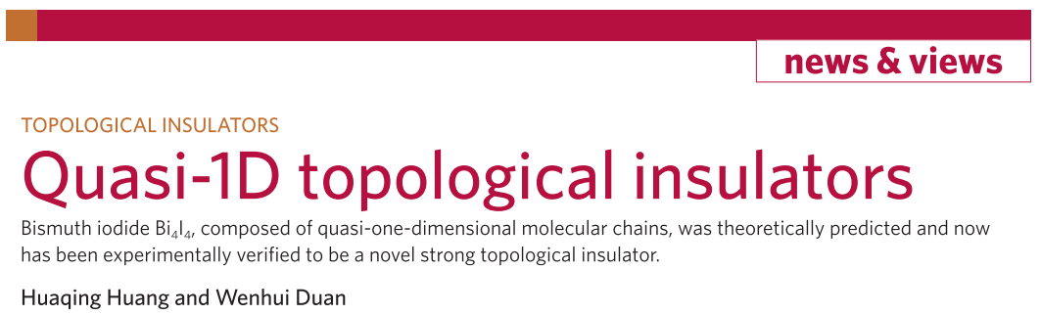
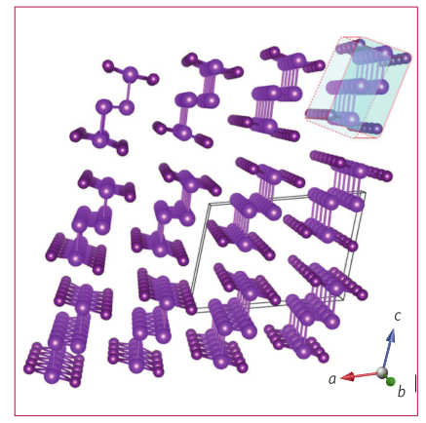
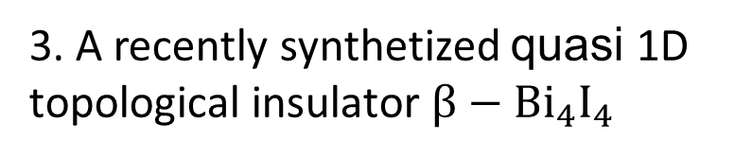
INTRODUCTION
3. A recently synthetized quasi 1D topological insulator $β−Bi_{4}I_{4}$
H. Huang and W. Duan, Nat. Mater., 2016, 15, 129–130.

Slide 6
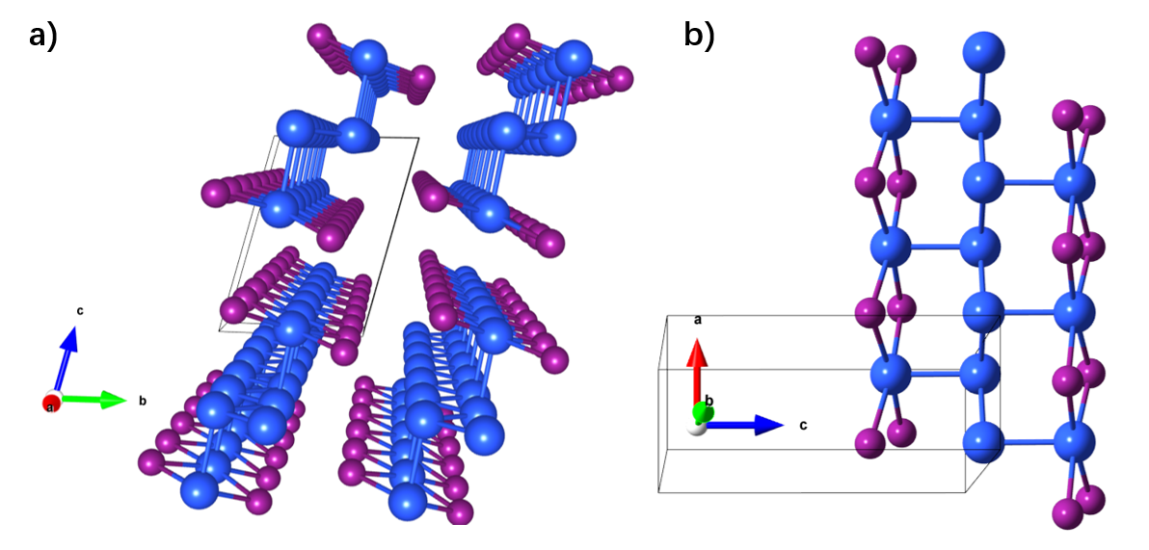
Structure
Quasi 1D material
1D building block
Perspective
Sideview

Slide 7
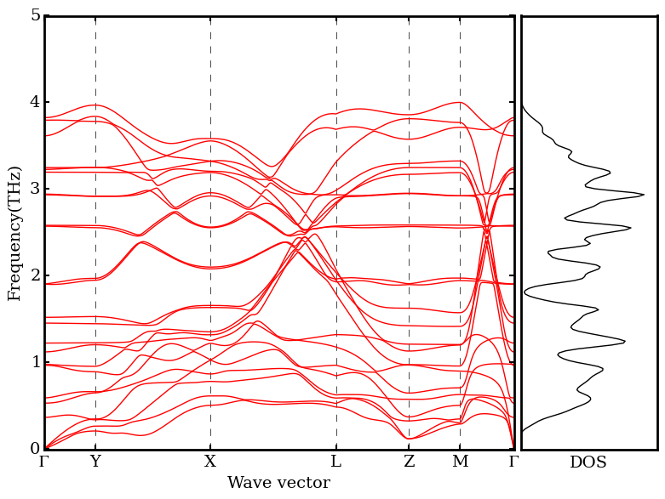
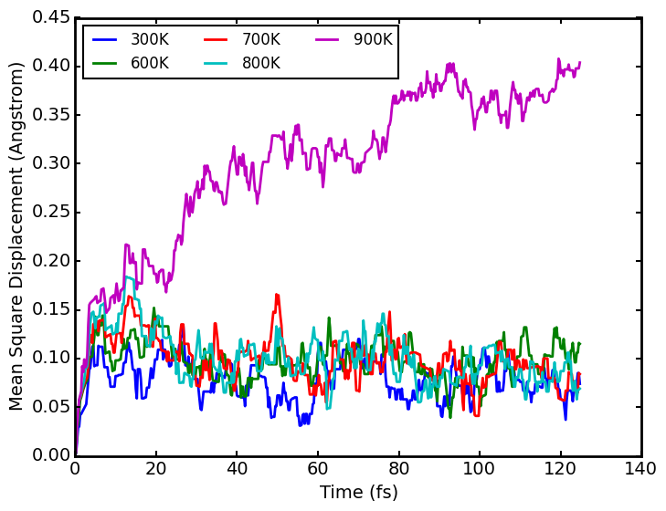
Stability of Structure
Dynamical Stability
Thermal Stability
The high symmetry k points are: Γ (0, 0, 0), Y (0, 1/2, 0), X (1/2, 0, 0), L ([ 0,0.67, 0.33]), Z (0,0,1/2) and M (0, 1/2, 1/2).

Slide 8
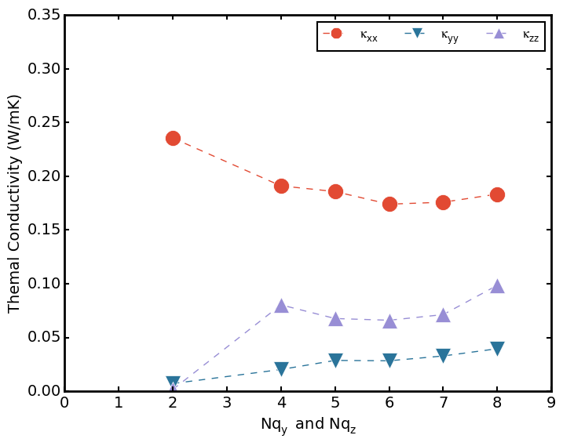
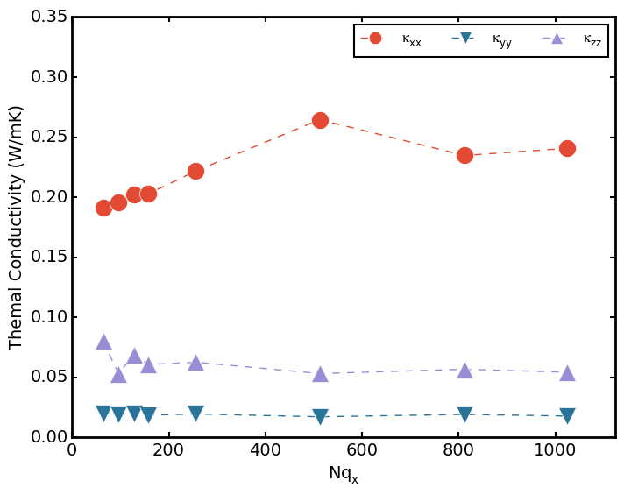
Convergence of TC
Transverse Convergence(Nqz=64)
Longitude Convergence(Nqy=Nqz=4)

Slide 9
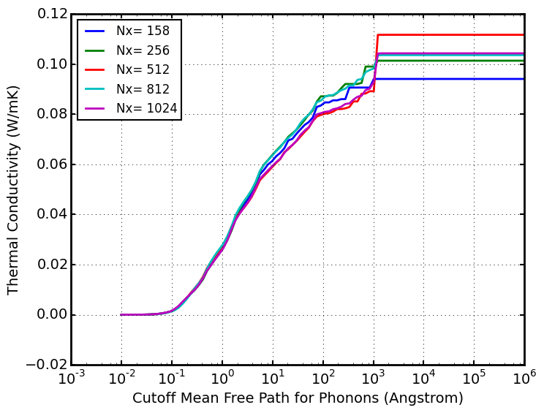
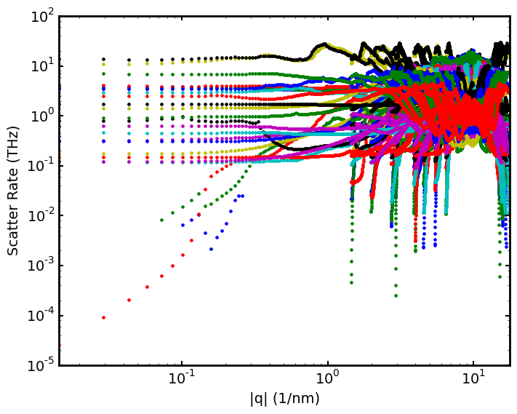
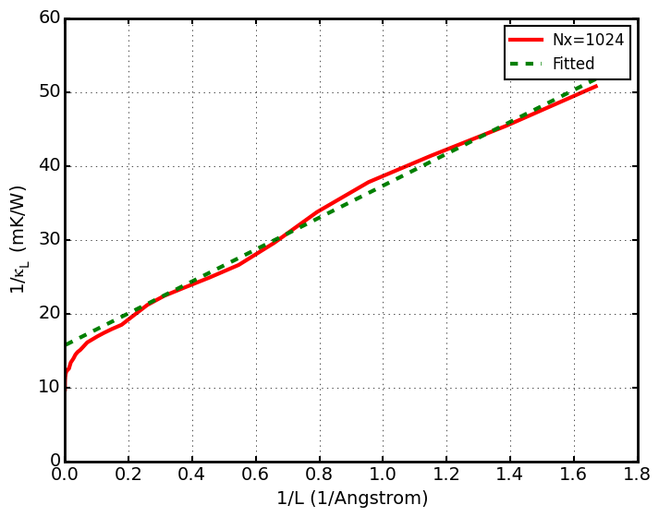
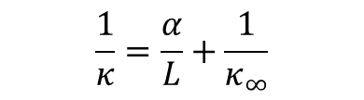
Convergence of TC
Difficult to converge due to 1D nature
$$\frac{1}{κ}=\frac{α}{L}+\frac{1}{κ_{∞}}$$

Slide 10
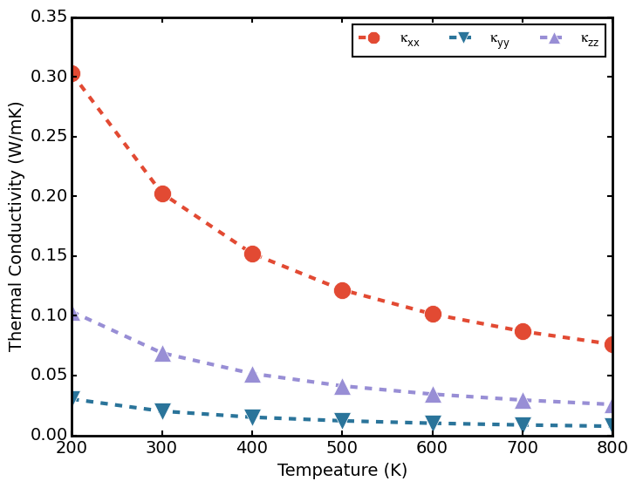
TC Vs. Temperature

Slide 11
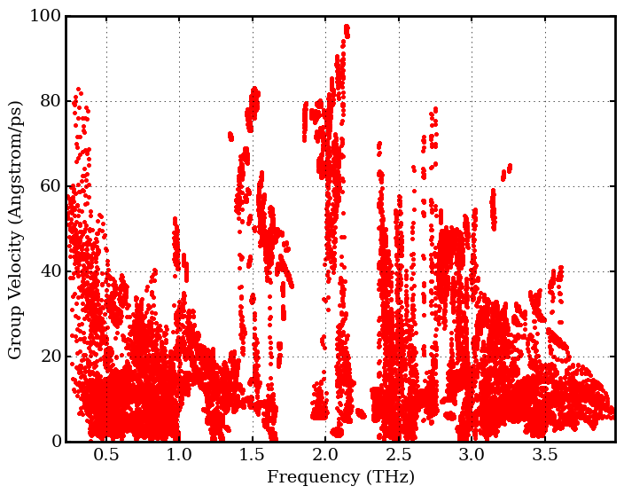
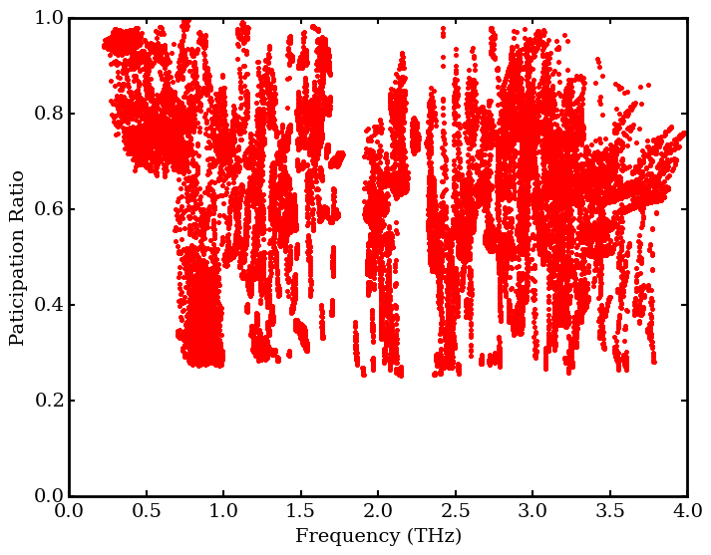
Why TC is small
From harmonic aspects

Slide 12
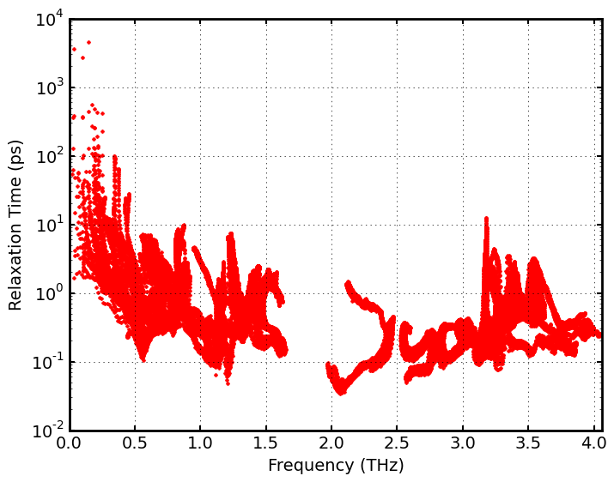
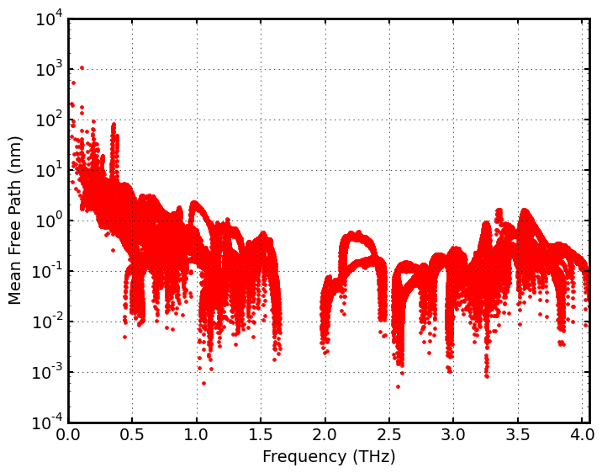
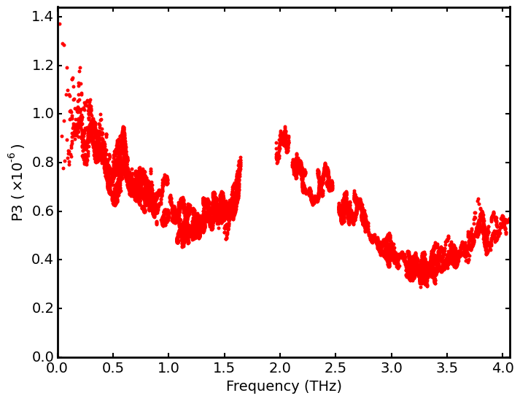
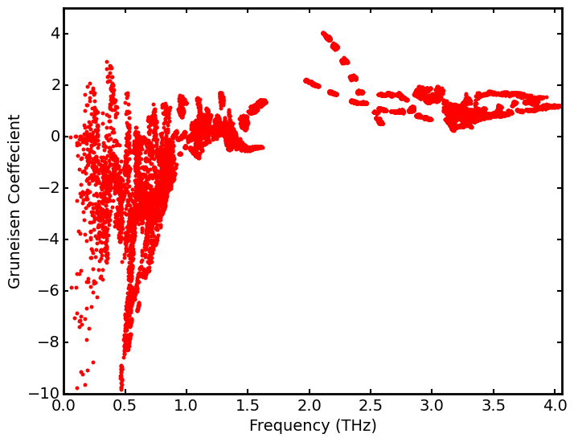
Why TC is small
From anharmonic aspects

Slide 13
Why TC is small

Slide 14
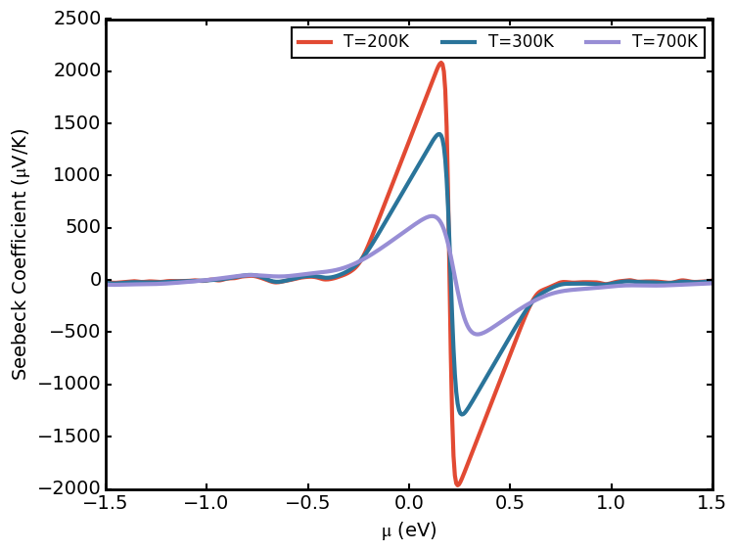
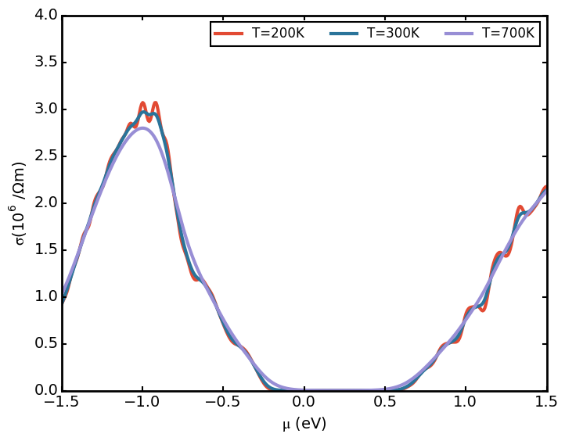
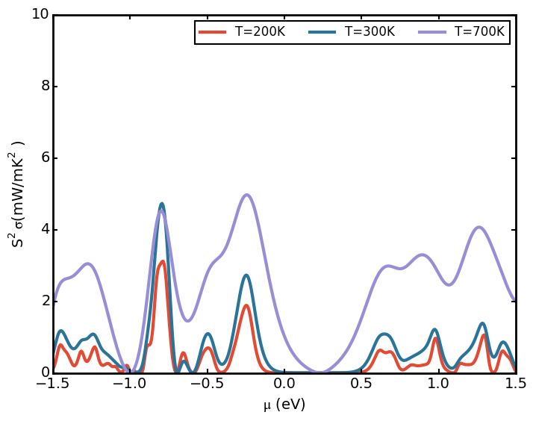
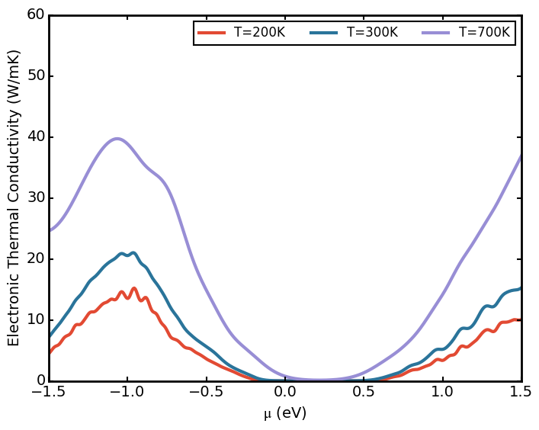

Thermoelectricity
Seebeck Coefficient , power factor and ZT
$$τ=29.3fs$$

Slide 15
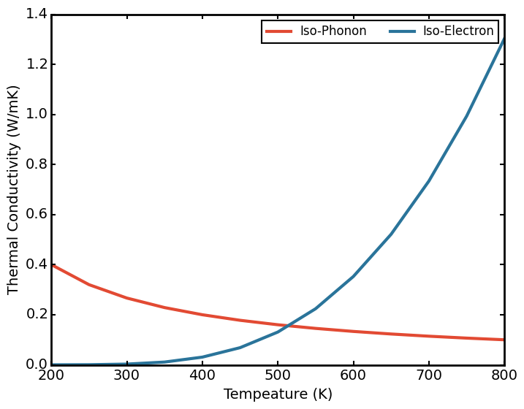
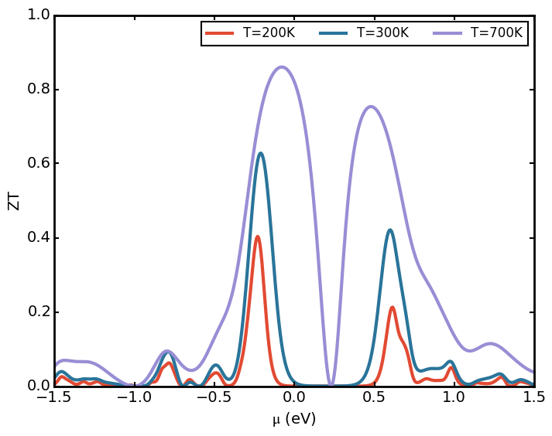

Thermoelectricity
$$τ=29.3fs$$

Slide 16
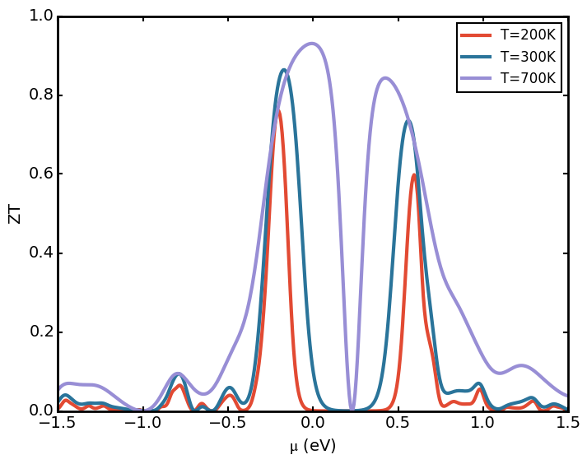
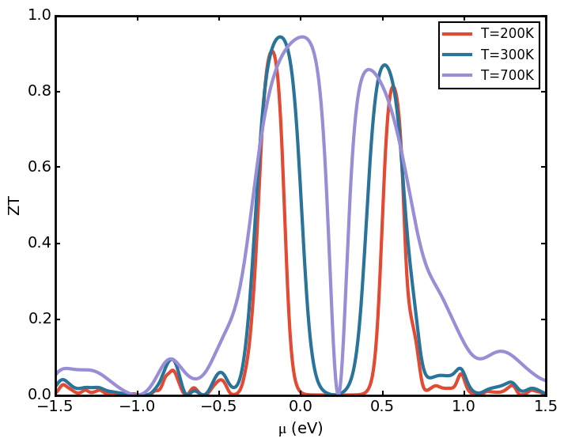
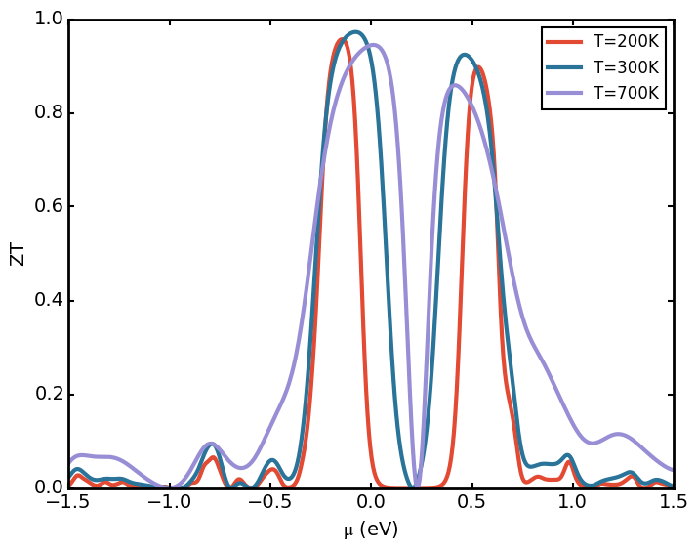




Thermoelectricity
Dependence of ZT on relaxation time
$$τ=29.3fs$$
$$τ=293fs$$
$$τ=2930fs$$
$$τ=29300fs$$

Slide 17
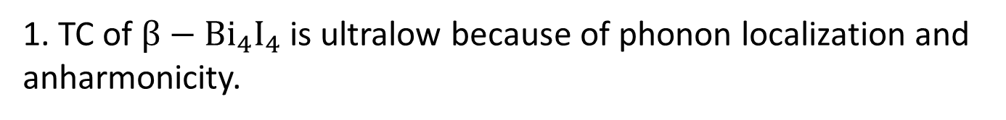
CONCLUSION
1. TC of $β−Bi_{4}I_{4}$ is ultralow because of phonon localization and anharmonicity.
2. ZT is not sensitive to electron relaxation time which is always not available from ab-initial calculation.
3. $β−Bi_{4}I_{4}$ may be a potential thermoelectric materials.

Slide 18
THANK FOR YOUR ATTENTION!
Yang Zhou
@ Fudan University

