Slide 1


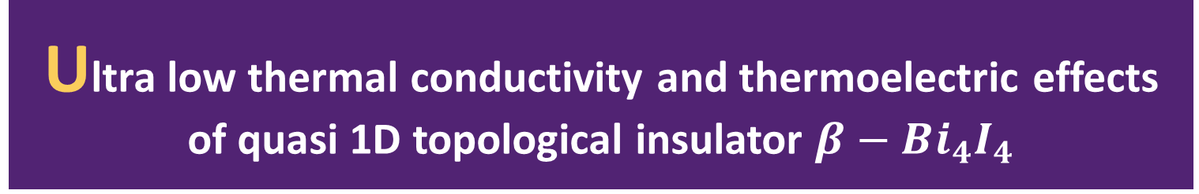
Ultra low thermal conductivity and thermoelectric effects of quasi 1D topological insulator $β−Bi_{4}I_{4}$
Yang Zhou
@ Fudan University

Slide 2
INTRODUCTION
1. Thermoelectricity
2. The potential of topological insulator and nanowire in the field of thermoelectricity
3. A recently synthetized quasi 1D topological insulator $β−Bi_{4}I_{4}$
4. From first principle we systematically investigate the phonon anharmonic thermal conductivity , Seebeck coefficient and electric conductivity with phonon-electron coupling considered

Slide 3
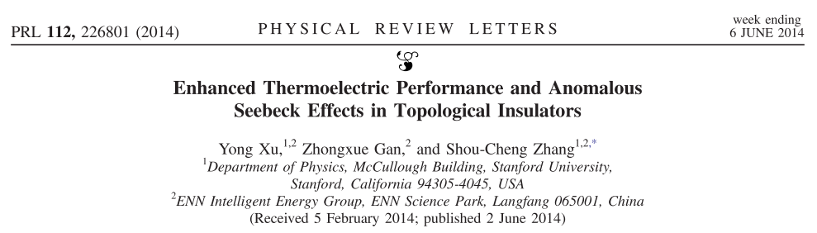
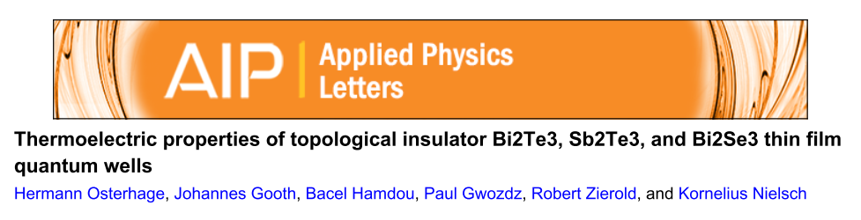
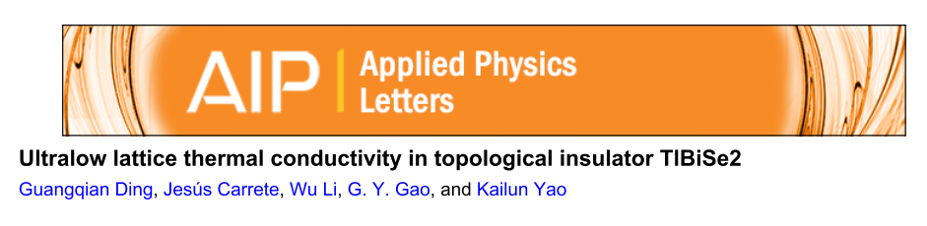
INTRODUCTION
2. The potential of topological insulator and nanowire in the field of thermoelectricity
Topological Insulator
narrow band gaps ->large Power Factor
heavy elements -> low TC
Y. Xu, Z. Gan and S. C. Zhang, Phys. Rev. Lett., 2014, 112, 1–5.
H. Osterhage, J. Gooth, B. Hamdou, P. Gwozdz, R. Zierold and K. Nielsch, Appl. Phys. Lett., 2014, 105, 2012–2017.
G. Ding, J. Carrete, W. Li, G. Y. Gao and K. Yao, Appl. Phys. Lett., 2016, 108, 233902.

Slide 4
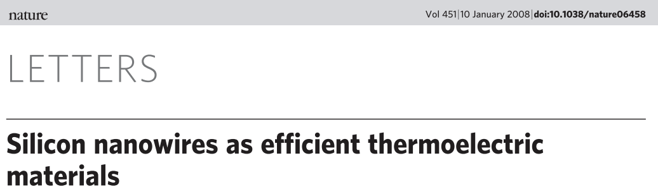
INTRODUCTION
2. The potential of topological insulator and nanowire in the field of thermoelectricity
A. I. Boukai, Y. Bunimovich, J. Tahir-Kheli, J.-K. Yu, W. A. Goddard and J. R. Heath, Nature, 2008, 451, 168–71.
Large reduction in TC while keep the value of power factor

Slide 5
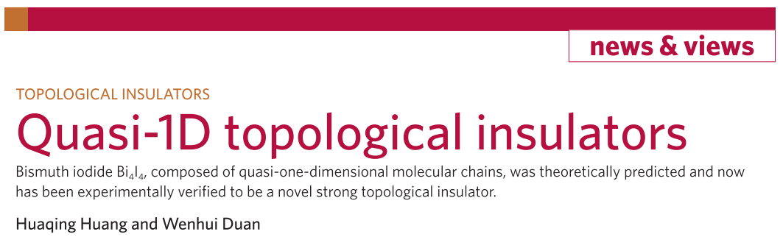
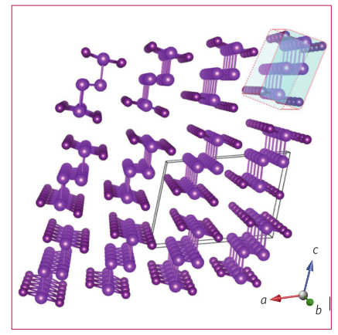
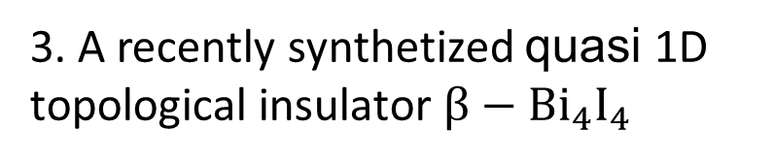
INTRODUCTION
3. A recently synthetized quasi 1D topological insulator $β−Bi_{4}I_{4}$
H. Huang and W. Duan, Nat. Mater., 2016, 15, 129–130.

Slide 6
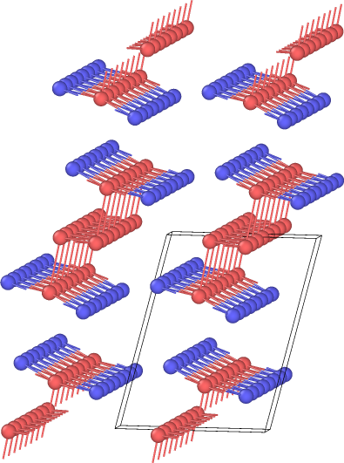
COMPUTATIONAL DETAILS
1. Phonon dos : Phonopy +VASP 3x3x3 supercell 2x2x2 kpoints
2. TC: ShengBTE + VASP 4x4x4 supercell 2x2x2 kpoints
3. Electronic band & dos: VASP 10x10x10 kpoints
4. e-p coupling : EPW+ QE 4x4x4 qpoints 6x6x6 kpoints

Slide 7
RESULTS & ANALYSIS
1. Band , dos and topological properties
2. Phonon dispersion & dos
3. Phonon Related Properties
4. Thermal Conductivity
5. Seebeck Coefficient and power factor and ZT
6. e-p coupling and it’s effects on electric conductivity and TC

Slide 8
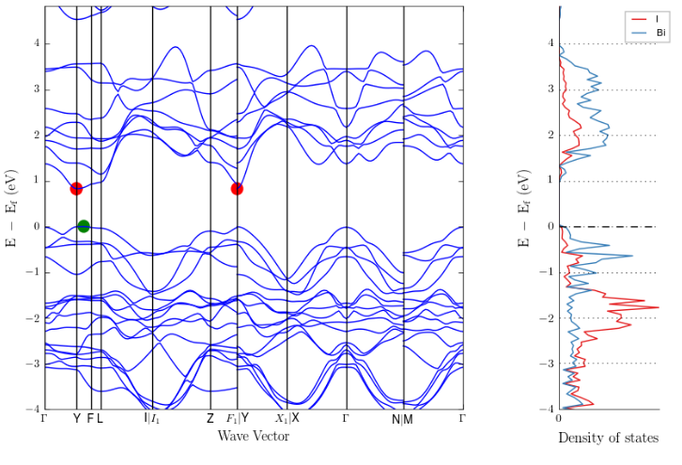
RESULTS & ANALYSIS
Band , dos and topological properties

Slide 9
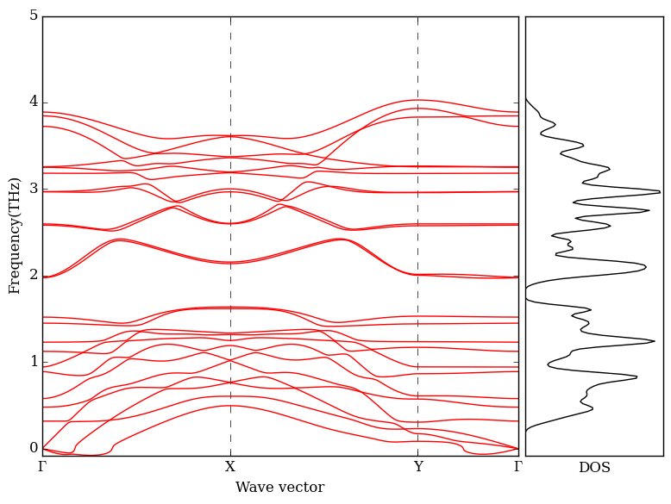
RESULTS & ANALYSIS
Phonon dispersion & dos

Slide 10
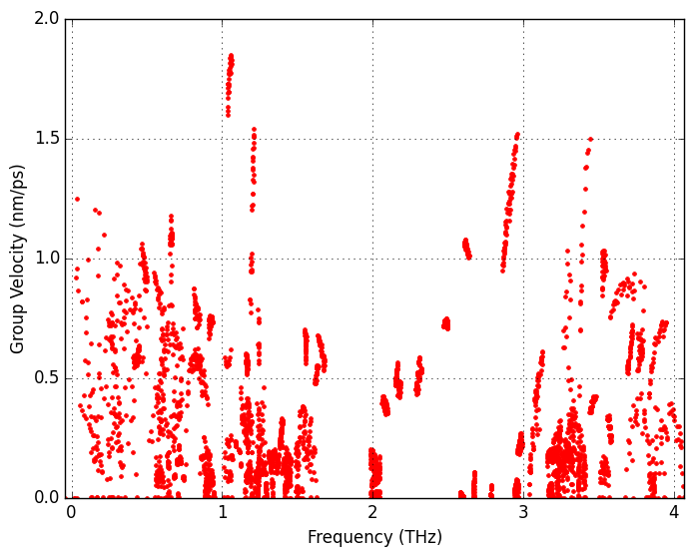
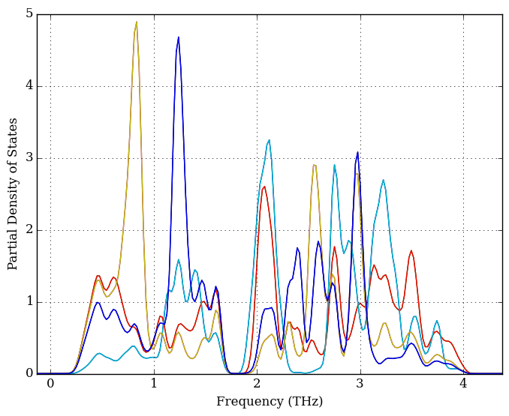
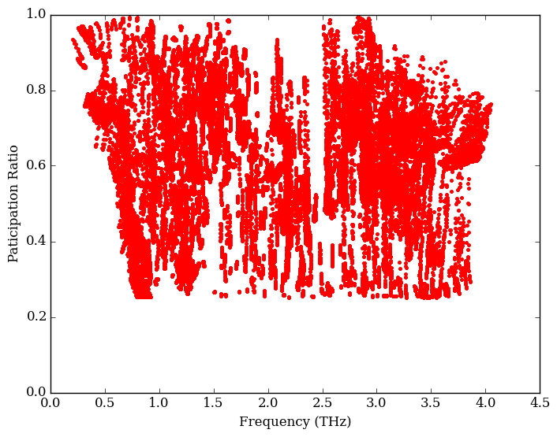
RESULTS & ANALYSIS
Phonon Related Properties

Slide 11
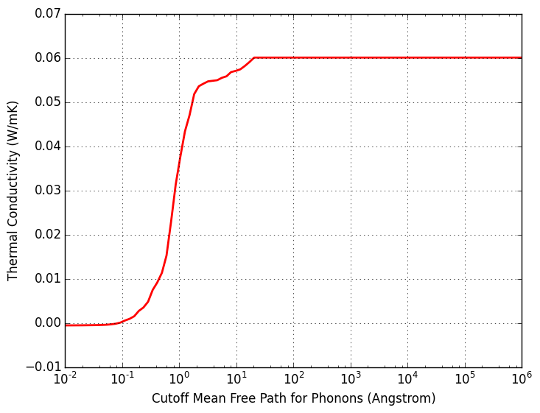
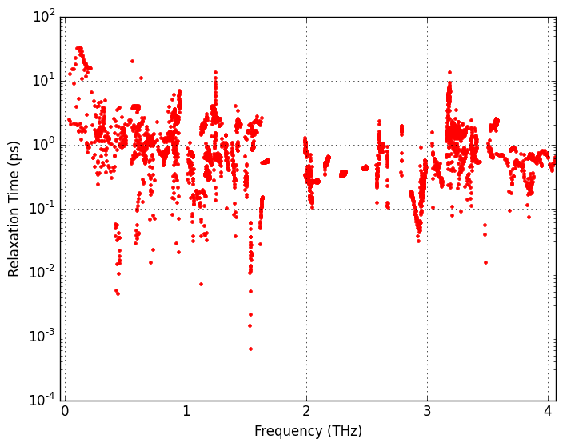
RESULTS & ANALYSIS
Thermal Conductivity

Slide 12
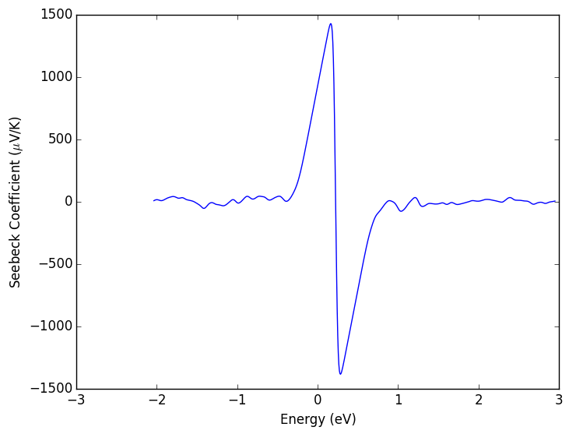
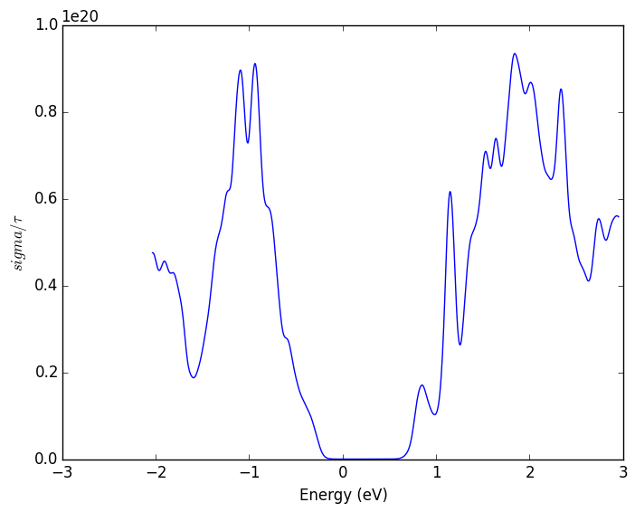
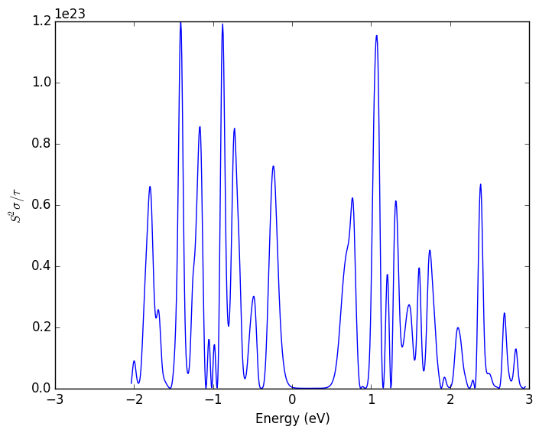
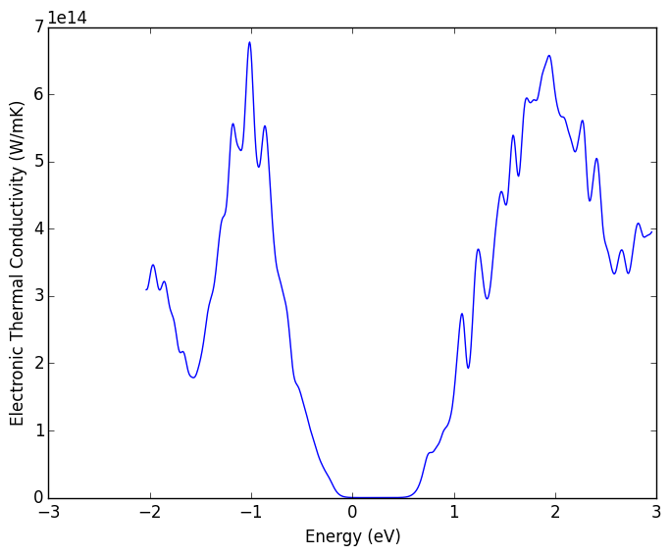
RESULTS & ANALYSIS
Seebeck Coefficient , power factor and ZT

Slide 13
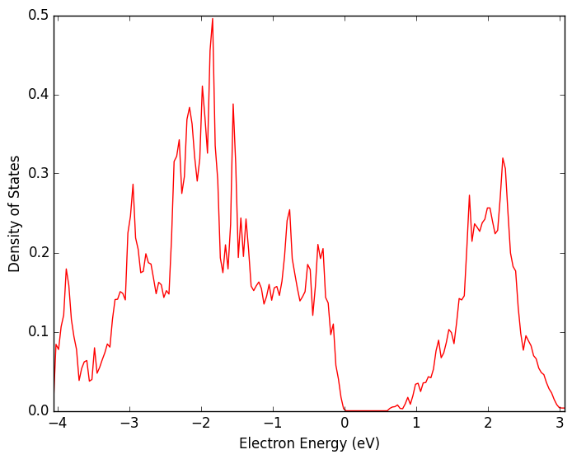
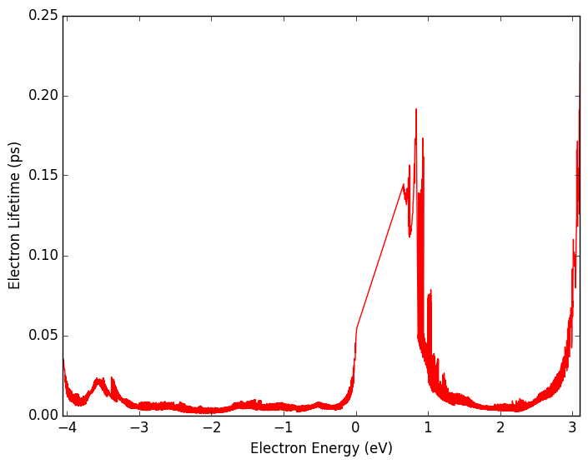
RESULTS & ANALYSIS
e-p coupling and it’s effects on electric conductivity and TC

Slide 14
CONCLUSION
1. From first principle we systematically investigate the phonon anharmonic thermal conductivity , Seebeck coefficient and electric conductivity with phonon-electron coupling considered
2. We found the low thermal conductivity is caused by the strong anharmonic scattering.

Slide 15
THANK FOR YOUR ATTENTION!
Yang Zhou
@ Fudan University

