Slide 1
Discussion----Possible ways to realize EMD method in thermal conductivity simulation for CPMD
Zhi-Xin Guo
@Oshiyama group
2013.11.27

Slide 2
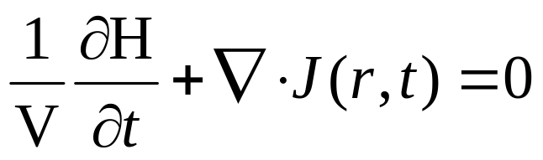
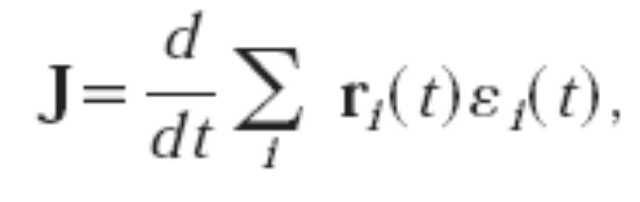


EMD:
Green-Kubo form for heat flux calculation, from the fluctuation-dissipation theorem:
NVE
Green-Kubo form:
(1)

Slide 3
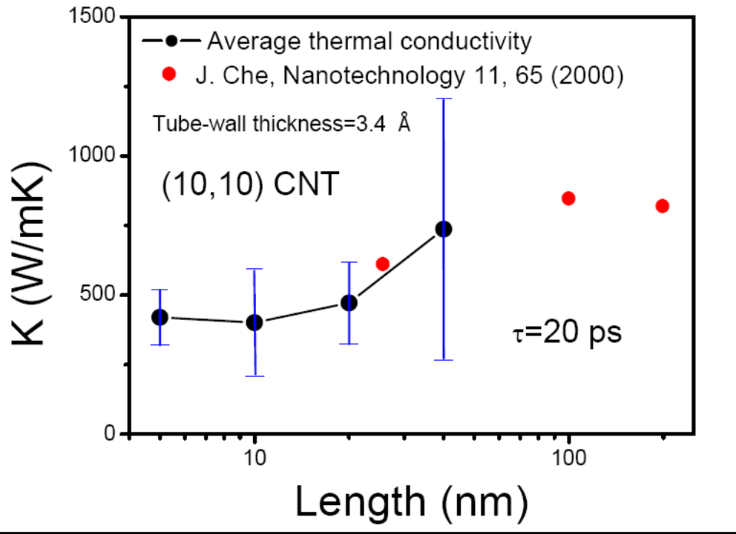
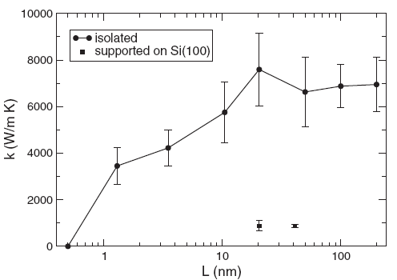
PRL 99, 255502 (2007)
(10,0) CNT
Converged length within L=50 nm for CNT,
L would be much more shorter for SiNW case
50 nm

Slide 4

But it is hard to realize EMD thermal conductivity calculation using DFT:
Simulation steps in EMD:
(1) NVT: Thermostat the whole system to constant temperature .eg. 300K
(2) NVE: count the heat flux of every time-step
(3) Calculate the heat flux correlation function and thus the thermal conductivity using eq. (1)
Why?

Slide 5
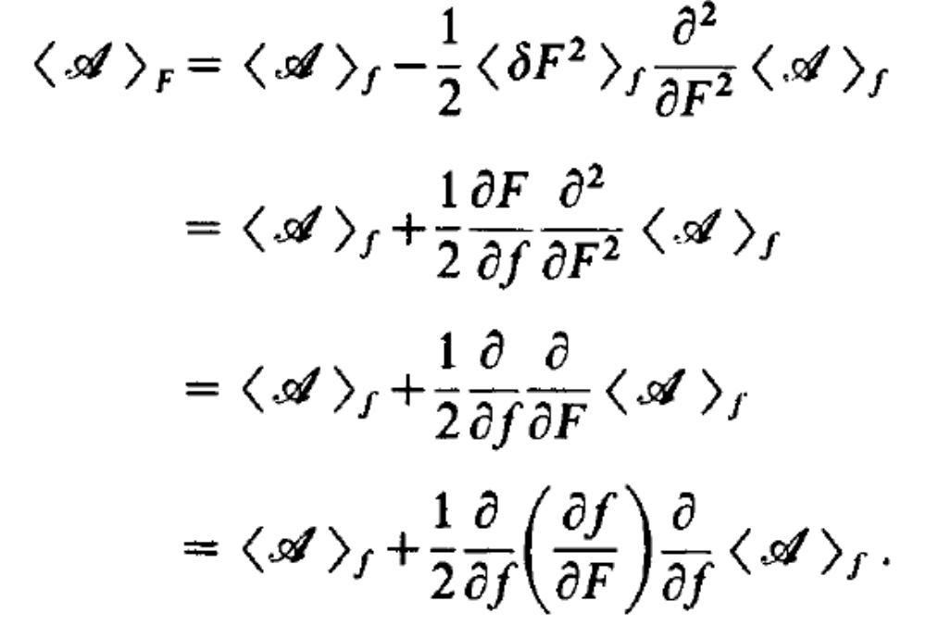
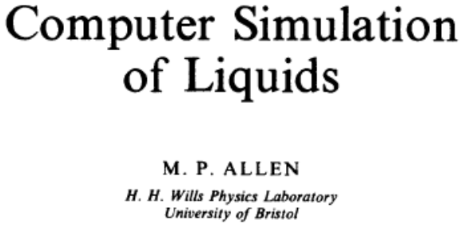
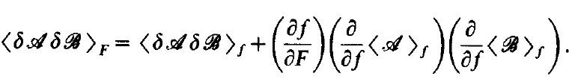
NVT
NVE
Correlation function:
nonzero

Slide 6

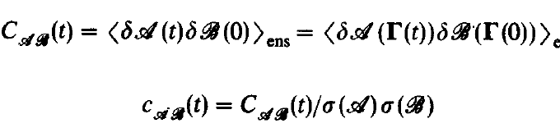
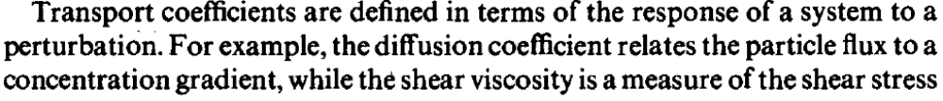
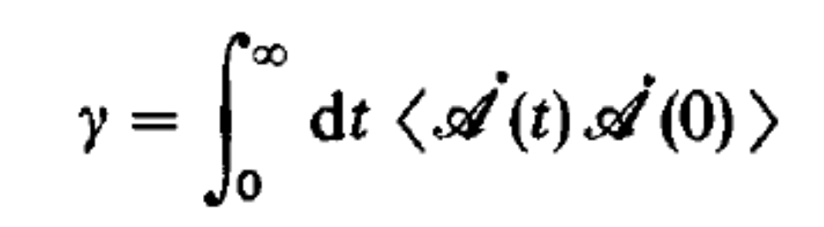
No limit in the NVE or NVT esemble from the definition of calculating transport coefficients

Slide 7
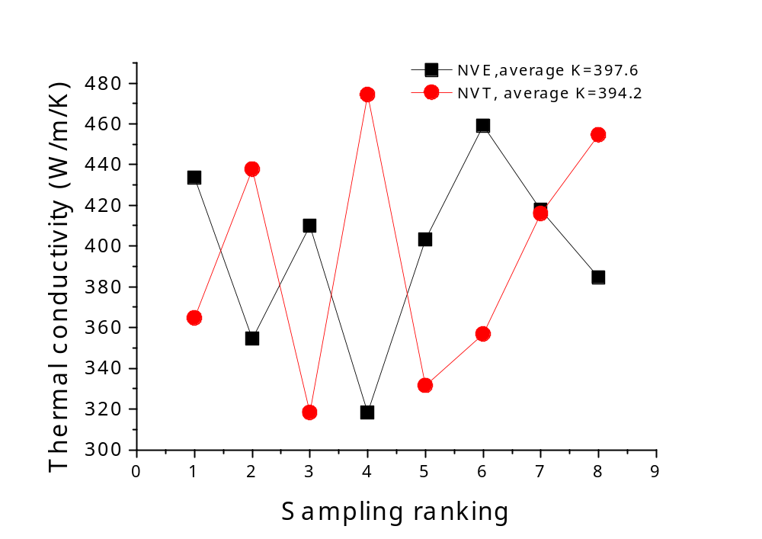
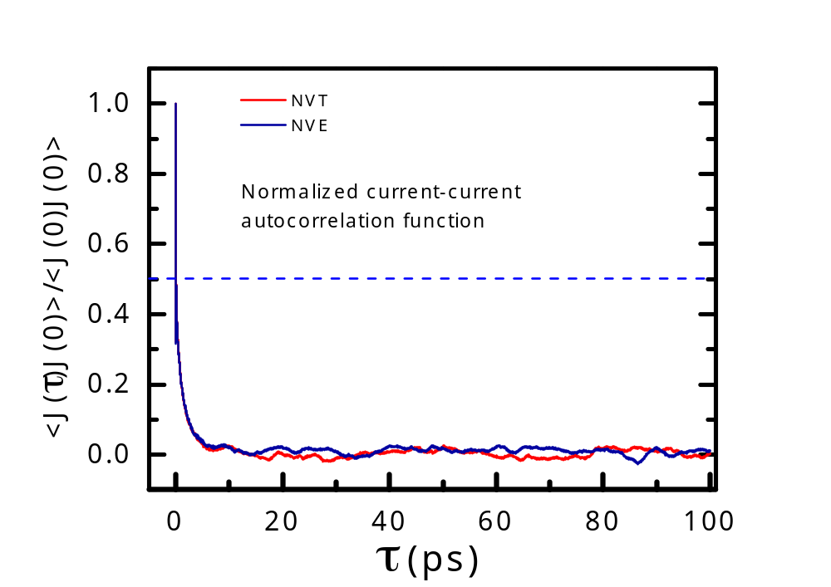
I have performed both NVE and VNT calculations, and got similar thermal conductivity by using:
Cut-off integration time

Slide 8
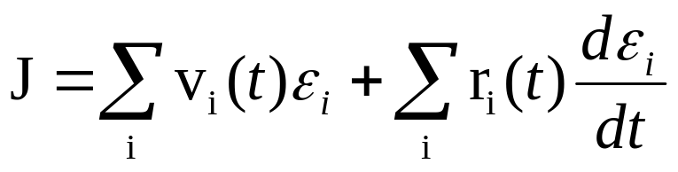
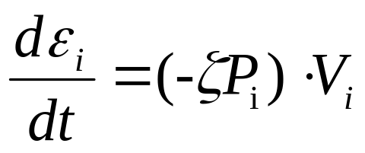
So can we get thermal conductivity in use of the power of heat both in NVT?
Change of Hamiltonian with time==Power
Does it corresponds to the power from heat hath? Or there is some relationship between them?
First I tried to directly use the power from heat bath
We don’t have to calculate Fij in this case

Slide 9
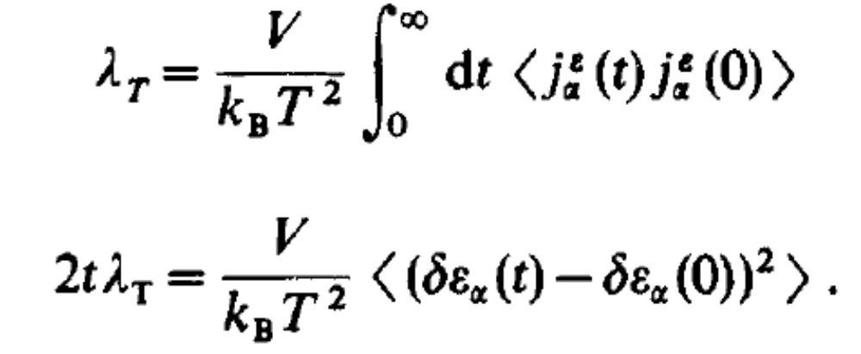
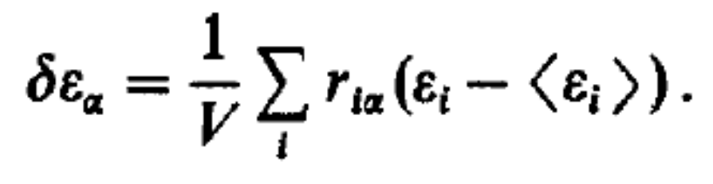
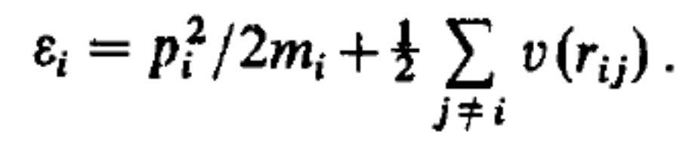
Another approach:
Einstein relation
Hold only for NVE ensemble
We don’t have to calculate Fi or Fij.
But we have to check the applicable in solid, we have to properly deal with definition of integrated heat current
Yesterday, I noticed that some people
have done something on this method:
J.Phys.Chem. 137 (2012) 014106

