Slide 1
CI/CD Overview

Slide 2
Agenda
CI&CD Overview
Continuous Integration
Continuous Delivery & Continuous Deployment
Deployment Strategies

Slide 3
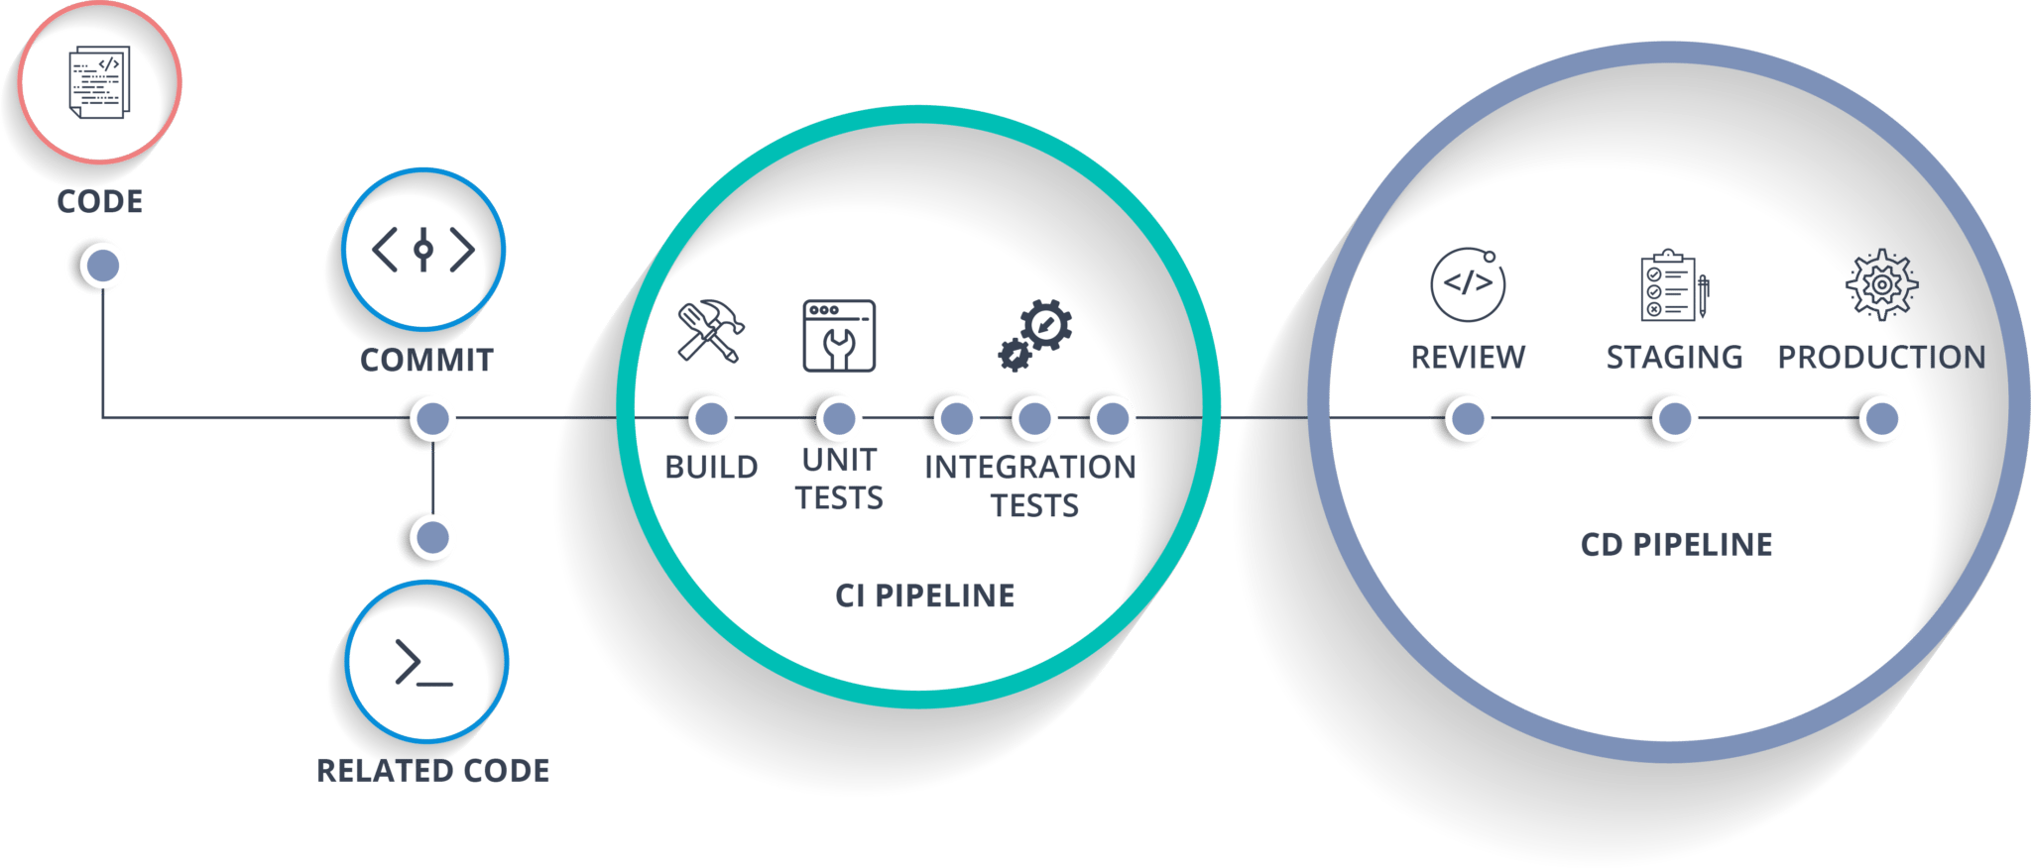
CI & CD Overview

Slide 4
Continuous Integration
Continuous Integration (CI) is a development practice where developers integrate code into a shared repository frequently, preferably several times a day.
Each integration can then be verified by an automated build and automated tests.
One of the key benefits of integrating regularly is that you can detect errors quickly and locate them more easily.
Notes:
<number>

Slide 5
Continuous Delivery
Continuous Delivery is the next extension of continuous integration.
The delivery phase is responsible for packaging an artifact together to be delivered to end users.
This build phase is kept ‘green,’

Slide 6
Continuous Deployment
Continuous Deployment is the final phase of the pipeline.
The deployment phase is responsible for automatically launching and distributing the software artifact to end users.
This will happen through scripts or tools that automatically move the artifact to public servers.
Notes:
<number>

Slide 7
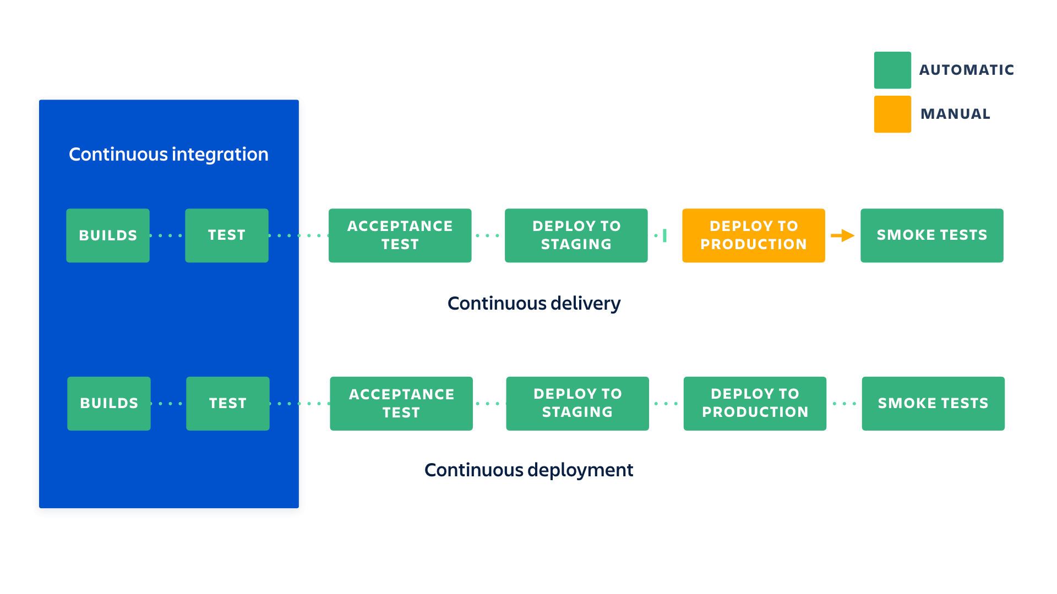
What’s difference?

Slide 8
Real case study
Micro-service application
Multiple instances application
Zero downtime
Performance testing with real traffic
Reduce deployment risks
Support marketing campaign
Notes:
<number>

Slide 9
Deployment Strategies
Recreate: Version A is terminated then version B is rolled out.
Ramped (also known as rolling-update or incremental): Version B is slowly rolled out and replacing version A.
Blue/Green: Version B is released alongside version A, then the traffic is switched to version B.
Canary: Version B is released to a subset of users, then proceed to a full rollout.
A/B testing: Version B is released to a subset of users under specific condition.
Shadow: Version B receives real-world traffic alongside version A and doesn’t impact the response.

Slide 10
Deployment Strategies
Recreate: Version A is terminated then version B is rolled out.
Pros:
Easy to setup.
Application state entirely renewed.
Cons:
High impact on the user, expect downtime that depends on both shutdown and boot duration of the application.

Slide 11
Deployment Strategies
Ramped (also known as rolling-update or incremental): Version B is slowly rolled out and replacing version A.
Pros:
Easy to set up.
Version is slowly released across instances.
Convenient for stateful applications that can handle rebalancing of the data.
Cons:
Rollout/rollback can take time.
No control over traffic.

Slide 12
Deployment Strategies
Blue/Green: Version B is released alongside version A, then the traffic is switched to version B.
Pros:
Instant roll-out/rollback.
Avoid versioning issue, the entire application state is changed in one go.
Cons:
Expensive as it requires double the resources.
Proper test of the entire platform should be done before releasing to production.

Slide 13
Deployment Strategies
Canary: Version B is released to a subset of users, then proceed to a full roll out
Pros:
Version released for a subset of users.
Convenient for error rate and performance monitoring.
Fast rollback.
Con:
Slow roll out

Slide 14
Deployment Strategies
A/B testing: Version B is released to a subset of users under specific condition.
Pros:
Several versions run in parallel.
Full control over the traffic distribution.
Cons:
Requires intelligent load balancer.

Slide 15
Deployment Strategies
Shadow: Version B receives real-world traffic alongside version A and doesn’t impact the response.
Pros:
Performance testing of the application with production traffic.
No impact on the user.
No roll out until the stability and performance of the application meet the requirements.
Cons:
Expensive as it requires double the resources.
Not a true user test and can be misleading.
Complex to setup.
Requires mocking service for certain cases.

Slide 16




Deployment strategies metric
Strategy | Zero downtime | Real traffic testing | Targeted users | Cloud cost | Rollback duration | Negative impact on user | Complexity of setup
Recreate | No | No | No
Ramped (rolling update) | Yes | No | No
Blue/green | Yes | No | No
Canary | Yes | Yes | No
A/B Testing | Yes | Yes | Yes
Shadow | Yes | Yes | No
Source: https://thenewstack.io/deployment-strategies/

