Slide 1

#16: Identity server 4 authorization grants
Trainer: Bach Ngoc Toan - Phát hành tại: www.tedu.com.vn

Slide 2
What Is OAuth?
To begin at a high level, OAuth is not an API or a service: it’s an open standard for authorization and anyone can implement it.
OAuth is a standard that apps can use to provide client applications with “secure delegated access”.
OAuth works over HTTPS and authorizes devices, APIs, servers, and applications with access tokens rather than credentials.
There are two versions of OAuth: OAuth 1.0a and OAuth 2.0.
Nowadays, OAuth 2.0 is the most widely used form of OAuth. So from now on, whenever I say “OAuth”, I’m talking about OAuth 2.0 – as it’s most likely what you’ll be using.

Slide 3
Why OAuth?
OAuth was created as a response to the direct authentication pattern.
Before OAuth, sites would prompt you to enter your username and password directly into a form and they would login to your data (e.g. your Gmail account) as you. This is often called the password anti-pattern.
To create a better system for the web, federated identity was created for single sign-on (SSO)

Slide 4
OAuth Central Components
Scopes and Consent
Actors
Clients
Tokens
Authorization Server
Flows

Slide 5
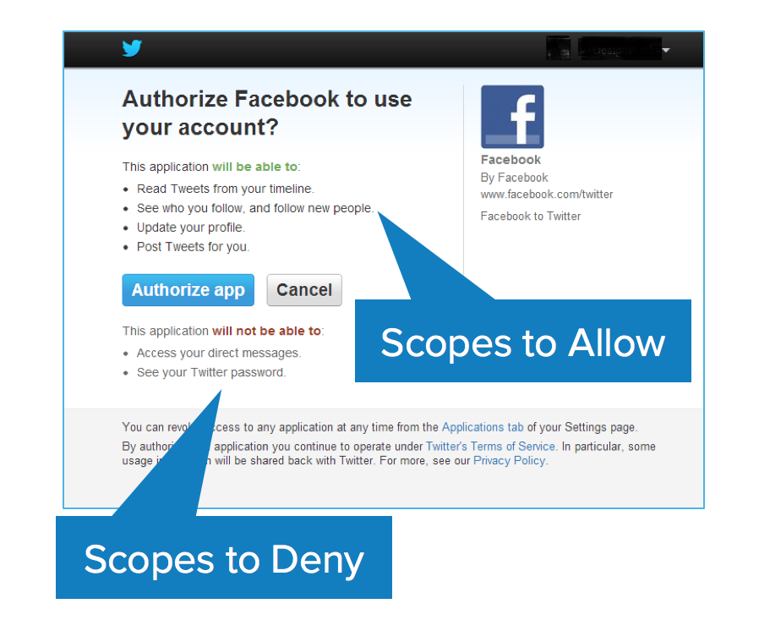
OAuth Scopes

Slide 6
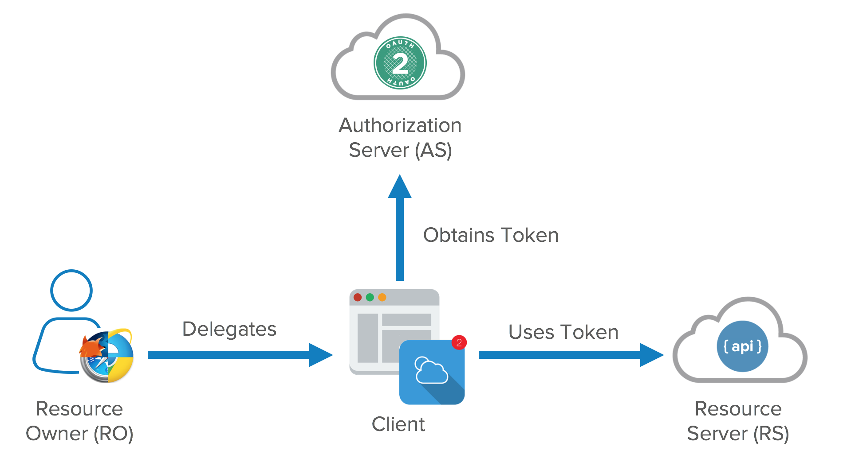
OAuth Actors
Resource Owner: owns the data in the resource server. For example, I’m the Resource Owner of my Facebook profile.
Resource Server: The API which stores data the application wants to access
Client: the application that wants to access your data
Authorization Server: The main engine of OAuth

Slide 7
OAuth Tokens
Access tokens are the token the client uses to access the Resource Server (API).
Short-lived: hours and minutes, not days and month
The other token is the refresh token: longer-lived; days, months, years
Refresh tokens can be revoked.

Slide 8
Authorization Grant
Authorization Code: used with server-side Applications
Implicit: used with Mobile Apps or Web Applications (applications that run on the user’s device)
Resource Owner Password Credentials: used with trusted Applications, such as those owned by the service itself
Client Credentials: used with Applications API access

Slide 9
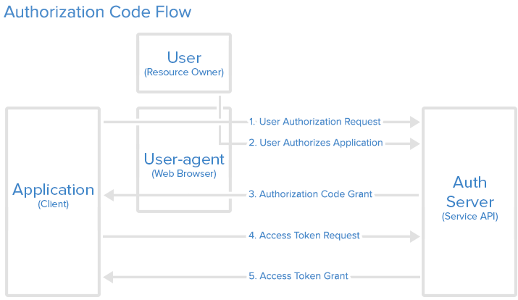
Grant Type: Authorization Code
The authorization code grant type is the most commonly used because it is optimized for server-side applications, where source code is not publicly exposed, and Client Secret confidentiality can be maintained.
This is a redirection-based flow, which means that the application must be capable of interacting with the user-agent (i.e. the user’s web browser) and receiving API authorization codes that are routed through the user-agent.

Slide 10
Grant Type: Implicit
The implicit grant type is used for mobile apps and web applications (i.e. applications that run in a web browser), where the client secret confidentiality is not guaranteed.
The implicit grant type does not support refresh tokens.
The reason it’s called the implicit flow is because all the communication is happening through the browser.
There is no backend server redeeming the authorization grant for an access token. An SPA is a good example of this flow’s use case.

Slide 11
Grant Type: Resource Owner Password Credentials
With the resource owner password credentials grant type, the user provides their service credentials (username and password) directly to the application, which uses the credentials to obtain an access token from the service.
This grant type should only be enabled on the authorization server if other flows are not viable.
Also, it should only be used if the application is trusted by the user (e.g. it is owned by the service, or the user’s desktop OS).

Slide 12
Grant Type: Client Credentials
The client credentials grant type provides an application a way to access its own service account.
Examples of when this might be useful include if an application wants to update its registered description or redirect URI, or access other data stored in its service account via the API.

Slide 13
Summary
Machine to Machine Communication
This one is easy – since there is no human directly involved, client credentials are used to request tokens.
Browser-based Applications
This might be a JavaScript-based application or a “traditional” server-rendered web application. For those scenarios, you typically want to use the implicit flow (OpenID Connect / OAuth 2.0).
A side effect of the implicit flow is, that all tokens (identity and access tokens) are delivered through the browser front-channel. If you want to use the access token purely on the server side, this would result in an unnecessary exposure of the token to the client. In that case I would prefer the authorization code flow – or hybrid flow.
Native Applications
- The same with Browser-based

Slide 14
References
https://www.digitalocean.com/community/tutorials/an-introduction-to-oauth-2
https://leastprivilege.com/2016/01/17/which-openid-connectoauth-2-o-flow-is-the-right-one/
https://identityserver4.readthedocs.io/en/latest/intro/big_picture.html

