Slide 1

#19: Using CQRS Pattern
Trainer: Bach Ngoc Toan - Phát hành tại: www.tedu.com.vn

Slide 2
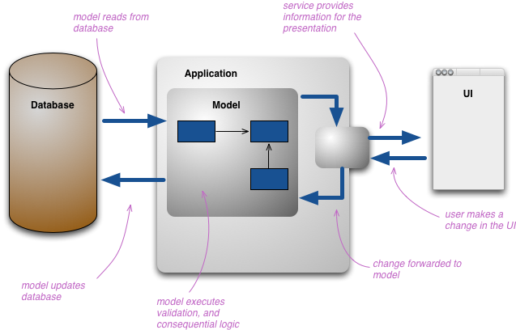
Normal Application

Slide 3
What is CQRS?
CQRS stands for Command Query Responsibility Segregation. It's a pattern that I first heard described by Greg Young.
At its heart is the notion that you can use a different model to update information than the model you use to read information.
Notes:
The mainstream approach people use for interacting with an information system is to treat it as a CRUD datastore. By this I mean that we have mental model of some record structure where we can create new records, read records, update existing records, and delete records when we're done with them. In the simplest case, our interactions are all about storing and retrieving these records.

Slide 4
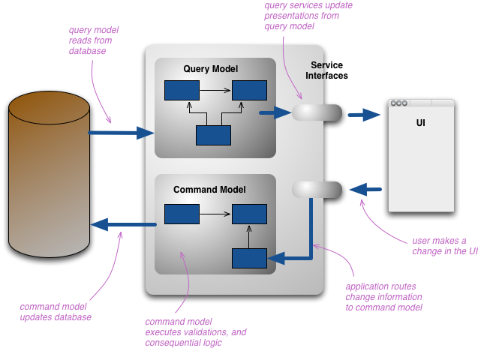
CQRS Application

Slide 5
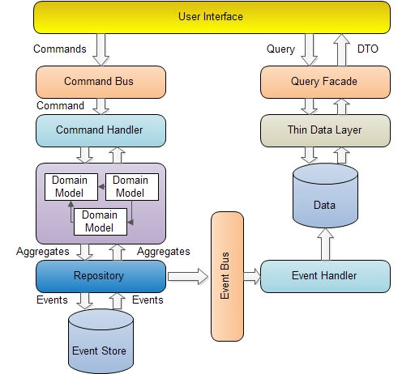
How to CQRS work?

Slide 6
Advantages
As we move away from a single representation that we interact with via CRUD, we can easily move to a task-based UI.
CQRS fits well with event-based programming models. It's common to see CQRS system split into separate services communicating with Event Collaboration. This allows these services to easily take advantage of Event Sourcing.
Having separate models raises questions about how hard to keep those models consistent, which raises the likelihood of using eventual consistency.
For many domains, much of the logic is needed when you're updating, so it may make sense to use EagerReadDerivation to simplify your query-side models.
If the write model generates events for all updates, you can structure read models as EventPosters, allowing them to be MemoryImages and thus avoiding a lot of database interactions.
CQRS is suited to complex domains, the kind that also benefit from Domain-Driven Design.

Slide 7
When use it?
CQRS should only be used on specific portions of a system (a BoundedContext in DDD lingo) and not the system as a whole.
The other main benefit is in handling high performance applications.

Slide 8
References
https://microservices.io/patterns/data/cqrs.html
https://docs.microsoft.com/en-us/azure/architecture/patterns/cqrs
https://martinfowler.com/bliki/CQRS.html

