Slide 1

#6: Tactical Domain driven design
Trainer: Bach Ngoc Toan - Phát hành tại: www.tedu.com.vn

Slide 2
Concepts
Value Objects
Entities
Aggregate
Domain Events
Distributing Domain Events
Repositories
Domain Services
Factories
Modules

Slide 3
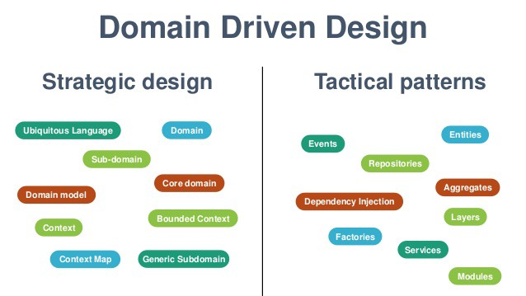
Source: Internet

Slide 4
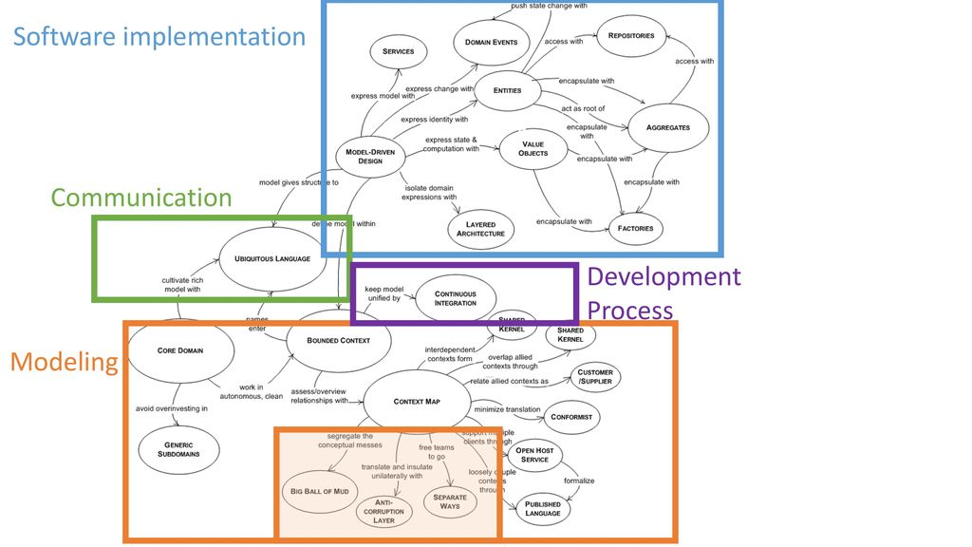

Slide 5
Value object
An object that represents a descriptive aspect of the domain with no conceptual identity is called a Value Object.
Value Objects are instantiated to represent elements of the design that we care about only for what they are, not who or which they are. — Eric Evans
A value object is an object whose value is of importance.
Value objects should always be made immutable.
Value objects are not only containers of data - they can also contain business logic.
Example:
Money
StreetAddress
EmailAddress

Slide 6
Entity
Many objects are not fundamentally defined by their attributes, but rather by a thread of continuity and identity. – Eric
An entity is an object whose identity is of importance.
To be able to determine the identity of an entity, every entity has a unique ID that is assigned when the entity is created and remains unchanged throughout the lifespan of the entity.
Example:
Customer
Contract
…

Slide 7
Entity or Value Object?
Make decision by domain specific

Slide 8
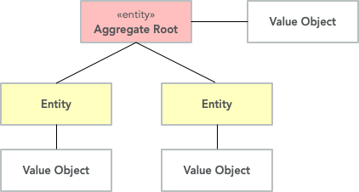
Aggregates
An AGGREGATE is a cluster of associated objects that we treat as a unit for the purpose of data changes. Each aggregate has a root and a boundary. — Eric Evans
The aggregate is created, retrieved and stored as a whole.
The aggregate is always in a consistent state.
The aggregate is owned by an entity called the aggregate root, whose ID is used to identify the aggregate itself.

Slide 9
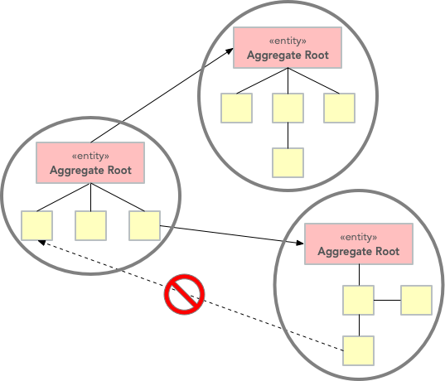
Aggregate restrictions
The aggregate is created, retrieved and stored as a whole.
The aggregate is always in a consistent state.
The aggregate is owned by an entity called the aggregate root, whose ID is used to identify the aggregate itself.

Slide 10
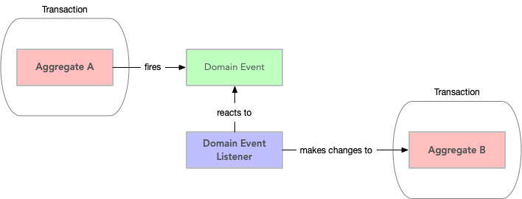
Domain Events
The essence of a Domain Event is that you use it to capture things that can trigger a change to the state of the application you are developing. — Martin Fowler

Slide 11

Distributing Domain Events
Distribution Through a Message Queue
Distribution Through an Event Log

Slide 12
Repositories
A repository is a service that uses a global interface to provide access to all entities and value objects that are within a particular aggregate collection.
Capability to save an aggregate in its entirety in some kind of data storage
Capability to retrieve an aggregate in its entirety based on its ID
Capability to delete an aggregate in its entirety based on its ID
Repositories are typically either collection-oriented or persistence-oriented.

Slide 13
Domain Services
Some concepts from the domain aren’t natural to model as objects…a service tends to be named for an activity, rather than an entity — a verb rather than a noun. — Eric Evans
When an operation does not conceptually belong to any object. Following the natural contours of the problem, you can implement these operations in services. — Wikipedia
Domain services have the following characteristics:
They are stateless
They are highly cohesive (meaning they are specialized in doing one thing and one thing only)
They contain business logic that does not naturally fit elsewhere
They can interact with other domain services and to some extent with repositories
They can publish domain events
A domain service should not be confused with an application service.
Notes:
We have already mentioned that both value objects and entities can (and should) contain business logic. However, there are scenarios where a piece of logic simply does not fit into one particular value object or one particular entity. Putting business logic in the wrong place is a bad idea so we need another solution. Enter our second static object: the domain service.
A domain service should not be confused with an application service. We are going to have a closer look at application services in the next article in this series but in short, an application service acts as the middle man between the isolated domain model and the rest of the world. The application service is responsible for handling transactions, ensuring system security, looking up the proper aggregates, invoking methods on them and saving the changes back to the database. Application services do not contain any business logic themselves.
You can summarize the difference between application and domain services as follows: a domain service is only responsible for making business decisions whereas an application service is only responsible for orchestration (finding the correct objects and invoking the correct methods in the correct order). Becasue of this, a domain service should generally not invoke any repository methods that alter the state of the database - that is the responsibility of the application service.

Slide 14
Factories
Factories are often used to create Aggregates. Aggregates provide encapsulation and a consistent boundary around a group of objects.
Aggregates are important because they enforce the internal consistency of the object they are responsible for.
A Factory can be useful when creating a new Aggregate because it will encapsulate the knowledge required to create an Aggregate in a consistent state and with all invariants enforced.

Slide 15
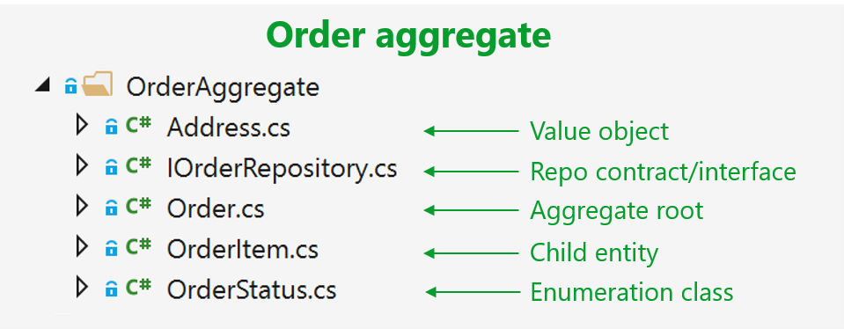
Modules
Modules in DDD correspond to packages in Java and namespaces in C#.
A module can correspond to a bounded context, but typically, a bounded context will have multiple modules.
Classes that belong together should be grouped into the same module
Notes:
You should not put all repositories into one module, all entities into another, etc. Rather, you should put all classes that relate to a particular aggregate or a particular business process into the same module.

Slide 16
References
https://vaadin.com/learn/tutorials/ddd/tactical_domain_driven_design
https://patrickdesjardins.com/blog/how-to-work-with-value-object-in-c
https://bhuwanupadhyay.github.io/posts/domain-driven-design-building-blocks/

