Slide 1

#4: System architecture
Trainer: Bach Ngoc Toan - Phát hành tại: www.tedu.com.vn

Slide 2
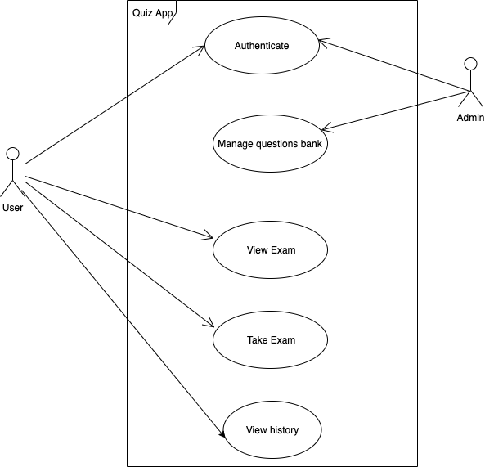
Use case diagram

Slide 3
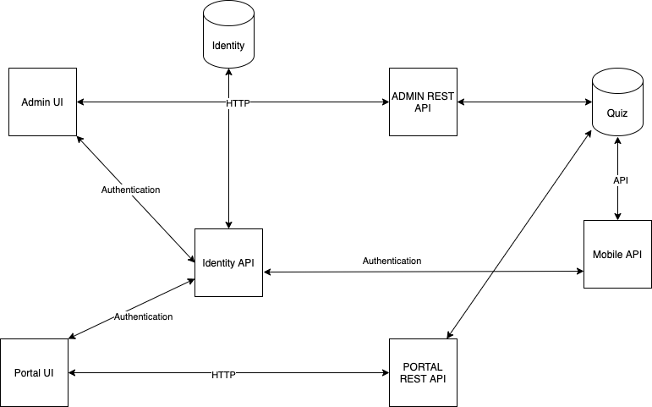
Architecture

