Slide 1

#5: Strategic Domain Driven Design
Trainer: Bach Ngoc Toan - Phát hành tại: www.tedu.com.vn

Slide 2
Domain Driven Desgin
Domain-Driven Design (DDD) has been around since Eric Evans published his book about the subject in 2003.
Domain-Driven Design: Tackling Complexity in the Heart of Software
Implementing Domain-Driven Design by Vaughn Vernon

Slide 3
What is domain driven design?
Focus on the core domain and domain logic.
Base complex designs on models of the domain.
Constantly collaborate with domain experts, in order to improve the application model and resolve any emerging domain-related issues.

Slide 4
Advantages of Domain-Driven Design
Eases Communication
Improves Flexibility
Emphasizes Domain Over Interface

Slide 5
Concepts
Domain
Subdomains
The Ubiquitous Language
Bounded Context
Relationships Between Contexts
Context Map

Slide 6
Building Blocks
Entity
Value Object
Domain Event
Aggregate
Service
Repositoríe
Factories

Slide 7
Domain
The common dictionary definition of domain is: “A sphere of knowledge or activity.”
Drilling down a bit from that, domain in the realm of software engineering commonly refers to the subject area on which the application is intended to apply.
Notes:
Another common term used during software development is the domain layer or domain logic, which may be better known to many developers as the business logic. The business logic of an application refers to the higher-level rules for how business objects (see: OOAD) interact with one another to create and modify modelled data.

Slide 8
Subdomains
The domain concept is very broad and abstract.
To make it more concrete and tangible, it makes sense to split it up into smaller parts called subdomains.
All subdomains can be divided into three categories:
Core domains
Supporting subdomains
Generic subdomains

Slide 9
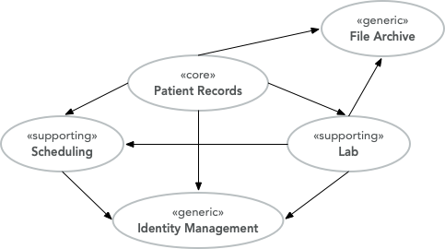
Example
Let’s say we are building an EMR (Electronic Medical Records) system for smaller clinics. We have identified the following subdomains:
Patient Records for managing patient medical records (personal information, medical history, etc.).
Lab for ordering lab tests and managing test results.
Scheduling for scheduling appointments.
File Archive for storing and managing files that are attached to the patient records (such as different documents, X-ray pictures, scanned paper documents).
Identity Management for making sure the right people have access to the right information.
Source: Internet

Slide 10
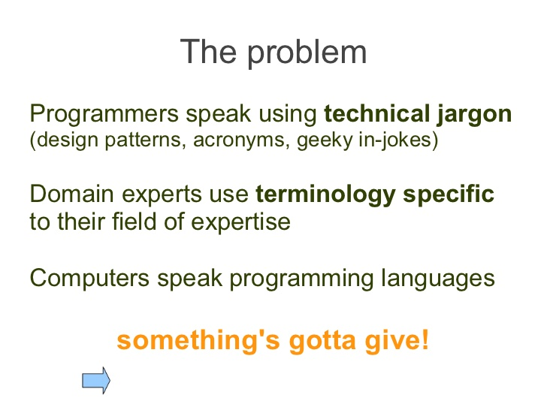
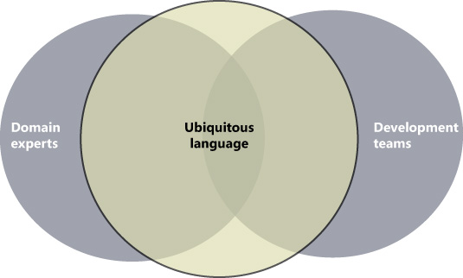
Ubiquitous Language
Source: Internet

Slide 11
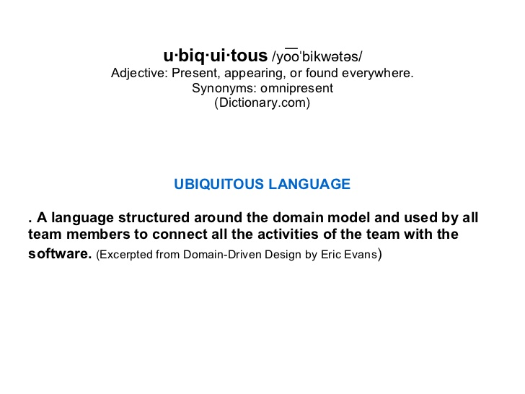
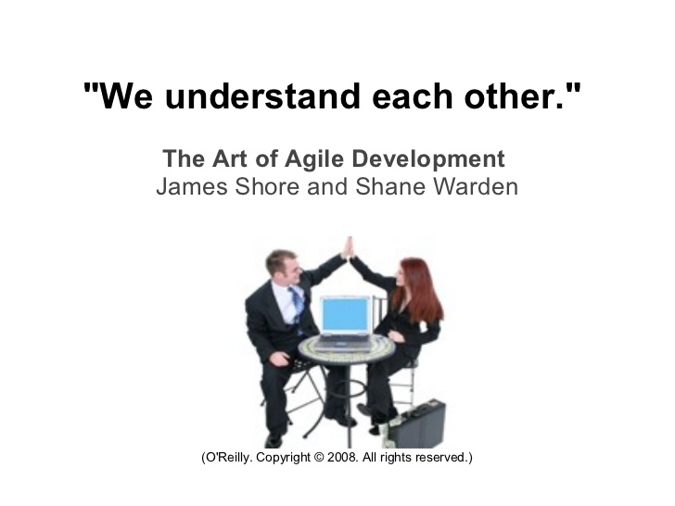
Ubiquitous Language
Source: Internet

Slide 12
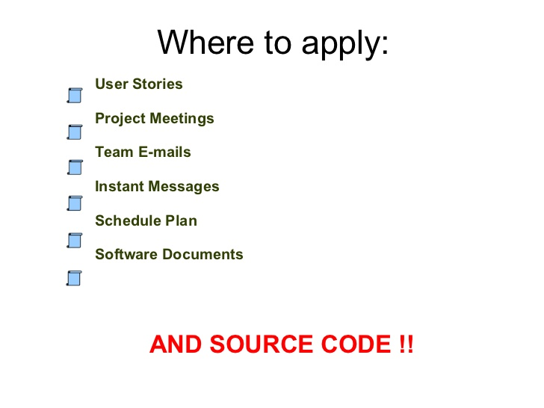
Source: Internet

Slide 13
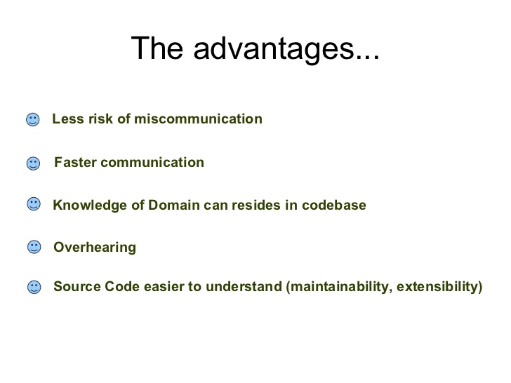
Source: Internet

Slide 14
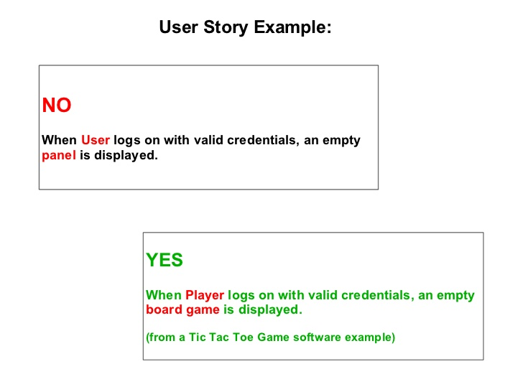
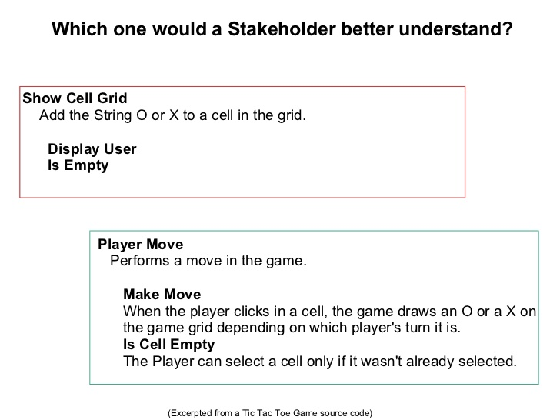

Slide 15
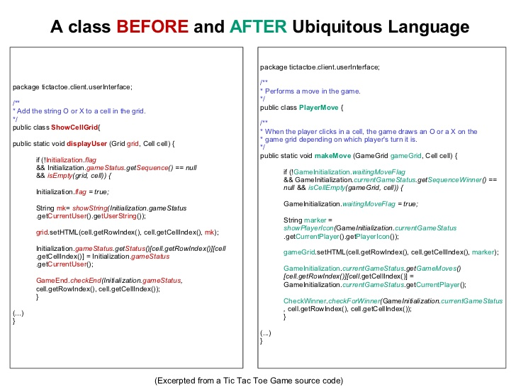
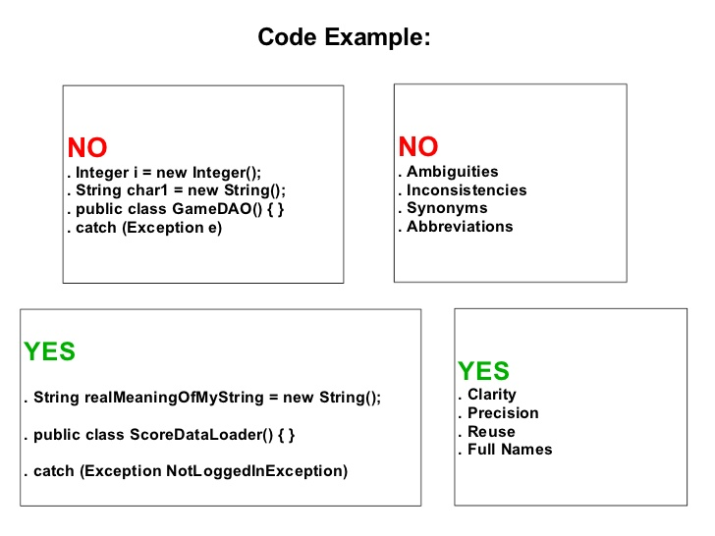

Slide 16
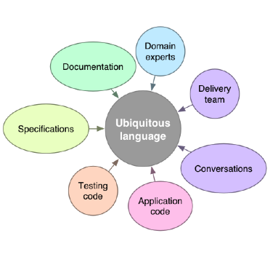
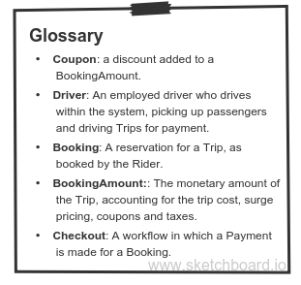
UL Summary

Slide 17
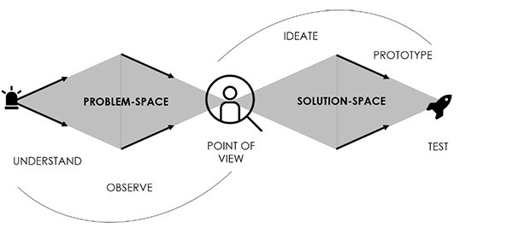
Problem to solution
Source: Internet

Slide 18
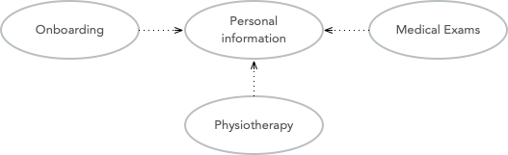
Bounded Contexts
Personal information for managing the patient’s personal information (name, address, financial information, medical background, etc).
Onboarding for introducing new patients into the system.
Medical Exams used by doctors when examining and treating the patient.
Physiotherapy used by physiotherapists when examining and treating the patient.

Slide 19
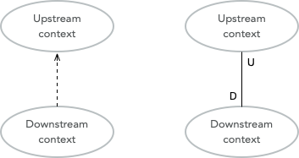
Relationships Between Contexts

Slide 20

Context Maps and Integration Patterns
Partnership
Shared Kernel
Customer-supplier
Conformist
Anticorruption Layer
Open Host Service
Published Language
Separate Ways
Notes:
Where are the context boundaries?
How are the contexts going to communicate technically?
How are we going to map between the contexts' domain models (i.e. how are we translating from one ubiquitous language to another)?
How are we going to guard against unwanted or problematic changes occurring upstream?
How are we going to avoid causing trouble for downstream contexts?

Slide 21
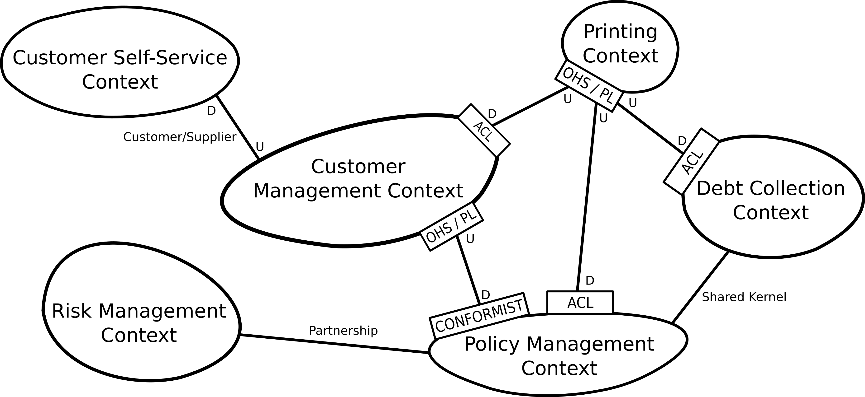
Example
Source: Internet

Slide 22
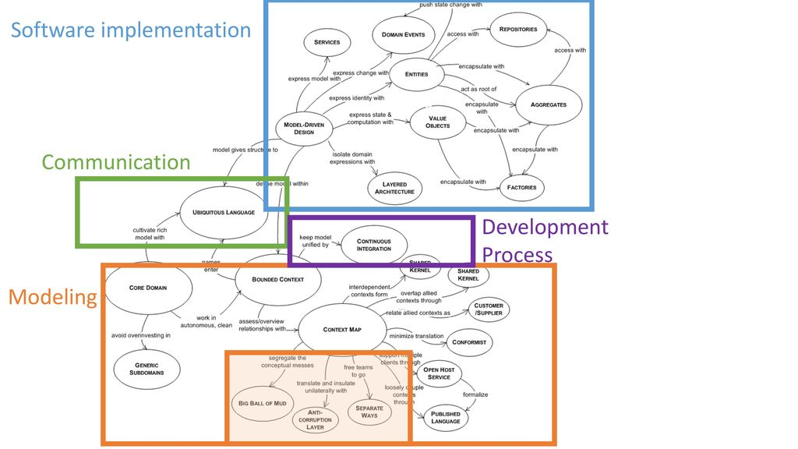
Source: Internet

Slide 23
References
https://vaadin.com/learn/tutorials/ddd/strategic_domain_driven_design
https://airbrake.io/blog/software-design/domain-driven-design
https://www.slideshare.net/allineoliveira/ubiquitous-language

