Slide 1

#9: clean architecture
Trainer: Bach Ngoc Toan - Phát hành tại: www.tedu.com.vn

Slide 2
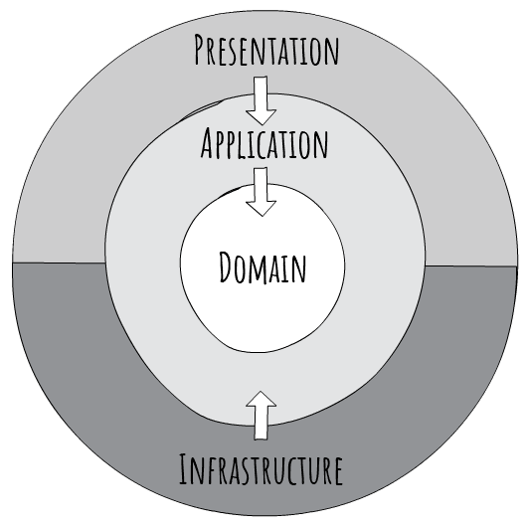
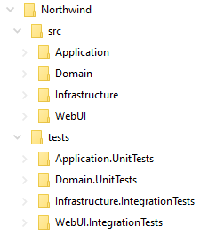
Clean Architecture

Slide 3
Advantages
Independent of frameworks it does not require the existence of some tool or framework
Testable easy to test – Core has no dependencies on anything external, so writing automated tests is much easier
Independent of UI logic is kept out of the UI so it is easy to change to another technology – right now you might be using Angular, soon Vue, eventually Blazor!
Independent of the database data-access concerns are cleanly separated so moving from SQL Server to CosmosDB or otherwise is trivial
Independent of anything external in fact, Core is completely isolated from the outside world – the difference between a system that will last 3 years, and one that will last 20 years

Slide 4
Technologies
.NET 5
Entity Framework Core 5
Blazor
MediatR
AutoMapper
FluentValidation
XUnit
Docker

Slide 5
References
Clean Architecture with .NET Core: Getting Started – Jason Taylor
https://github.com/jasontaylordev/CleanArchitecture
https://blog.cleancoder.com/uncle-bob/2012/08/13/the-clean-architecture.html

