Slide 1

#14: MVC Application and Integrate wITH is4
Trainer: Bach Ngoc Toan - Phát hành tại: www.tedu.com.vn

Slide 2
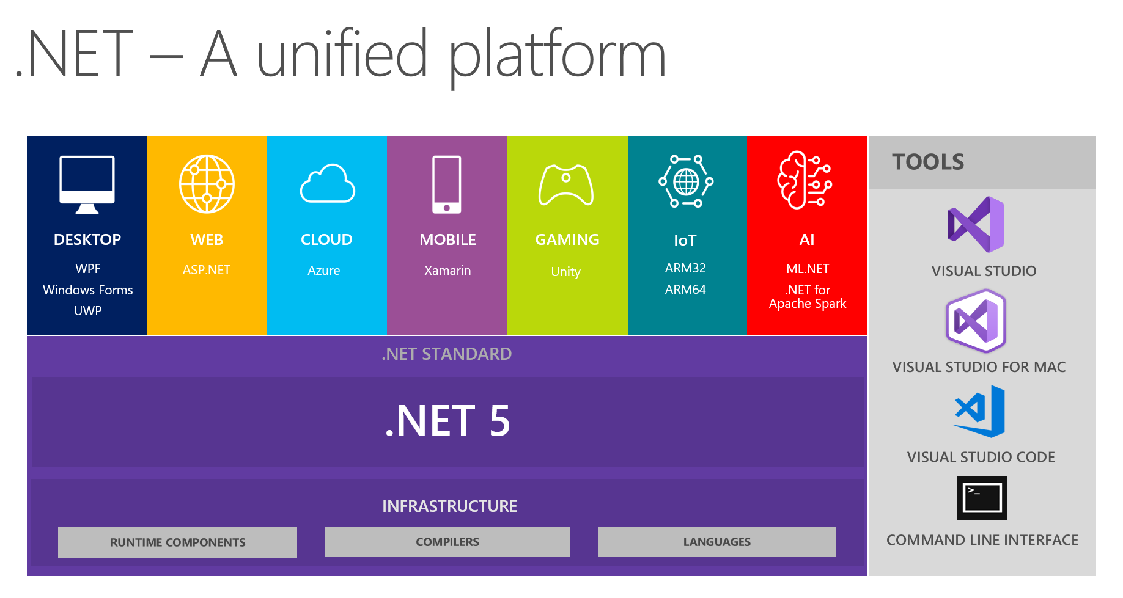
.NET Core Architecture

Slide 3
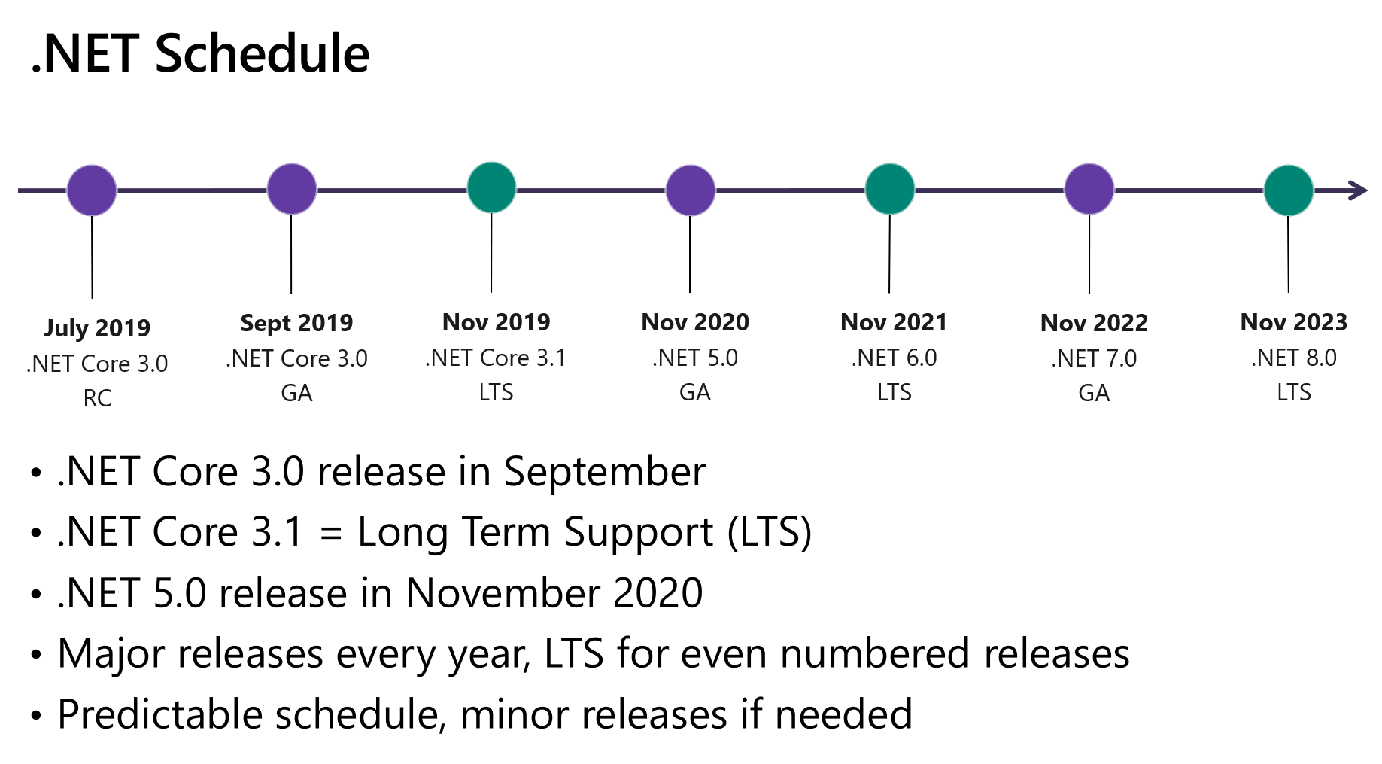
Roadmap

Slide 4
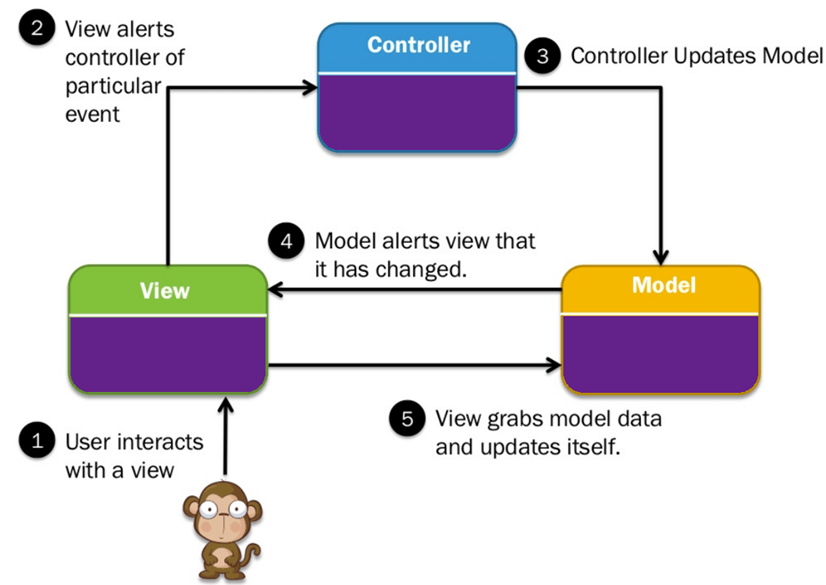
MVC Application

Slide 5
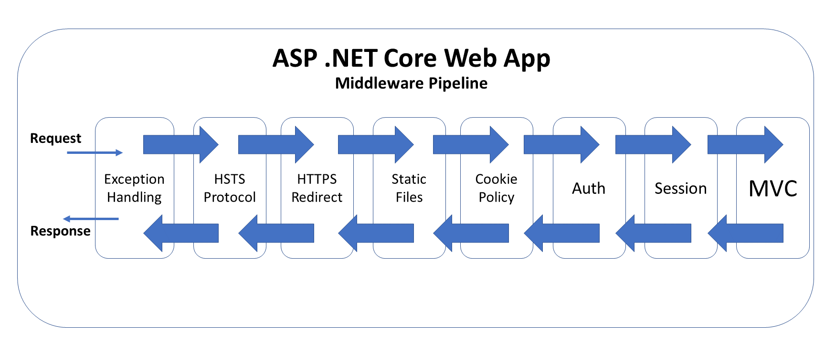
Request Pipeline

Slide 6
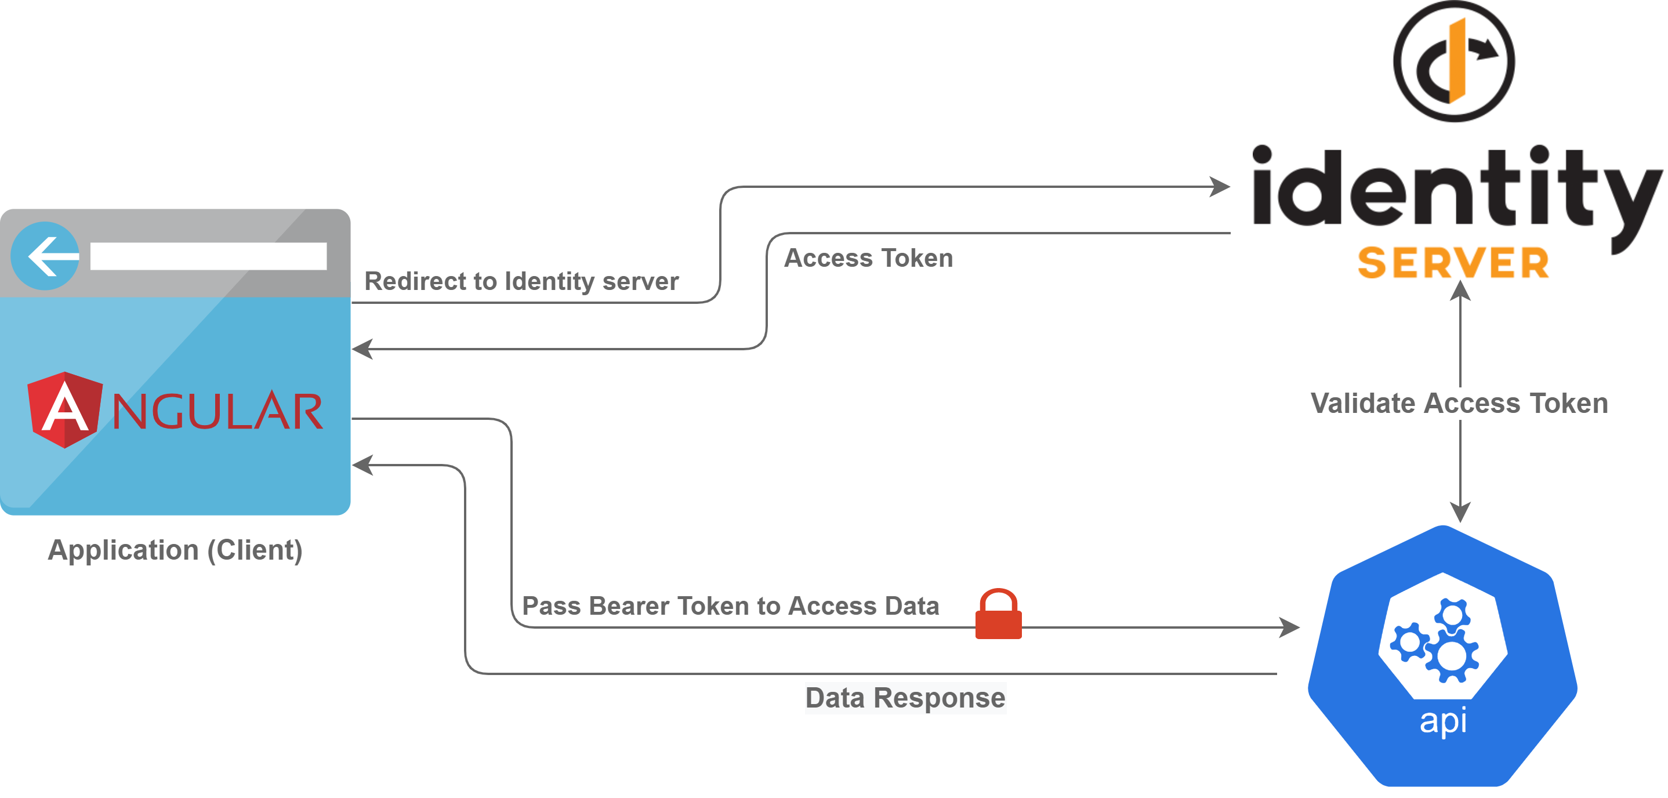
Identity Server Flow

Slide 7
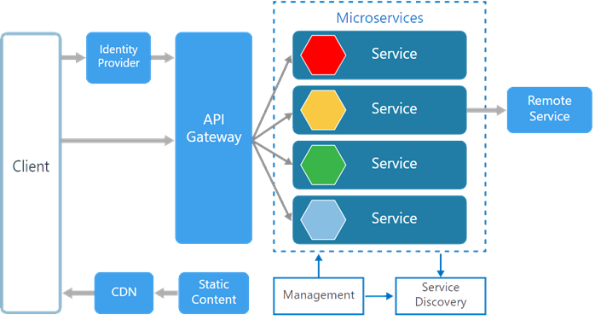
Microservices

Slide 8
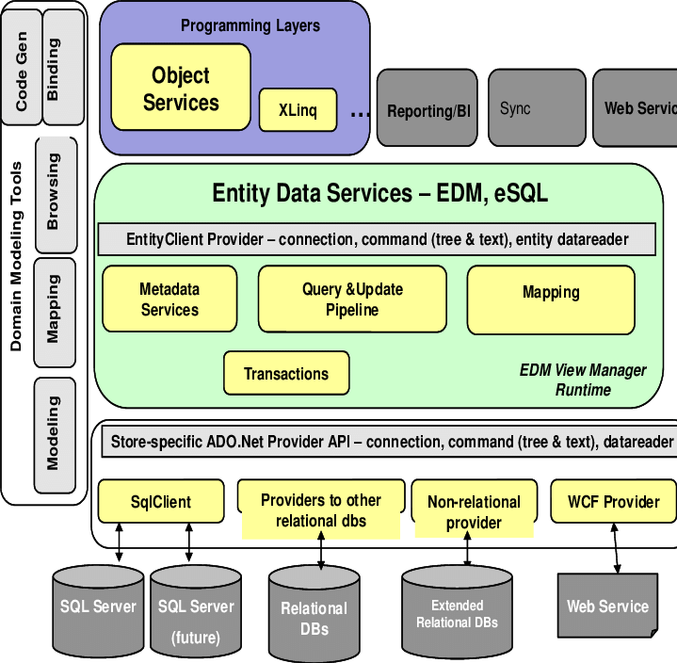
Entity Framework Architecture

