Slide 1
Jenkins Introduction

Slide 2
Jenkins
What is a Jenkins pipeline?
What is a Jenkins file?
Pipeline concepts

Slide 3
Jenkins Job Types
Freestyle project
Create CI CD workflow with UI configuration combine with code.
Pros:
Easy to setup
Cons:
Hard to manage version
Pipeline project
Create CI CD workflow by source code.
Pros:
Can manage all setup steps by source control
Cons:
Hard to learn and code.

Slide 4
What is a Jenkins pipeline?
A pipeline is a collection of commands that brings the software from version control into the hands of the end users by using automation tools.
Jenkins pipeline is a CI&CD pipeline that executes the workflow as code.

Slide 5
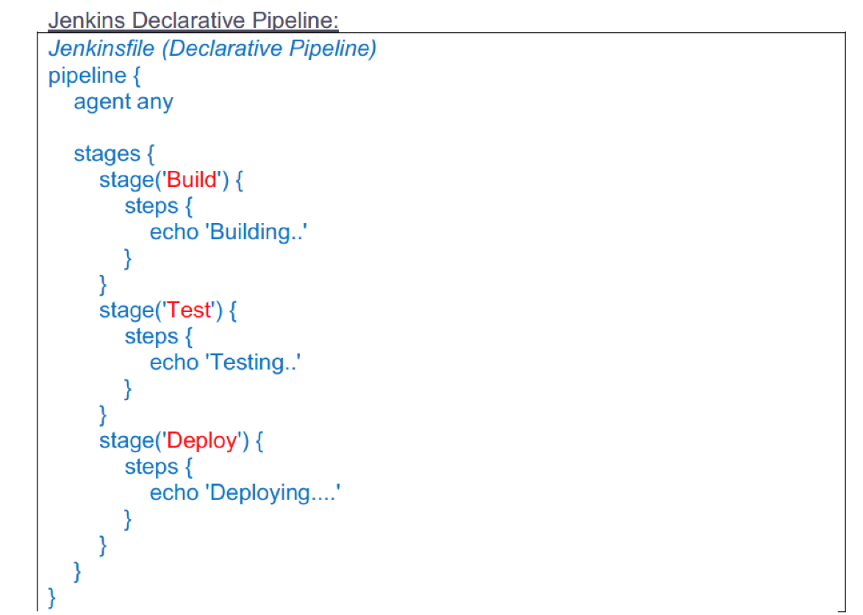
Jenkins file
The key feature of this pipeline is to define the entire deployment flow through code.
It basically follows the ‘ pipeline as code’ discipline.
Instead of building several jobs for each phase, you can now code the entire workflow and put it in a Jenkinsfile.

Slide 6
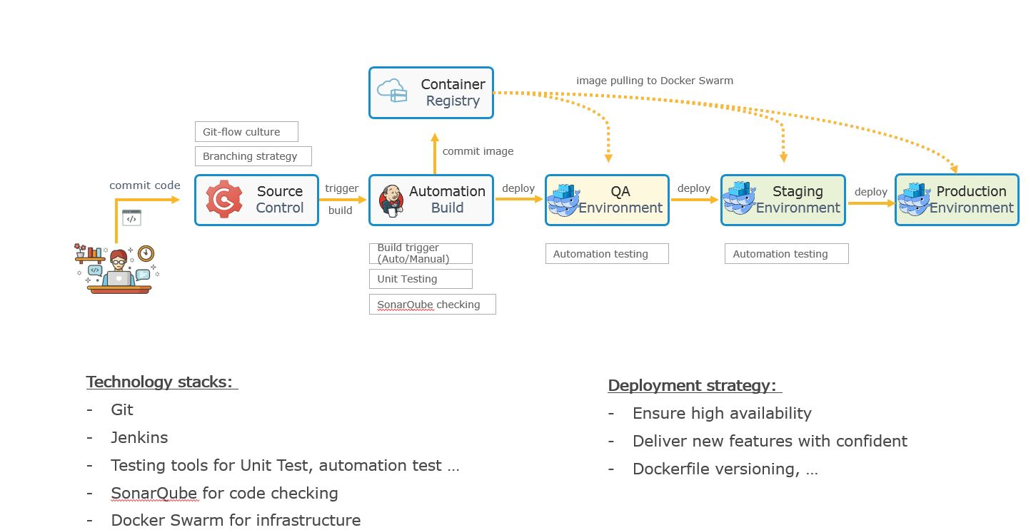
CI & CD tools

Slide 7
How to setup CI CD?
Tools
Jenkins - https://jenkins.io/
Git client - https://git-scm.com/
Check code quality – Sonarqube - https://www.sonarqube.org/
- Unit test coverage report MS Test
Plugins for Jenkins:
PowerShell plugin
SonarQube Scanner for Jenkins
MSTest plugin
Docker plugin

Slide 8
Q&A

Slide 9
References
https://medium.com/edureka/jenkins-pipeline-tutorial-continuous-delivery-75a86936bc92
https://martinfowler.com/articles/continuousIntegration.html
https://www.atlassian.com/continuous-delivery/continuous-integration/how-to-get-to-continuous-integration

