Slide 1

#11: Docker Infrastructure Setup
Trainer: Bach Ngoc Toan - Phát hành tại: www.tedu.com.vn

Slide 2
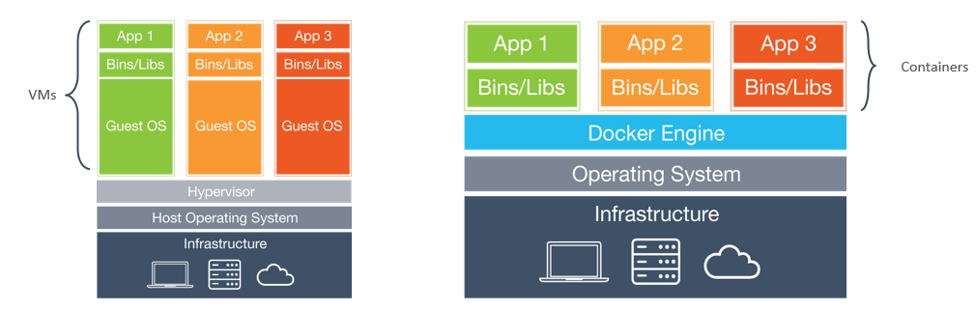
Docker vs Virtual Machine
Source: Internet

Slide 3
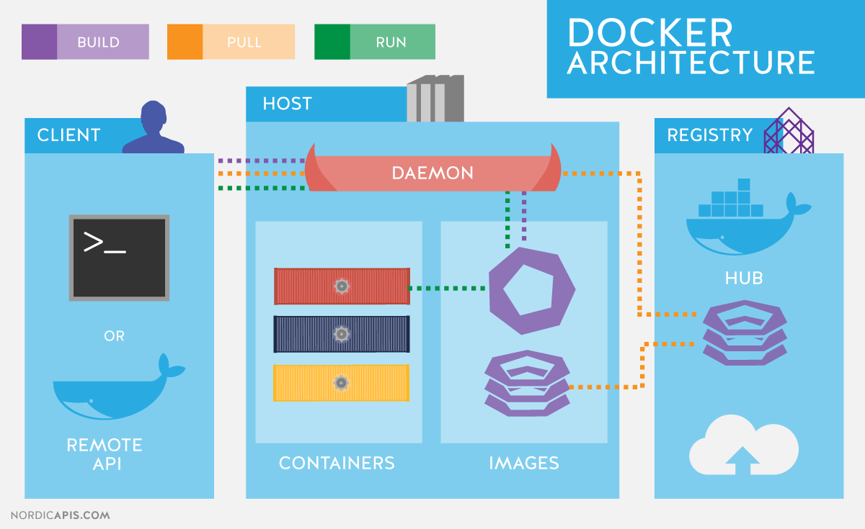
Docker Architecture
Source: Internet

Slide 4
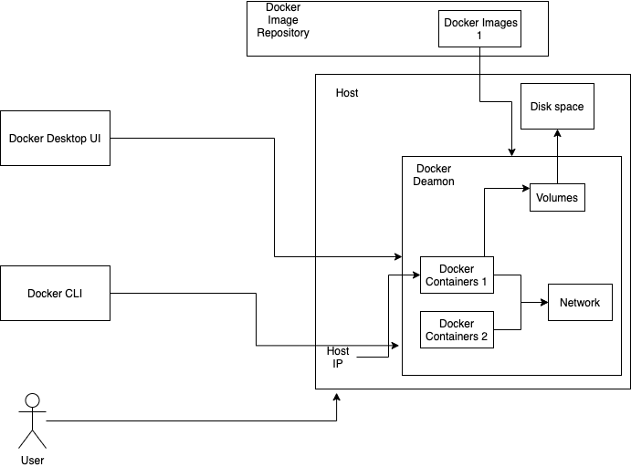
Docker Overview

Slide 5
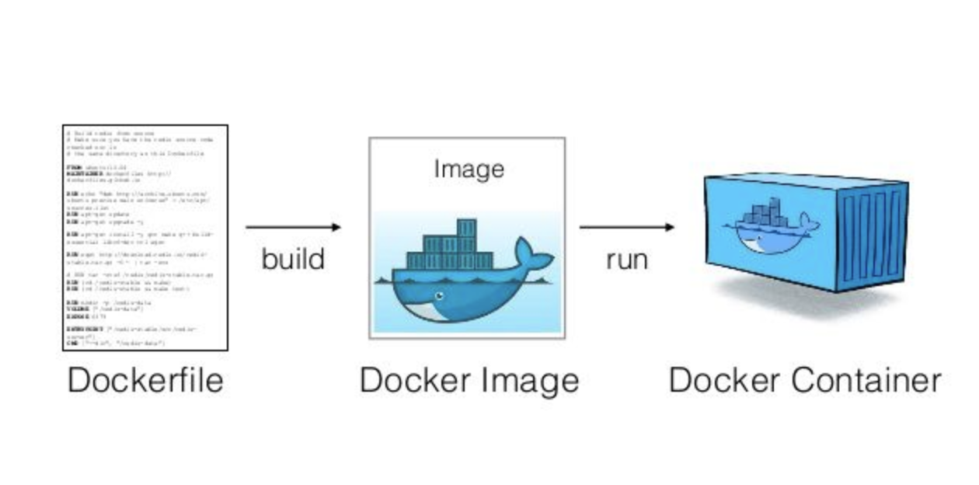
Docker Images and Container
Source: Internet

Slide 6
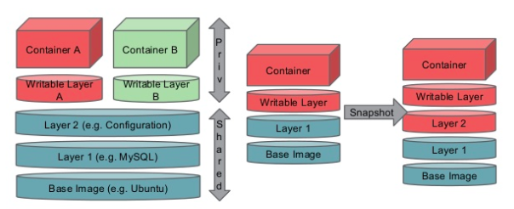
Docker Images
Source: Internet

Slide 7
Setup Infastructure
MongoDB: No SQL management system
Robo3T: UI for manage Mongo on Desktop
Mongo Express: Web UI
SQL Server: Relational database system
Mac: Azure Data Studio: UI for manage SQL Server on Mac
Windows: SQL Server Management Studio
Setup services:
Docker run
Docker compose: .yml or .yaml

Slide 8
References
Home: https://www.docker.com/
Public registry: https://hub.docker.com/
Docker compose: https://docs.docker.com/compose/
Install: https://docs.docker.com/docker-for-mac/install/

