Slide 1

#7: MongoDB Introduction
Trainer: Bach Ngoc Toan - Phát hành tại: www.tedu.com.vn

Slide 2
Introduction
Home: https://www.mongodb.com/
MongoDB is a document based database management system with high scalabality and flexibility.
MongoDB has been writen by C+++

Slide 3
Overview
MongoDB is multiple platform, document based, high speed and easy to scalable.
Concept:
MongoDB server: contains databases, can contain multiple databases in one server.
Database: single unit contains list of documents (same with table in SQL)
Collection: contains the data is group of records (document) same with a table in RDBMS, flexible in storage because it’s schema less and do not the same number of fields.
Document: is collection of key/value pairs, dynamic schema.

Slide 4
Comparing with RDBMS
RDBMS | MongoDB
Database | Database
Table | Collection
Tuple/Row | Document
column | Field
Table Join | Embedded Documents
Primary Key | Primary Key (Default key _id provided by MongoDB itself)

Slide 5
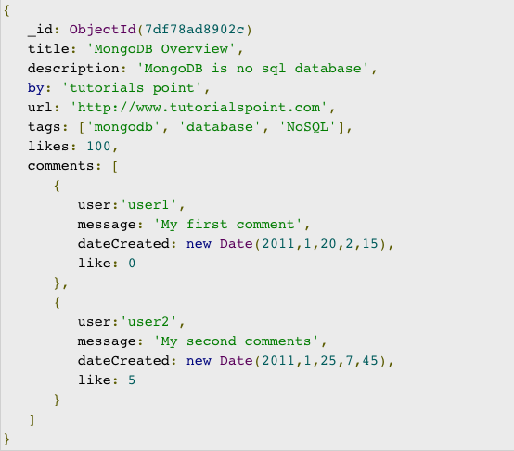
Document example in MongoDB

Slide 6
Advantages of MongoDB with RDBMS
MongoDB is schema less. It is a document database in which one collection holds different documents.
There may be difference between number of fields, content and size of the document from one to other.
Structure of a single object is clear in MongoDB.
There are no complex joins in MongoDB.
MongoDB provides the facility of deep query because it supports a powerful dynamic query on documents.
It is very easy to scale.
It uses internal memory for storing working sets and this is the reason of its fast access.

Slide 7
Performance analysis of MongoDB and RDBMS
In relational database (RDBMS) tables are using as storing elements, while in MongoDB collection is used.
In the RDBMS, we have multiple schema and in each schema we create tables to store data while, MongoDB is a document oriented database in which data is written in BSON format which is a JSON like format.
MongoDB is almost 100 times faster than traditional database systems.

Slide 8
Note
Combine multiple documents if you using them together.
Consider priority duplication over computed because memory is cheaper than CPU.
Join in writing instead of reading
Optimize schema for most used cases.
Do not contains complex aggregate in Schema

Slide 9
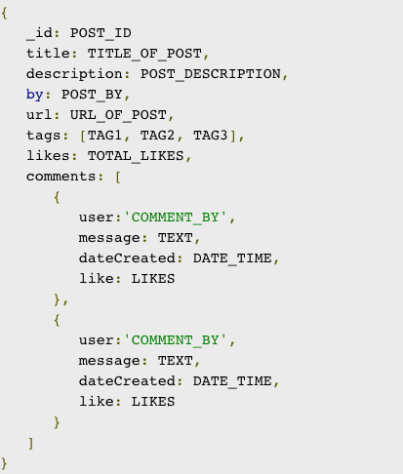
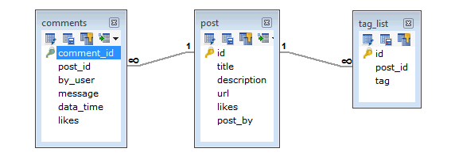
Example

Slide 10
Data Type
String
Integer
Boolean
DoubleMin/ Max keys.
Arrays
Timestamp
Object
Date
Object ID
Regular expression

