Slide 1
QUESTION What is adding value and ROI of kitchen renovation on house price of Ames? STAKEHOLDERS Home owners / sellers

Slide 2
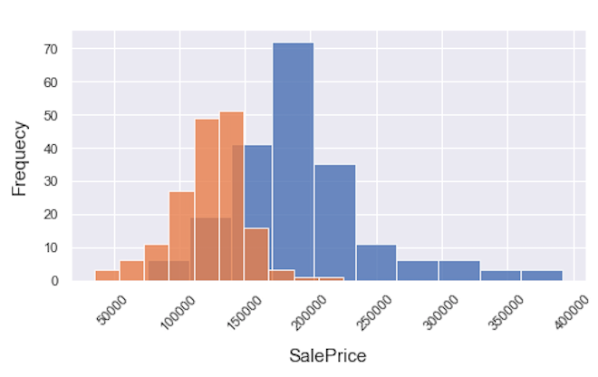
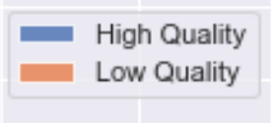
High quality houses vs low quality houses

Slide 3
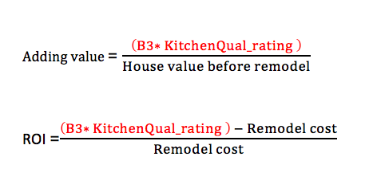
Linear Regression Model to predict house price
SalePrice = B0
+ B1* ExterQual_rating
+ B2 * OverallQual
+ B3* KitchenQual_rating
+ B4 * GarageCars
+ B5 * BsmtQual_rating
+ B6 * HeatingQC_rating
+ B7 * Age
+ B8 * YearSinceRemOrBuilt
+ B9 * GrLiveArea
+ B10 * TotalBsmtSF
+ B11 * BsmtUnfSF
+ B12* MassVnrArea
+ B13* LotArea

Slide 4
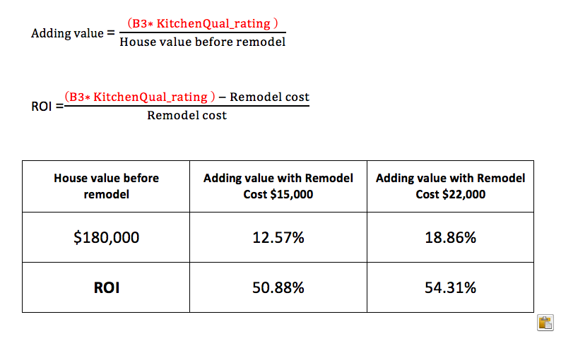

Slide 5
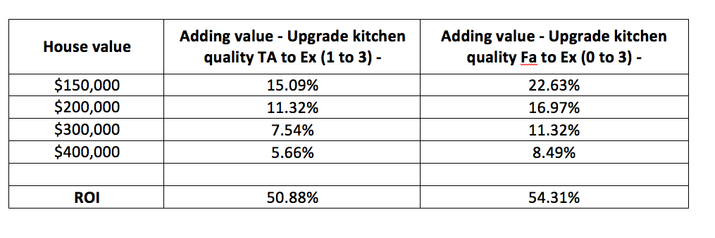

Slide 6
INDEX

Slide 7
Project prototype
EDA
Core insights of dataset focused on SalePrice, LotArea and OverallQuality
Model data: start with Linear Regression with simple feature selection
Features engineering:
• Categorise column: numerical, categorical (nominal, ordinal)
• Missing values
• Treat outliers - remove or standardise?
• Encode categorical features
Features selection:
• What features selection most improves the price prediction model’s score?
• any of them related to remodeling objects such as bedroom, bathroom, kitchen, garage, basement?
• if yes, can we use coef of these features to project their adding value into house price?

Slide 8
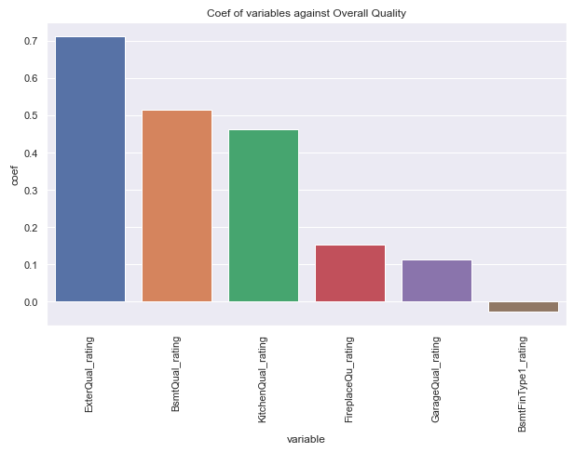

Slide 9
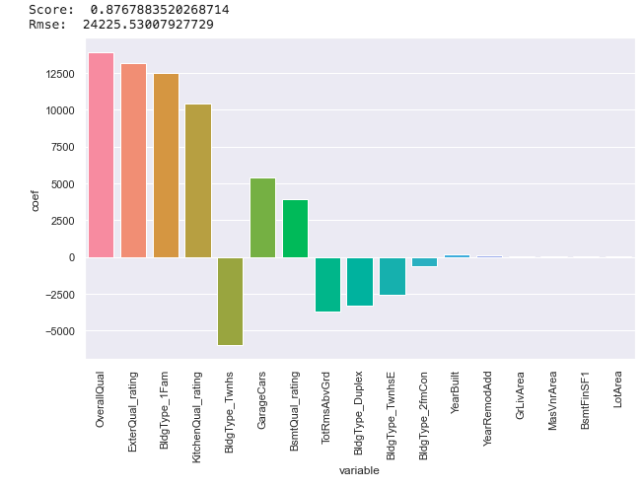

Slide 10
