Slide 1

Predicting target customers
for marketing
campaigns at Kroger
Chau Tran
Data Scientist in training

Slide 2
AGENDA
Challenges at Kroger
Executive summary
Process workflow
Delivery
Summary & Next Steps

Slide 3




BUSINESS PROBLEM DEFINITION
If an average cart’s value is $30, a lost of 1% customers daily results in a lost of $3,300,000 revenue daily.
KROGER in 2019:
$122 Billion sale
2757 stores
240 carts / second
11 million customers daily
DIRECT MARKETING PROCESS
START
COLLECT CUSTOMER DATA FROM
LOYALTY CARDS
SEND CUSTOMERS
DISCOUNT COUPONS
(1.6 million coupons per year)
CUSTOMERS GO SHOPPING REDEEMING COUPONS

Slide 4
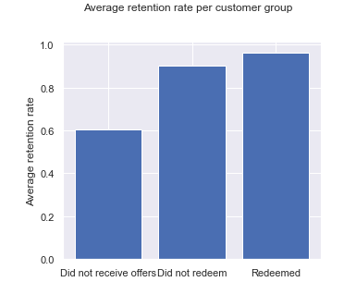
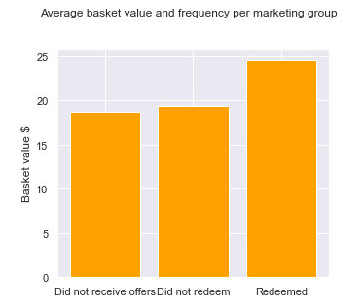
IMPACTS OF DIRECT MARKETING
RENTENTION RATE vs customer groups
BASKET VALUE vs customer groups
0.964
$24.5
Mean retention rate
0.903
$18.7
$19.3
0.604
Mean basket value $
Did not receive coupons
Did not redeem
REDEEMED
Did not receive coupons
Did not redeem
REDEEMED

Slide 5



STAKEHOLDER
BUSINESS QUESTION
Can we identify target customers who will take offers from direct marketing?
Josue Hernandez
Marketing Manager
at Kroger
DATA QUESTION
By using customer demographic and history purchase data, can we predict target customers who will take offers from direct marketing?

Slide 6
AGENDA
Challenges at Kroger
Executive summary
Process workflow
Delivery
Summary & Next Steps

Slide 7




EXECUTIVE SUMMARY
DATA EXPLORATION
KEY INSIGHTS
DATA REQUIRED:
Transaction data
Customer demographic
Products
Campaigns
Coupon redemption
DATA after aggregation:
2500 loyal customers (801 with demographic), 57 features.
Campaign 18 (out of 30 campaigns) is chosen for prediction.
Target variable is redemption action taken (True or False)
Single male or married people age 25 to 44 with income 35 - 49k who belong to segment Need Attention and Loyal are those likely to redeem the coupons.
CUSTOMERS with COUPON REDEMPTION has 6% higher retention rate and higher average purchase than other customers.
Champions customer segment has the highest redemption rate 25%
MODELING
Best model:
Random Forest – 85% accuracy
Most important features influencing on marketing response:
Total coupons received
Customer segment
Zip code
Income
Age
House ownership
Marital status

Slide 8
AGENDA
Challenges at Kroger
Executive summary
Process workflow
Delivery
Summary & Next Steps

Slide 9

Process workflow
Identify Business Question
Explore Data
Build & Evaluate Models
Identify DATA Question
Engineer Features
Implement Solution

Slide 10


Dataset
102 weeks from 2009 fiscal year
2500 unique loyal customers
276,484 unique baskets
External data
store_id
Store zip code
Zip code Profile
household_id
household_id
product_id
Campaign and Household
Household Demographic (801)
Transactions (2,595,732)
Products
(92,353)
campaign_id
product_id
product_id
household_id
campaign_id
coupon_id
Campaign Description (30)
Coupon Redemption
Coupons
(1135)
Product Causal

Slide 11
AGENDA
Challenges at Kroger
Executive summary
Process Workflow
Delivery
Summary & Next Steps

Slide 12
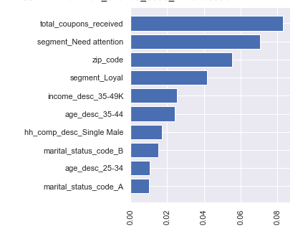
KEY FACTORS INFLUENCING REDEMPTION ACTION
Total coupons received
Segment ‘Need Attention’
Zip code
Segment ‘Loyal’
Income 35k - 49k
Age 35 - 44
Household component Single Male
Single
Age 25 - 34
Married

Slide 13
MODELS DEVELOPMENT & EVALUATION
MODEL | ACCURACY | STD | BALANCE SCORE
Random Forest | 0.85 | +/- 0.03 | 0.84
Logistic Regression | 0.84 | +/- 0.04 | 0.83
Gradient Boosting | 0.84 | +/- 0.04 | 0.81
eXtreme Gradient Boosting | 0.83 | +/- 0.02 | 0.82
Naïve Bayes | 0.73 | +/- 0.05 | 0.76
Based line: 75% accuracy
Imbalanced data
Hyperparameter tuning
Focus Camp
Day 1
Day 587
Day 642
Day 714

Slide 14
AGENDA
Challenges at Kroger
Executive summary
Process Workflow
EDA & Modelling
Summary & Next Steps

Slide 15
SUMMARY
BUSINESS ANSWER
MODEL CHOSEN:
Random Forest 85% Accuracy
Explore Data
Build & Evaluate Models
YES, we can identify target customers who will take offers from direct marketing so marketing team can focus the budgets on those with the highest profit potential.
DATA ANSWER
Find the right features
SOLUTION IMPLEMENTATION
Using customer demographic and history purchase data, we can predict who will take the offers before we launch a marketing campaign at 85% accuracy.
Execute the model every time planning a new marketing campaign.
Make predictions to estimate redemption rate, revenue and ROI.
Refine and review the model with updated data achieved after each campaign finishes.

Slide 16

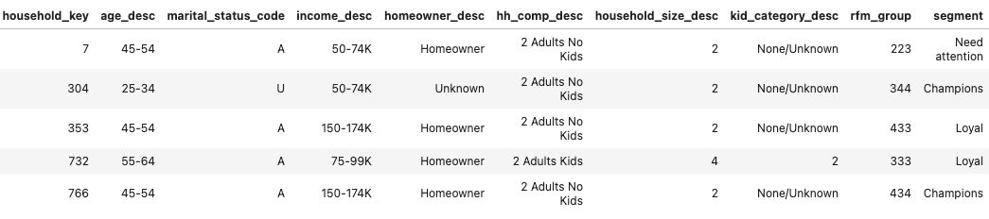
SOLUTION DEMPLOYMENT
https://kroger-target-customers-prediction.app.com
Campaign Type
Type A
Type B
Type C
TARGET CUSTOMERS PREDICTING TOOL
Customer Data
Upload File
PREDICT TARGET CUSTOMERS
CUSTOMERS WHO WILL LIKELY REDEEM THE COUPONS:

Slide 17
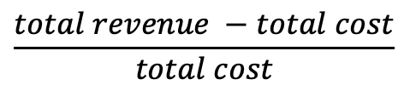
Focus Campaign ROI
Group | Household count | Total revenue | Revenue %
Redeemed | 214 | $71,501 | 20%
Did not redeem | 919 | $174,646 | 50%
Did not receive coupons | 1104 | $104,685 | 30%
Total | 2237 | $350,832 | 100%
Cost of focus campaign 18 Transaction discount $ 17762.12 Advertisement cost $ 5520 Extra cost $ 2328.212 TOTAL | $ 25,610
ROI = | 179 %
$$\frac{total revenue −total cost}{total cost}$$

Slide 18

Chau Tran vanchautran@gmail.com @github/vanchautran/capstone
THANK YOU!
QUESTIONS?

Slide 19
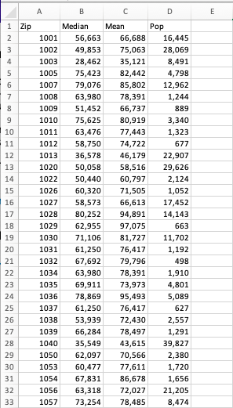
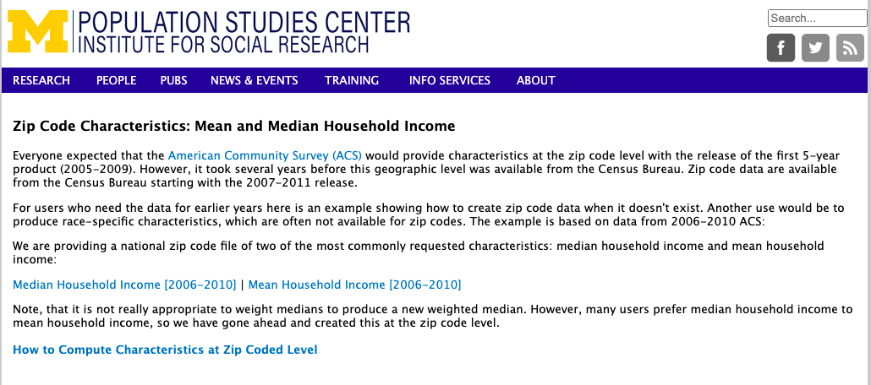
EXTERNAL DATASOURCE REFERENCE

Slide 20
NEXT STEPS
Solution implementation
Execute the model every time planning a new marketing campaign.
Make predictions to estimate redemption rate, revenue and ROI.
Review and refine the model with updated data achieved after each campaign finishes.

