Slide 1

Predicting target customers
for marketing
campaigns at Kroger
Chau Tran
Data Scientist in training

Slide 2
AGENDA
Challenges at Kroger
Executive summary
Process workflow
Delivery
Summary & Next Steps

Slide 3




CHALLENGES AT KROGER
If an average cart’s value is $30, a lost of 1% customers daily results in a lost of $3,300,000 revenue daily.
KROGER in 2019:
$122 Billion sale
2757 stores
240 carts / second
11 million customers daily
DIRECT MARKETING PROCESS
START
COLLECT CUSTOMER DATA FROM
LOYALTY CARDS
SEND CUSTOMERS
DISCOUNT COUPONS
(1.6 million coupons in 2019)
CUSTOMERS GO SHOPPING REDEEMING COUPONS

Slide 4
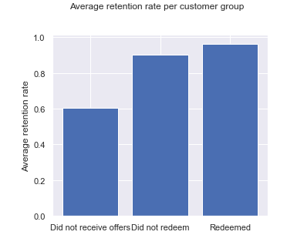
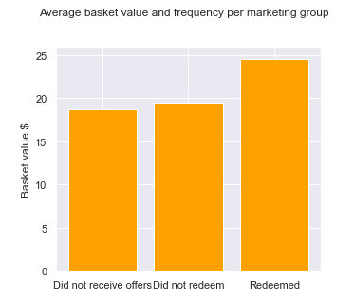
POSITIVE IMPACTS OF DIRECT MARKETING
RENTENTION RATE vs customer groups
BASKET VALUE vs customer groups
0.964
$24.5
Mean retention rate
0.903
$18.7
$19.3
0.604
Mean basket value $
Did not receive coupons
Did not redeem
REDEEMED
Did not receive coupons
Did not redeem
REDEEMED

Slide 5



STAKEHOLDER
BUSINESS QUESTION
Can we identify target customers who will redeem coupons offered by direct marketing campaigns so that we can focus the budgets on those with the highest profit potential?
Josue Hernandez
Marketing Manager
at Kroger
DATA QUESTION
By using demographic and history purchase data, can we predict target customers who will redeem coupons offered by direct marketing campaigns?

Slide 6
AGENDA
Challenges at Kroger
Executive summary
Process workflow
Delivery
Summary & Next Steps

Slide 7




EXECUTIVE SUMMARY
KEY INSIGHTS
DATA EXPLORATION
MODELING
Most important features influencing on redemption action:
‘Champions’ customer segment
Married
Home ownership
Income 35 - 74k
Age 25-44 or 45-54
Household component 2 adults with kids
CUSTOMERS with COUPON REDEMPTION has 6% higher retention rate and 27% higher average purchase than the others.
‘Champions’ customer segment has the highest redemption rate 25%.
DATA REQUIRED:
Transaction data
Customer demographic
Products
Campaigns
Coupon redemption
DATA aggregation:
2500 loyal customers (801 with demographic), 57 features.
More than 2 million transactions.
276,484 unique baskets.
Best model:
Random Forest – 84% accuracy
Campaign 18 (out of 30 campaigns) is chosen for prediction.
Target variable is coupon redemption (Yes or No)
External data reference
Imbalanced data handling
Solution deployment prototype

Slide 8
AGENDA
Challenges at Kroger
Executive summary
Process workflow
Delivery
Summary & Next Steps

Slide 9

Process workflow
Identify Business Question
Explore Data
Build & Evaluate Models
Identify DATA Question
Engineer Features
Implement Solution

Slide 10


Dataset
102 weeks from 2009 fiscal year
2500 unique loyal customers
276,484 unique baskets
External data
store_id
Store zip code
Zip code Profile
household_id
household_id
product_id
Campaign and Household
Household Demographic (801)
Transactions (2,595,732)
Products
(92,353)
campaign_id
product_id
product_id
household_id
campaign_id
coupon_id
Campaign Description (30)
Coupon Redemption
Coupons
(1135)
Product Causal

Slide 11
AGENDA
Challenges at Kroger
Executive summary
Process Workflow
Delivery
Summary & Next Steps

Slide 12
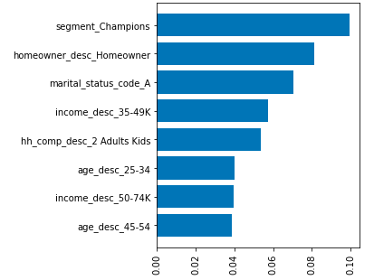
KEY FACTORS INFLUENCING REDEMPTION ACTION
Segment ‘Champions’
Homeowner
Married
Income 35k - 49k
Family of 2 adults with kids
Age 25 - 34
Income 50k - 74k
Age 45 - 54

Slide 13
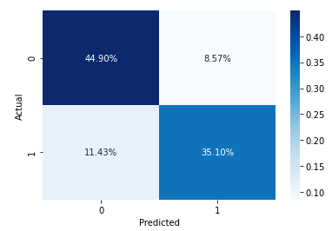
MODELS DEVELOPMENT & EVALUATION
MODEL | ACCURACY | STD | BALANCE SCORE
Random Forest | 0.84 | +/- 0.04 | 0.84
Naïve Bayes | 0.82 | +/- 0.02 | 0.78
Logistic Regression | 0.83 | +/- 0.02 | 0.80
AdaBoost | 0.82 | +/- 0.02 | 0.82
Gradient Boosting | 0.83 | +/- 0.04 | 0.82
eXtreme Gradient Boosting | 0.81 | +/- 0.04 | 0.80
Based line: 75% accuracy
Imbalanced data
Hyperparameter tuning
RANDOM FOREST
Not Redeem
Focus Camp
ACTUAL
Day 1
Day 587
Day 642
Day 714
Redeem
Not Redeem
Redeem
PREDICTED

Slide 14
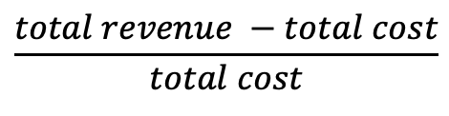
Focus Campaign ROI
Group | Household count | Total revenue | Revenue %
Redeemed | 214 | $71,501 | 20%
Did not redeem | 890 | $174,646 | 50%
Did not receive coupons | 1133 | $104,685 | 30%
Total | 2237 | $350,832 | 100%
COST of focus campaign 18 Total households: 1104 Total discount claimed $ 17762.12 Advertisement cost* $ 5520 Extra cost (15%) $ 4656.42 TOTAL | $ 27,839
ROI = | 156 %
* Assumption: design, printing & postage cost $5 / household
$$\frac{total revenue −total cost}{total cost}$$

Slide 15
AGENDA
Challenges at Kroger
Executive summary
Process Workflow
EDA & Modelling
Summary & Next Steps

Slide 16
SUMMARY
BUSINESS ANSWER
MODEL CHOSEN:
Random Forest 84% Accuracy
Explore Data
Build & Evaluate Models
YES, we can identify target customers who will take offers from direct marketing so marketing team can focus the budgets on those with the highest profit potential.
DATA ANSWER
Find the right features
SOLUTION IMPLEMENTATION
Using customer demographic and history purchase data, we can predict who will take the offers before we launch a marketing campaign at 84% accuracy.
Execute the model every time planning a new marketing campaign.
Make predictions to estimate redemption rate and ROI from the campaign.
Refine and review the model with updated data achieved after each campaign finishes.

Slide 17

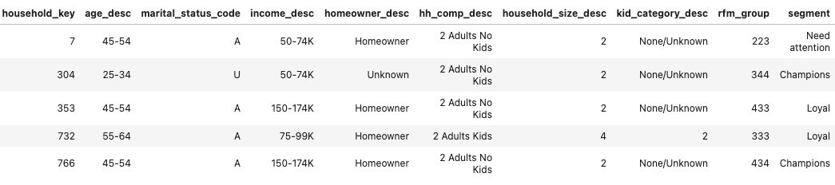
SOLUTION DEPLOYMENT
https://kroger-target-customers-prediction.app.com
Campaign Type
Type A
Type B
Type C
TARGET CUSTOMERS PREDICTING TOOL
PREDICT TARGET CUSTOMERS
CUSTOMERS WHO WILL LIKELY REDEEM THE COUPONS:

Slide 18

Chau Tran vanchautran@gmail.com @github/vanchautran/capstone
THANK YOU!
QUESTIONS?

Slide 19
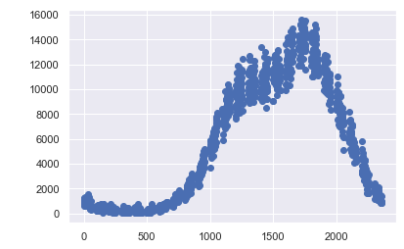
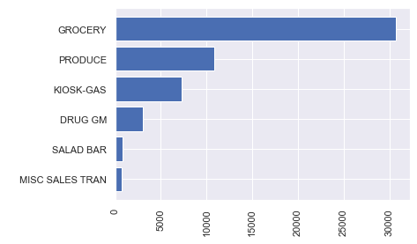
INDEX
TOP 6 CATEGORIES MOST PURCHASED
REVENUE BY SHOPPING TIME
Revenue $
12AM
5AM
10AM
3PM
8PM

Slide 20
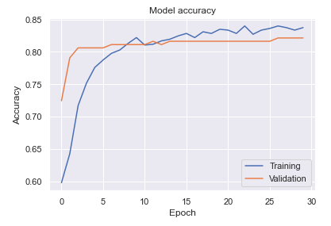
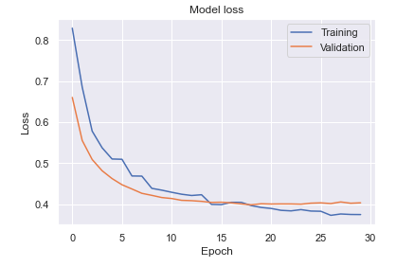
Deep Learning method
Convolutional Neural Network (CNN) – Accuracy 82%

Slide 21
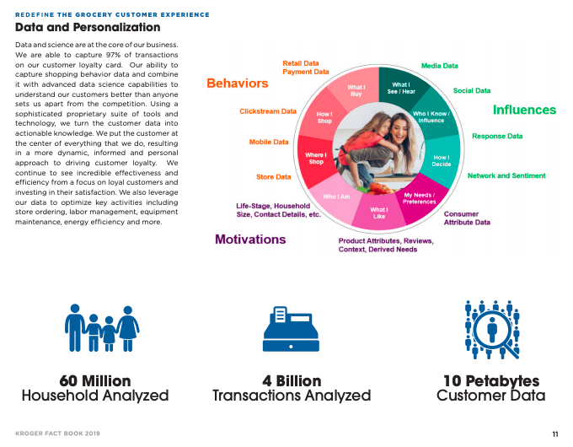
POTENTIAL OPPORTUNITIES
Capable to capture 97% of transactions on customer loyalty card.

