Slide 1

MINI PROJECT III
THE COST OF EMPLOYEE
TURNOVER
By Chau Tran
Notes:
A survey performed by Australian HR Institute during May and June 2018 attracted a total of 501 respondents.
A majority (63 per cent) of respondents report their organisation does not measure the financial cost of employee turnover.
https://www.ahri.com.au/media/1222/turnover-and-retention-report_final.pdf

Slide 2
AGENDA
01. Problem definition
02. Project summary
03. EDA
04. Modeling
05. Business answer and suggestion

Slide 3
PROBLEM DEFINITION
STAKE HOLDER
Troy Poposki
Special Project Lead
Business model planning and
growth strategy
COMPANY
Drake Medox
Human Resource Recruitment & Consultant
Business question:
How to reduce the cost of employee turnover at InnoLab?
Data question:
What are key drivers of employee turnover at InnoLab and how to predict turnover using their attrition data?
CLIENT
InnoLab
Employees: 1470
Business requirements: develop strategies on effective recruitment and retention

Slide 4
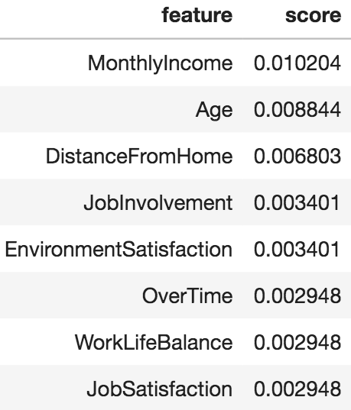
PROJECT SUMMARY
ETL/EDA
MODELING
KEY INSIGHTS
Kaggle: IBM fictional dataset – Employee Attrition.csv
Observations: 1470
Numerical columns: 27
Categorical columns: 8
Columns with missing value : 0
Dataset was imbalanced and was oversampled during modeling process.
Models: LR, RF, GB, XGB, KN and NB
Most important features selected by using the best model GB (94% accuracy):
Age, MonthlyIncome, DistanceFromHome, JobInvolvement, OverTime, EnvironmentSatisfaction, EducationField_Medical, JobSatisfaction, WorkLifeBalance
Millennials (23-38 y.o) with monthly income under $7500 took highest level of turnover (62%).
Job roles having most churned employees: Laboratory
Technician, Sales Executive, Research Scientist, Sales
Representative
Minimum turnover cost: 35% annual salary of the churned employee.
Total cost of turnover per year
$ 5,250,735
By reducing 30% of current turnover rate (16%) can save $ 2,064,384

Slide 5
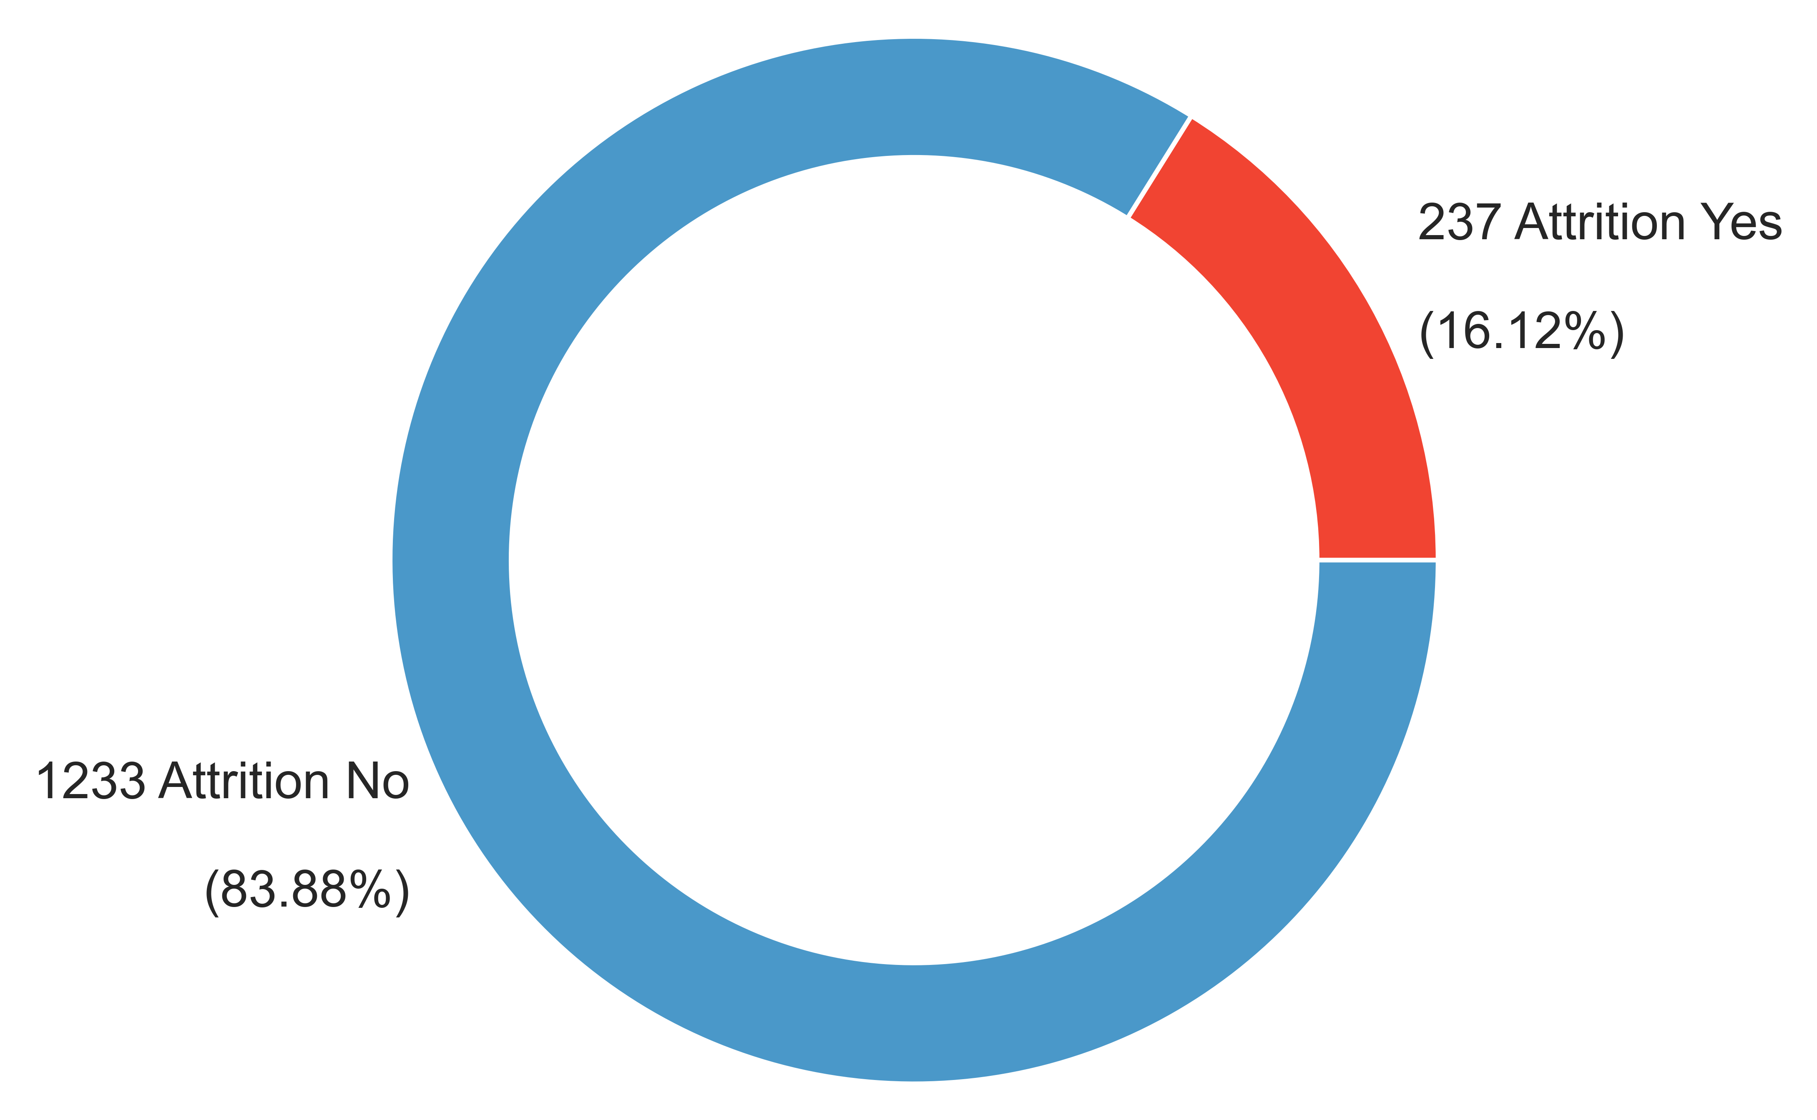
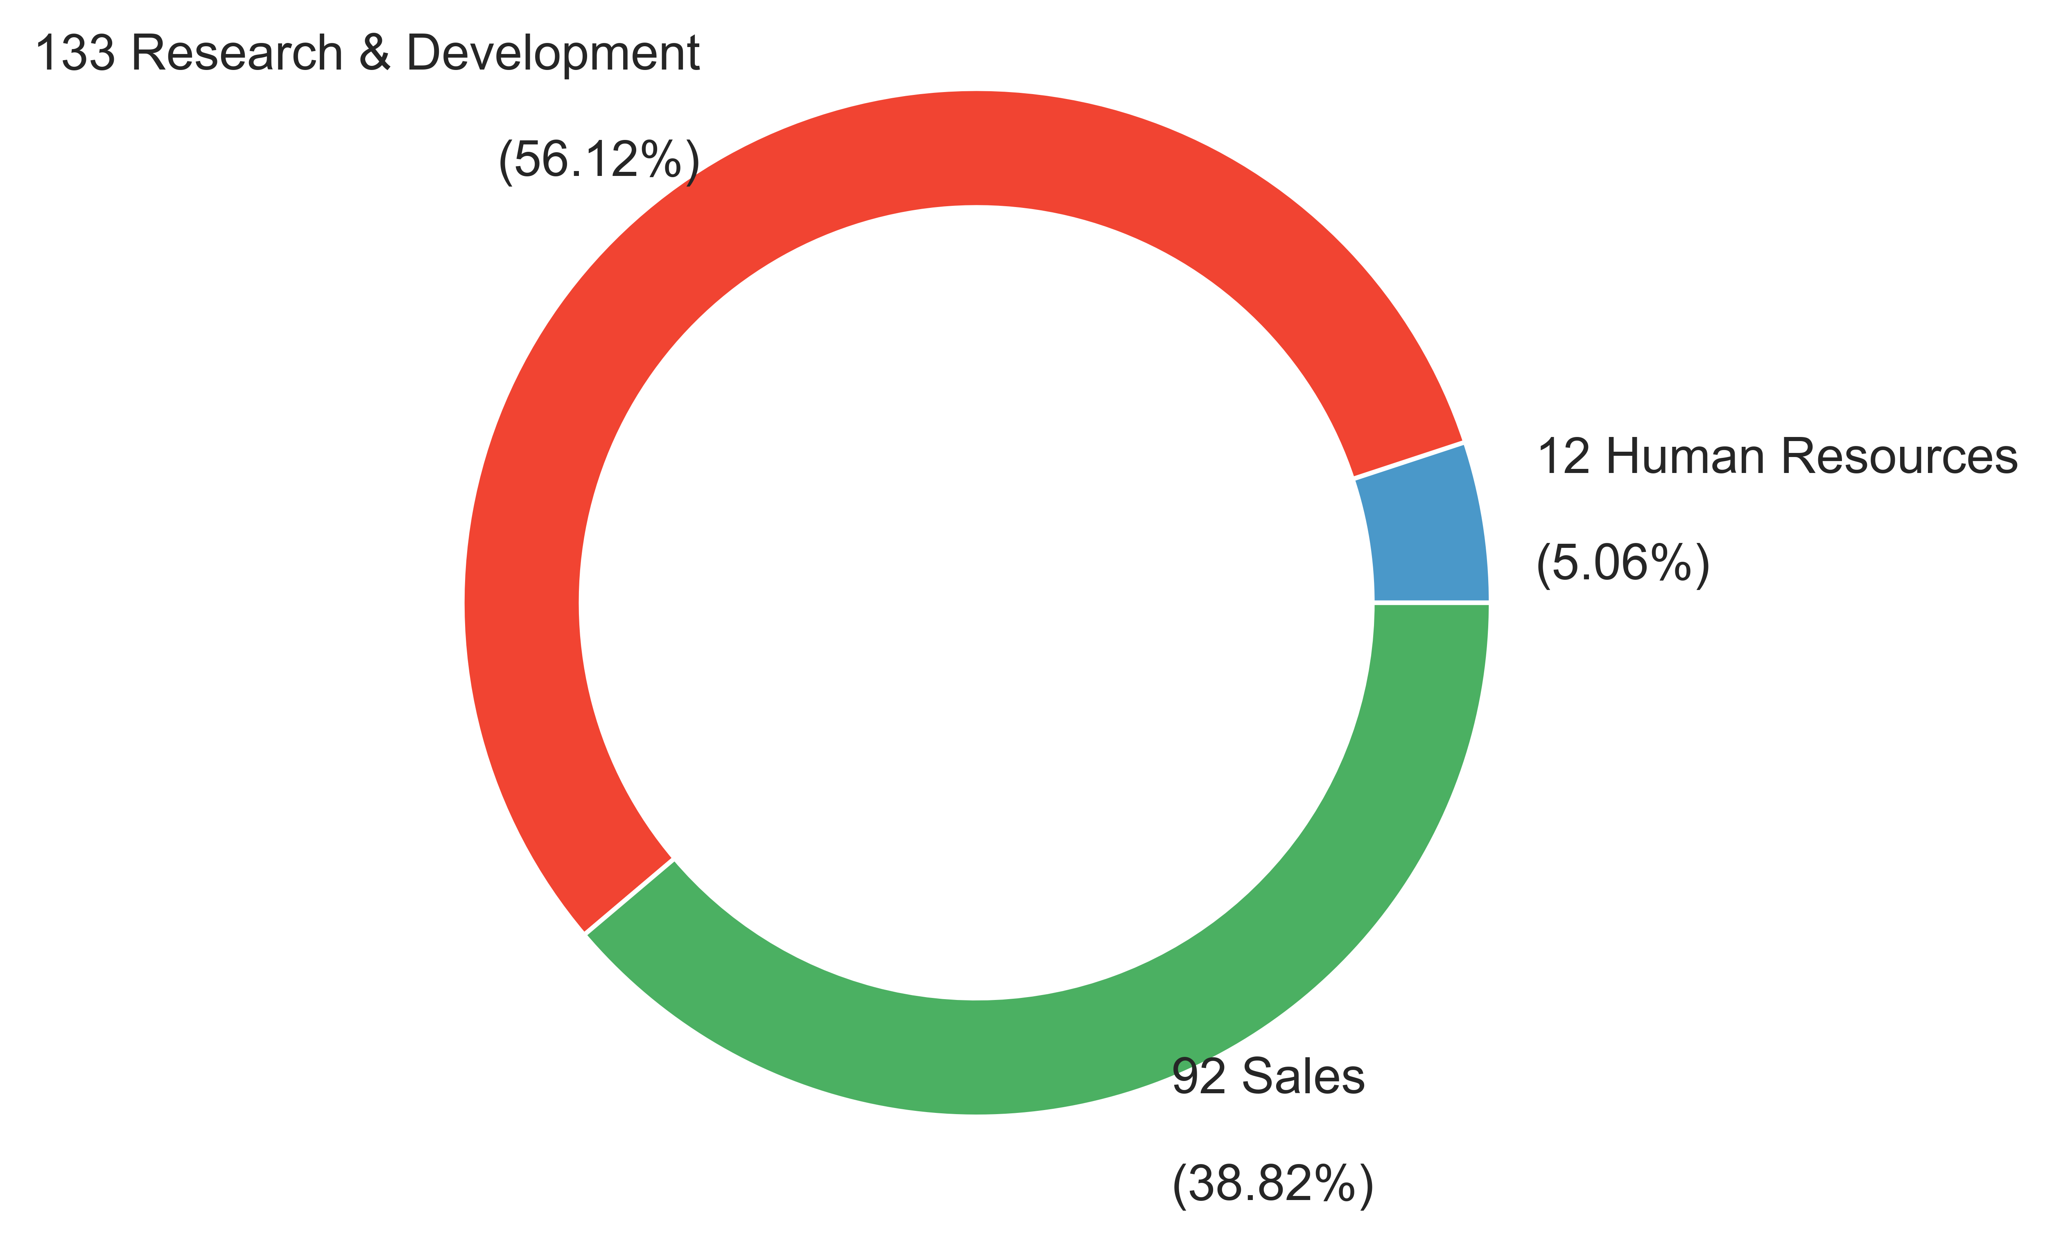
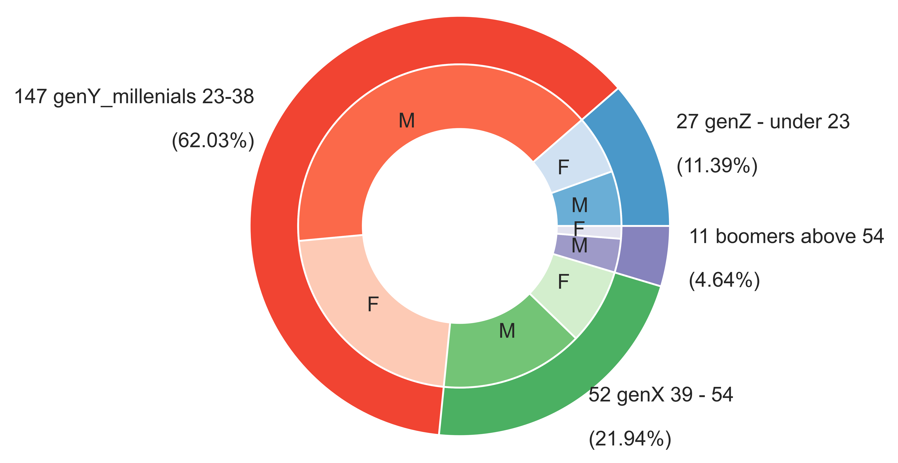
EDA

Slide 6
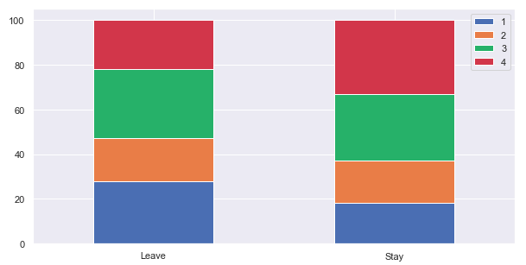
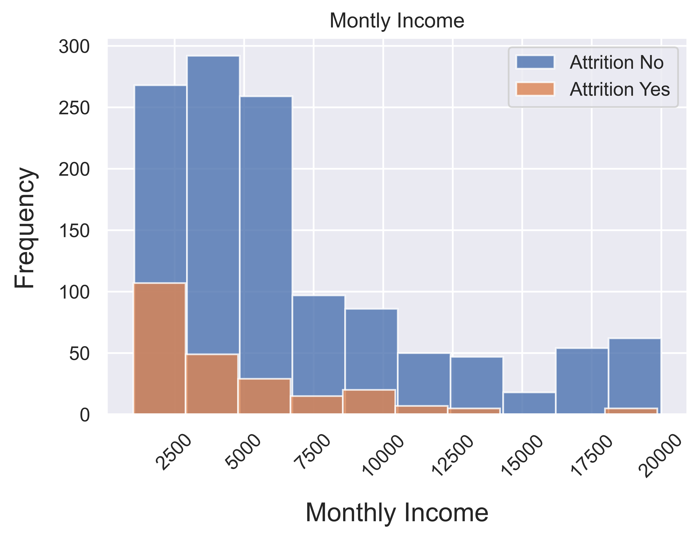
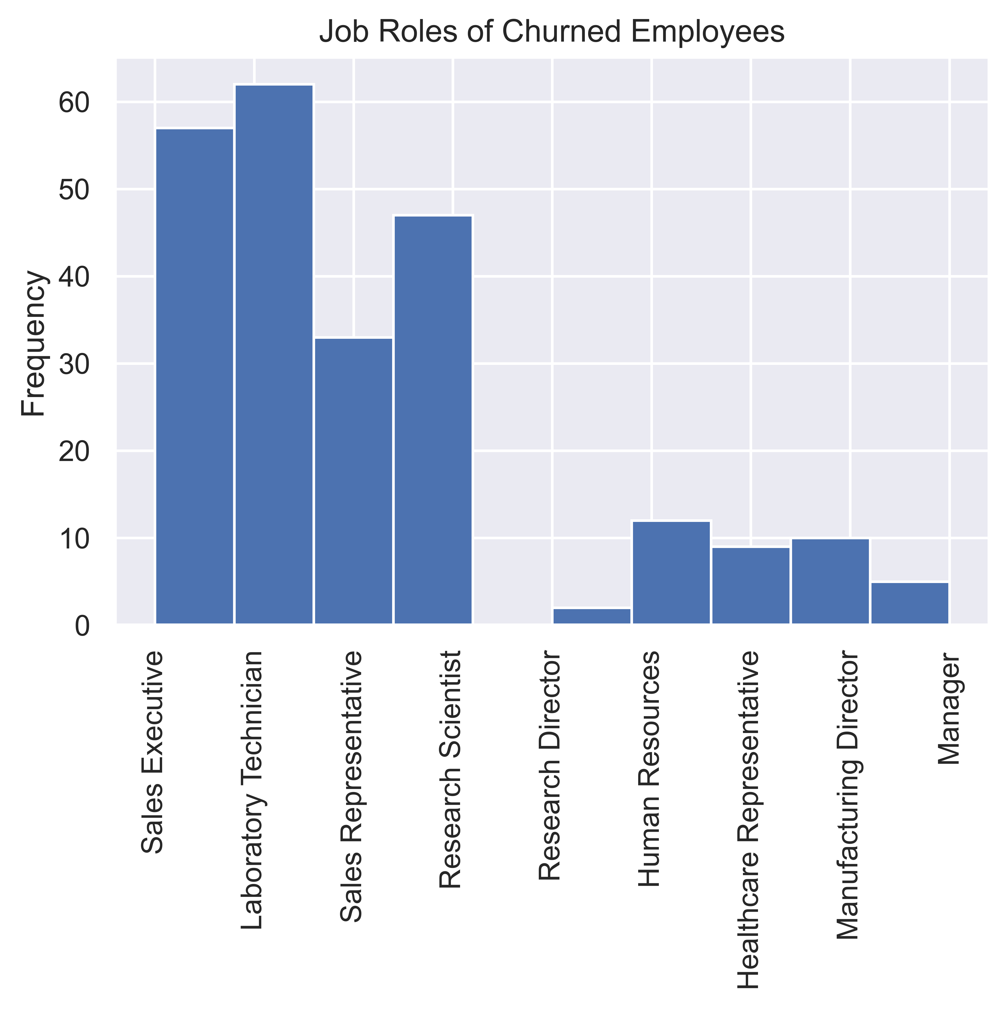
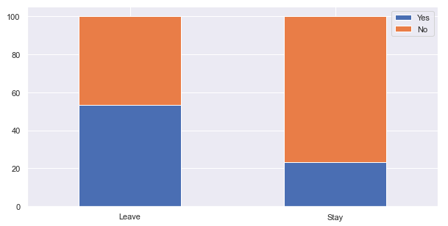
EDA
Job satisfaction
Overtime

Slide 7
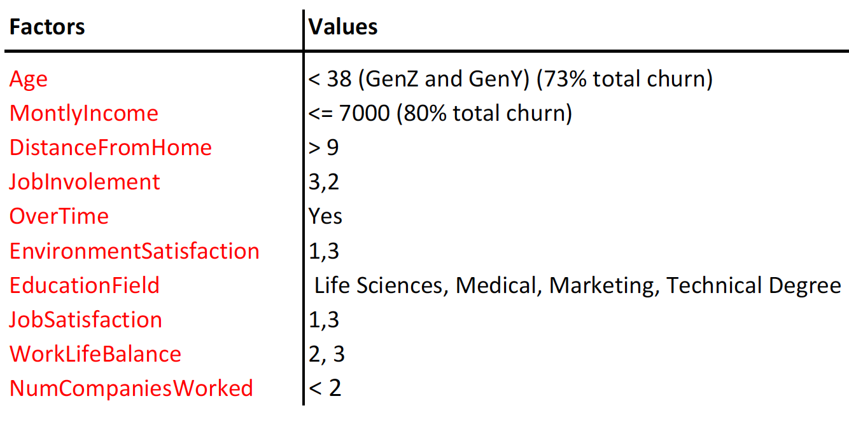
Common factors of more than 50% employee churn
EDA

Slide 8
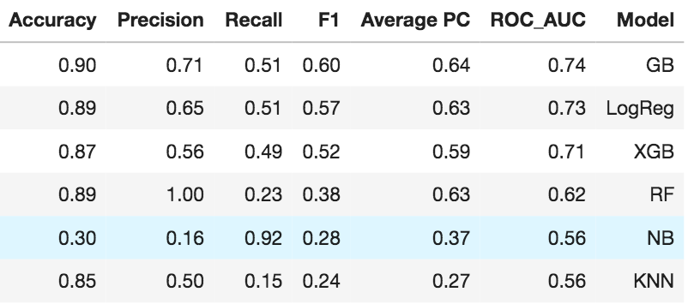
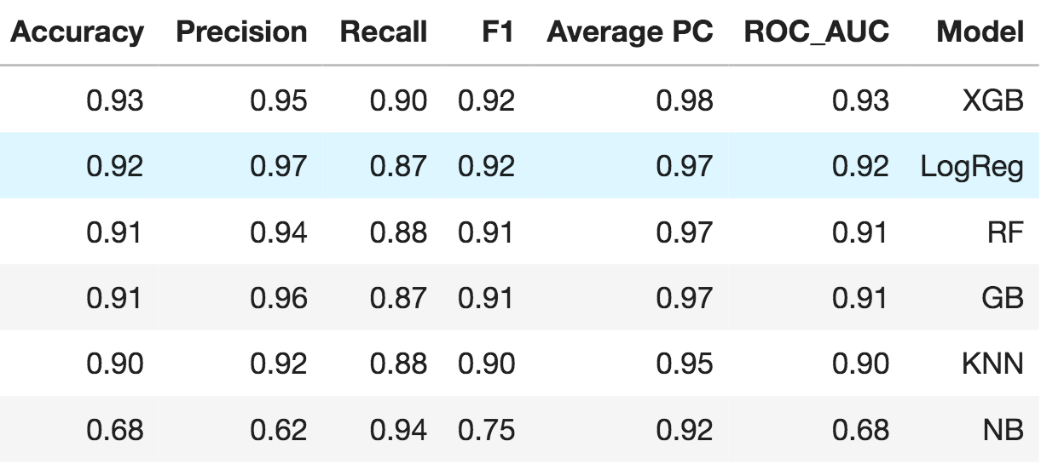
IMBALANCED DATA
MODELING
BALANCED DATA
train_test_split(X,y,test_size=0.2,random_state=42,stratify=y)
Standardise features
Set class_weight='balanced’ for RandomForest
Set scale_pos_weight for XGBClassifier
Filter high MonthlyIncome > 15000 to improve models
Oversampling data by SMOTE
Standardise features

Slide 9

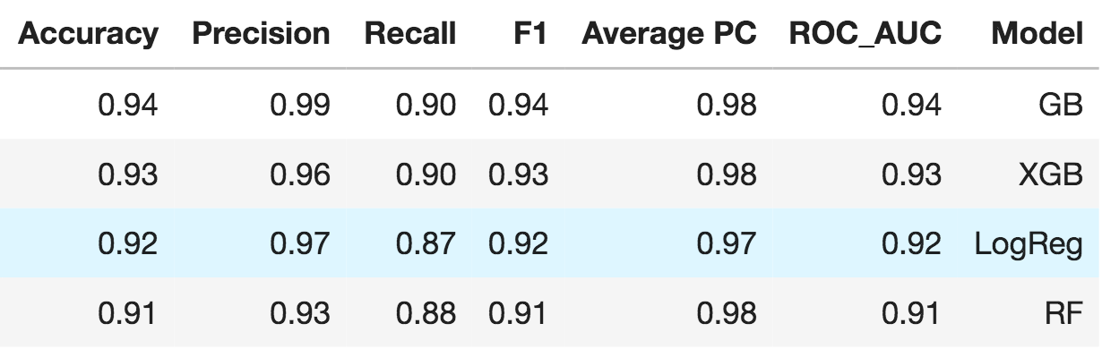
HYPERPARAMETERS TUNING
Gradient Boosting
Fitting 5 folds for each of 150 candidates, totalling 750 fits
Elapsed: 12.6min
{'learning_rate': 1, 'max_depth': 9, 'n_estimators': 50}
Random Forest
Fitting 5 folds for each of 500 candidates, totalling 2500 fits
Elapsed: 37.6min
{'max_depth': 25, 'min_samples_leaf': 1,
'min_samples_split': 2, 'n_estimators': 1200}
XGBoost
Fitting 3 folds for each of 9000 candidates, totalling 27000 fits
Elapsed: 107.8min
{'colsample_bytree': 0.6, 'gamma': 1,
'learning_rate': 0.1, 'max_depth': 12,
'min_child_weight': 1, 'n_estimators': 200, 'subsample': 1.0}
Logistic Regression
Fitting 5 folds for each of 30 candidates, totalling 150 fits
Elapsed: 8.2s
{'C': 0.1, 'penalty': 'l2', 'solver': 'newton-cg'}
BEFORE
AFTER

Slide 10
AGENDA
01. Problem definition
02. Project summary
03. EDA
04. Modeling
05. Business answer and suggestion

Slide 11
TURNOVER COST
Churned employee
Annual salary $62,400
Calculated monthly salary $5,200
Calculated daily salary $240
1. Cost of 'covering' a vacant position
$396
2. Cost to fill a vacant position
$1829
3. Onboarding and Orientation cost
$3131
4. Cost of productivity ramp-up
(first 3 months)
$16800
TOTAL TURNOVER COST PER EMPLOYEE CHURN
$ 22,155
(35% of annual salary of the churned employee)
+
+
+
=
Current employee turnover rate 16%
Number of employees lost (assumed in the last 12 months) 237
TOTAL COST OF TURNOVER PER YEAR $ 5,250,735
SAVING BY REDUCING TO 30% TURNOVER PER YEAR $ 2,064,384
Turnover cost template is referenced from https://au.drakeintl.com/clients/calculate/

Slide 12
SUGGESTION ON RETENTION STRATEGY
HR experts to look into the key turnover drivers identified by the analysis:
Different strategies targeting different demographic groups
Millennials GenY vs Gen X vs Boomers
Salary and benefits review routine
Overtime hours and benefits review
Job satisfaction improvement:
Regular performance feedback and recognition
Opportunities for career progression, training and promotion
Environment satisfaction improvement:
positive work environment and culture

Slide 13
Questions & feedback?
IMPROVEMENTS
Largerer and more quality data
Pipeline
Hyperparameters
THANK YOU

