Slide 1
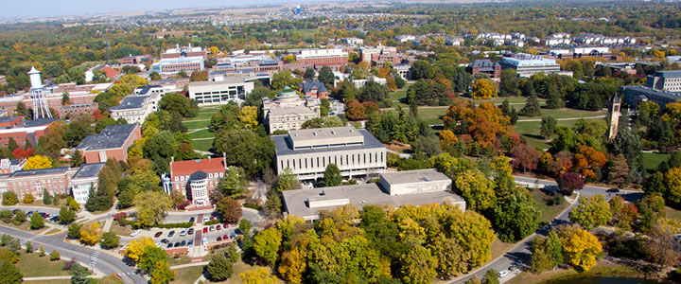
QUESTION What is adding value and ROI of kitchen remodel to house price of Ames between January 2007 and July 2010?
MINI PROJECT II
By Supriya and Chau
STAKEHOLDERS
_ Marketing manager of House Remodel Service _ Home owners

Slide 2
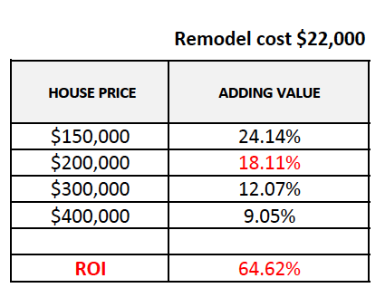
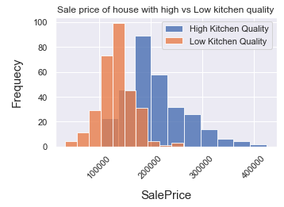
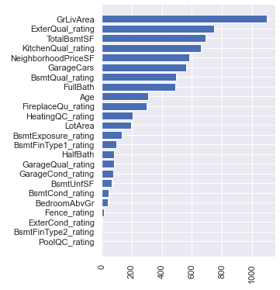
Summary
DATASET
Ames housing data
MODELING
KITCHEN ADDING VALUE
& ROI
LR cv_rsme: 24,638
Ridge cv_rsme: 26,785
Lasso cv_rsme: 27,164
Best model:
Linear Regression
Kitchen adding value:12,072
EDA
FEATURES

Slide 3
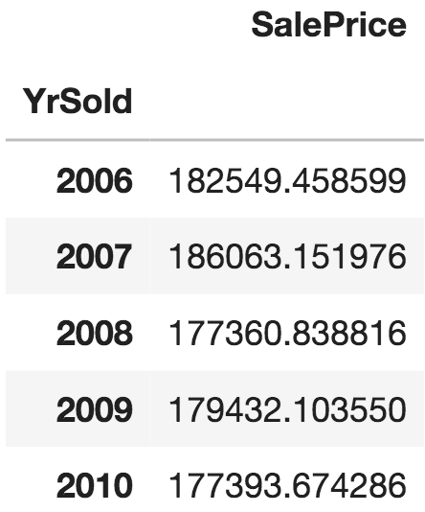
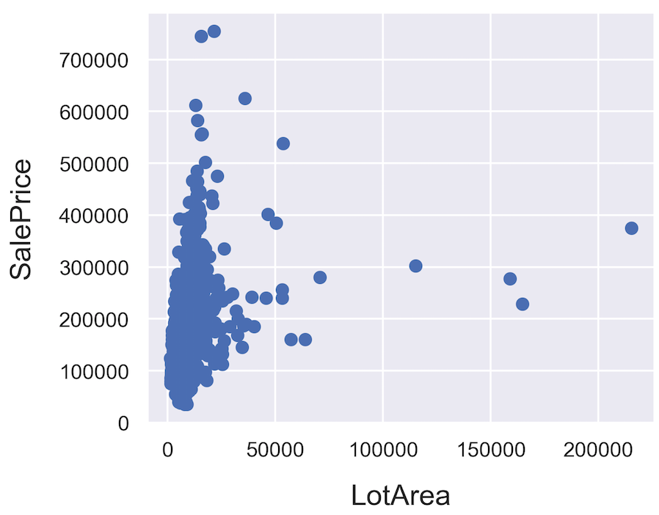
EDA
DATA CLASSIFICATION
IMPACT OF FINANCIAL CRISIS 2008?
UNSUAL DATA
Filter out lot area > 50,000 SF (~4000 m2)
Rows: 1460
Columns: 81
Numerical columns: 38
Ordinal columns: 14
Nominal columns: 29
Missing value columns: 19
Duplicated rows: 0
Column names to reformat: 0

Slide 4
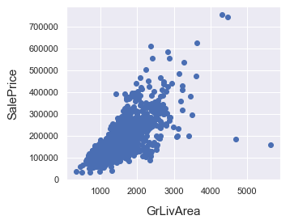
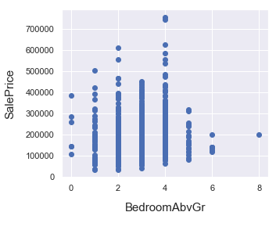
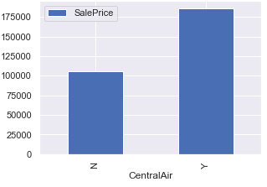
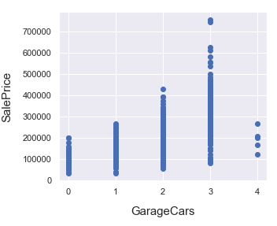
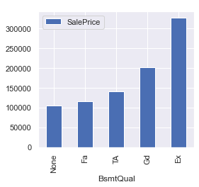
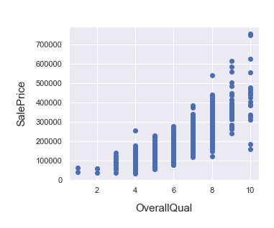
House features

Slide 5
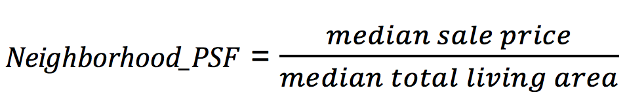
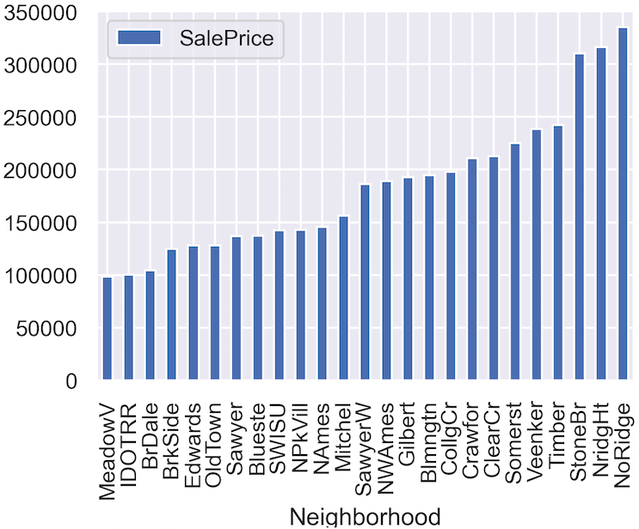
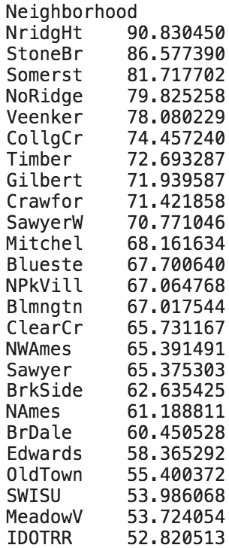
Location – neighborhood value
Neighborhood price per square feet
Neighborhood_PSF

Slide 6
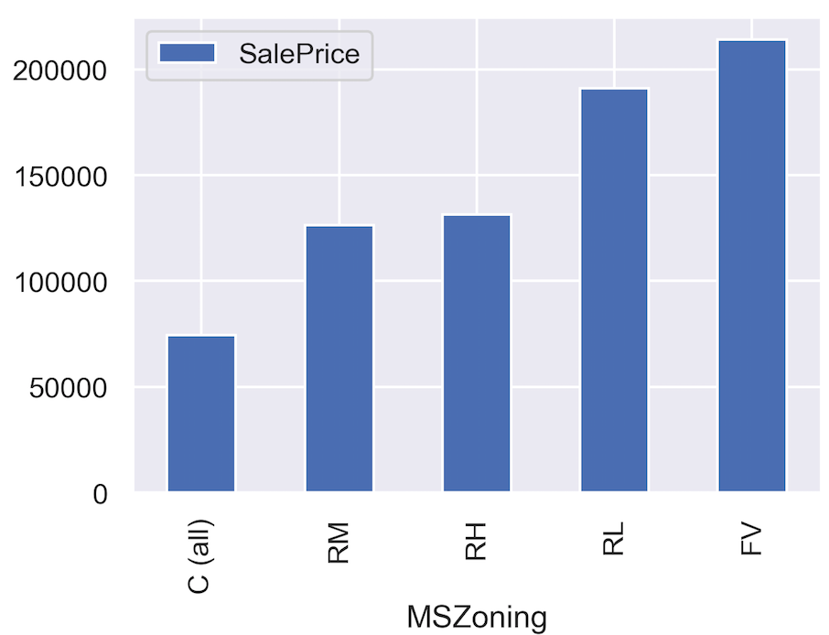
Location
6 neighborhoods with only high quality houses
indicating new developed areas:
Northridge Heights
Northpark Villa
Somerset (retirement village) – FV zone
Stone Brook
Bloomington Heights
Bluestem Northridge
Best U.S. Job Market (CNBC, 2018)
Best College Towns in America (24/7 Wall St., 2018)
Top 5 Small Metro Areas for Retirees to Age Successfully (Investopedia, 2018)
https://en.wikipedia.org/wiki/Ames,_Iowa

Slide 7
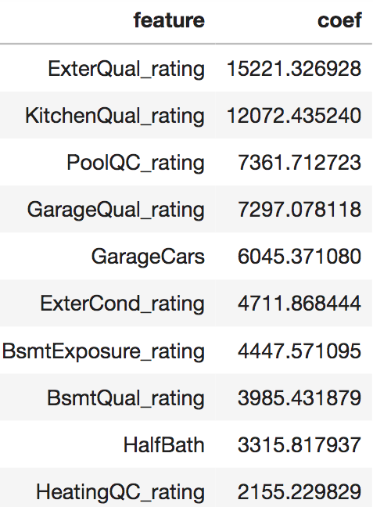
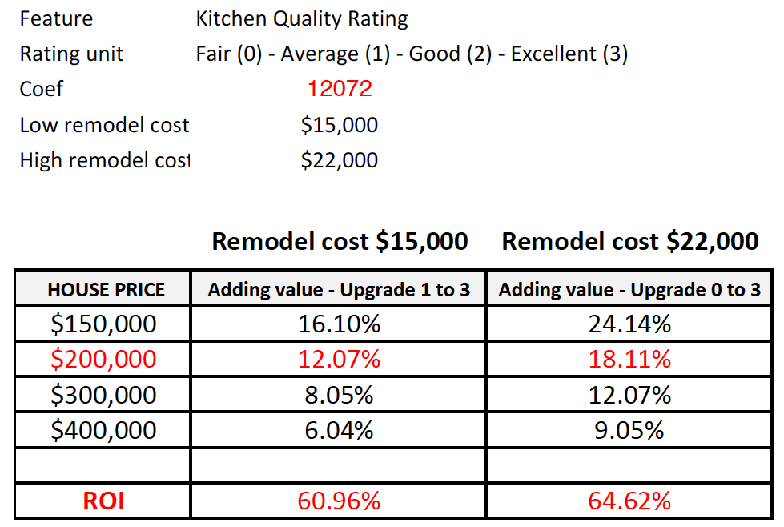
MODELING
FEATURE ENGINEERING
Predictors chosen
Location
Size
House Age
House features (kitchen, bedroom, bathroom, basement, garage)
Material
Quality
DEVELOP MODELS
Linear Regression, Ridge, Lasso
Target: SalePrice
Predictors:
GrLivArea
ExterQual_rating
TotalBsmtSF
KitchenQual_rating
NeighborhoodPriceSF
GarageCars
BsmtQual_rating
FullBath
Age
s
MODELS ASSESSMENT
To improve performance, take sale condition as ‘Normal’ as the most common type of sale.
Updated amount of observations: 1188
LR cv_rsme: 24,638 | R2: 0.86
Ridge cv_rsme: 26,785 | R2: 0.87
Lasso cv_rsme: 27,164 | R2: 0.87
Best model:
Linear Regression
ENCODE FEATURES
Age, NeighborhoodPSF and features related to quality rating
Not taking total rooms and overall quality to avoid multicollinearity.

Slide 8
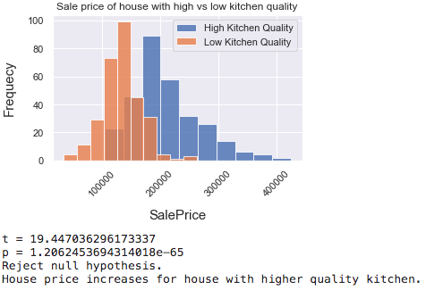
Kitchen quality vs house price
Random sample size: 300
Lot area: 7,000 – 11,000SF (600 m2 – 1000m2)

Slide 9
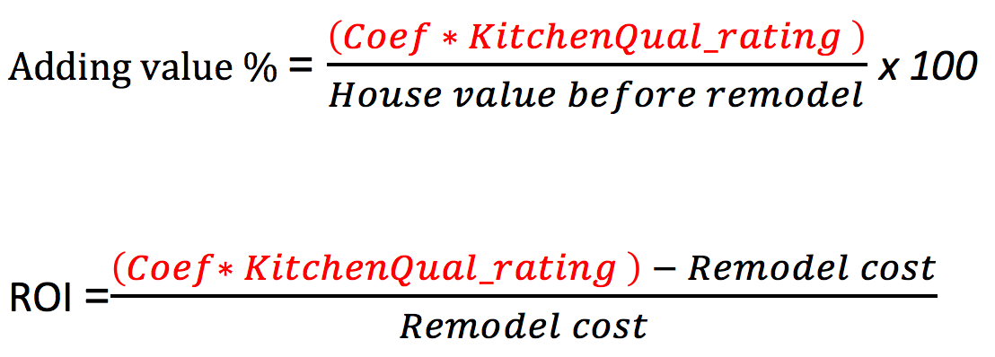
KITCHEN REMODEL ADDING VALUE and ROI

Slide 10
FINAL NOTES
Improvement on kitchen quality increases house price 12% on an average house value (200k).
Higher kitchen renovation brings higher ROI.
Model improvements: hyperparameters tuning, normalisation and standardisation.

Slide 11
Questions & feedback?
THANK YOU

Slide 12
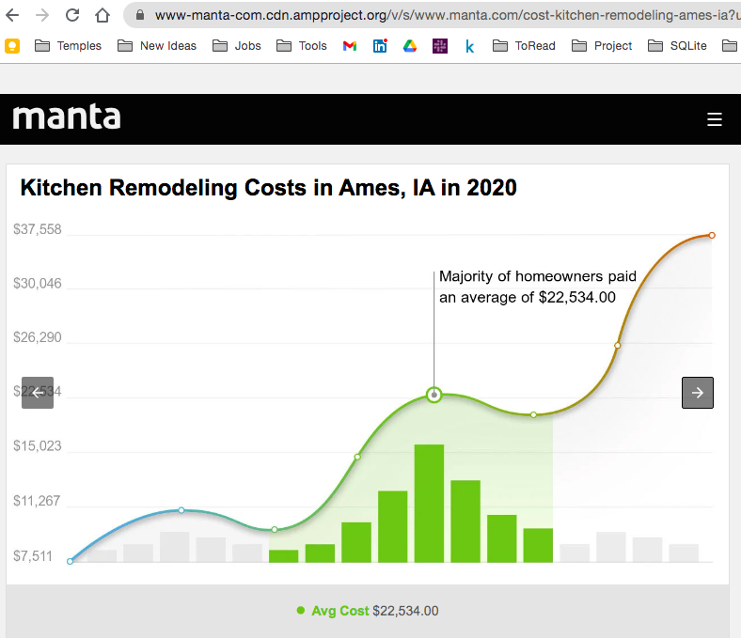
INDEX

