Slide 1
Food Sync
Be in sync with nature
Food Scanning AI for analyzing food, Food waste and food sharing

Slide 2
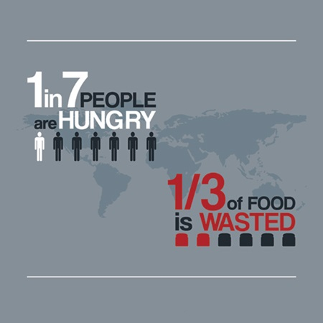
challenge Problem
Ensure information and access to safe, nutritious and sufficient food all year around
Halve per capita food waste and reduce food losses
Inform users about food carbon footprint, making them more eco friendly
Reduce World Hunger

Slide 3
Challenge Solution
AI Food Scanner for food identification and analyzing
Scanning the food
Identification of the type, properties, carbon footprint
giving useful and eco friendly information about the food
It there is a food waste, recommending how to use the spoiled food
If there is too much food – share it
Optimizing the way you shop for food
Creating dataset for further analysis and comprehension of the problem

Slide 4
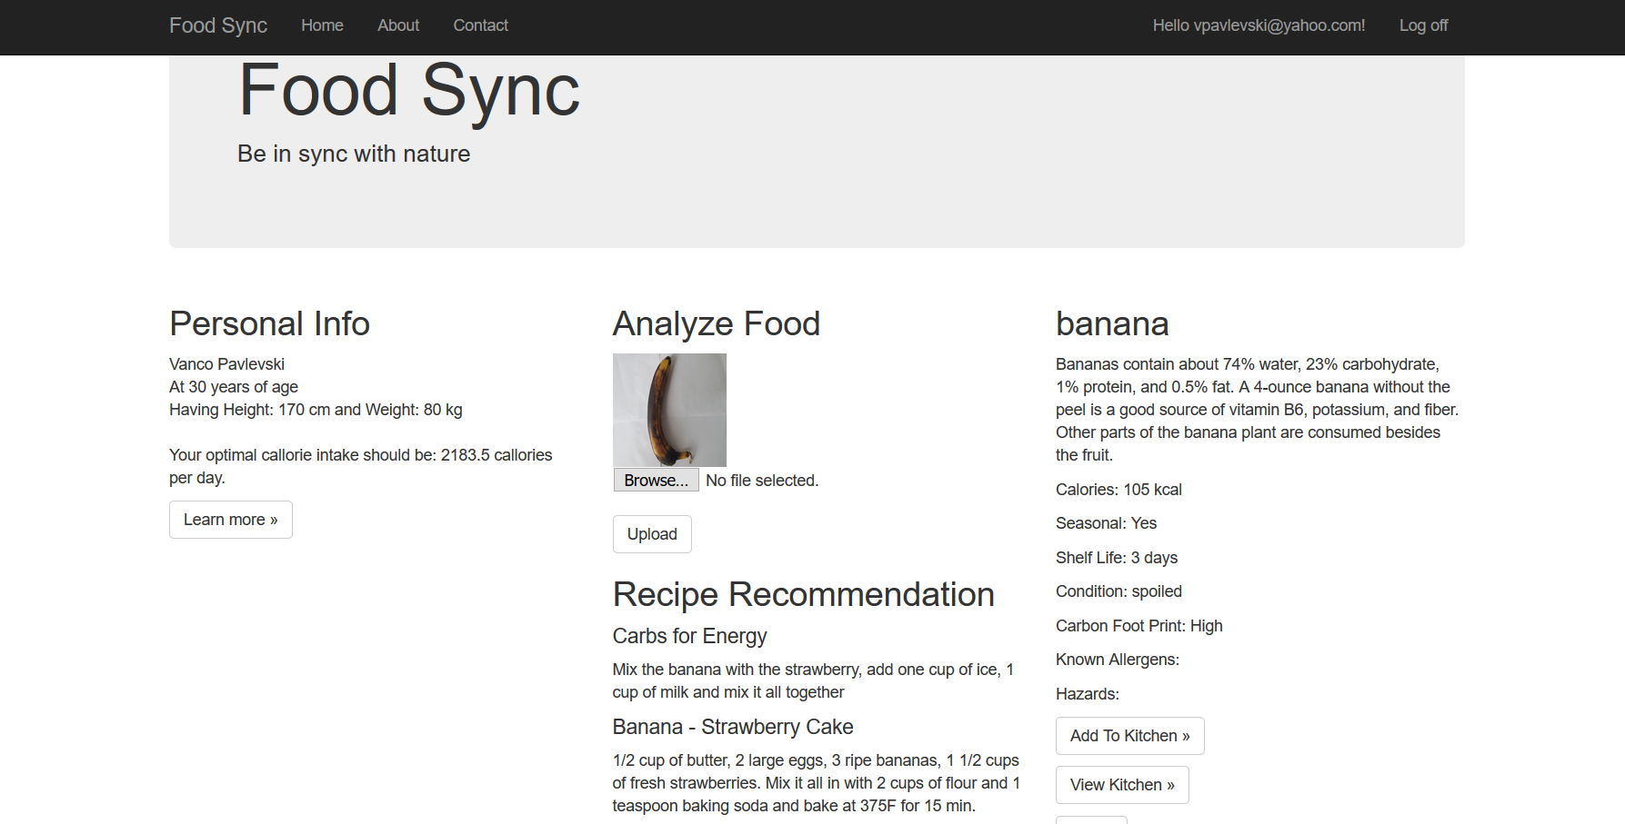

Slide 5
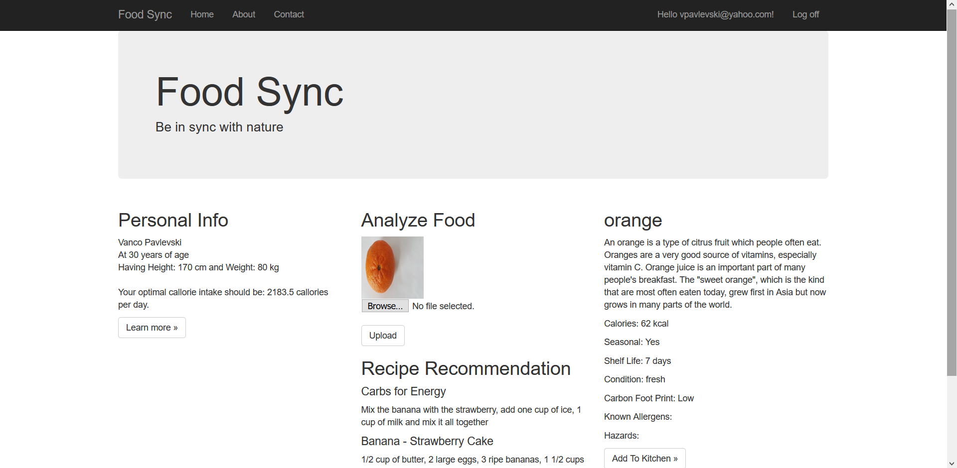

Slide 6
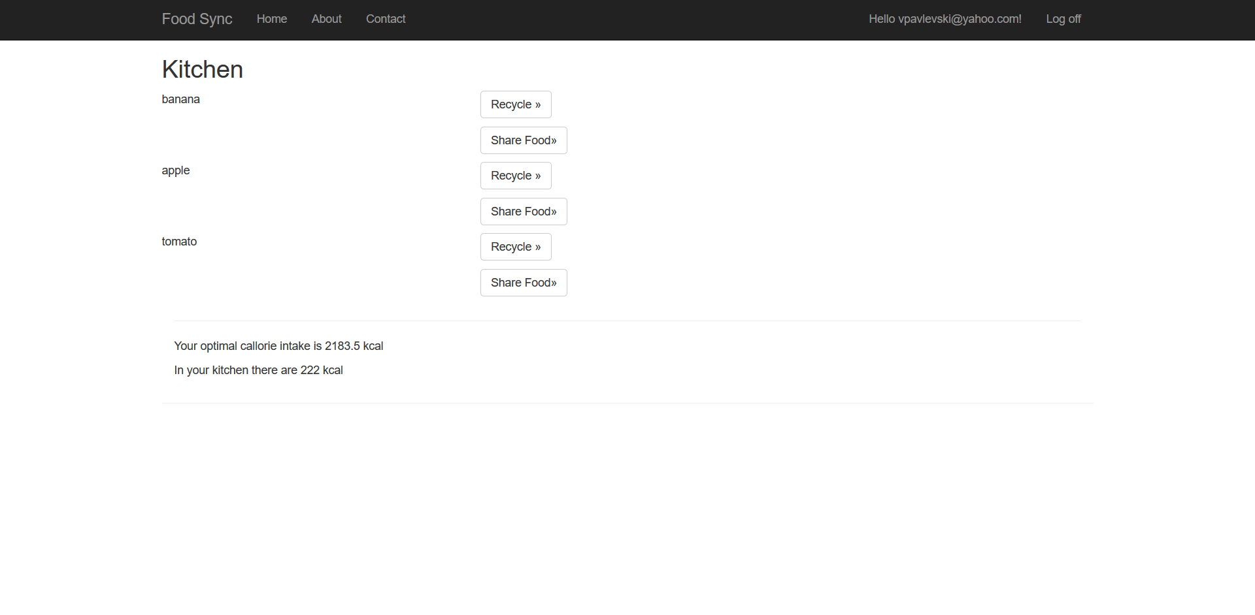

Slide 7

The tech we use
Convolutional Deep Neural Network identifying and classification of the product and its current state.
Fully Connected Neural Network to solve the problem of regression and to detect when you have bought too much of a certain product.
AI:
Python with TensorFlow
Application:
C# and .NET
Using AI will help us analyze our purchase habits, products and the way we think about carbon footprint of everything we buy.

Slide 8
Foodsync future
Future FoodSync programs will have similar software with a large database filled with food nutrition information, optimized and precise analysis hardware for superior calculation of optimal and eco friendly consumption guides.
FoodSync will provide a wide range of quality-of-life improvements for local agriculture, knowledge and education, as well as the health, economic and ecological consequences from the consumption of a certain food produce.
Raising the awareness of food waste and promoting food sharing, thus significantly reducing world hunger.

Slide 9
Earth provides enough to satisfy every man's needs, but not every man's greed.
Mahatma Gandhi
Thank you for your attention.
Eat healthy, endorse eating unrefined endemic meals, plan ahead - don’t let your food go to waste and share with those that need it most.

